Slide 1
Water Dams
Broňa Božoňová 7.A

Slide 2
Liptovská Mara
The work was built in the years 1969-1975. In the building it was flooded 13 villages, 12 of which were completely The main purpose of the dam is flood protection, but is also used to produce electricity, as the dam there are 4 turbines From centers in Liptovský Trnovec it is possible to go on a cruise after Mare

Slide 3
Zemplínska šírava
Zemplínska Šírava is a dam in eastern Slovakia in the Bodrog River Basin under the Vihorlat vrchm It is the second largest dam in Slovakia (the Orava dam). It is a popular tourist destination with seven recreational centers

Slide 4
ORAVA
Orava is a favorite tourist resorts. Every year thousands of tourists come here. In summer, tourists most popular line south and western parts of the dam. In winter during periods of heavy frosts it used not only domestic population to develop winter sports and walks on the frozen waters.

Slide 5
MALá DOMšA
Malá Domaša water reservoir is a small buffer tank Domaša in the United Ondavská Highlands. It located in the valley Ondava, between the villages of Slovak Kajňa and Small Domaša in the eastern part of Slovakia (upper Zemplín).

Slide 6
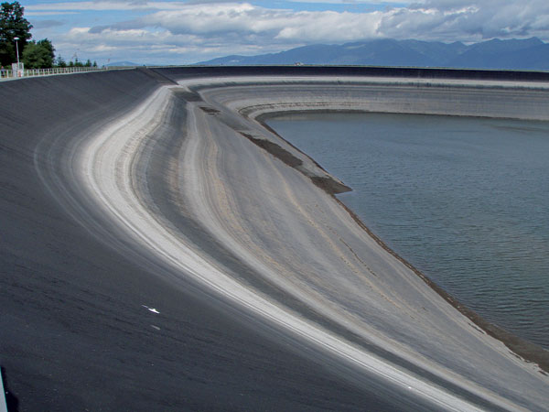
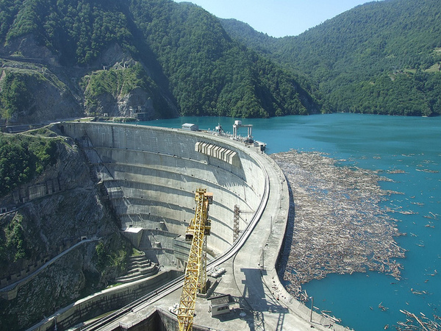
THANKS FOR YOU ATTENTION

