Slide 1
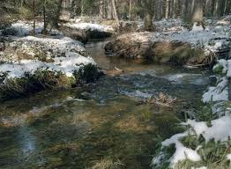
Water in nature

Slide 2
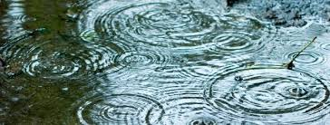
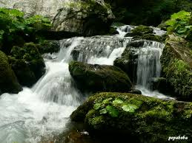
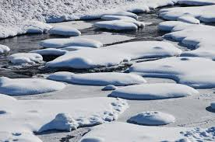
The water is in the form of ice and snow , lakes, rivers , rain and water vapour .

Slide 3
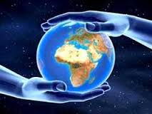
Most of the water is ocean water in the form of salt , about 71 % of world surface.

Slide 4
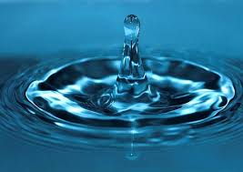
The water vapor in the atmosphere represents from 1 to 4 percent .

Slide 5
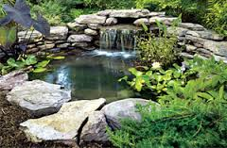
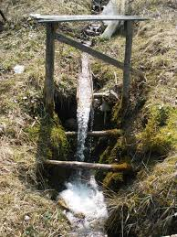
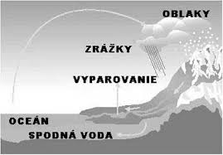
THE END
Matej Szentivániy 7.A
CLOUDS
RAINFALL
EVAPORATION
OCEAN
GROUNDWATER

