Slide 1
Poprad city St. Egidio Square
Jakub Chlebec 7.A

Slide 2
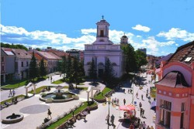
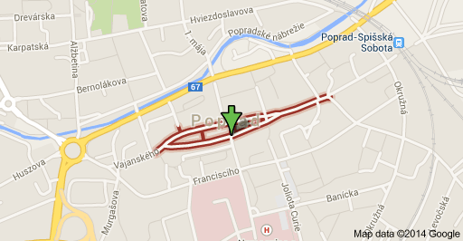
In the middle of city Poprad we can see the spindle shaped St. Egidio Square.

Slide 3
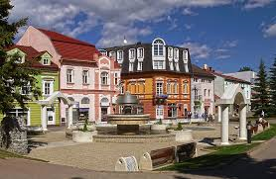
On the square are the old houses in the baroque and classical style.

Slide 4
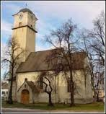
The square is dominated by the St. Egidio Church from the 13th century. Church of St. Egidio is located in the middle of the square of St.Egidio. Repeated fatal fires destroyed the church in Aug. 19, 1708 .

Slide 5
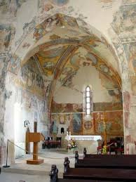
The most interesting element of the church interior is decoration with many frescoes, which are almost completely covering the surface of the walls.

Slide 6
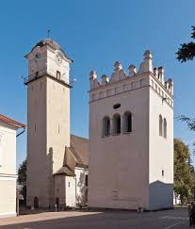
Near this church you will find a renaissance bell tower from the 1658.

Slide 7
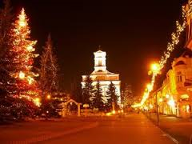
In winter there are selling Christmas carps. In Christmas time there are Christmas markets, beautiful Christmas decorations.

