Slide 1
Slovensko
Slovakia
Slowakei
Frederika Okresová
Katarína Krupičková
Broňa Božoňová
Lucia Szentiványiová
Vanesa Kováčová

Slide 2
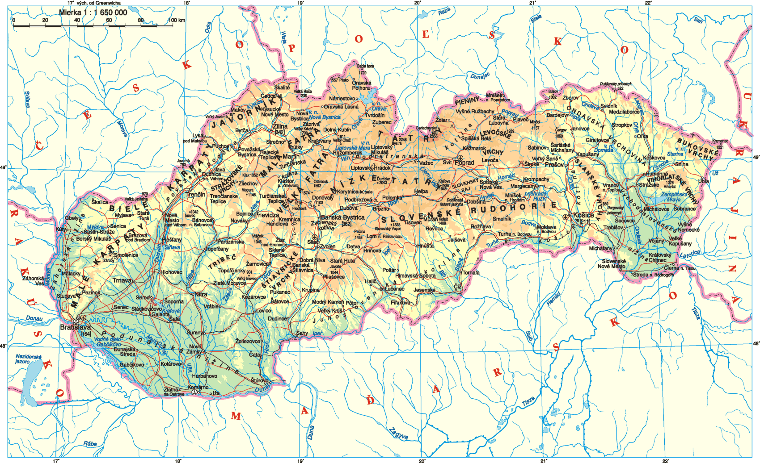
Slovensko
Capital City: Bratislava
President : Andrej Kiska
Area : 49 036 ${km}^{2}$
Population : 5,43 million
Official language : Slovak

Slide 3
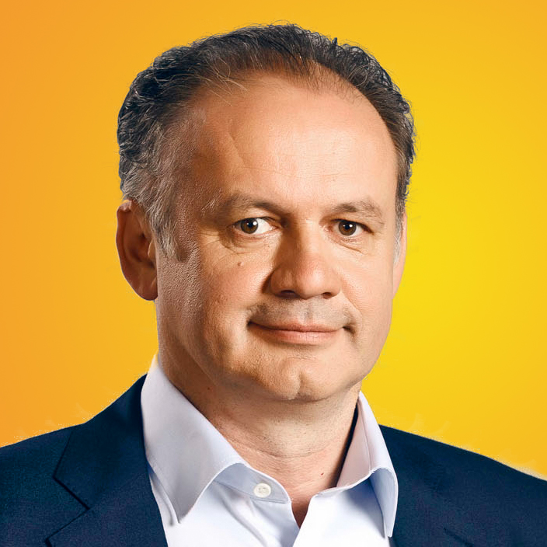
Andrej Kiska

Slide 4
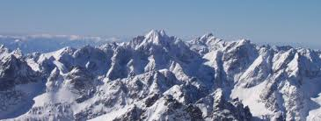
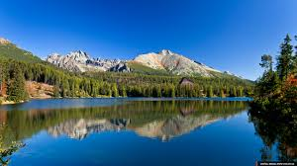
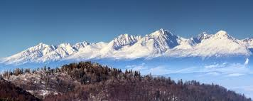
Vysoké Tatry
Tatry Mountains lie to the north-eastern Slovakia .
Highest peak is Gerlachovský štít – Gerlach Peak . He is 2 654m tall .

Slide 5
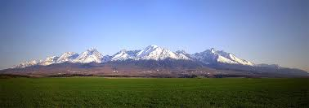
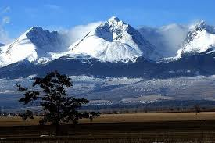
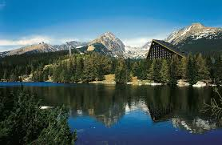
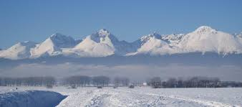

Slide 6
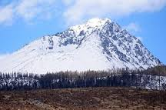
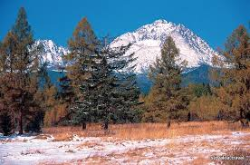
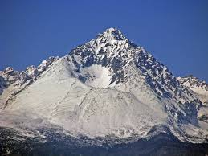
Gerlach Peak

Slide 7
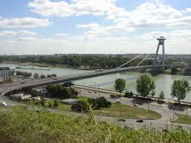
River Danube- Dunaj
The Danube is Europe's second longest river and the longest river in the European Union.
Flows through southern Germany, Austria, Slovakia , Hungary, Serbia, then formed over many tens of kilometers of the Romanian-Bulgarian border and the mouth of the delta into the Black Sea at the border between Romania and Ukraine.
Its length is 2860 km .

Slide 8
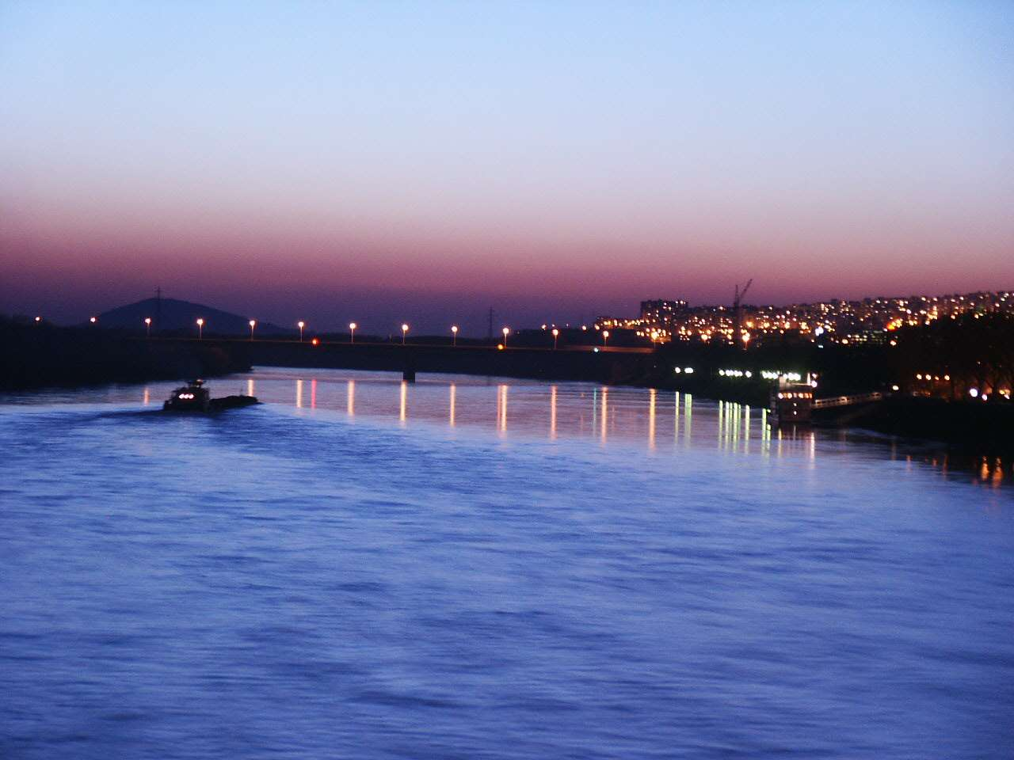
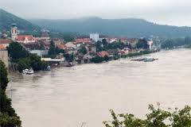
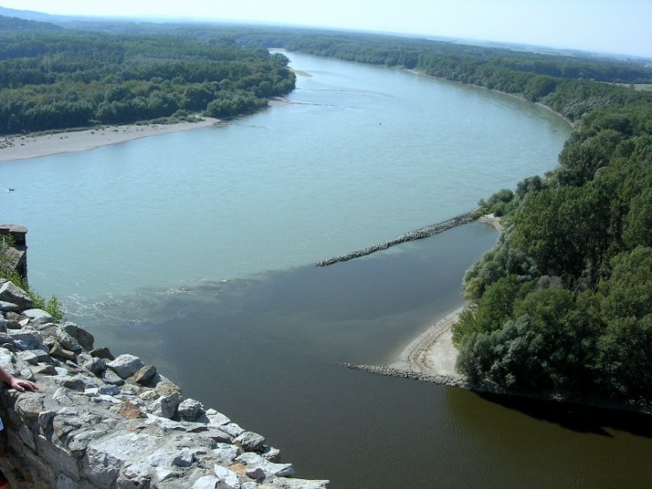
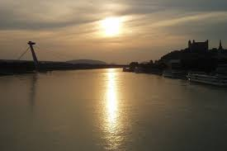
Dunaj

Slide 9
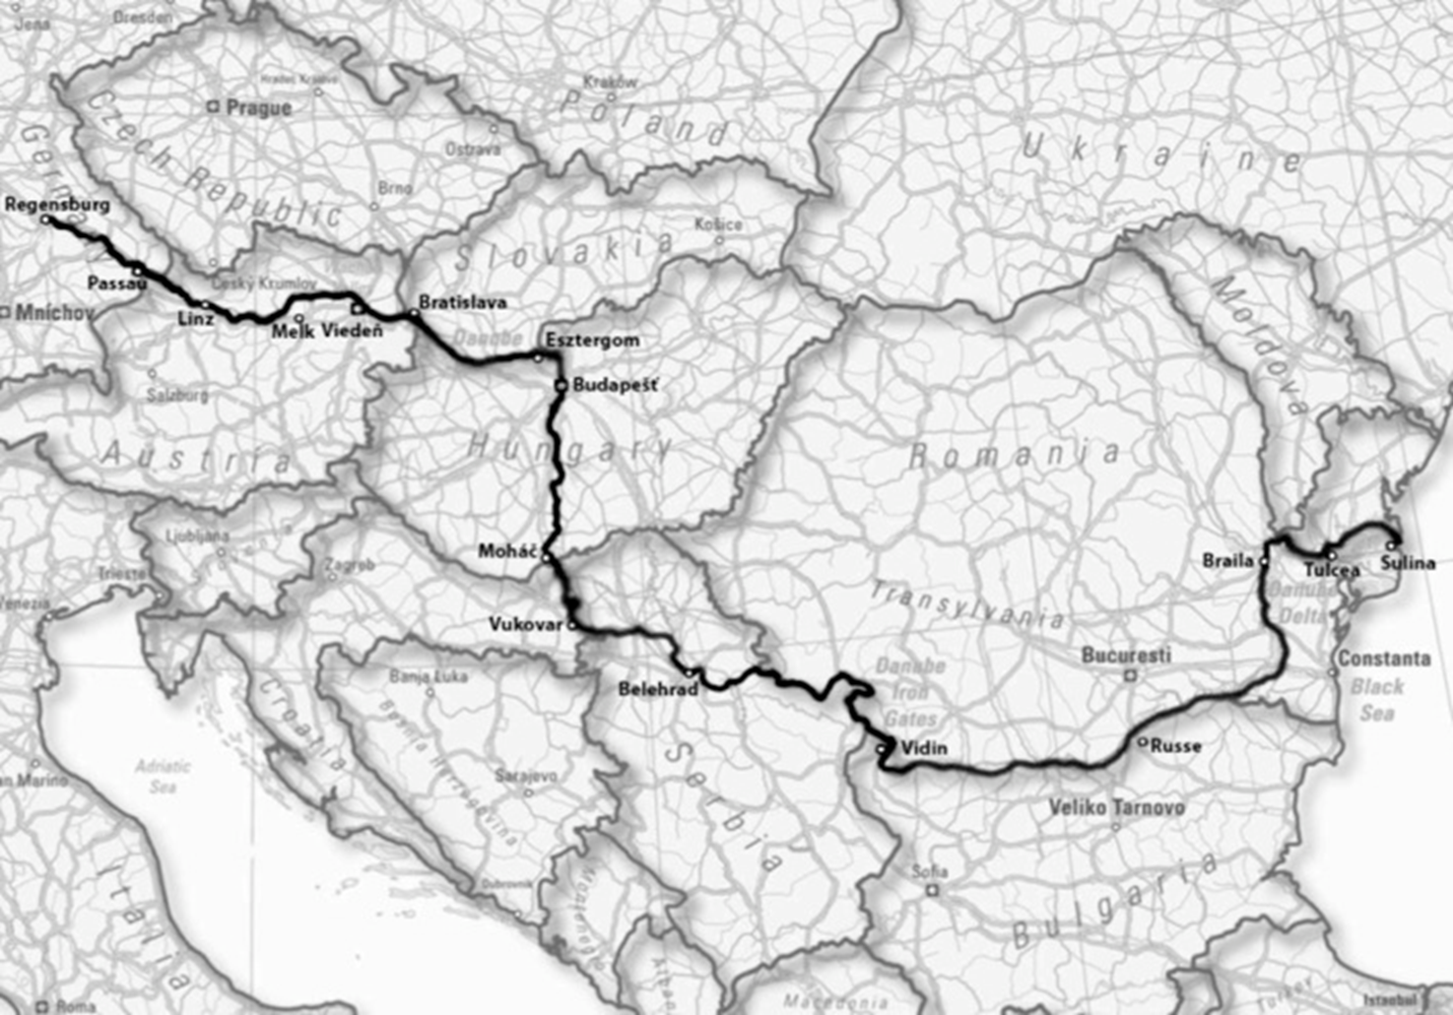

Slide 10
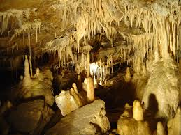
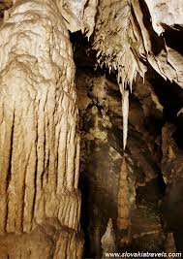
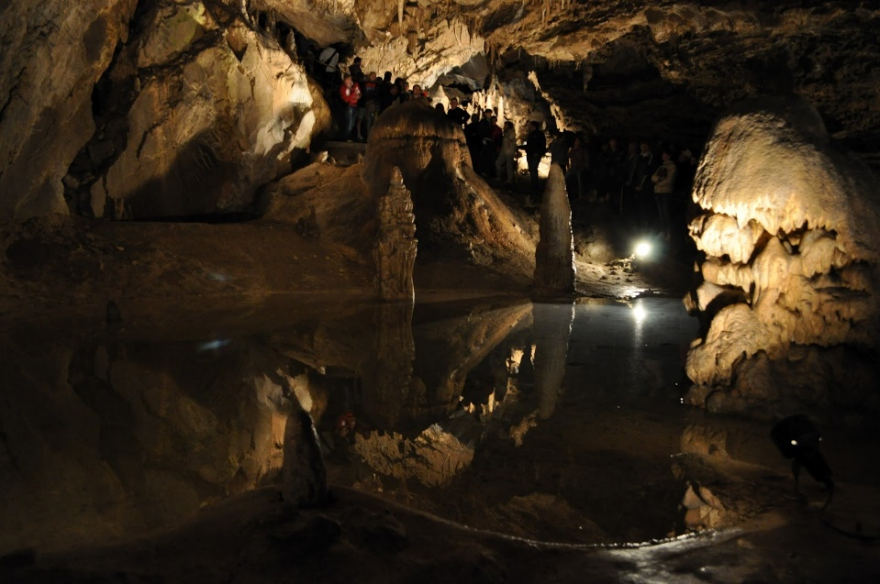
Belianska jaskyňa
Belianska Cave belongs among the most visited caves in Slovakia.
Located on the northern slope of the Kobylí hill in the eastern part of the Belianske Tatras. It is located in the National Nature Reserve Tatry in the Tatra National Park. Formed in the Middle Triassic dark-gray Gutenstein limestones of the Krížna Nappe.

Slide 11
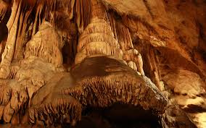
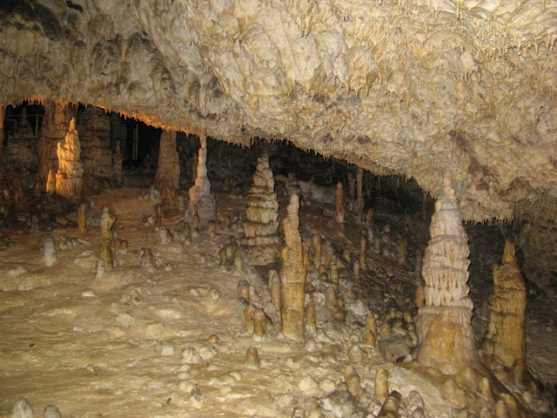
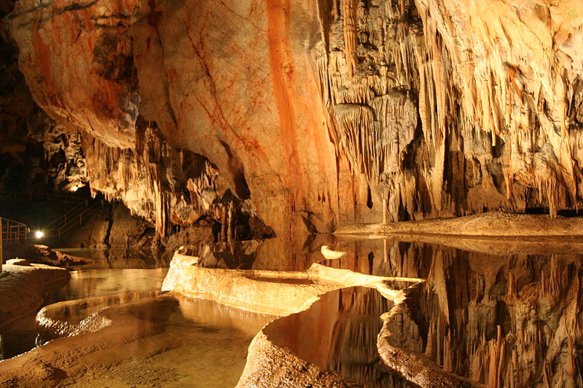

Slide 12
The other cave :
Bystrianska jaskyňa , Demänovská jaskyňa slobody (Cave of freedom ) , Demänovská ľadová jaskyňa (Ice cave ) , Dobšinská ľadová jaskyňa ( Ice cave ) , Gombasecká jaskyňa , Harmanecká jaskyňa ,Silická ľadnica , jaskyňa Drinky , jaskyňa Domnica , jaskyňa Zlá diera (wrong hole ) , Jasovská jaskyňa , Ochtinská araginitová jaskyňa , Važecká jaskyňa , Šakanová jaskyňa , Malá Stanišovská jaskyňa , ...
Slovakia is a beautiful country. You can not write about everything. Want to learn more about Slovakia? Go to Google!☺ :*

Slide 13
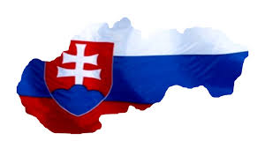
WE LOVE SLOVAKIA !!

