Slide 1
Our country - PRAGUE
Teaching: An effective key to self-learning
This project was funded by European Union.

Slide 2
Prague Castle
National cultural monument, the symbol of more than millennial development of the Czech state. Since its foundation in the last quarter of the 9th century it has been developing uninterruptedly throughout the past eleven centuries. It is a monumental complex of ecclesiastical, fortification, residential and office buildings representing all architectural styles and periods, surrounding three castle courtyards and covering 45 hectares. Originally it used to be the residence of princes and kings of Bohemia, since 1918 it is the seat of the president.
St. Vitus, St. Wenceslas and St. Adalbert Cathedral is A gothic cathedral, the spiritual symbol of the Czech state, founded in the year 1344 by Jan Lucembursky (John of Luxembourg) and his sons Karel (Charles) and Jan Jindrich (John Henry) in the place of the original romanesque rotunda. The construction proceeded according to the plans of Matthias of Arras (until 1352), and then Petr Parler (1356 - 1399). The construction period protracted to nearly 600 years and it was finally completed in 1929. Decorated by precious works of art it encloses St. Wenceslas' Chapel and the Crypt with tombs of Bohemian kings. The coronation jewels are deposited here, too

Slide 3
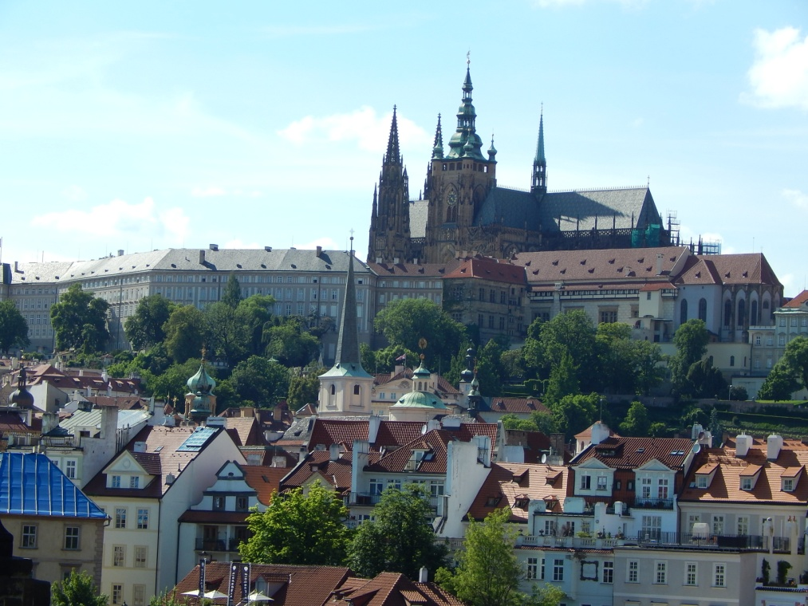
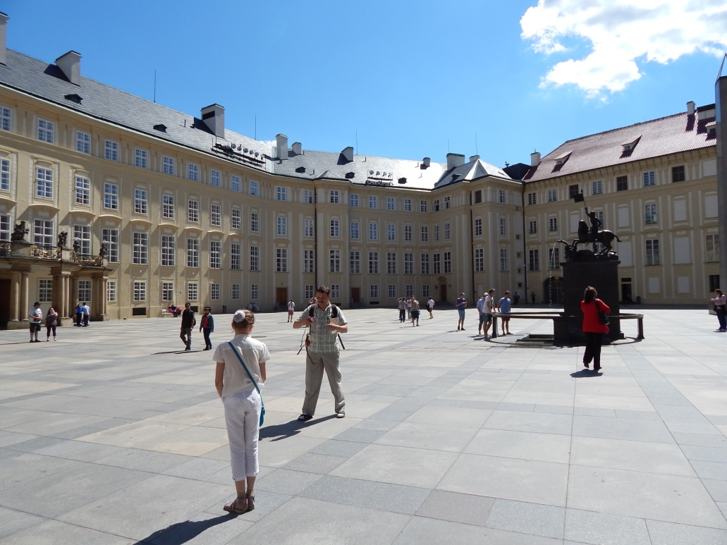
Prague Castle

Slide 4
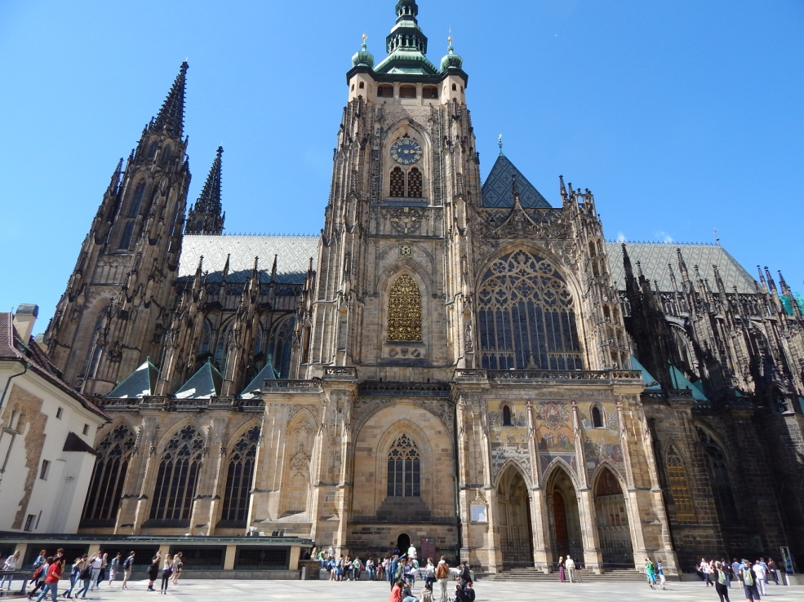
St. Vitus Cathedral

Slide 5
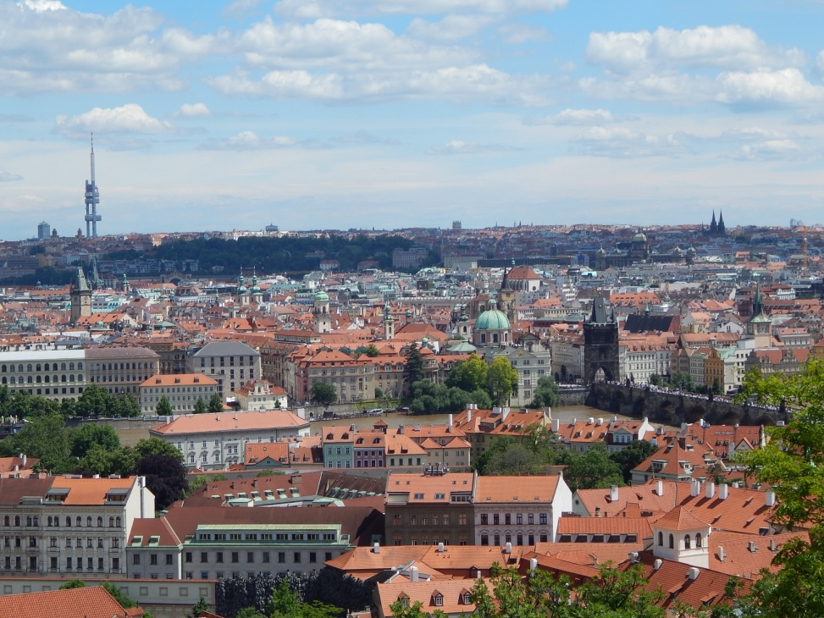
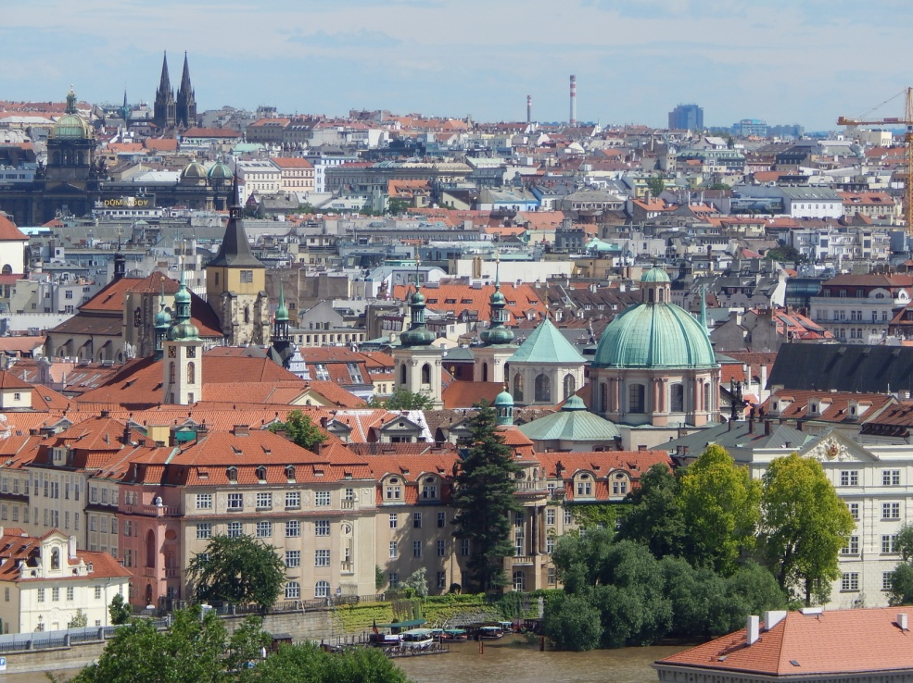
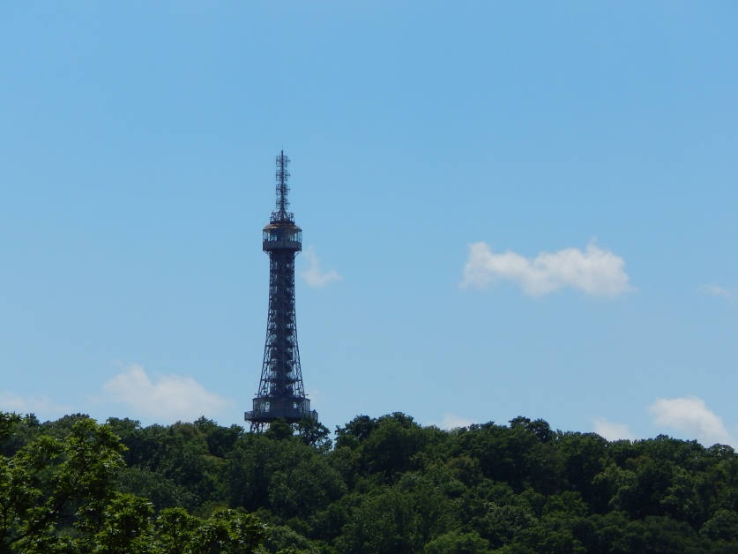
Views from the Old Kings´ Castle
Petřín Watch tower
on Strahov hill

Slide 6
Views from the Old Kings´ Castle
National
Theatre

Slide 7
Strahov Monastery view from the Old Kings´ Castle

Slide 8
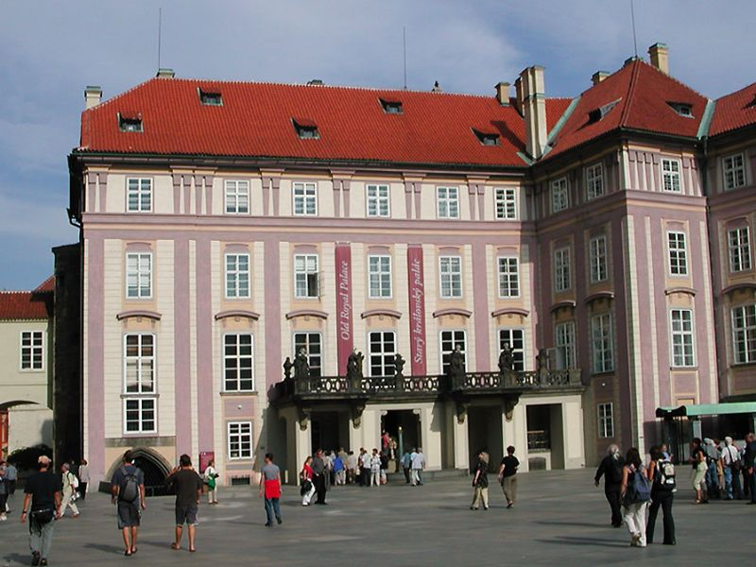
The Old Kings´Castle Vladislav Hall

Slide 9
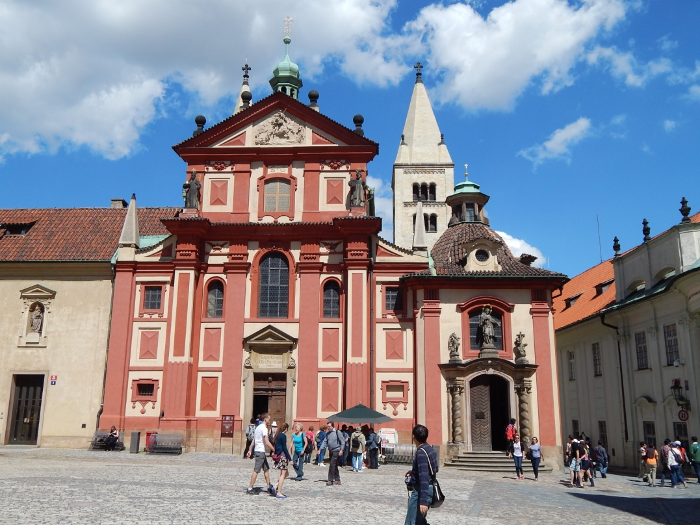
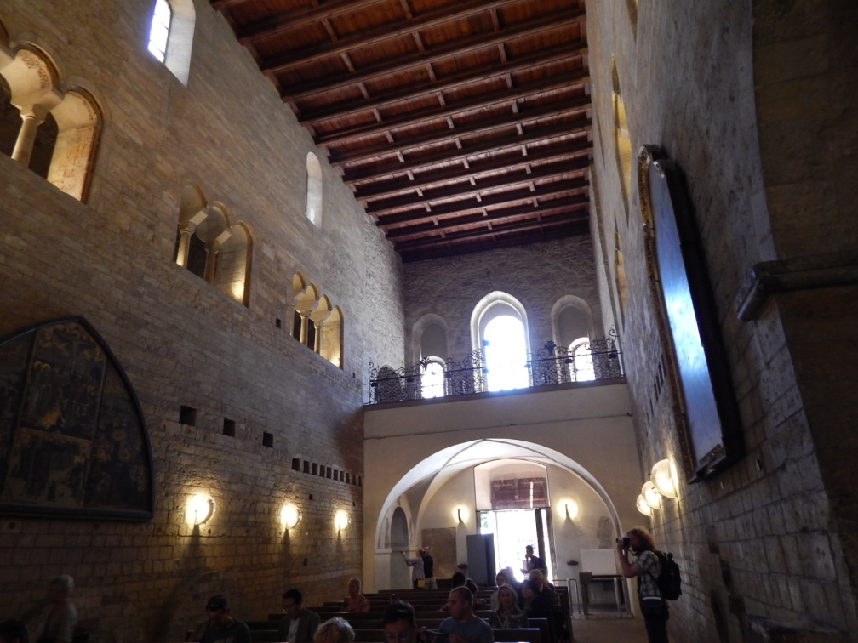
St George Church

Slide 10
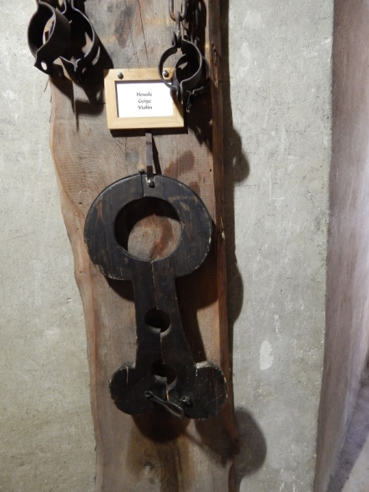
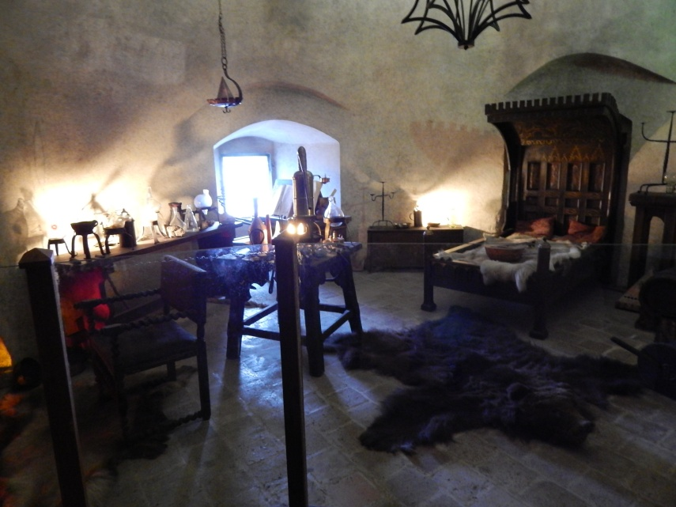
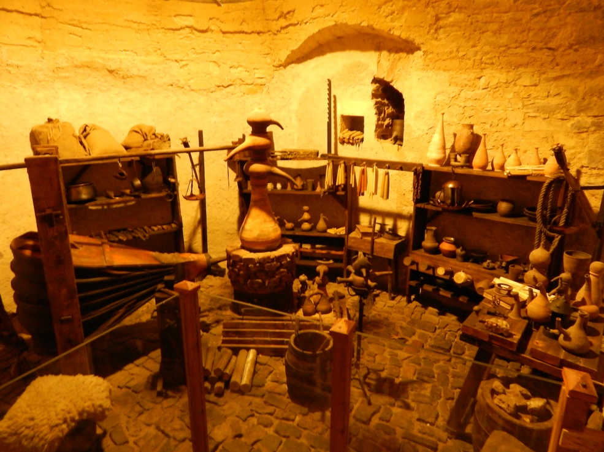
Golden Line

Slide 11
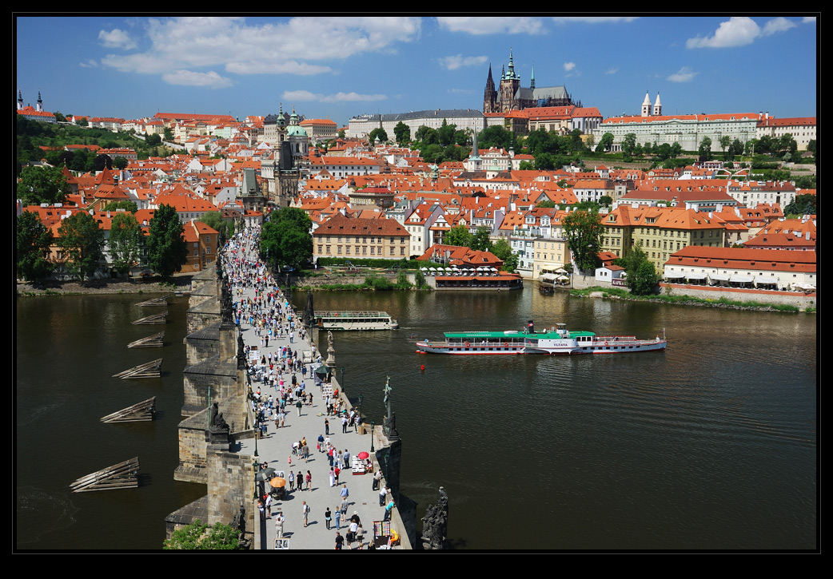
Charles Bridge

Slide 12
Charles Bridge
Prague’s oldest bridge, and one of its most iconic structures, is Charles Bridge, which connects
Old Town with Malá Strana. Dating to 1347, it was originally called the Stone Bridge, or Prague
Bridge, before being named Charles Bridge in 1870, after its founder King Charles IV.
One of the city’s most popular and recognisable sites, Charles Bridge is adorned with 30 stone statues
of saints and personages, added between 1683 and 1928; however, these are all replicas today. The
originals are housed in the Lapidarium museum in Holešovice. The most famous statue on the bridge is
that of St. John of Nepomuk (1345 – 1393), and rubbing his foot is rumored to bring good luck. There’s
an earlier legend, though, that says to find the spot where St. John was thrown from the bridge,
marked by a small brass cross, and make a wish.
The sandstone bridge replaced the former Judith Bridge, which had been badly damaged by floods in
1342, and served as an important connection for trade between the east and west. It was completed
by Petr Parléř, who also designed St. Vitus Cathedral, in 1402. The bridge was open to cars through 1965.
Each end of the 515-meter-long span is fortified by the Malá Strana Bridge Towers and the Old Town Bridge
Tower, respectively. The smaller of the Malá Strana towers is a relic of Judith Bridge dating to the 12th
century and was used as a jail for more than 200 years. The other was built in High Gothic style, drawing
upon Parléř’s Old Town Bridge Tower. Both are accessible to the public and afford great views.
On the Old Town side, the Bridge Tower is one of Europe’s most striking examples of High Gothic
Architecture. Completed in 1380, its exterior is richly adorned with sculptures, statues and coats of arms.

Slide 13
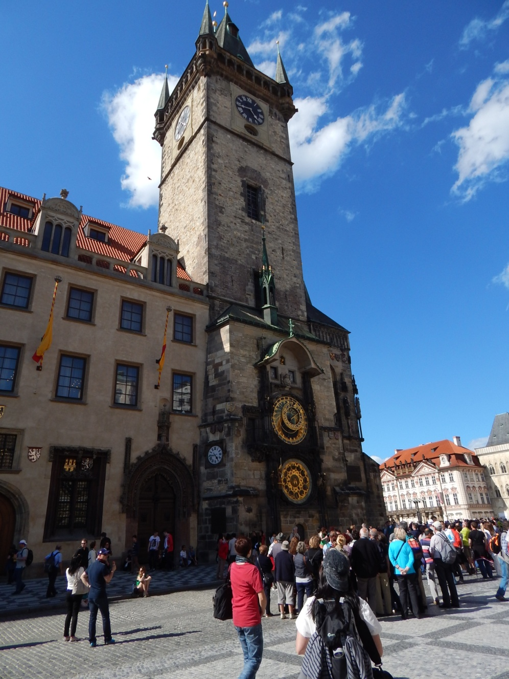
Old Town Square Astronomical Clock

Slide 14
Old town square, Astronomical clock
The history of the Old Town Hall began in 1338, when King John of Luxembourg granted Prague’s Old Town the right to establish its own administrative centre. The original basis for the town hall became the gothic house of the wealthy merchant Wolflin of Kamen, for whom a stately tower was built in 1364. The Old Town Hall is associated with the most significant events in the country’s history. This is the place where the king of Bohemia George of Poděbrady was selected in 1458. After the Battle of White Mountain, the leading participants in a revolt were imprisoned here. Twenty seven of these were subsequently executed on 21 June 1621 in front of the Town Hall. When the four districts of Prague merged in 1784, the Town Hall became the seat of the city’s unified official administration. At that time, the building underwent many alterations. Weddings have been held at the Town Hall since 1871. At the end of the Second World War, the Town Hall was the focal point of an insurrection, and the Czech National Committee directed operations from its basement. On 7 May 1945, the Town Hall was bombarded by tanks. In the conflagration that followed, the eastern and northern wings of the building, opposite Týn Church, were completely destroyed. The tower with the Astrological Clock and a chapel were also heavily damaged.

Slide 15
Old town square, Astronomical clock
The most valuable room in the Town Hall is the so-called Council Hall from the second half of the 15th century, where all important proceedings occurred. The joist ceiling, with its rich renaissance decoration of the lacunars from the second half of the 16th century and gilded chains, is authentic. The late-gothic console with an angel, which bears the legend Juste Iudicate Filii Hominis (Judge fairly, sons of man) is complemented by a high-gothic sculpture of the suffering of Christ from 1410. The municipal coats of arms above the portals and 46 guild coats of arms and 12 municipal coats of arms on the wooden panelling of the walls are authentic. The interior is completed with a baroque tiled stove.
The so-called Jiřík Hall and Brožík Hall on the second floor are worthy of separate attention. The Jiřík Hall gets its name from a bust of King George (Jíří in Czech) of Poděbrady. There are valuable paintings from the beginning of the 15th century on the walls. On the wall, there is a View of Petřín Hill by Karel Liebscher from 1902. The Brožík Hall took on its current appearance in 1910 and it is used as a conference room. It covers the entire ground plan of the building and the height of two floors. It bears the name of Václav Brožík, the artist responsible for two large oil paintings on canvas, which are displayed here. .

Slide 16
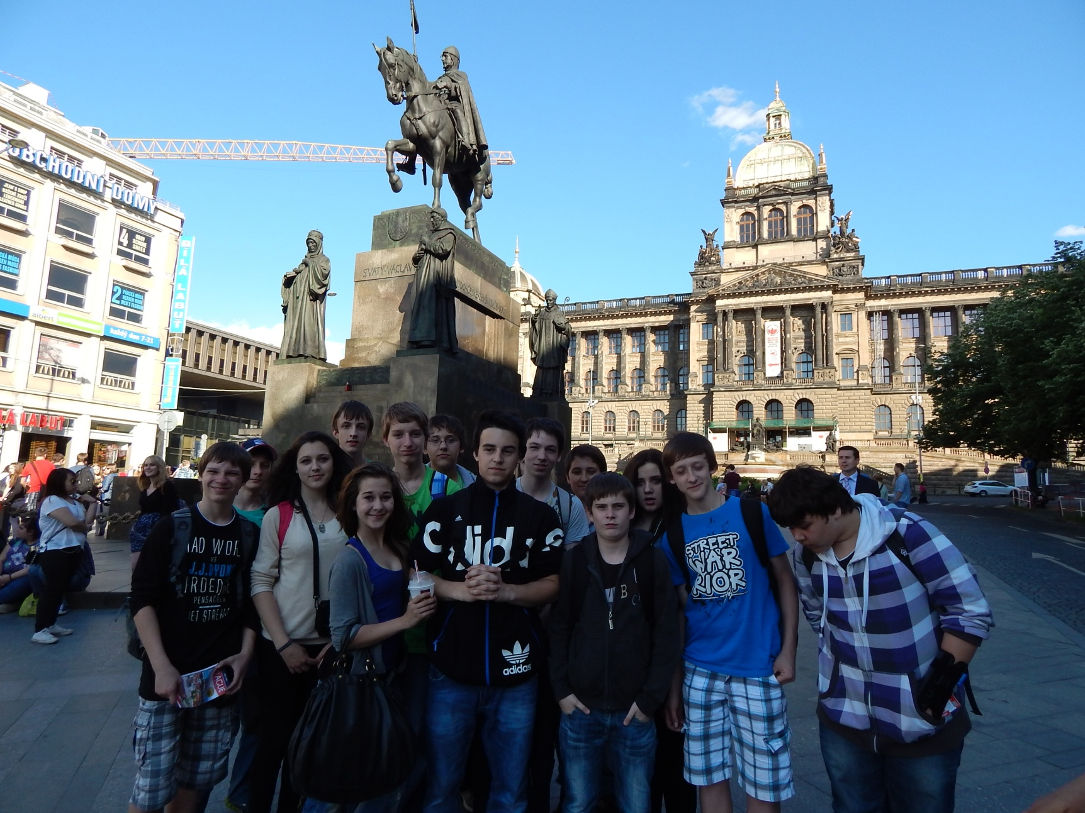
Vencesslas Square National Gallery, St. Vencesslas Statue

Slide 17
Powder Gate, Palladium shopping centre

