Slide 1
Our town - OSTRAVA
Teaching: An effective key to self-learning
This project was funded by European Union.

Slide 2
Our town Ostrava is well-known for its heavy industry, poluted environment, universities, beer, soccer, ice-hockey and our school Kosmonautů 15 ☺

Slide 3
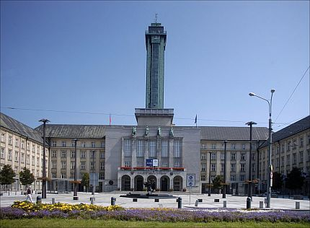
1) New town hall and watchtower
This is the largest town hall in the Czech Republic. The Tower was built at the New City Hall in 1930. It is 85 metres high and reaches 298 metres above the sea level. The lookout deck is 72 metres above the ground. On a clear day, it is possible to see the city, the nearby Beskydy Mountains in the south, the Jeseniky mountains in the west, and even Poland.

Slide 4
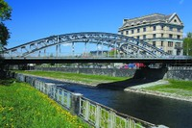
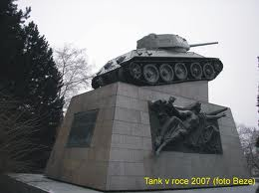
2) The Miloš Sýkora Bridge
There used to be a chain bridge (1847 – 1851. The current steel bridge over the river Ostravice was built in 1913. This interesting technical bridge construction connects the Moravian and the Silesian parts of Ostrava.
Miloš Sýkora, together with his friend volunteered to cut the wires of explosives placed under the bridge by the Nazis. Miloš Sýkora was killed. A Russian tank got over the bridge, but it was hit by three antitank missile.

Slide 5
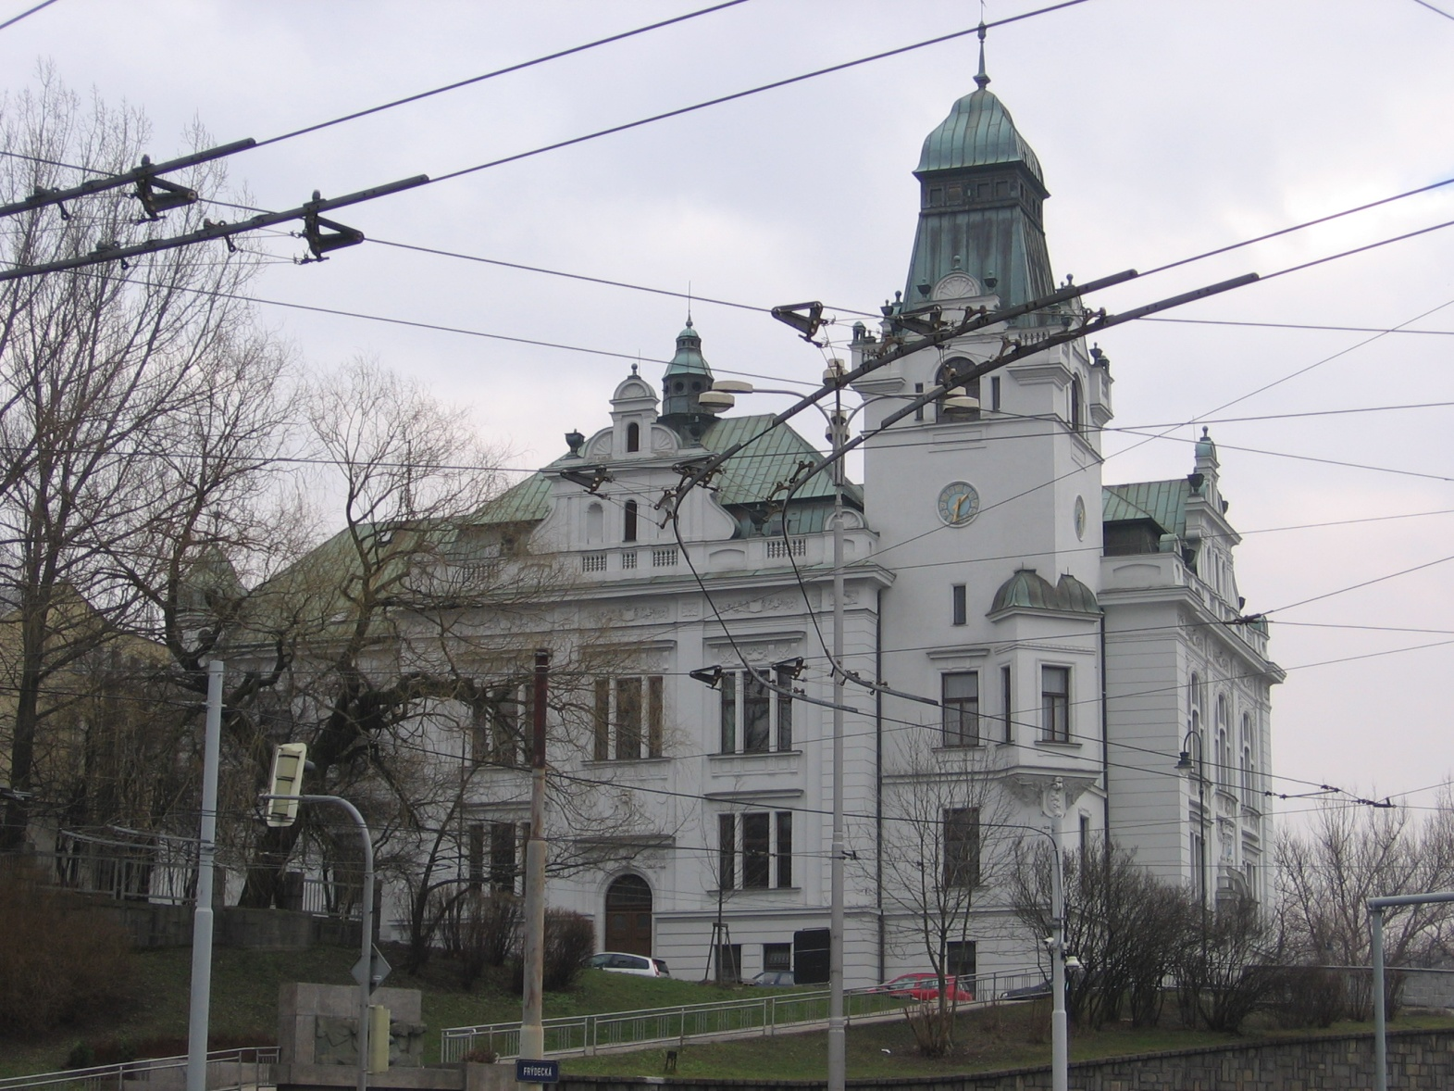
3) The Silesian town hall

Slide 6
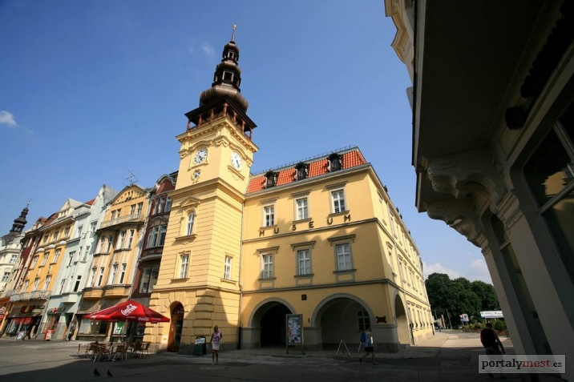
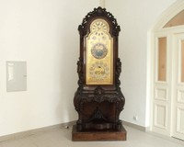
4) The Ostrava museum
In 1931, the Museum was opened in one of the oldest buildings in Ostrava, the Old Town Hall on Masaryk Square. A new permanent exhibit contains art history collections, history of the city and the nature of the local area.
The unique exhibit, and the pride of the Ostrava Museum, is the indoor astronomical clock, 225cm high – a work by Jan Mašek. The astronomical clock offers 4 parts – its own clock face, the calendar, and the astronomical and planetary parts.

Slide 7
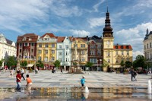
5) Moravian Ostrava Urban Heritage Zone
The largest heritage zone in the Moravian-Silesian Region was established in 1992 and occupies the central part of Moravian Ostrava. The zone offers architecture and urban planning of the 20th century.
Masaryk Square is lined by a number of buildings of architectural interest, including the Old City Hall, the former Habsburg café (now the Academia bookshop), and the Golden Crown pharmacy. In the centre of the square is a Marian plague column dating from 1702, and nearby is a statue of St Florien – the patron of fire-fighters.

Slide 8
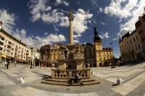
6) Mary´s column
Since 1702, Ostrava's main square has been decorated by a sandstone column of the Virgin Mary, carved by sculptor Johannes Hyacint Zelander. It was built in memory of the survivors of the plague that swept through the area at the end of the 17th century.

Slide 9
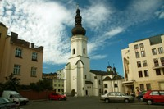
7) The Church of St. Wenceslas
The first written document about this parish church in Moravian Ostrava dates back to 1297. After a fire in the early 14th century, the church was rebuilt. The originally Gothic tower was rebuilt in renaissance style in 1594.
Two Baroque chapels were added in the 17th century, as was the side chapel of the Virgin Mary. The church is the oldest preserved building in Ostrava.

Slide 10
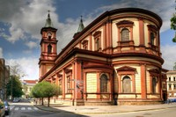
8) The Cathedral of Divine Saviour
The second largest cathedral in Moravia and Silesia is one of the most beautiful churches in the city. The three-aisled Neo-Renaissance basilica is completed with a semicircle apse with two 67m-high towers from) 1889.
Pope John Paul II founded the Ostrava-Opava diocese in May 1996, and in September of the same year, the basilica was upgraded to a cathedral. Since 1998, it has been equipped with a Neo-Baroque organ. It is often used as a venue for concerts, enhancing the musical experience with its acoustics and atmosphere.

Slide 11
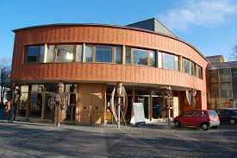
9) The Puppet Theatre
In 1953, a professional Puppet Theatre was established in Ostrava. In 1999, was finally built a modern theatre. They
perform fairy-tales for children as well as Czech classics for adults.

Slide 12
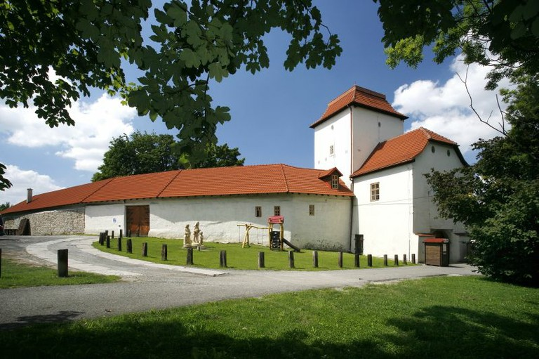
10) Silesian Ostrava Castle
It is the city's most historic cultural monument. It was built in the second half of the 13th century, near to the Lučina and Ostravice rivers, where a fortified Slavonic settlement had once stood. It served as a defensive stronghold.
There is a 4-m high and 2.5-m broad wall from the 13th century. In 1534, the Gothic castle was rebuilt into a Renaissance chateau. In 1872, the castle burnt down, but was later re-built. The main cause of its destruction was coal-mining directly beneath the castle. The castle sank 16 m into the ground!

Slide 13
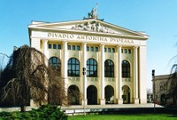
11) The Antonín Dvořák Theatre
In 1905, the city held a design competition that was later won by Viennese architect Alexander Graf. He brought a decidedly Baroque look. The last reconstruction of the building took place at the turn of the 21st century.
Much of the building was rebuilt to its original splendour, while at the same time technically modernised to meet the demands of a modern theatre. The Antonín Dvořák Theatre was reopened in a gala celebration on New Year's Eve, 2000.

