Slide 1
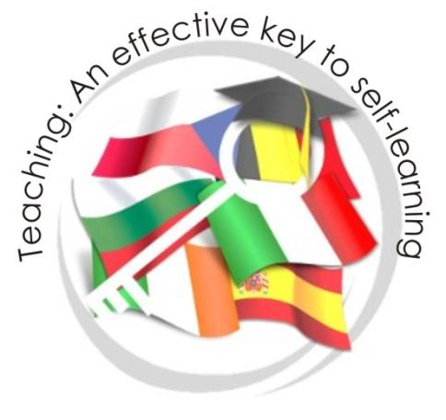
OUR SCHOOL ZŠ a MŠ Ostrava-Zábřeh, Kosmonautů 15, příspěvková organizace
Teaching: An effective key to self-learning
This project was funded by European Union.

Slide 2
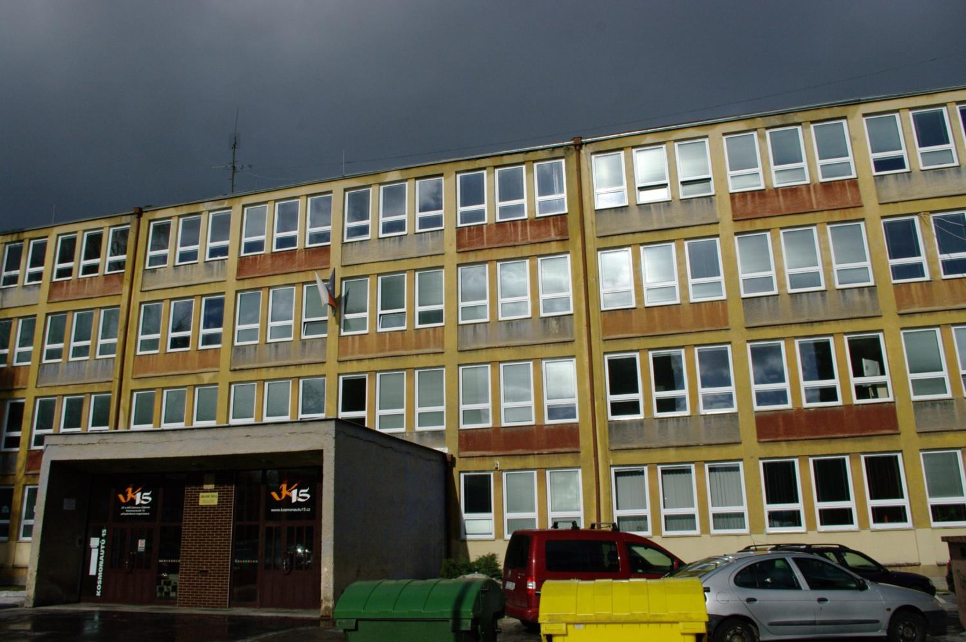
This is our school Kosmonautu 15.

Slide 3
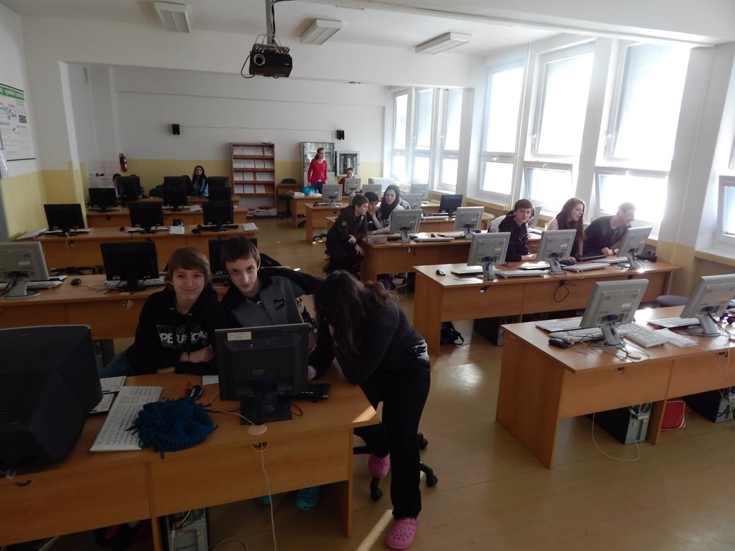
We can work on 30 computers in our IT room.

Slide 4
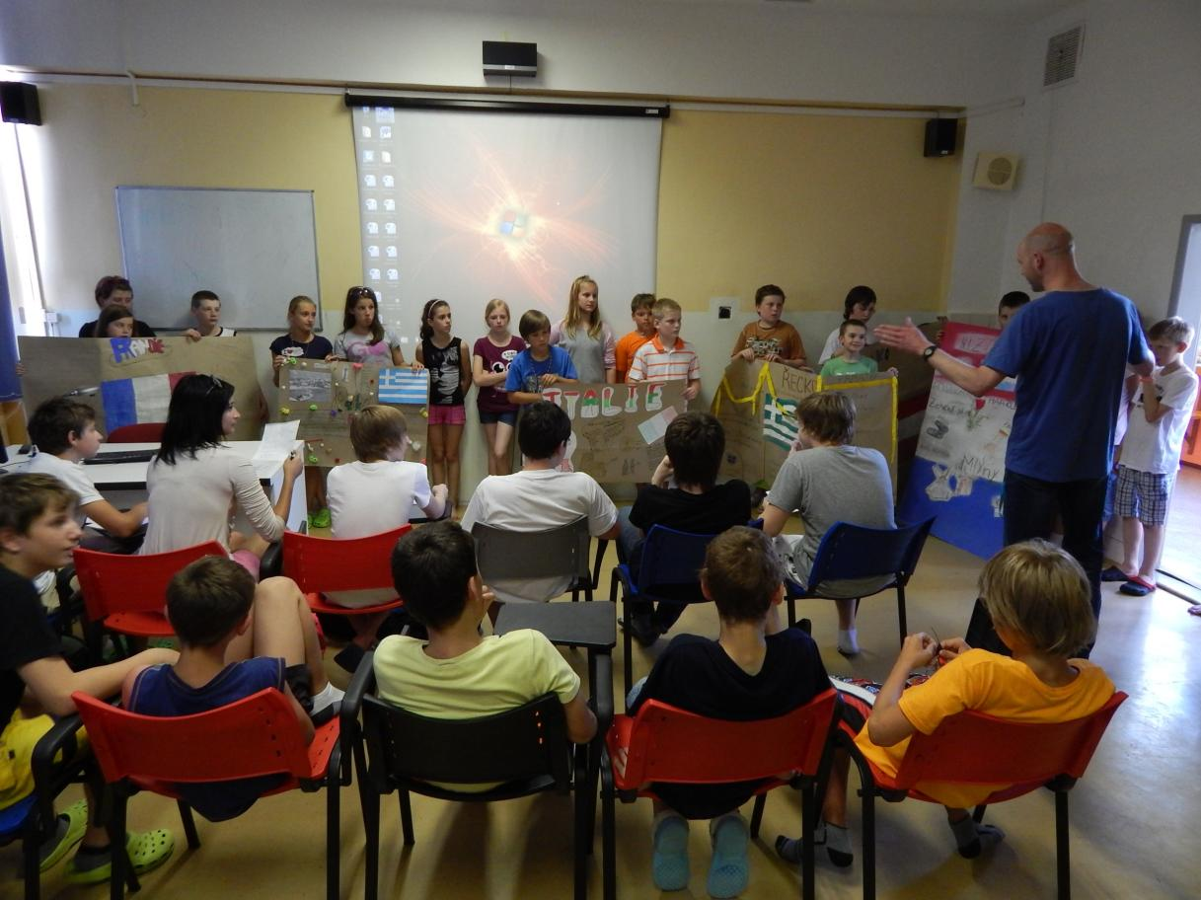
Media classroom is used for presentations.

Slide 5
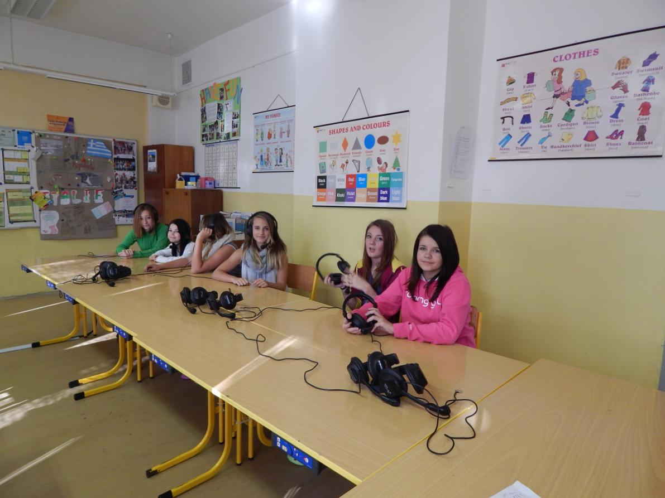
Language laboratory is equipped with Robotel system, Response system and White Board.

Slide 6
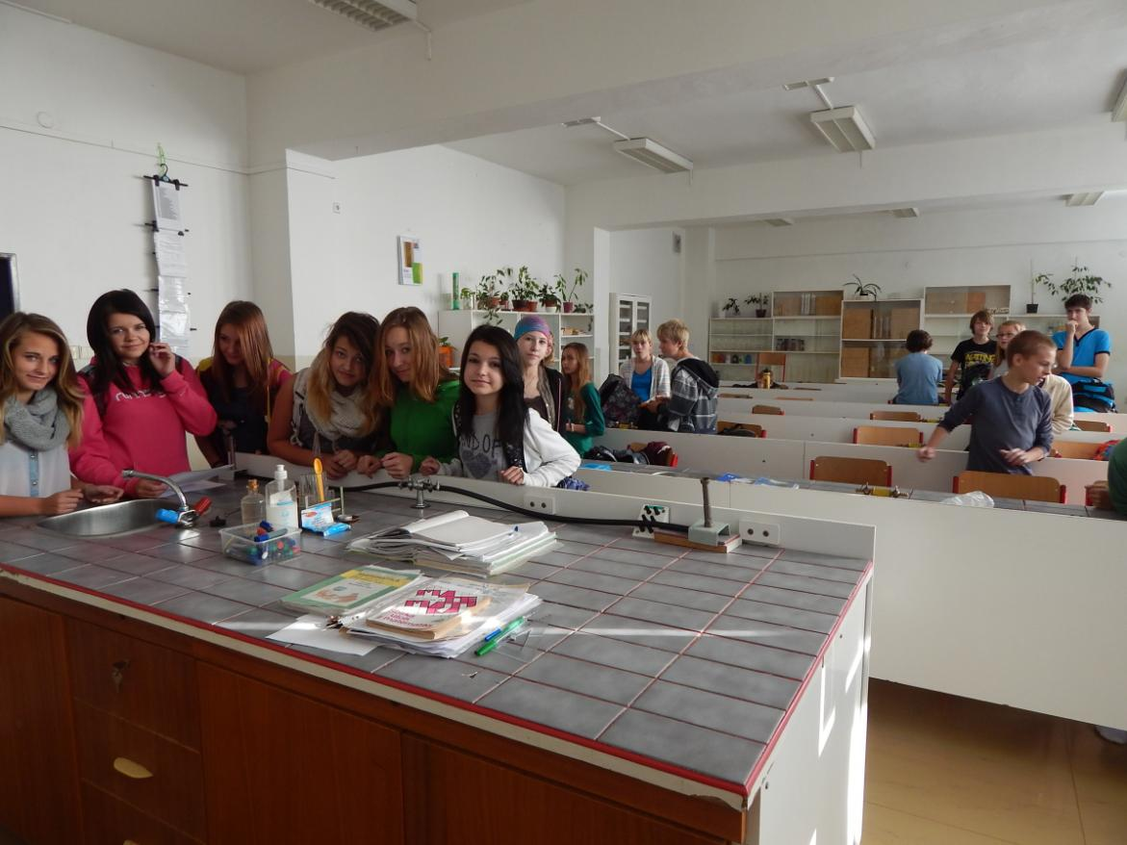
And this is our chemistry laboratory.

Slide 7
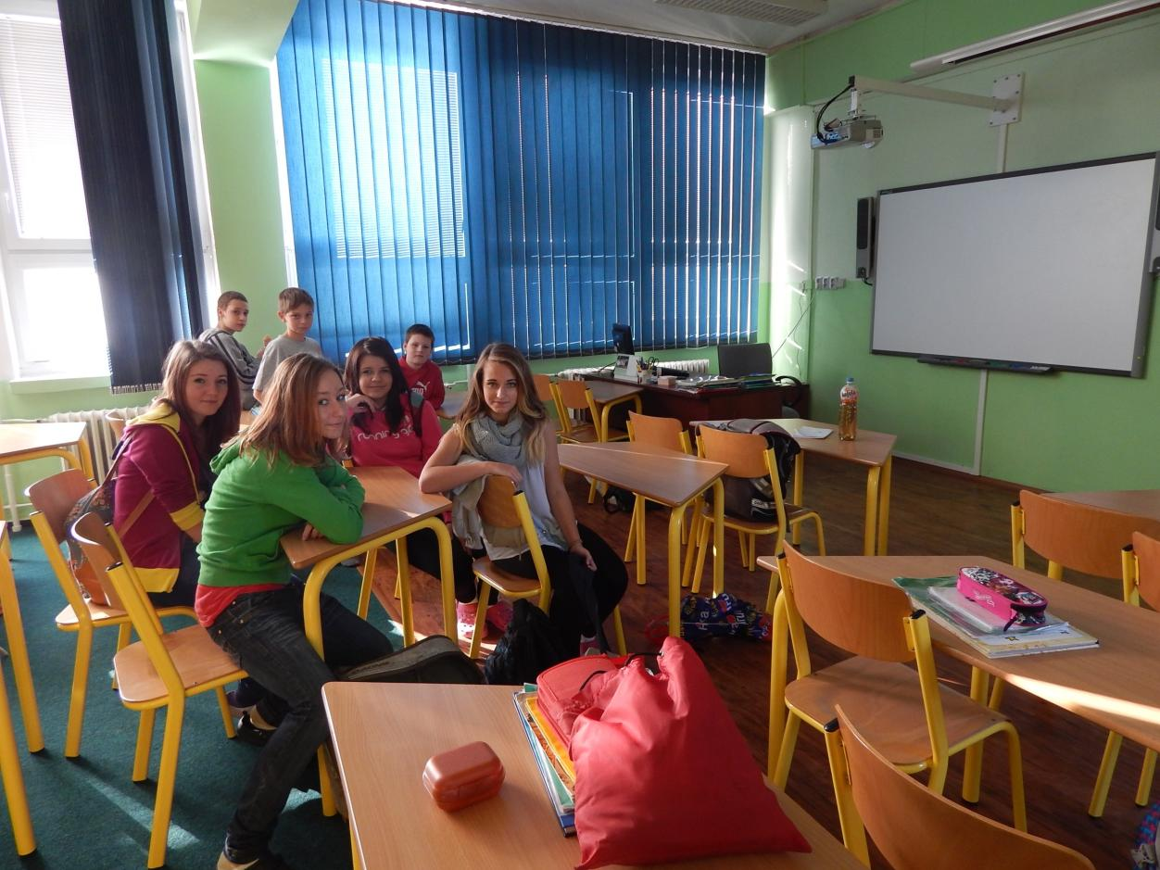
We realized project Praklíč financed by European Union and modernized our Biology classroom .

Slide 8
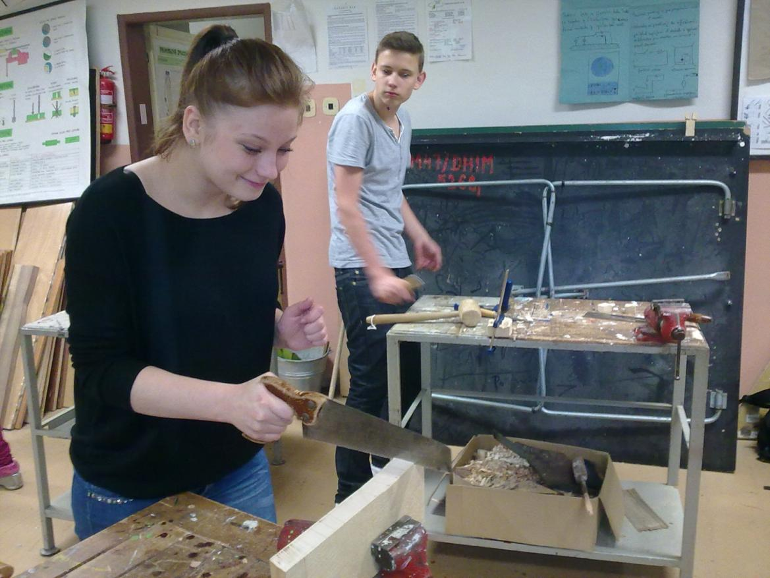
We learn how to make things with our hands.

Slide 9
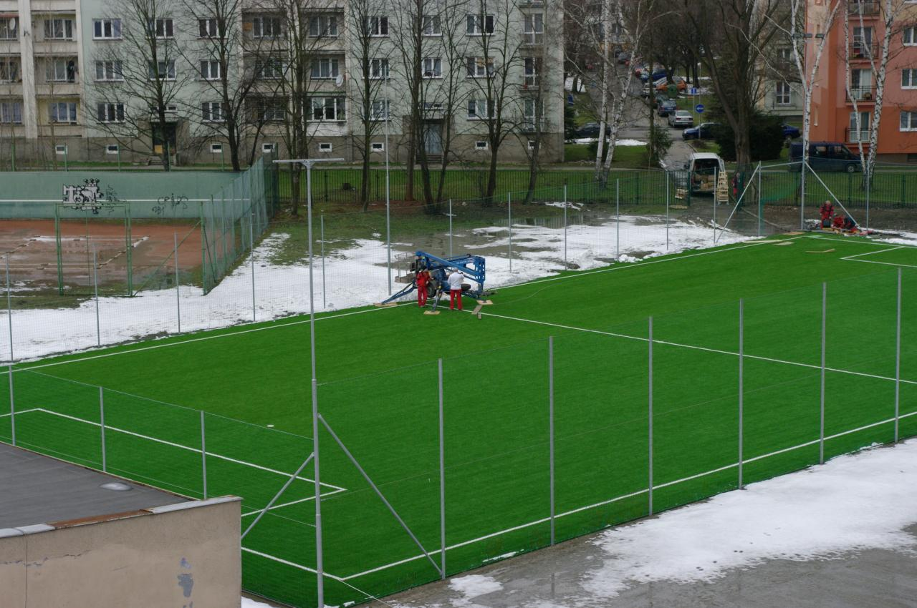
A new playground with plastic grass
was built behind our school in 2013.

Slide 10
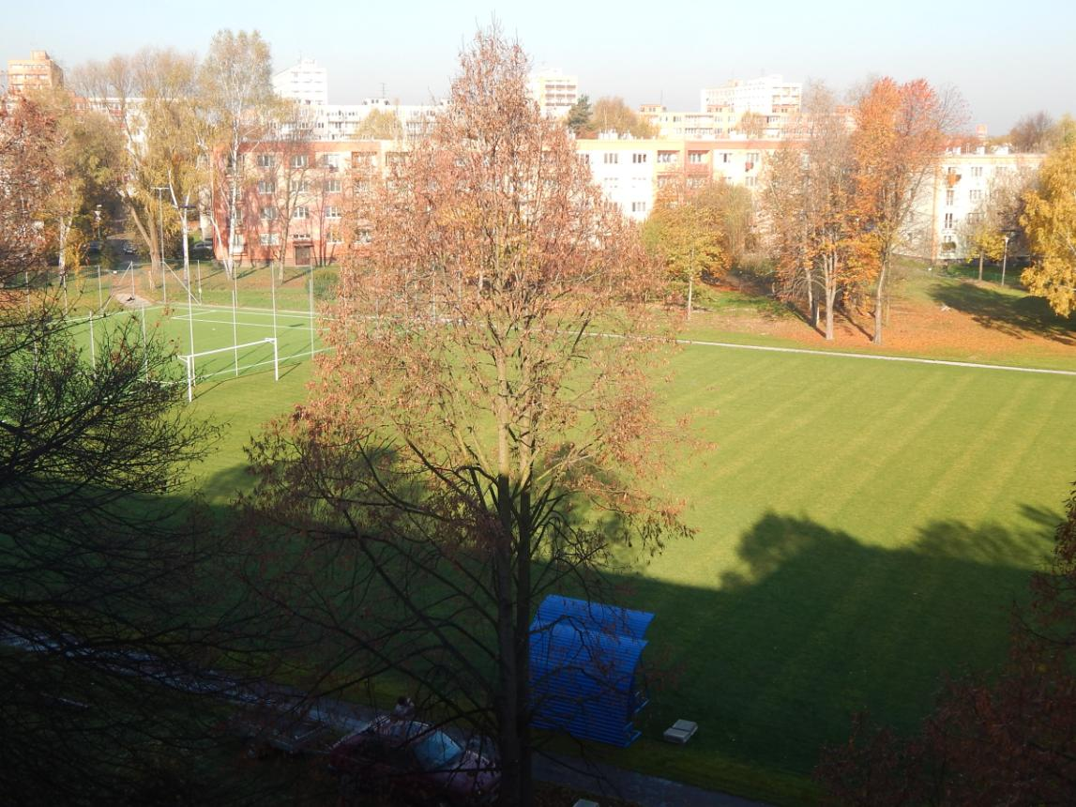
Football club rebuilt the playground behind our school and takes care of it. We can use it for P.E.

Slide 11
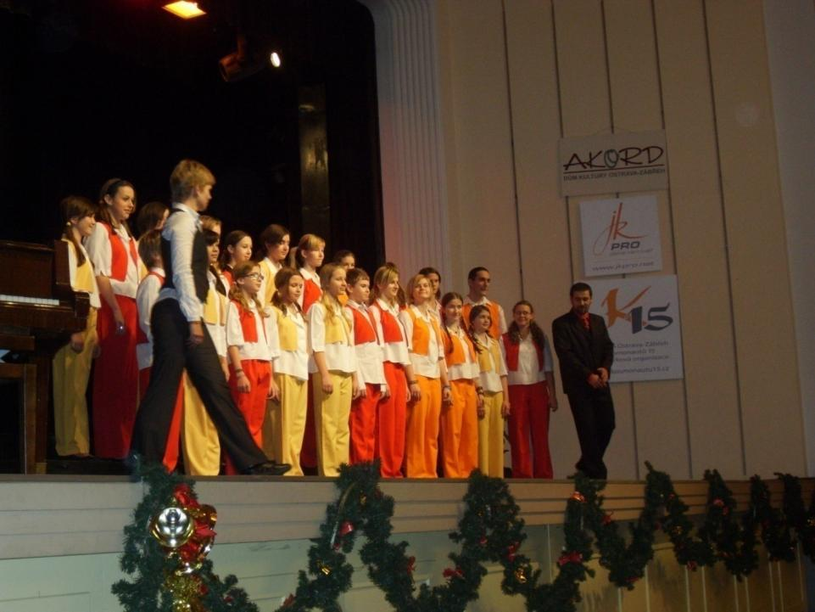
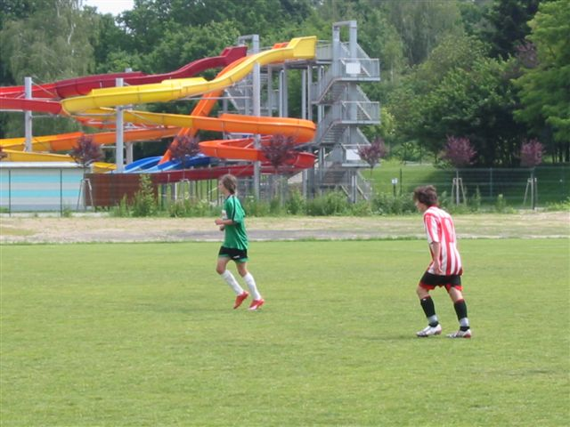
After school we can take part in many activities.
This is our school choir.
Many pupils play
soccer for FC Ova-Jih.
There is a new aqua park next to our school.

Slide 12
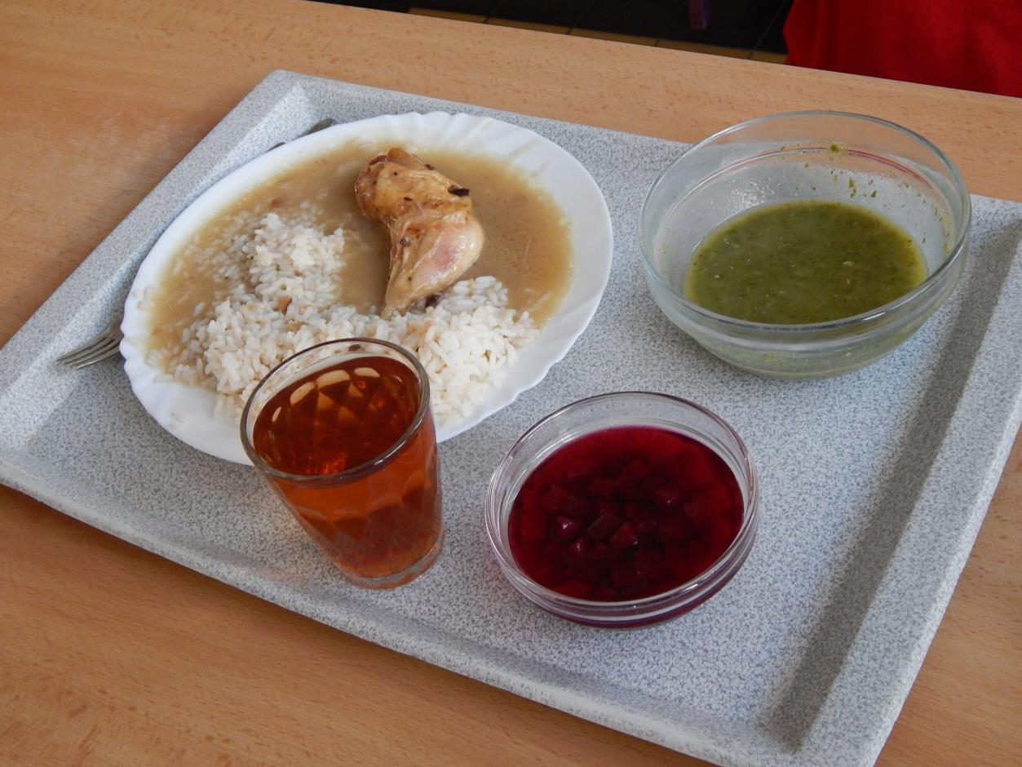
We can have lunch in the school canteen.

Slide 13
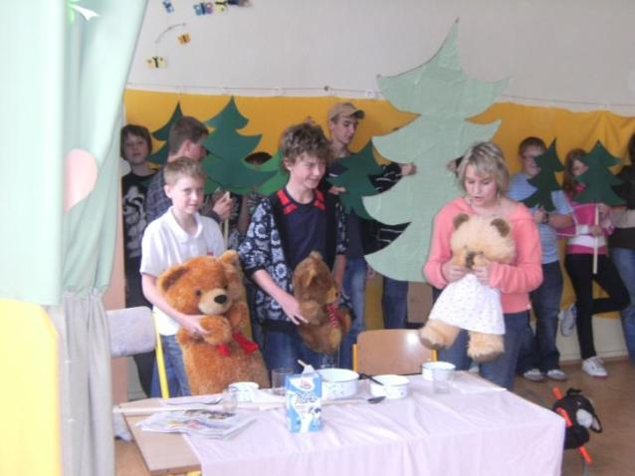
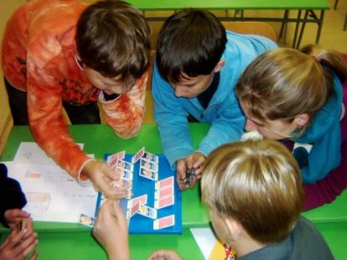
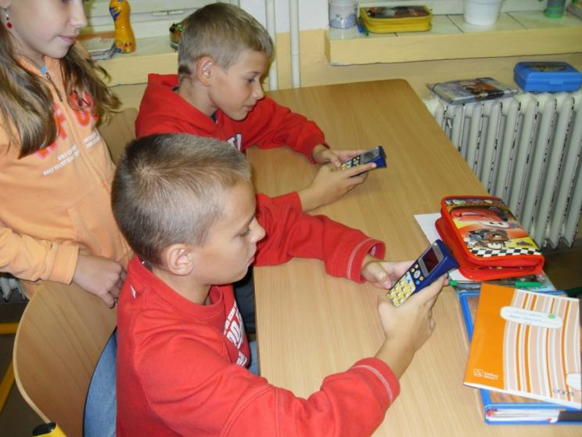
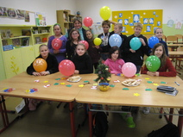
Some of us work on projects in our English club.

Slide 14
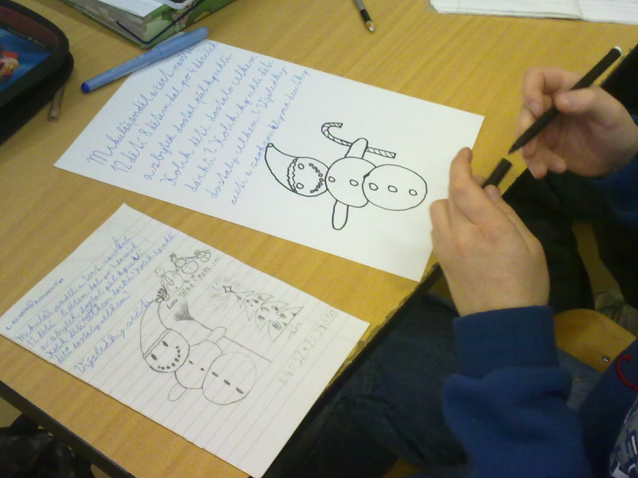
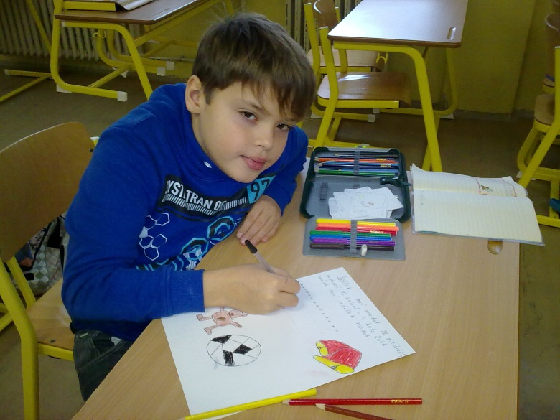
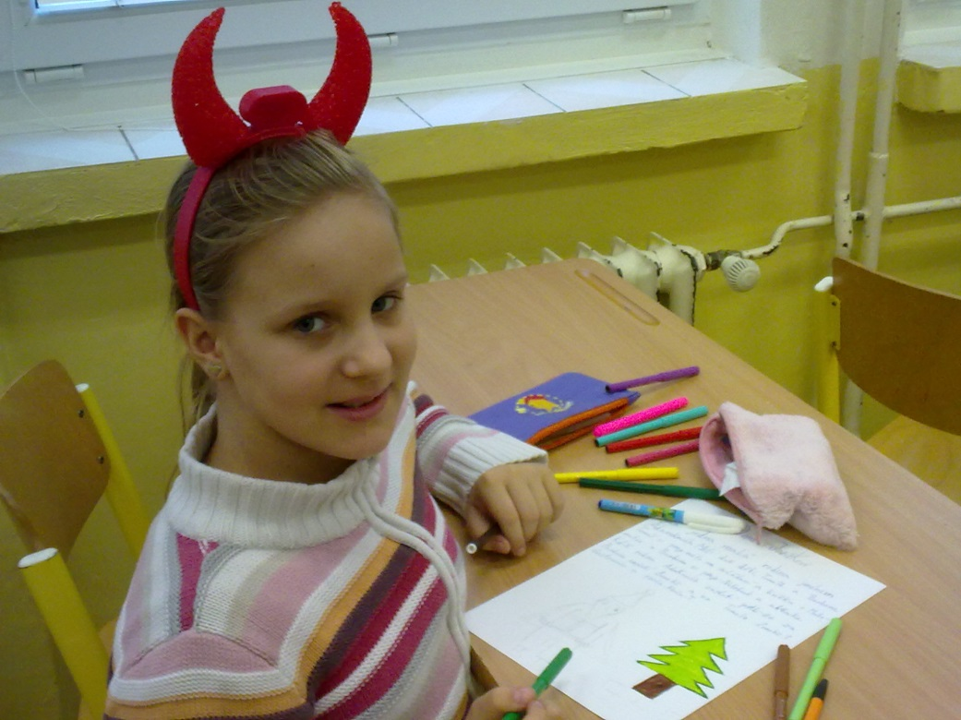
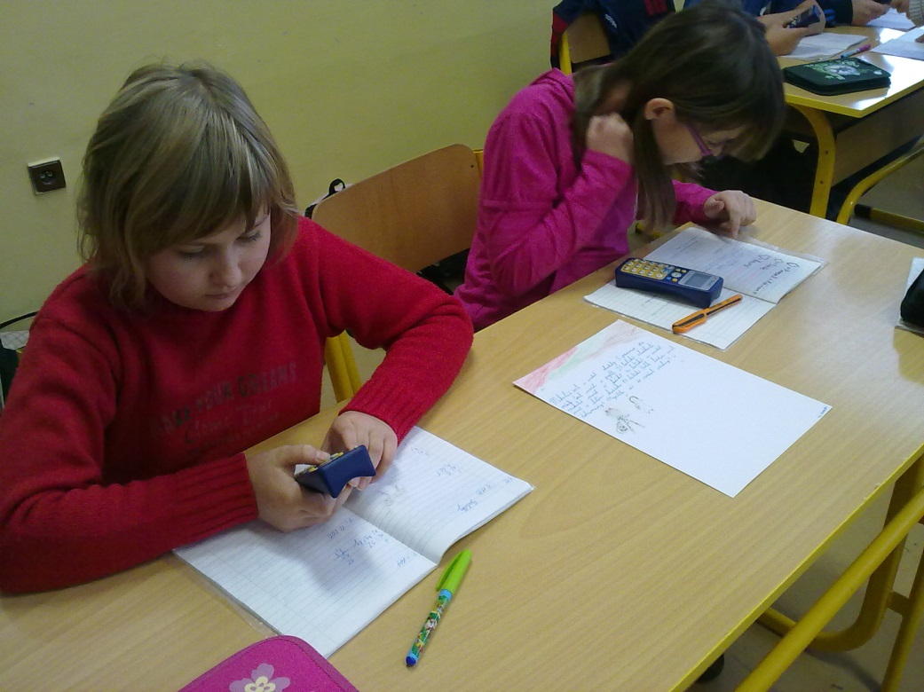
Our team worked on etwinning project CHRISTMAS MATHS POSTCARDS and won the Czech competition in 2012.
First creating tasks, then solving them.

Slide 15
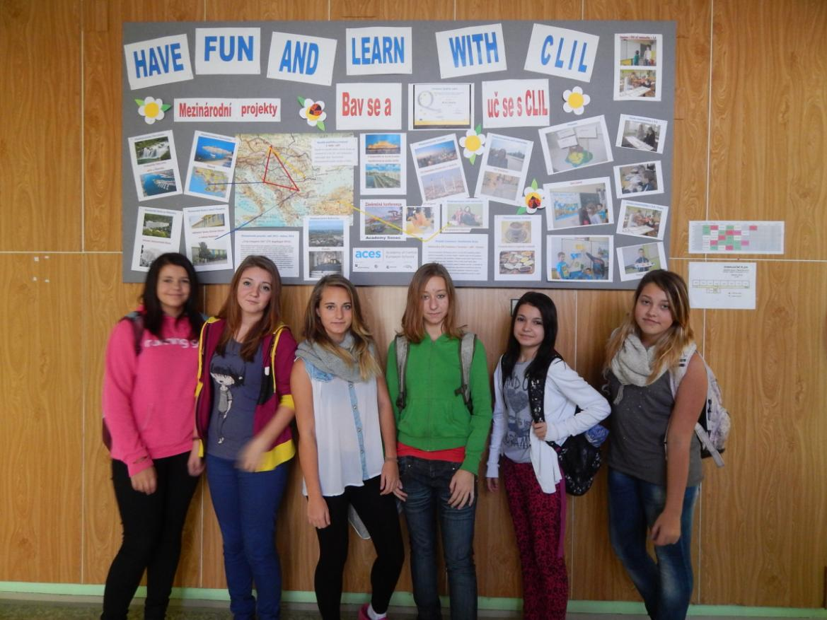
We inform about projects on notice board and web.

Slide 16
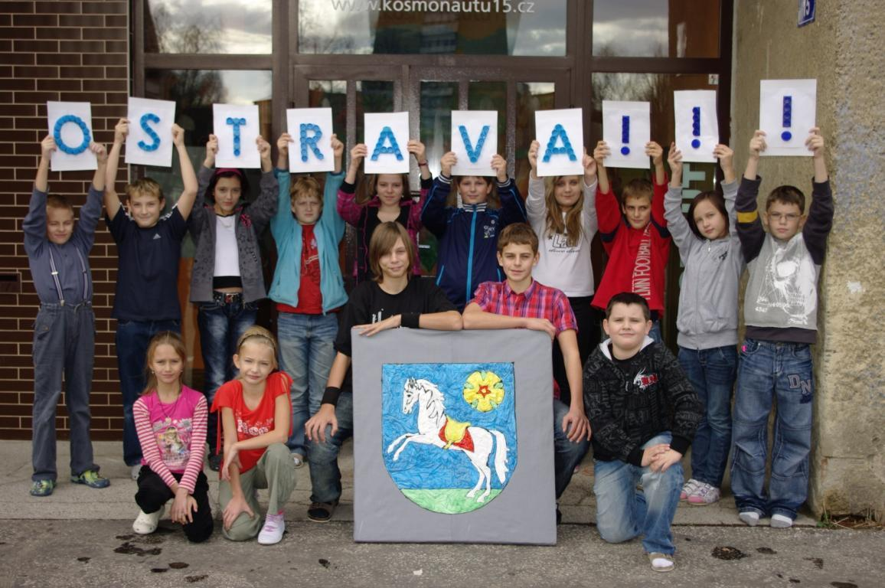
Good-bye from Ostrava

