Slide 1
OUR SCHOOL through Lucy Kobzova´s eyes
Teaching: An effective key to self-learning
This project was funded by European Union.

Slide 2
ENTRANCE HALL

Slide 3
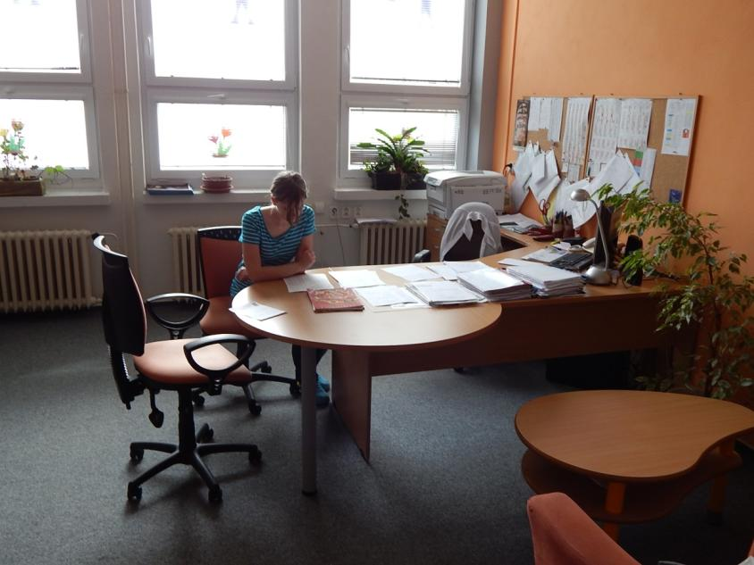
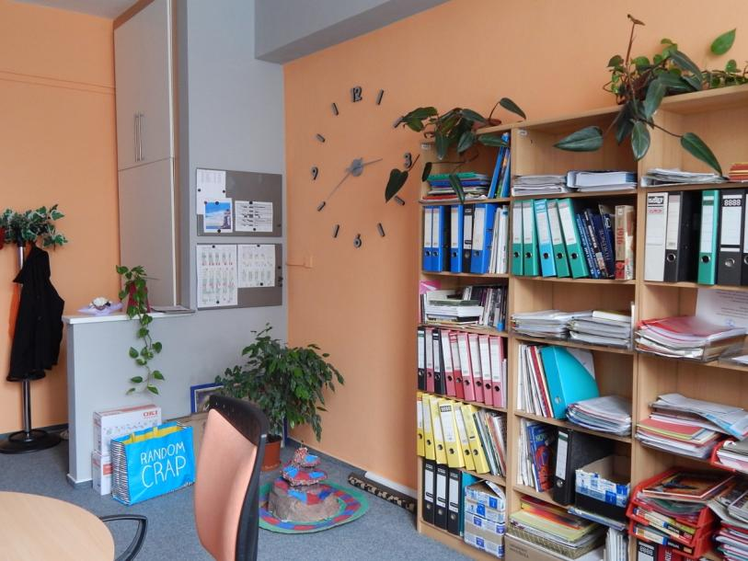
DEPUTY TEACHER´S OFFICE

Slide 4
TEACHERS´ ROOM

Slide 5
CORRIDORS

Slide 6
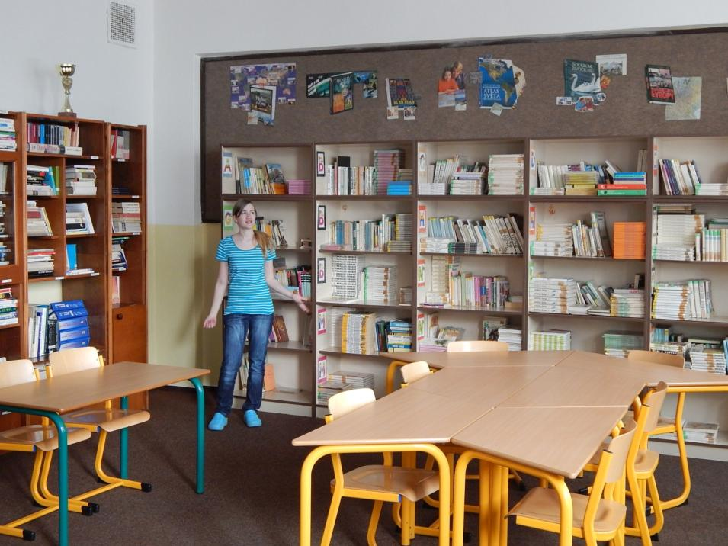
INFORMATION CENTRE

Slide 7
MUSIC CLASSROOM

Slide 8
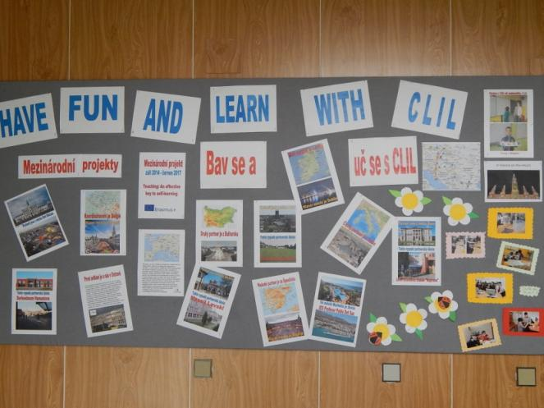
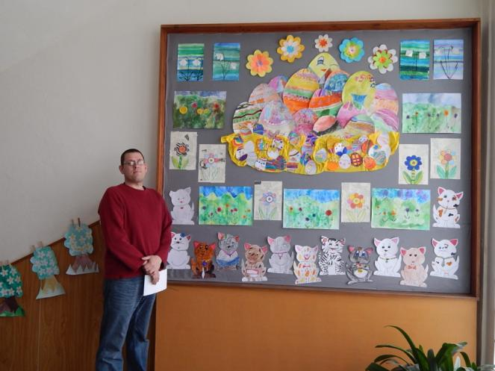
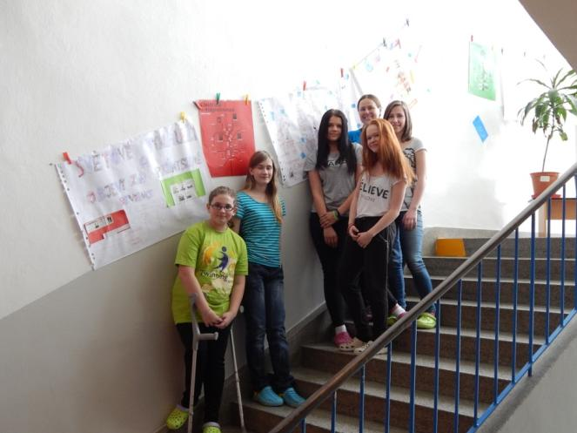
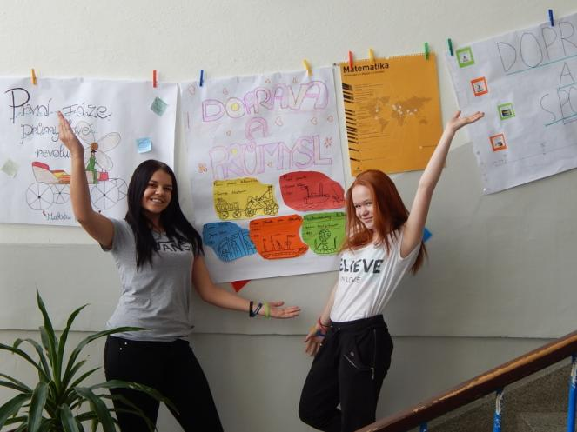
NOTICE BOARDS IN THE CORRIDORS

Slide 9
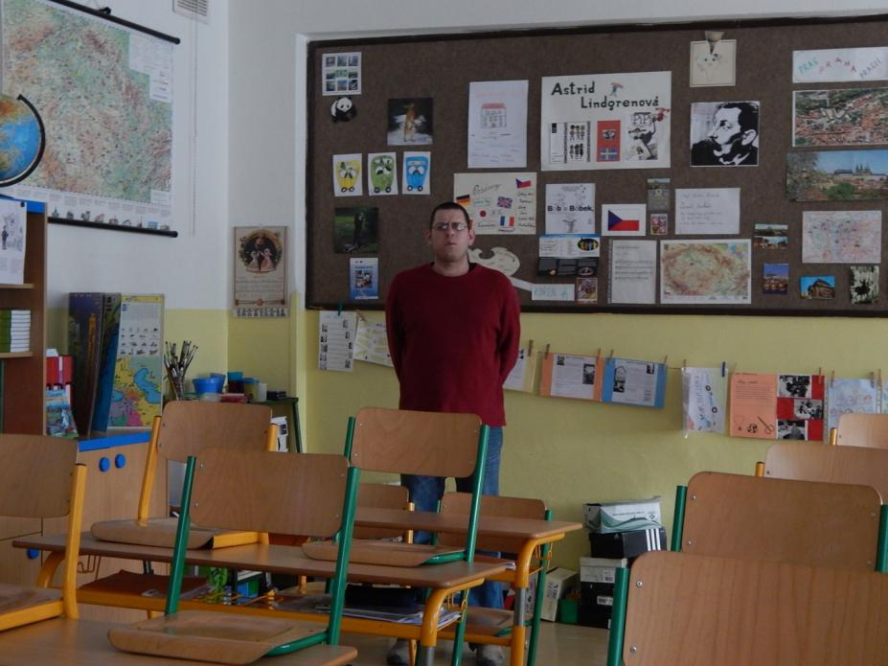
TYPICAL CLASSROOM

Slide 10
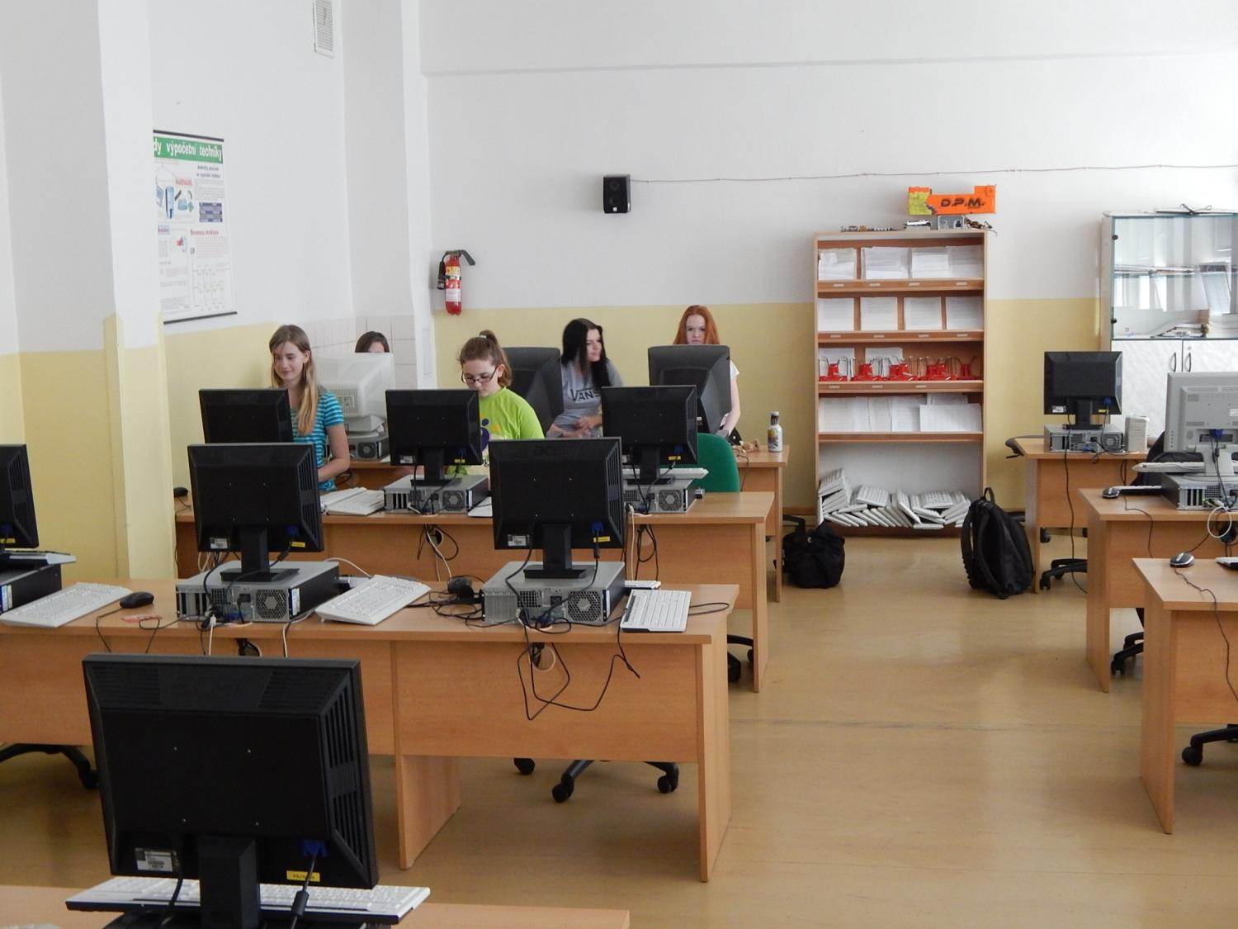
INFORMATION TECHNOLOGY CLASS

Slide 11
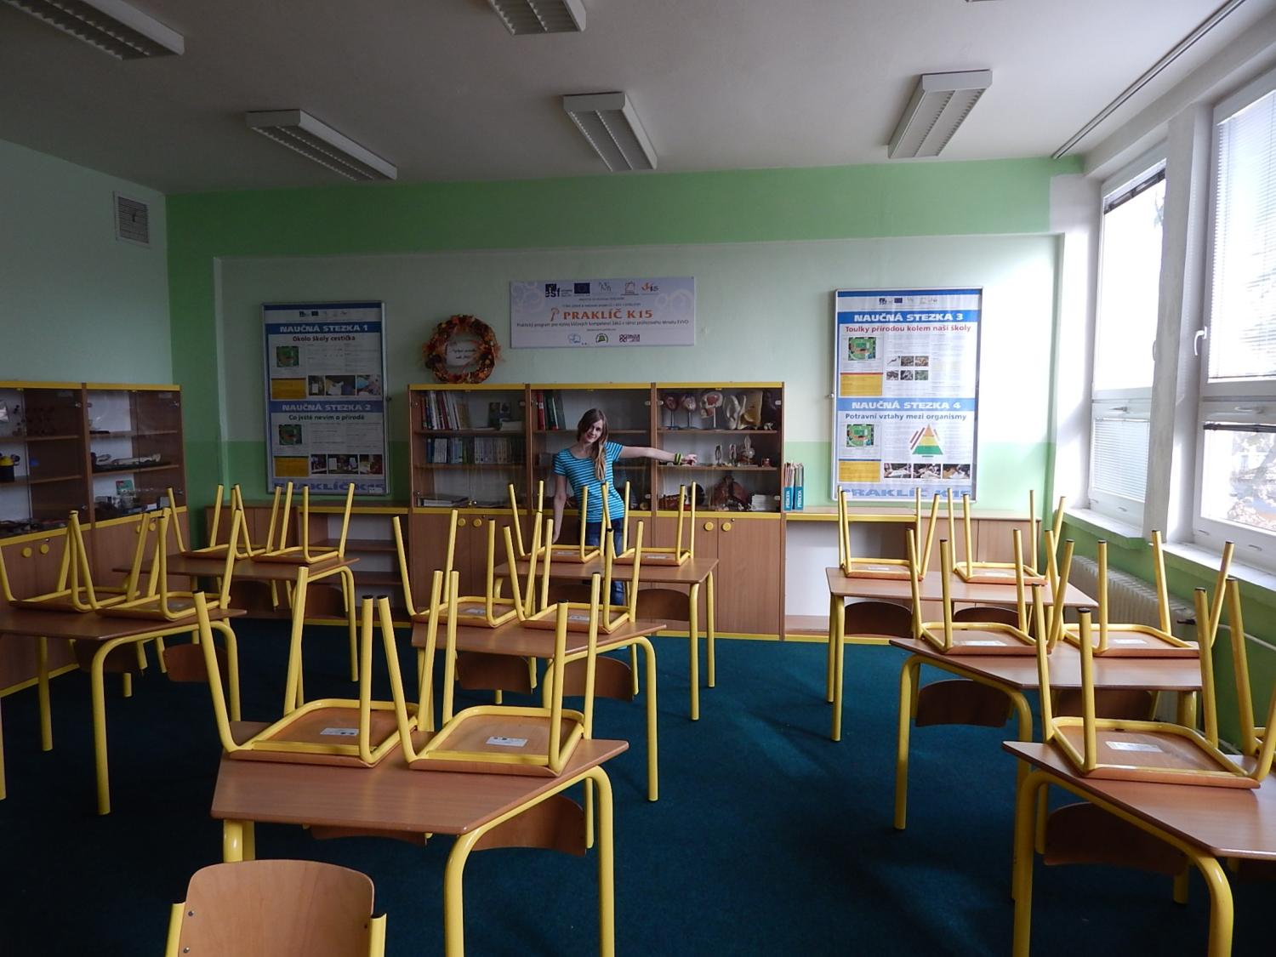
BIOLOGY + ENVIRONMENTAL CLASSROOM

Slide 12
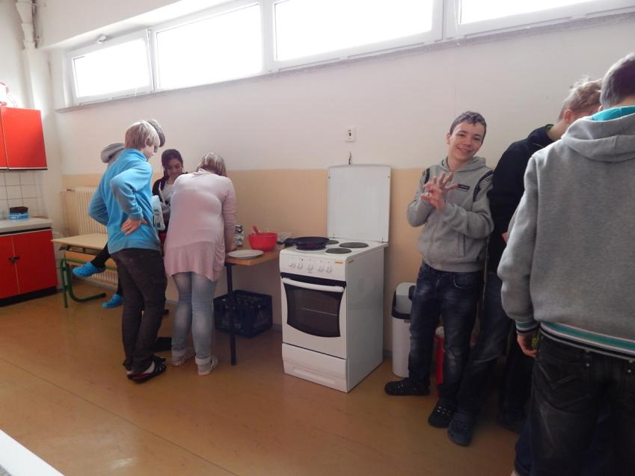
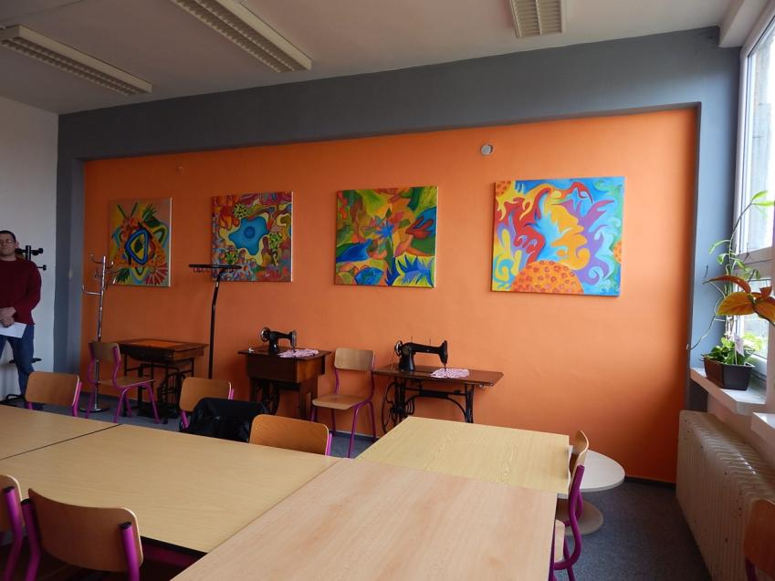
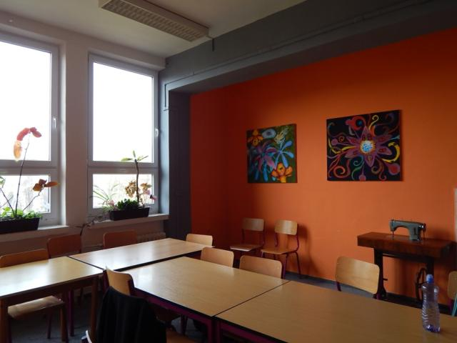
SCHOOL TRAINING KITCHEN WITH CLASSROOM

Slide 13
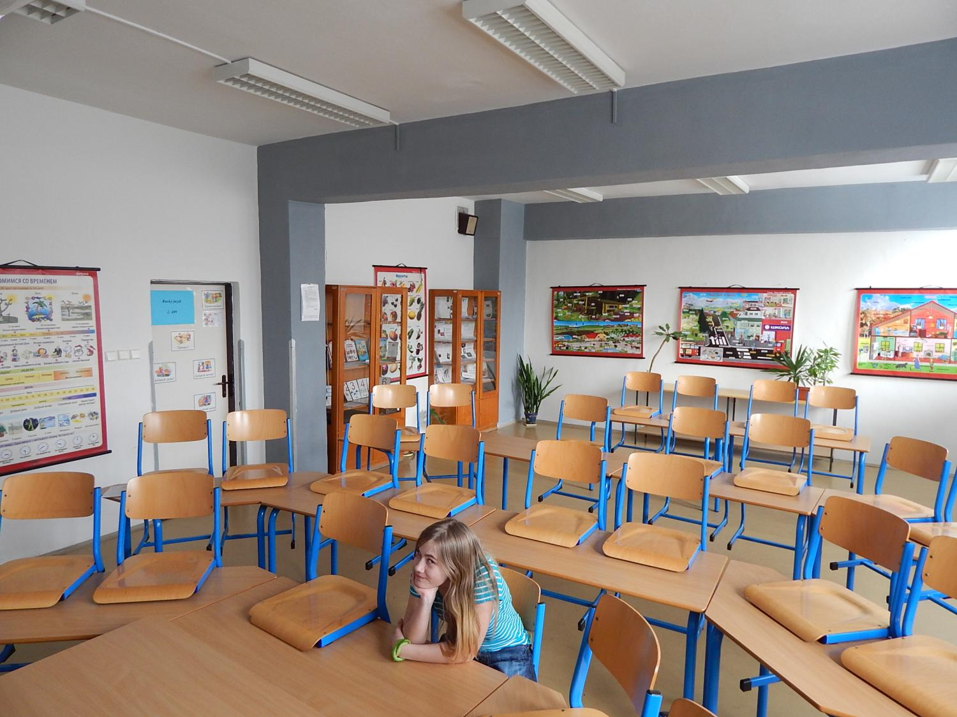
ENGLISH CLASSROOM

Slide 14
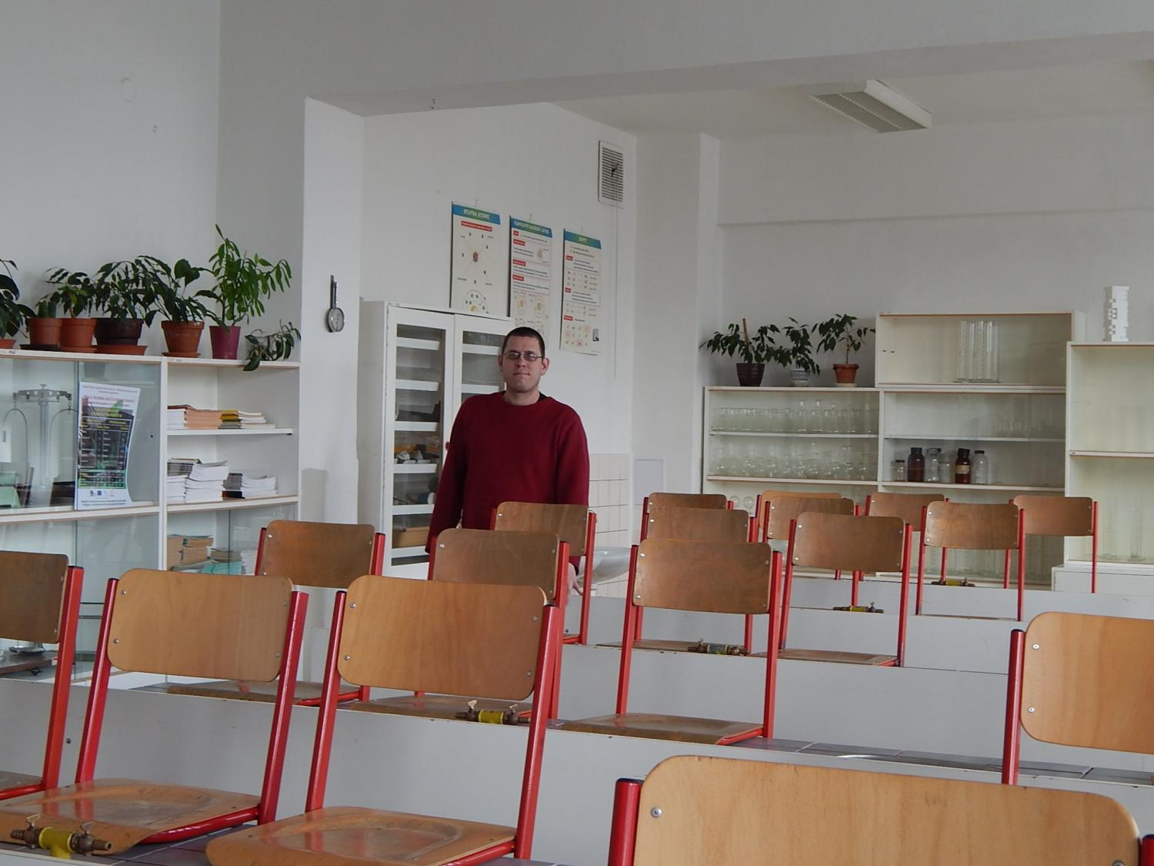
CHEMISTRY CLASSROOM

Slide 15
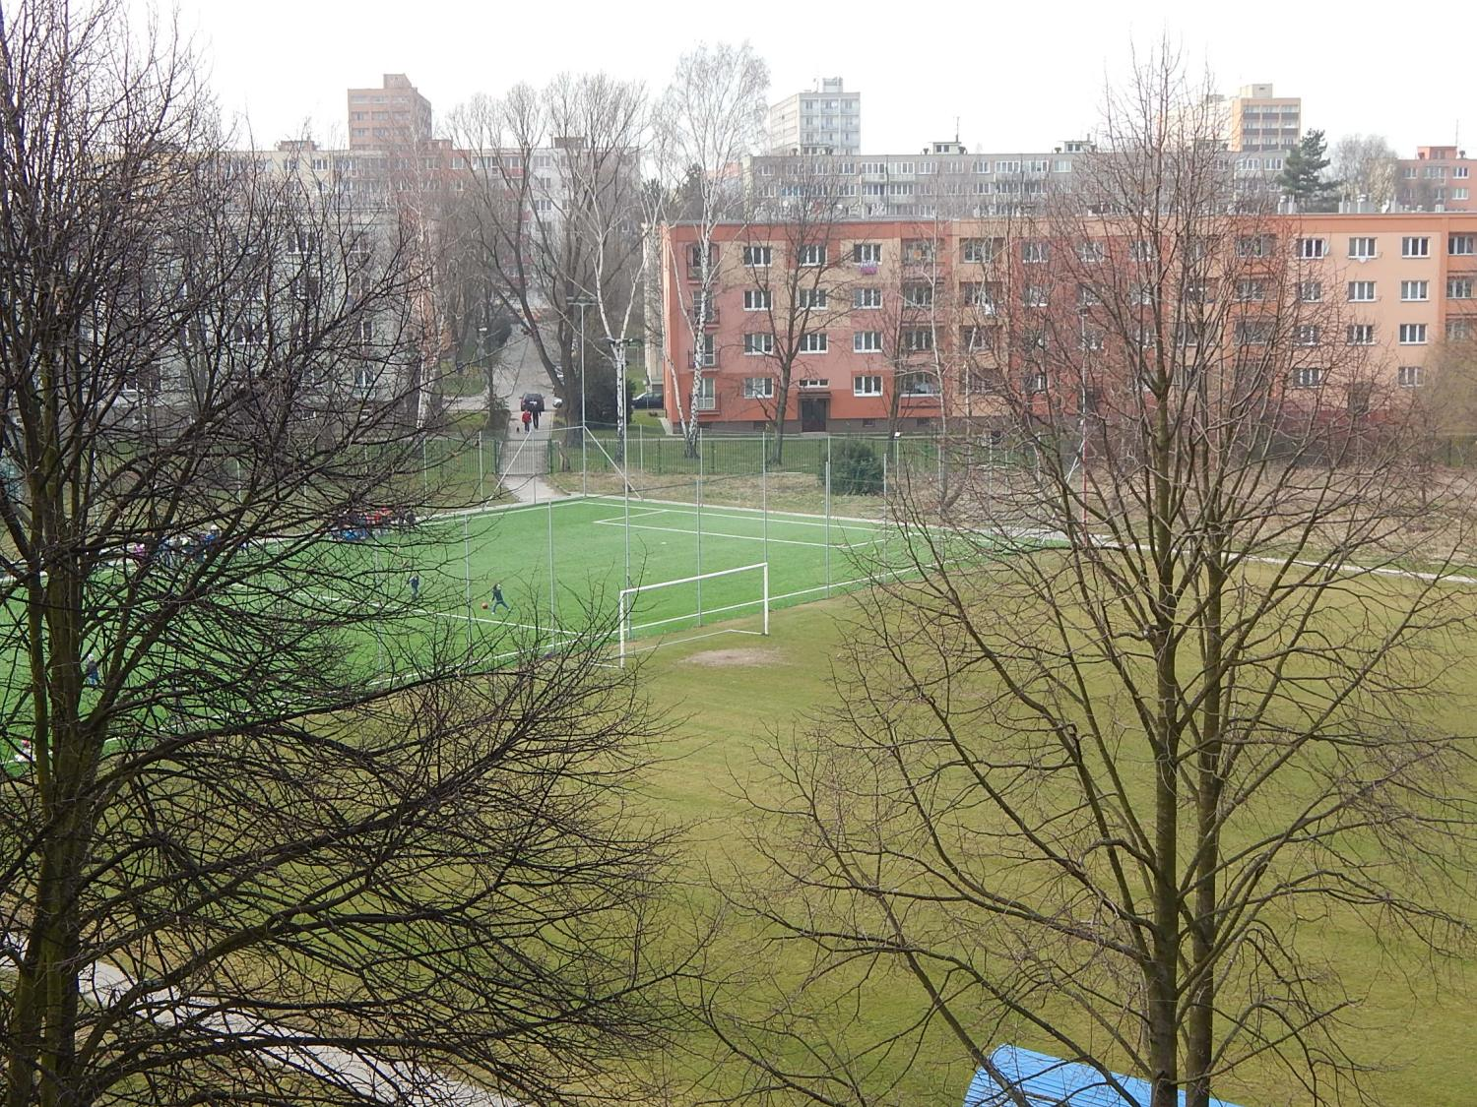
SCHOOL PLAYGROUND

