Slide 1
Project meeting in Ostrava
25 – 31 January 2015
Czech Republic
This project is funded by European Union.

Slide 2
Monday
8 – 9:00 Joined breakfast in school canteen
9:15 – 9:40 Welcome meeting
9:40 – 10 Geography lesson – Czech Republic
10:15 – 12 Ice-breakers in gym
12 – 13 Music lesson for Erasmus partners
13 – 14 Lunch
14 – 14:45 Fair-trade lesson
14:45 – 15:30 Team work on Fair-trade poster
16 – 18 Czech cold cuisine presentation + meeting involved Czech pupils, parents and teachers

Slide 3
What happened before the arrival of our guest? Hunt for the bread ☺
At eight o´clock, our guests were gathering at the hotel hall and a group of pupils from grade 8 was preparing their breakfast. Boys were going to bring the fresh rolls and bread from the supermarket. When we planned it on Friday, we had very nice sunny weather and no snow at all. And the weather forecast did not say anything about the snow fall which came on Saturday evening.

Slide 4
First joined breakfast in school

Slide 5
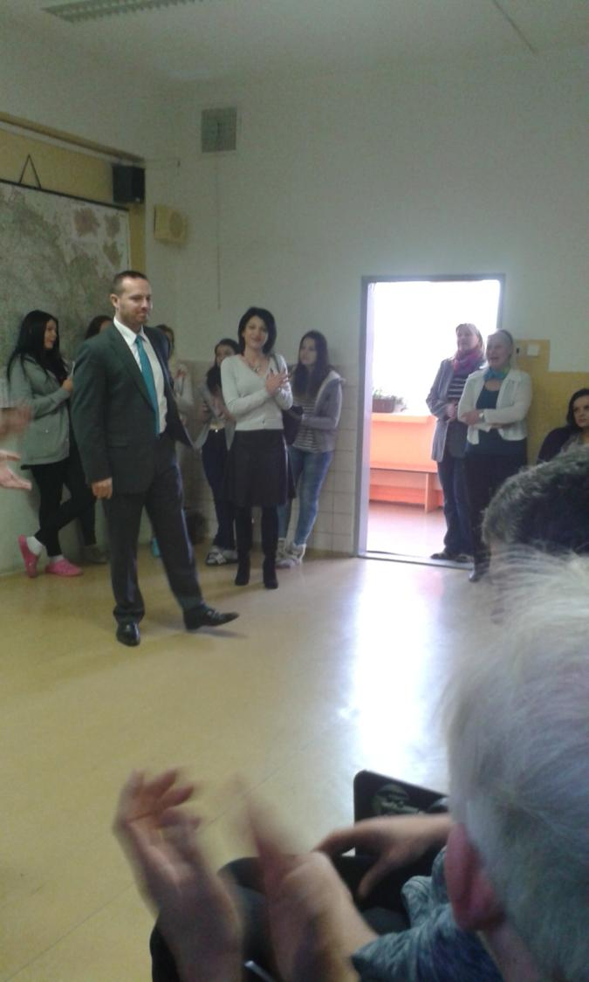
Welcome meeting
Representative of school education department of Ostrava-Zábřeh Mrs. Sládečková and headmaster Mr. Pabjan heartily welcomed 32 students and 10 teachers from Belgium, Bulgaria, Ireland, Italy and Spain.

Slide 6
Project coordinator Steven de Foer

Slide 7
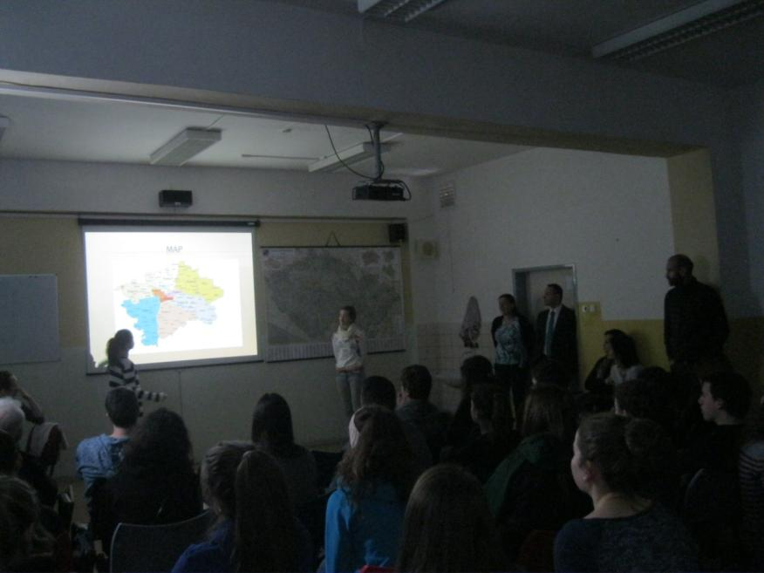
Czech Geography lesson for the guests

Slide 8
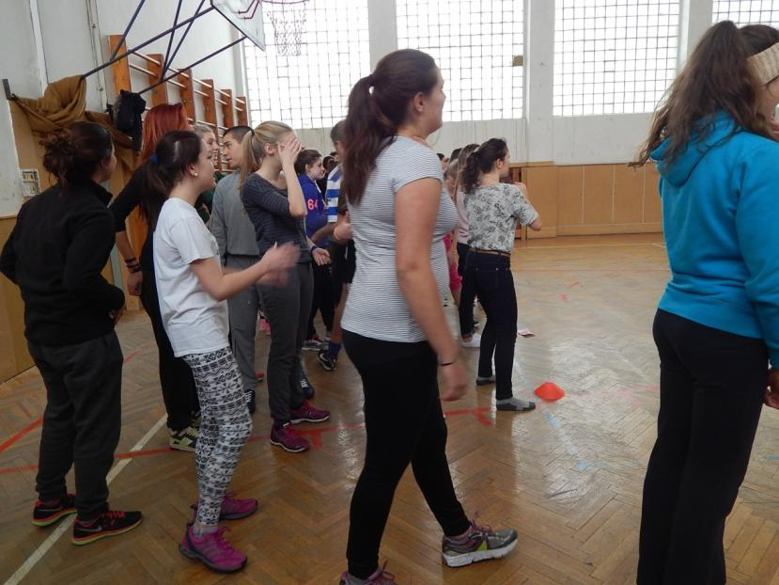
Ice-breakers in gym student were divided into 6 teams
Each team had a Czech, Belgium, Bulgarian, Italian, Irish and Spanish member

Slide 9
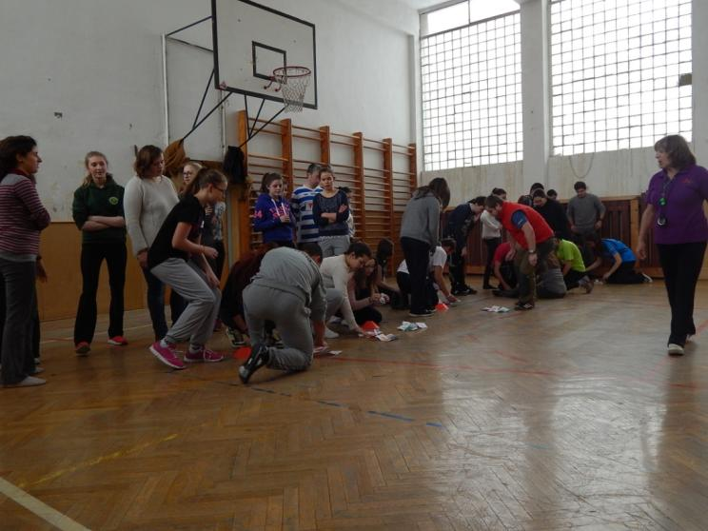
First activity was called „Traffic light“

Slide 10
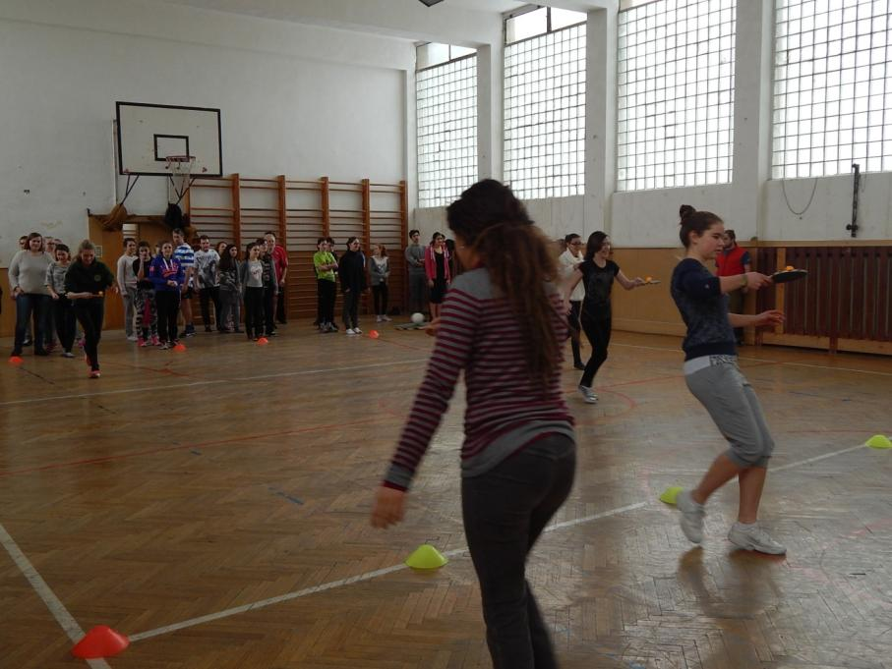
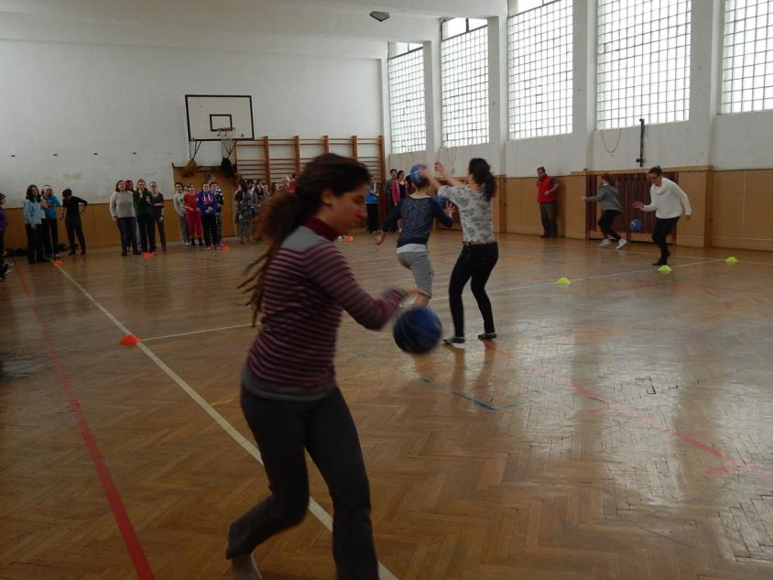
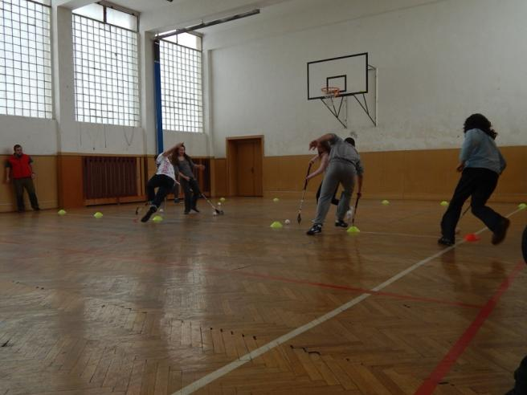

Slide 11
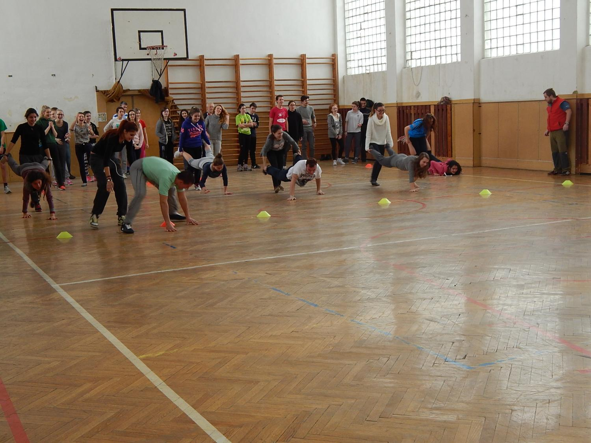
Activities were prepared by teachers Pavla Kachlířová and Adam Zielina

Slide 12
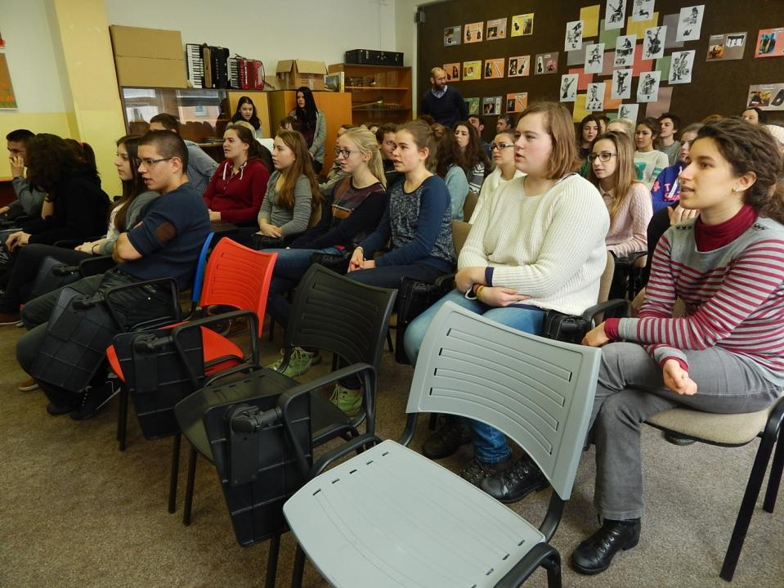
Music lesson prepared by Czech pupils
Falling down slowly
Oscar awarded song was sang by Czech girl Marketa Irglová and Irish songwriter Glen Hansard in movie Once.

Slide 13
Fair-trade lesson
If we can have fun why not the others too?

Slide 14
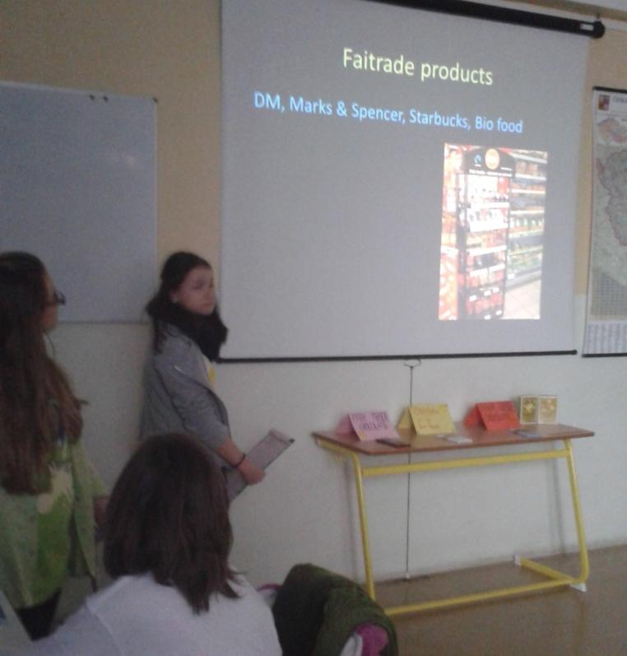
Czech lesson Fair-trade
Lesson was prepared by pupils from grade 8 for Erasmus+ project Teaching: An effective key to
self-learning.

Slide 15
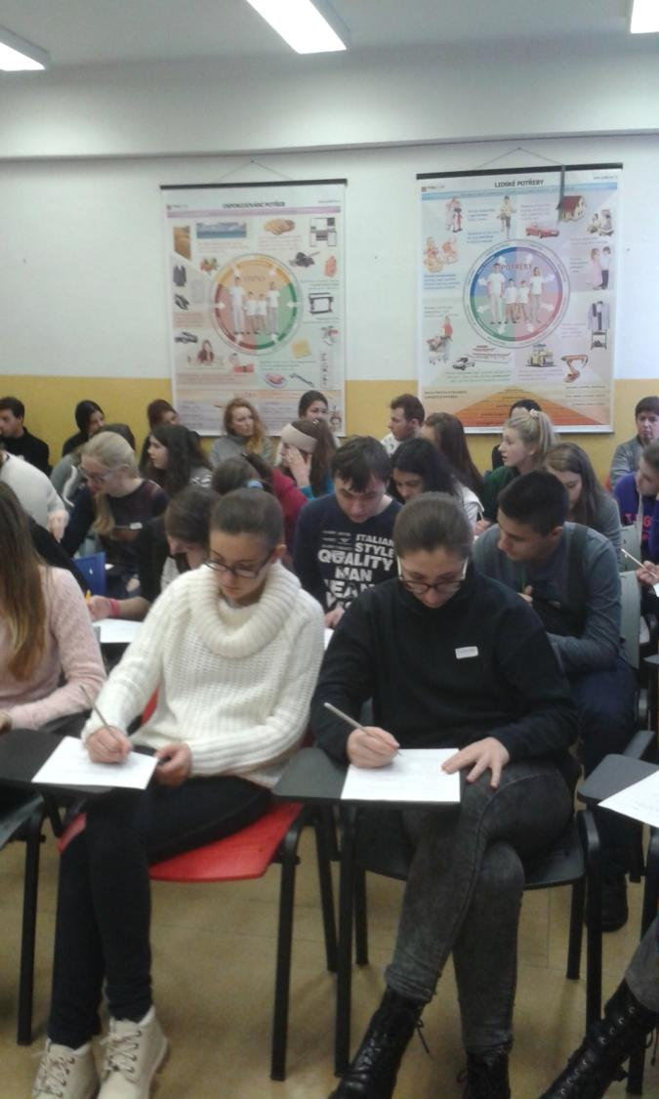
Czech lesson Fair-trade

Slide 16
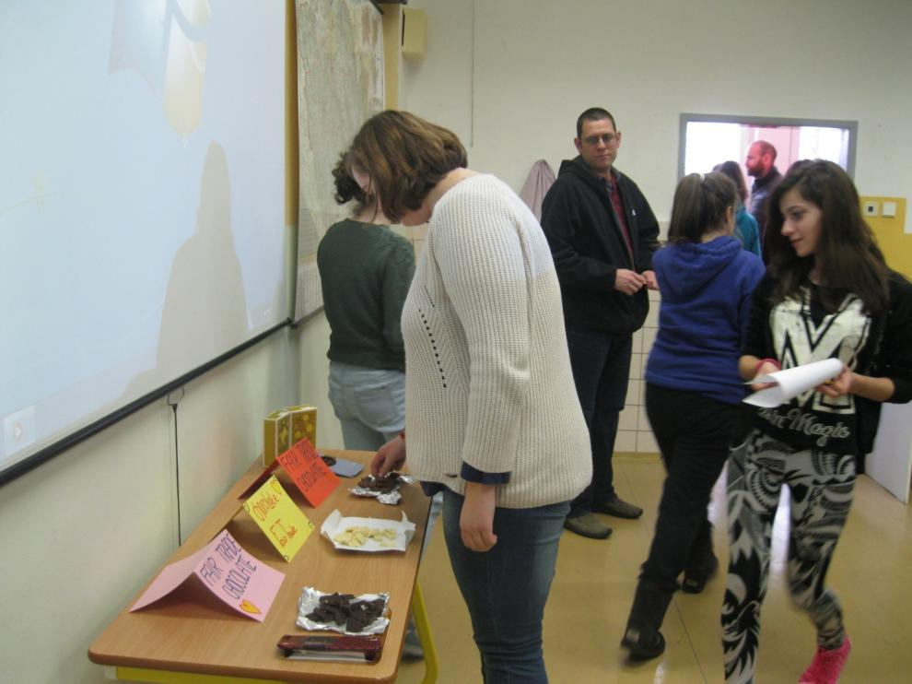
Fair-trade survey
Testing Fair-trade chocolate

Slide 17
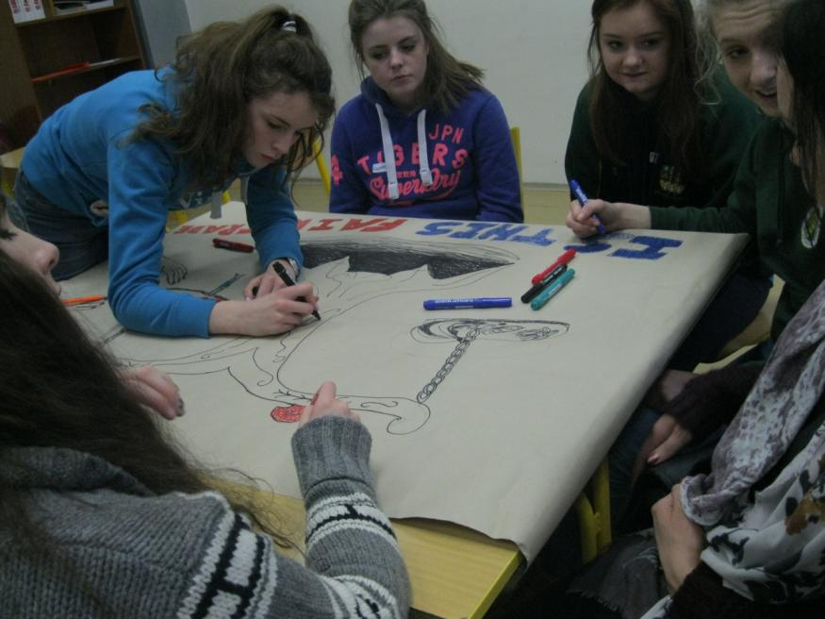
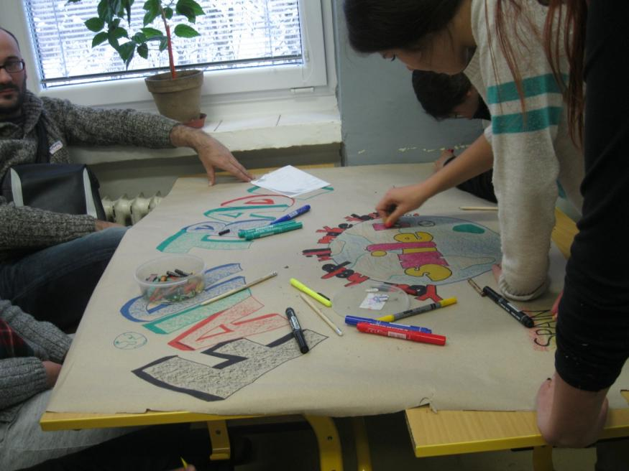
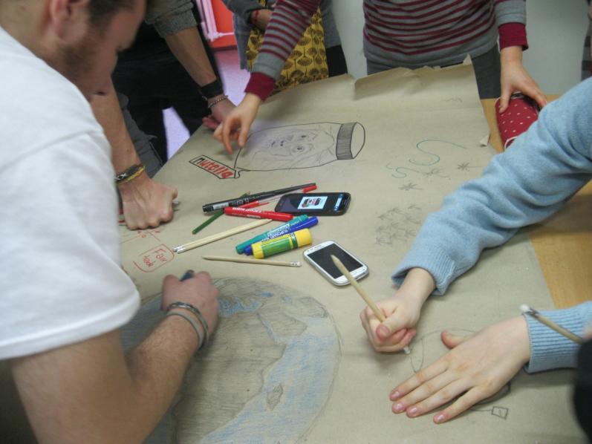
National teams work on the lesson outcome – Fair-trade posters

Slide 18
Czech cold cuisine
Pupils, teachers and parents were invited to come and meet our Erasmus guests – students and teachers from Belgium, Bulgaria, Italy, Ireland and Spain. There was one condition for the Czech pupils – to bring something with them. So in the morning pupils from classes 6. B and 7. A were bringing cakes, spreads and salads, also teachers baked and cooked to introduce Czech home made meals. Pupils from grade 8. prepared the feast. We would love to cook at school but there is only a little kitchen with one cooker. We had a good time talking and eating with new friends. Than some students were invited to have dinner in Czech families.

