Slide 1
Project meeting in Ostrava
25 – 31 January 2015
Czech Republic
This project is funded by European Union.

Slide 2
Friday
8 – 9:00 Breakfast in the hotel
9:15 Departure to the mountains
10 Funicular in Ráztoka to hill Pustevny
11 – 15 Trip to the Radegast statue
13 – 14 Lunch in Valaška restaurant at Pustevny
15 Funicular from Pustevny to Ráztoka
16 Arrival to Ostrava
Free time

Slide 3
Plan of the Pustevny ski resort

Slide 4
Ráztoka – the beginning of the trip

Slide 5
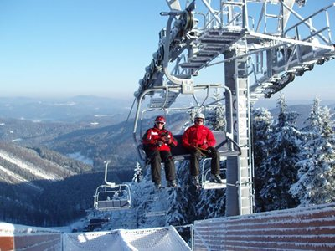
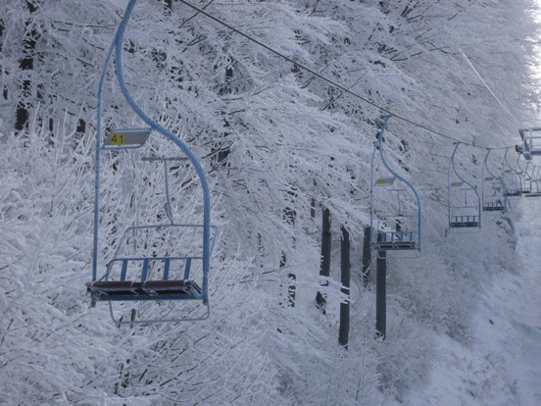
Planned view from funicular and reality

Slide 6
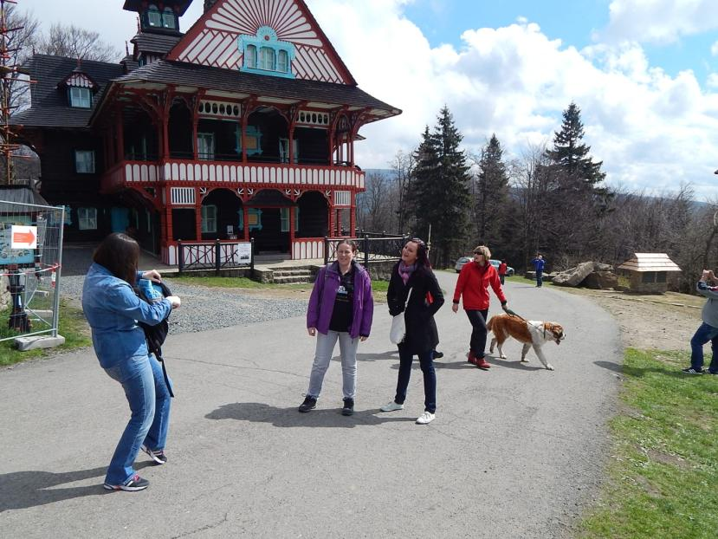
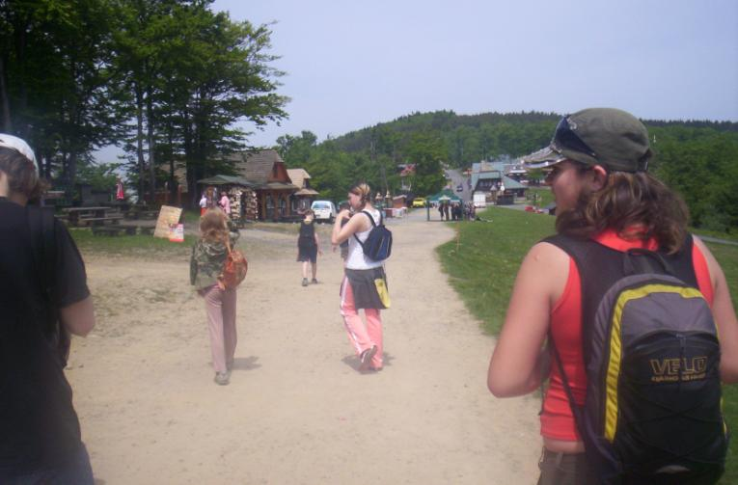
Compare Pustevny in summer

Slide 7
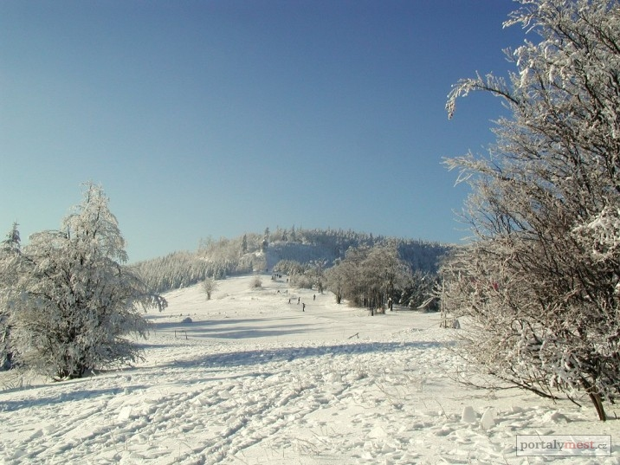
Pustevny hill in Winter, our reality during the trip

Slide 8
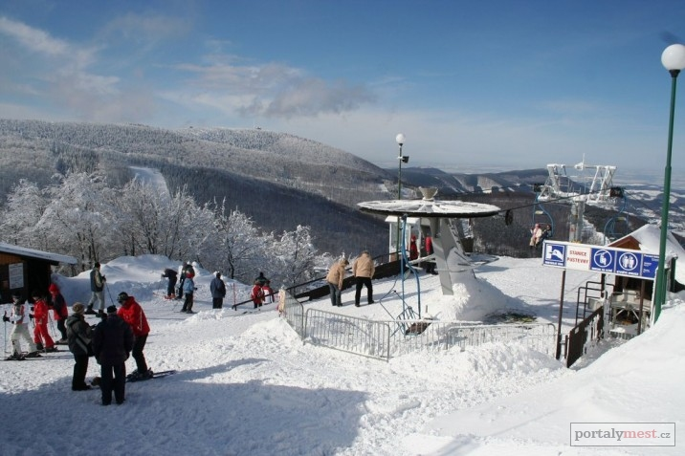
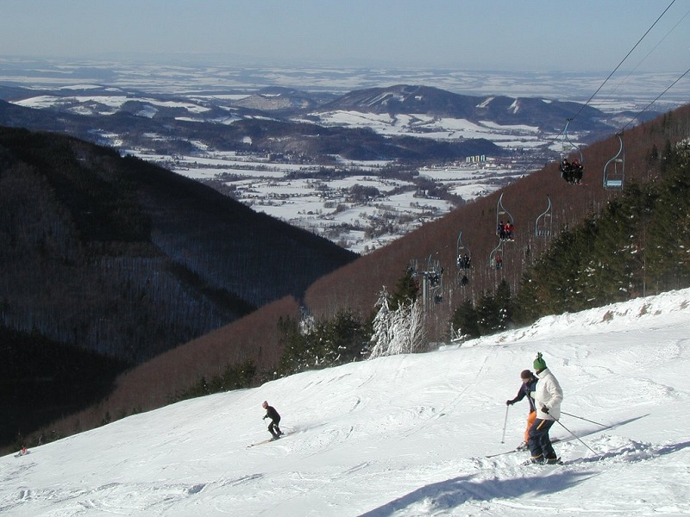
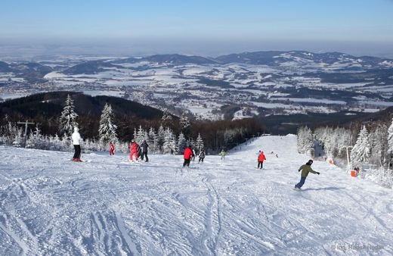
Planned view from Pustevny

Slide 9
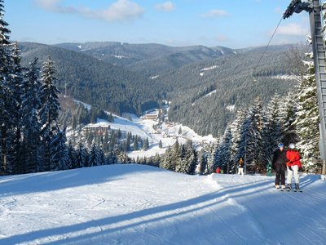
Reality was worst than in this photo.
On the left is what we could see.

Slide 10
Planned view of the Pustevny

Slide 11
Radegast statue – goal of our hike
This statue of pagan god Radegast is also logo of the well-known beer which is brewed in nearby town Nošovice.
God Radegast is god of Sun, wealth and corp.
It is 320 cm high.
It weighs 1 400 kg.

Slide 12
Lunch in stylish Valaška restaurant consisted of a Valachian HUGE sweet dumpling and other traditional meals.

Slide 13
Saturday – departure and farewell Italian group and their Czech hosts

