Slide 1
Project meeting in Ostrava
25 – 31 January 2015
Czech Republic
This project is funded by European Union.

Slide 2
Thursday
8 – 9:00 Joined breakfast in school canteen
9:15 – 10 Presentations of Fair-trade posters
10:15 – 11 International teams prepare interview
11:10 – 12 Writing the interview on the PC
12 – 14 Making video clips with the interviews
14 – 14:15 Official closing of the project meeting
14:15 – 15 Lunch
15 – 19 Free time, shopping centre etc.

Slide 3
Preparing the last breakfast at school

Slide 4
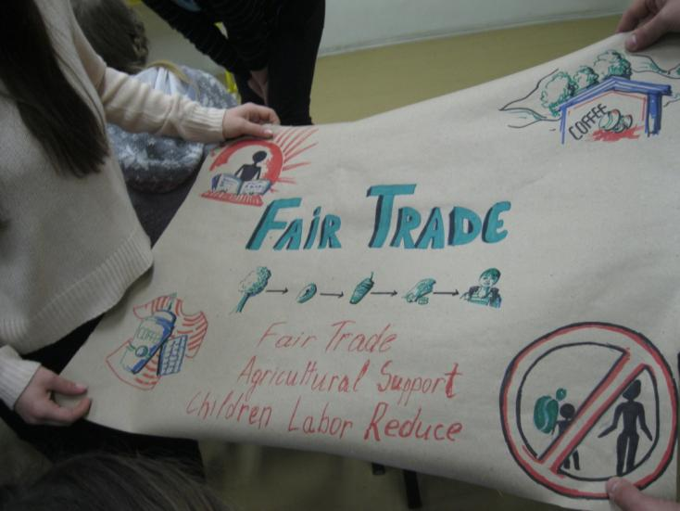
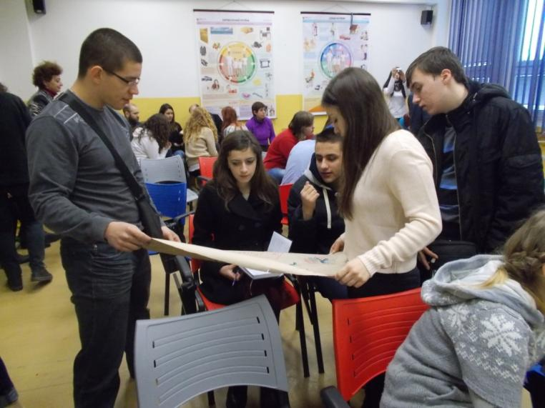
Getting ready for Fair-trade poster presentations

Slide 5
National teams prepare explanation of the main ideas of their posters so that the Czech project pupils can explain them to the their classmates on Fair-trade exhibition later.

Slide 6
Czech organizers of Fair trade activities

Slide 7
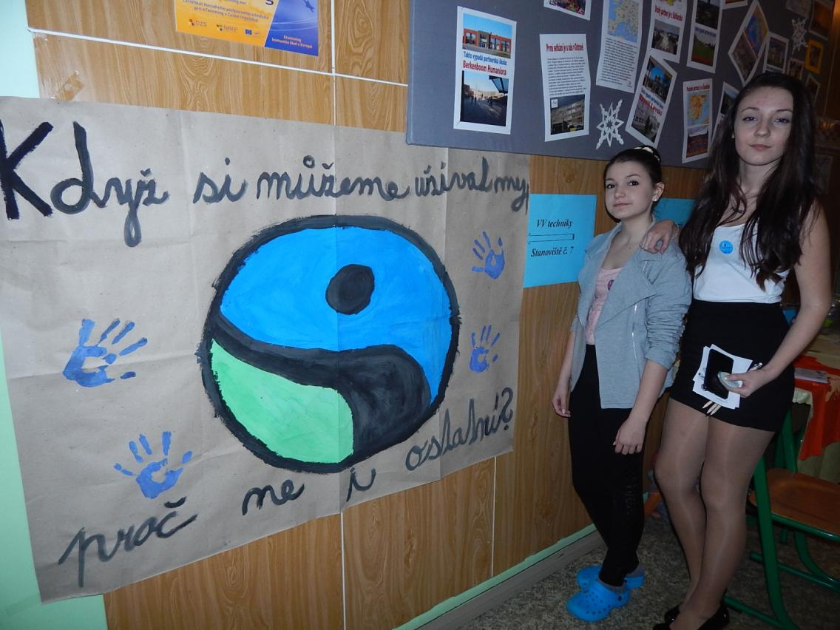
Czech Fair trade poster
„If we can enjoy life why not the others, too?“

Slide 8
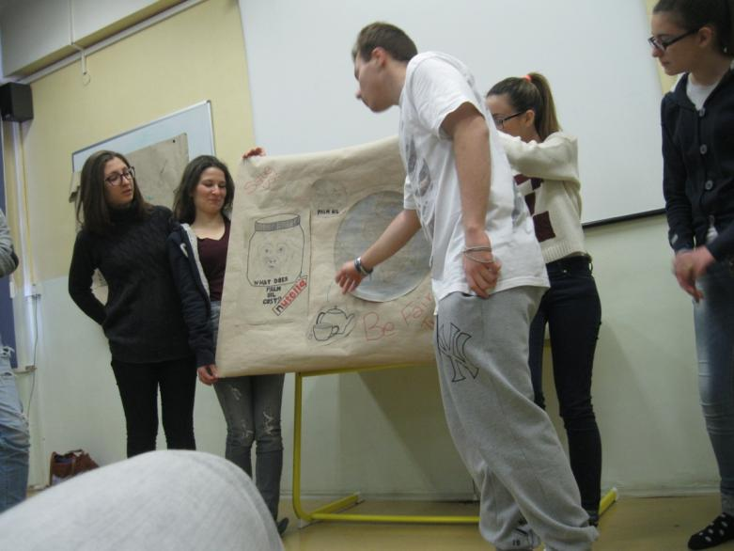
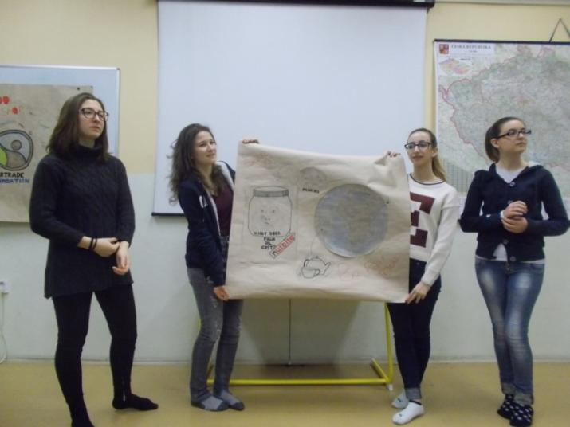
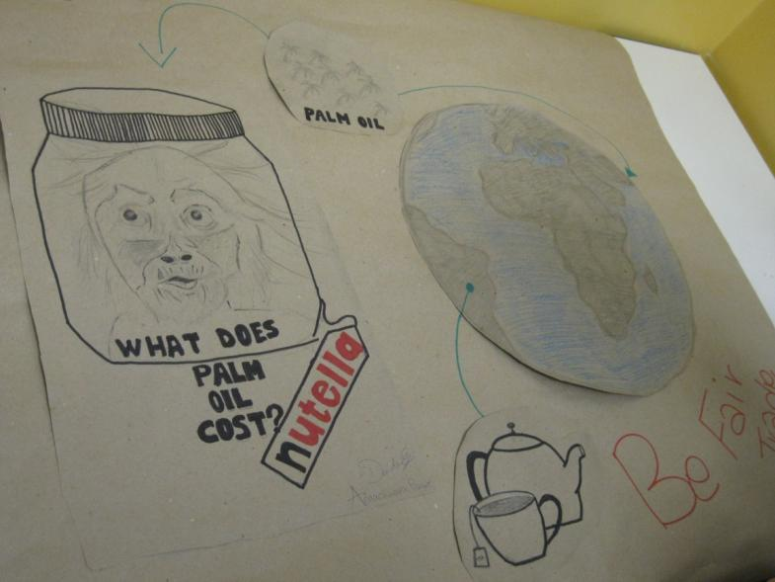
Italian poster

Slide 9
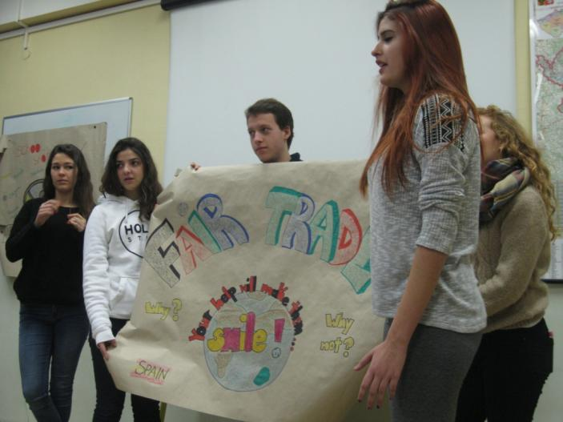
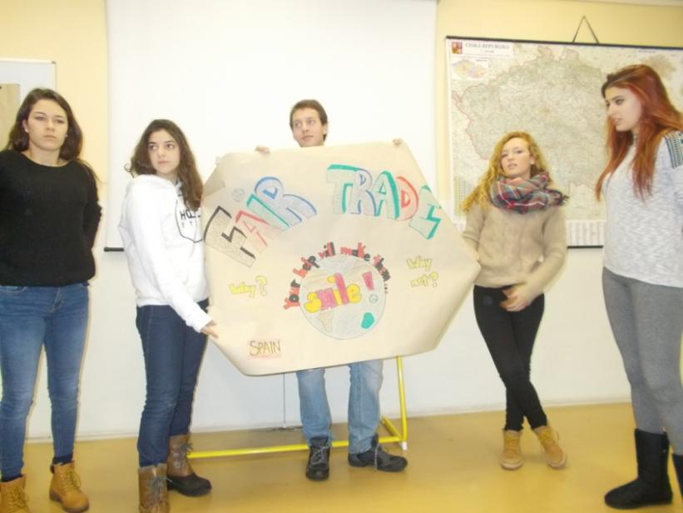
Spanish poster presentation

Slide 10
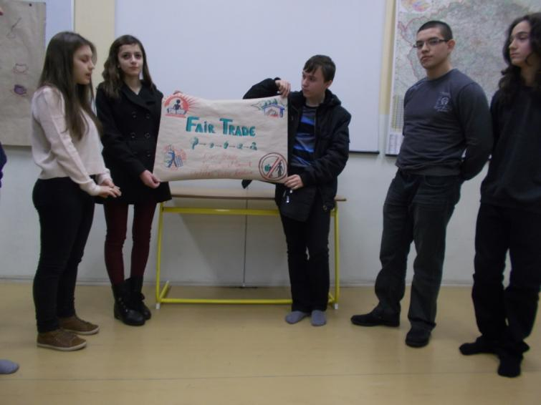
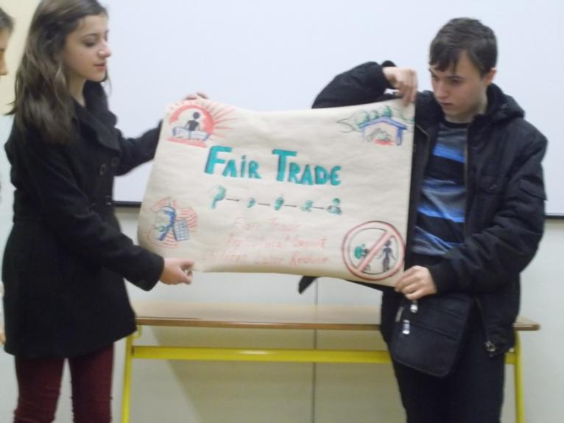
Bulgarian poster presentation

Slide 11
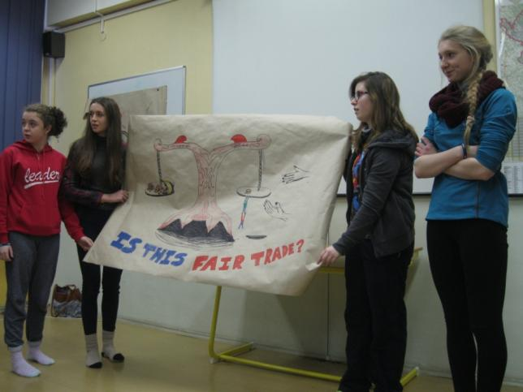
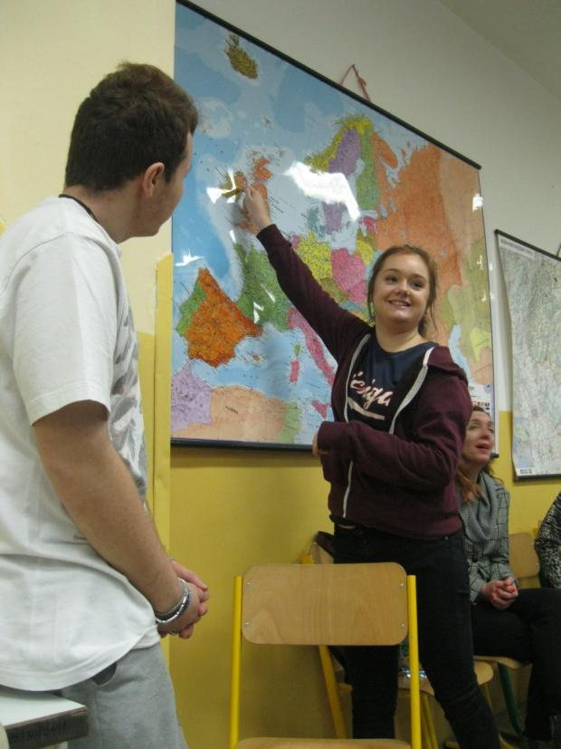
Irish poster presentation

Slide 12
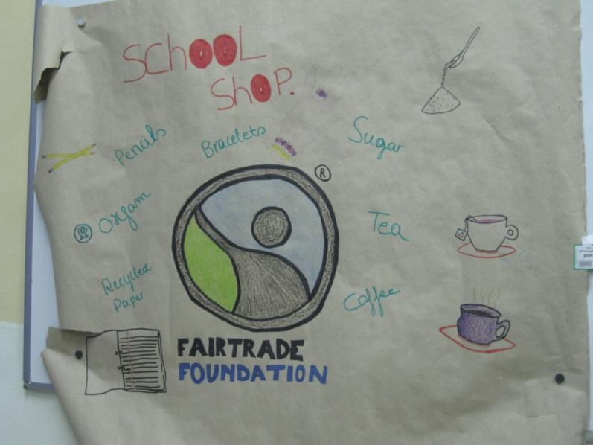
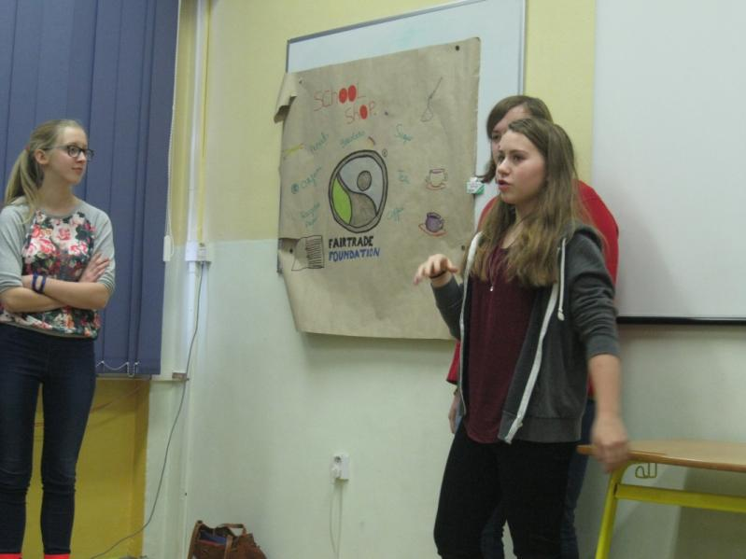
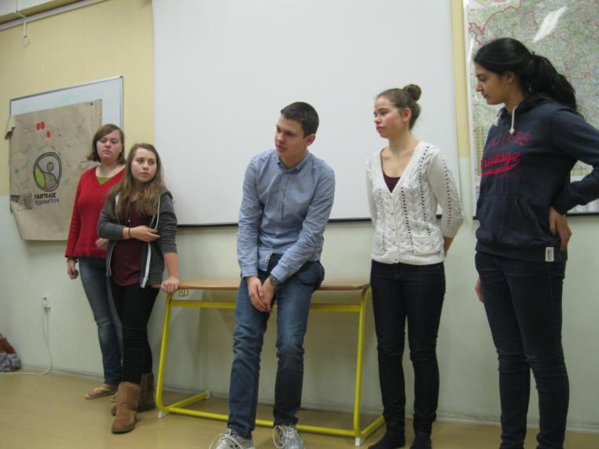
Belgium poster presentation

Slide 13
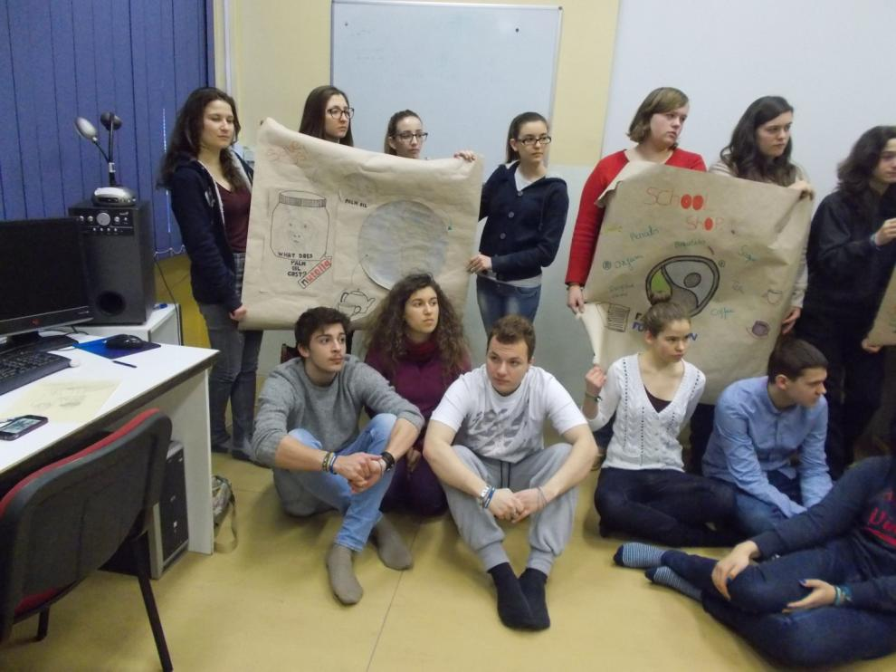
Fair-trade posters final exhibition

Slide 14
Fair-trade posters final exhibition

Slide 15
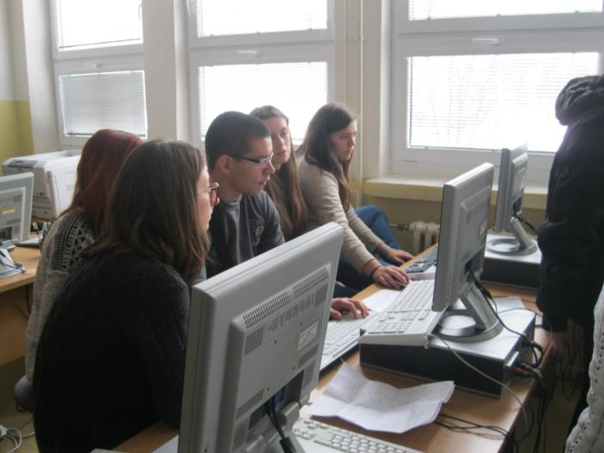
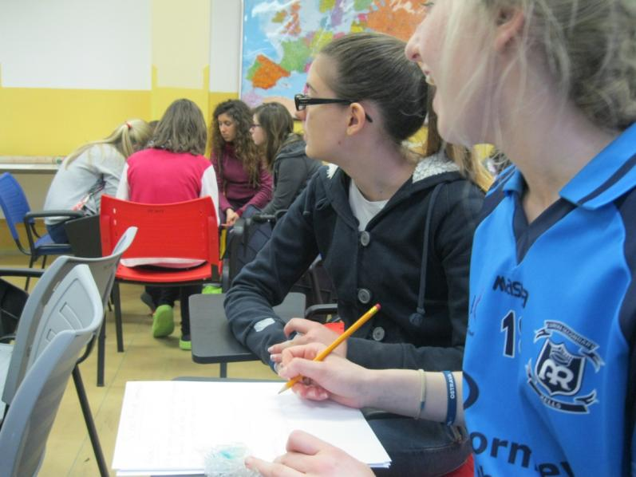
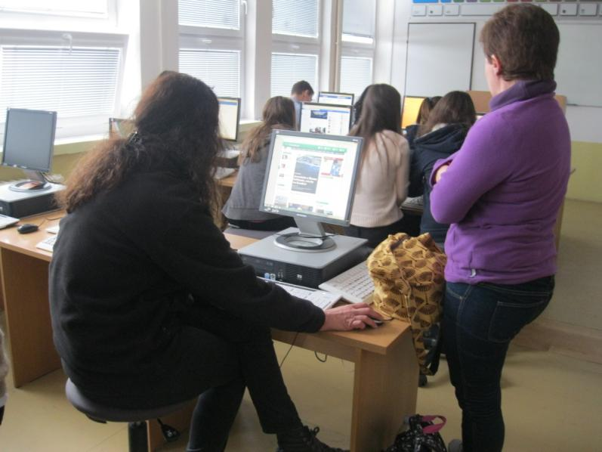
Students are working on their interview about the project meeting

Slide 16
