Slide 1
Project meeting in Ostrava
25 – 31 January 2015
Czech Republic
This project is funded by European Union.

Slide 2
Tuesday
8 – 9:00 Joined breakfast in school canteen
9:15 – 9:55 Erasmus students teach Czech pupils
10:15 – 11 Erasmus students teach Czech pupils
11 – 12 Evaluation of the lesson and sharing
12 – 13 Lunch
13 – 14 Journey to Ostrava town hall
14 – 14:45 Meeting deputy of Ostrava mayor
15 – 16 Ostrava town hall watchtower with guide
16 – 19 Sightseeing Ostrava centre and Karolina shopping centre

Slide 3
Breakfast team

Slide 4
Belgium culture lesson Animal fable in bilingual class 2. D

Slide 5
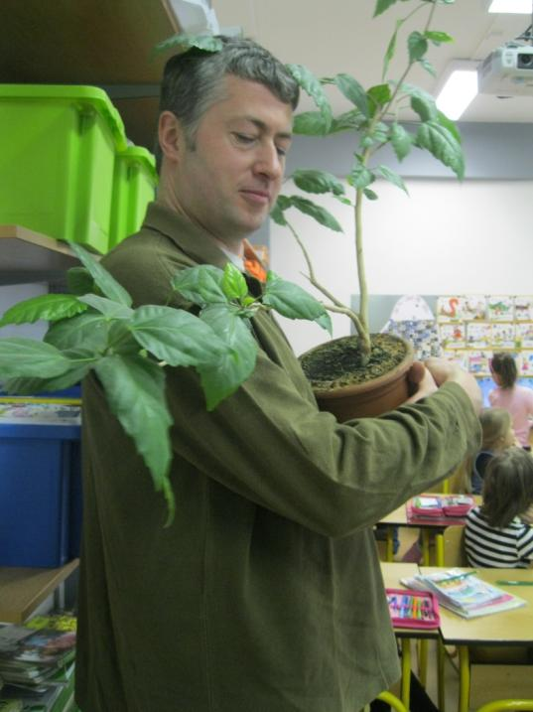
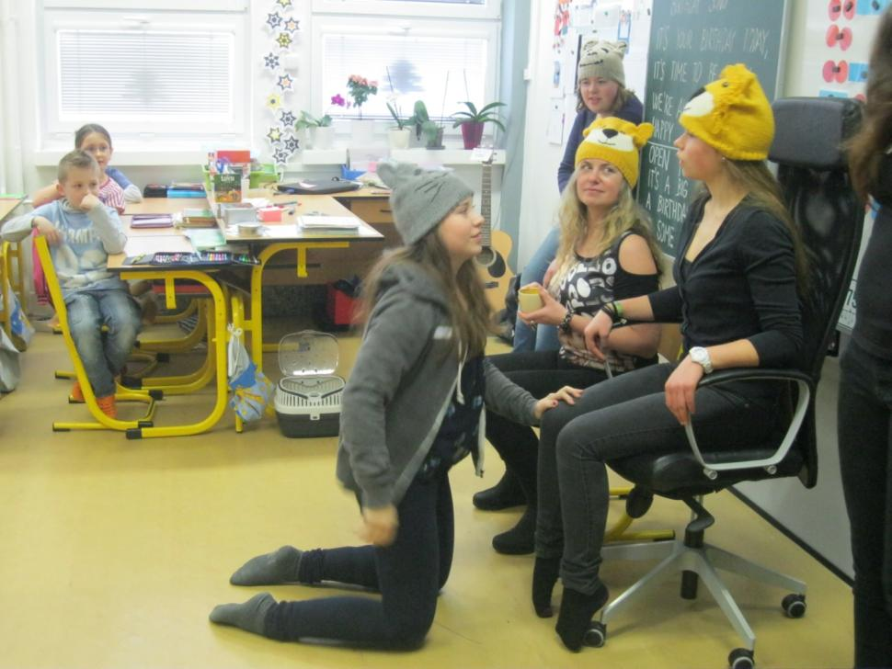
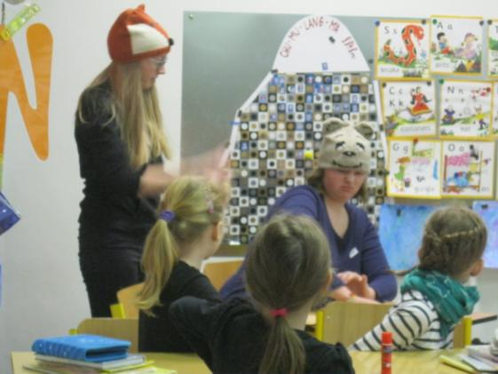
Belgian Animal fable

Slide 6
Czech pupils from 2. D loved the story

Slide 7
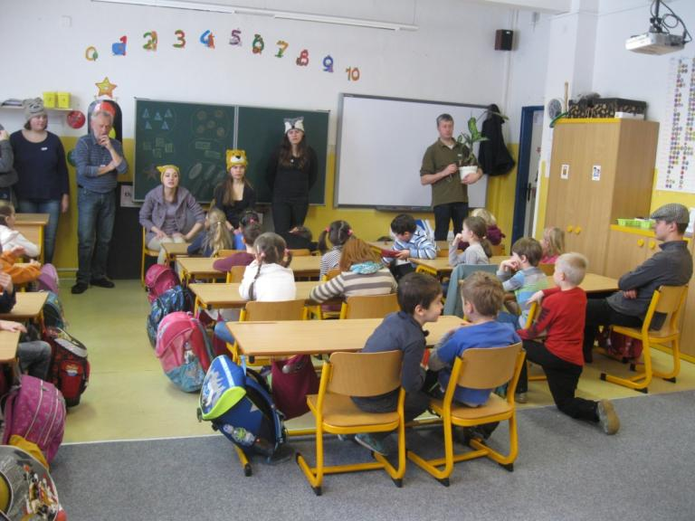
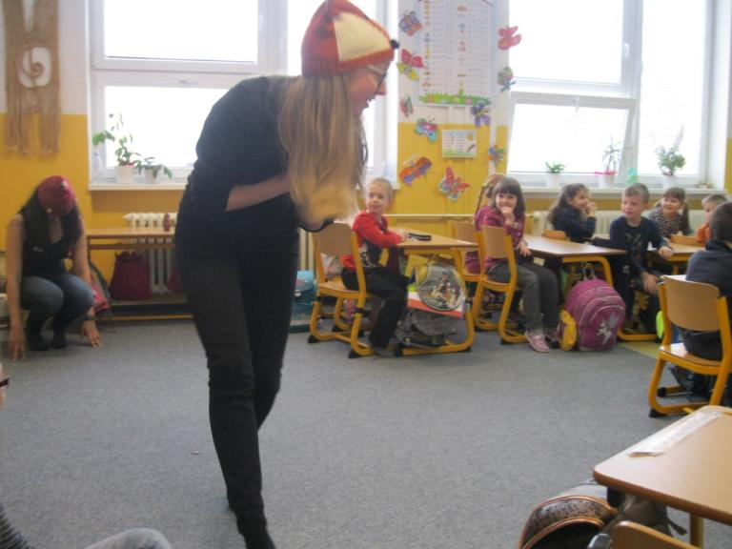
Belgium culture lesson Animal fable in bilingual class 1. D

Slide 8
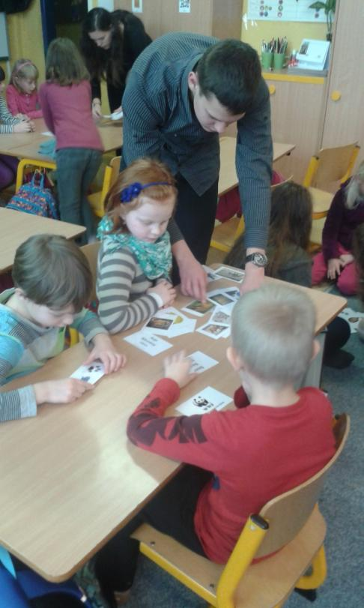
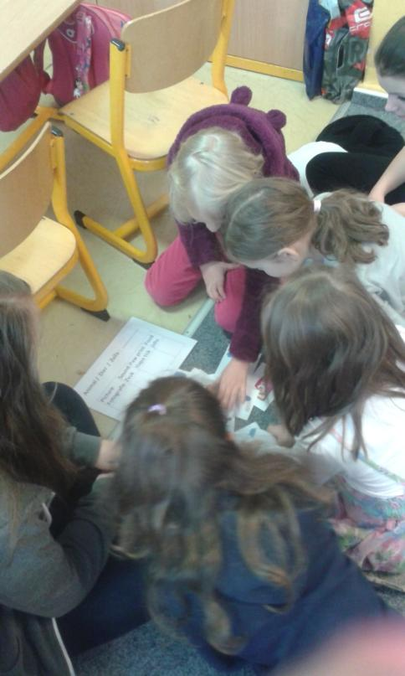
Belgium culture lesson Animal fable in bilingual class 1. D

Slide 9
What did we learn from the story?

Slide 10
Bulgarian Culture – Dance, class 9.

Slide 11
Bulgarian school introduction, class 9.

Slide 12
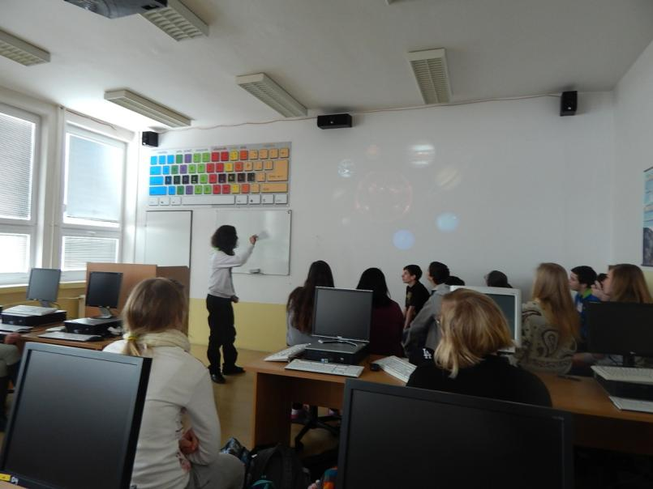
Bulgarian lesson Solar system in class 9.
Pupils are holding models of the planets and ordering them.

Slide 13
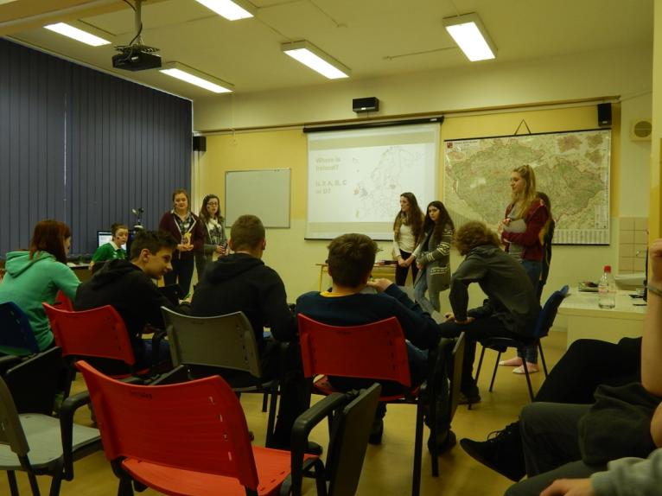
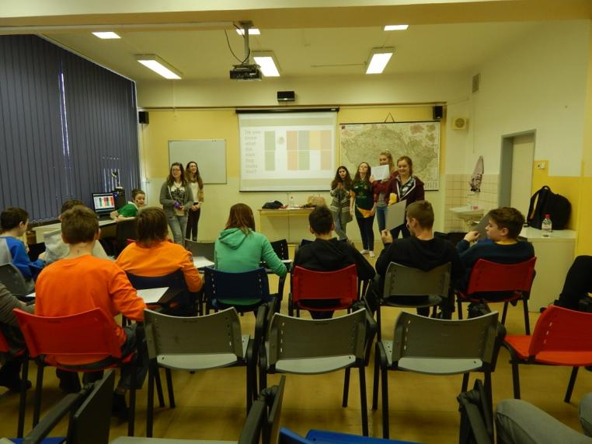
Irish Culture and History lesson - Quiz in class 7. B

Slide 14
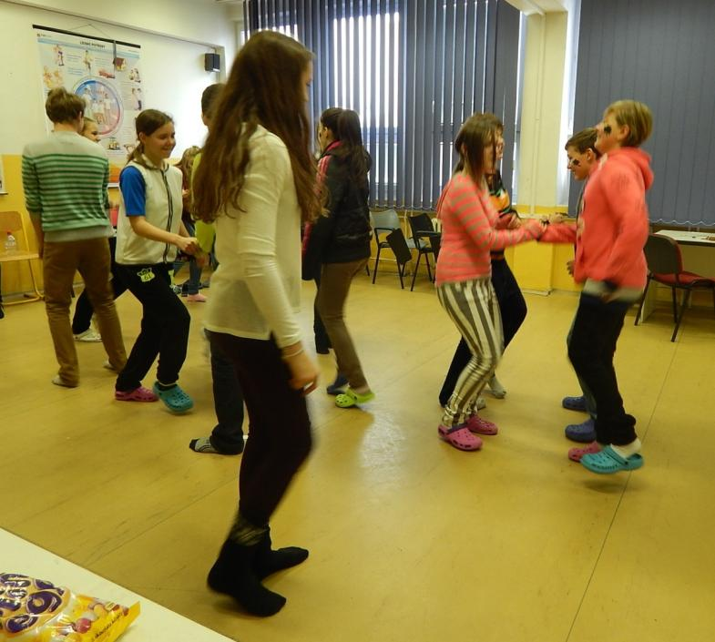
Irish P. E. lesson: folk dance in class 7. A

Slide 15
Spanish team in grade 9.

Slide 16
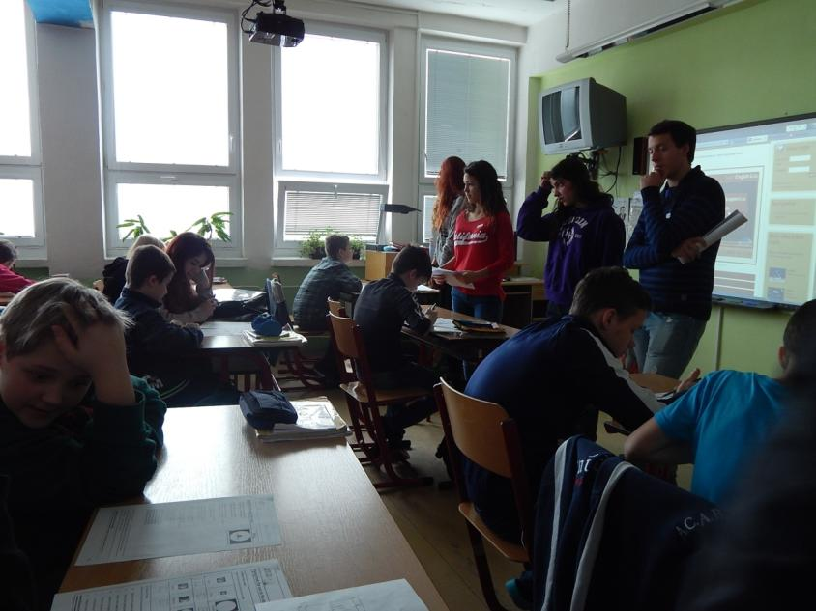
Spanish team in grades 6. B and 9.
Solar system is taught in grade 5 and again in grade 9 in Czech schools so pupils from grade 6. B asked to be allowed to stay in their classroom which we needed for the Italian lesson in grade 9.

Slide 17
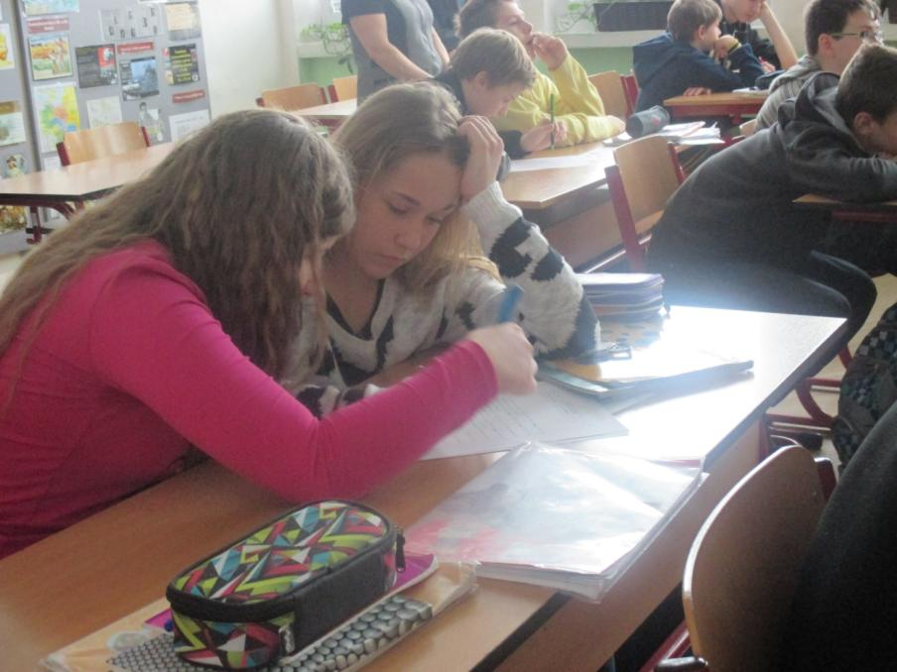
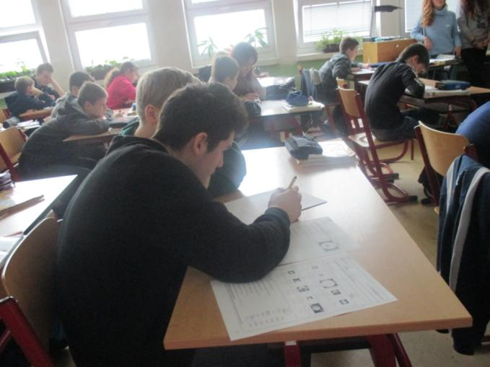
Spanish team
Forms 6. B and 9.

Slide 18
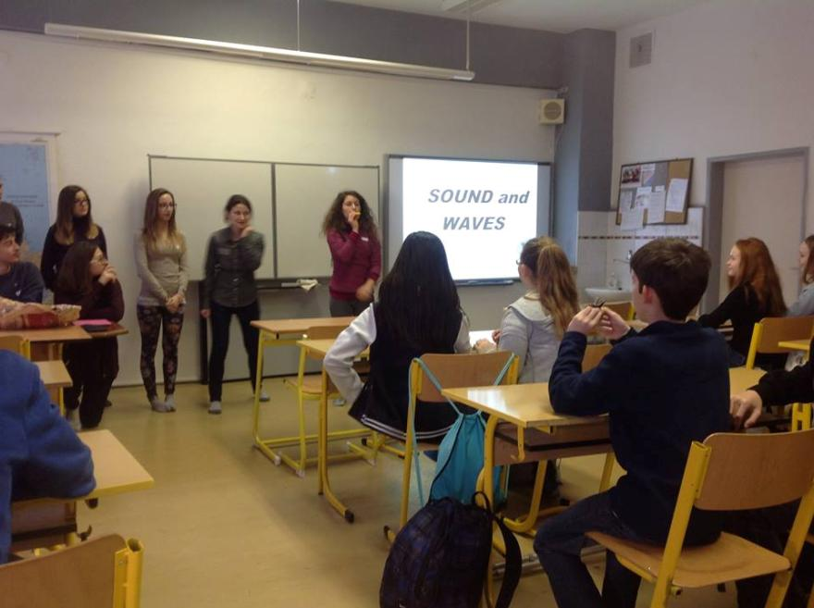
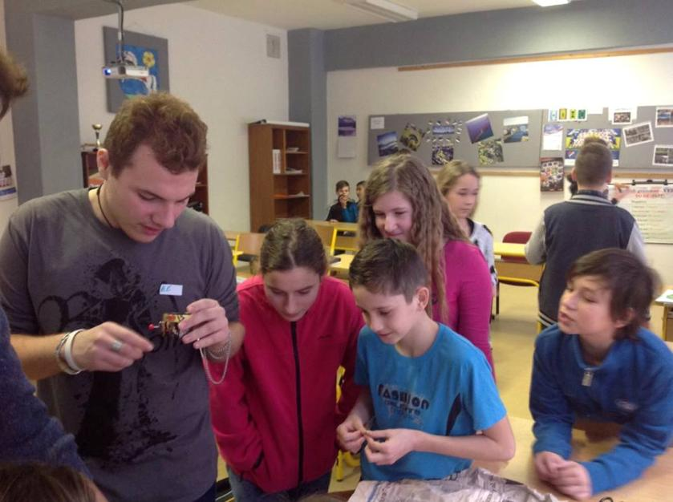
Italian lesson

Slide 19
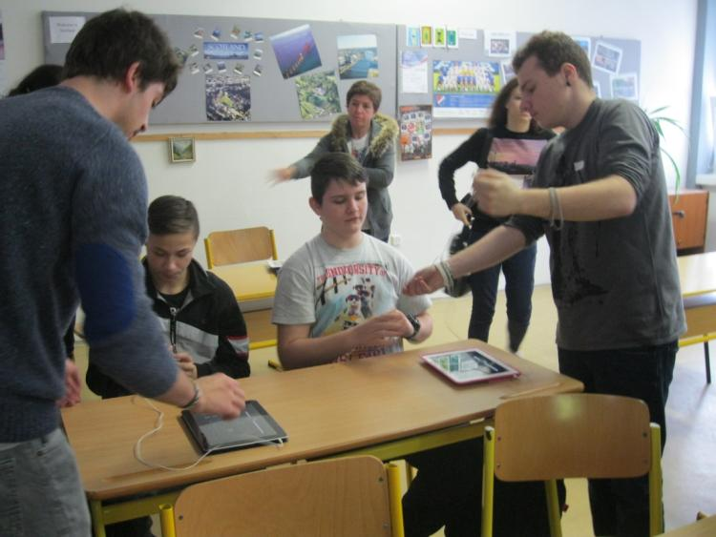
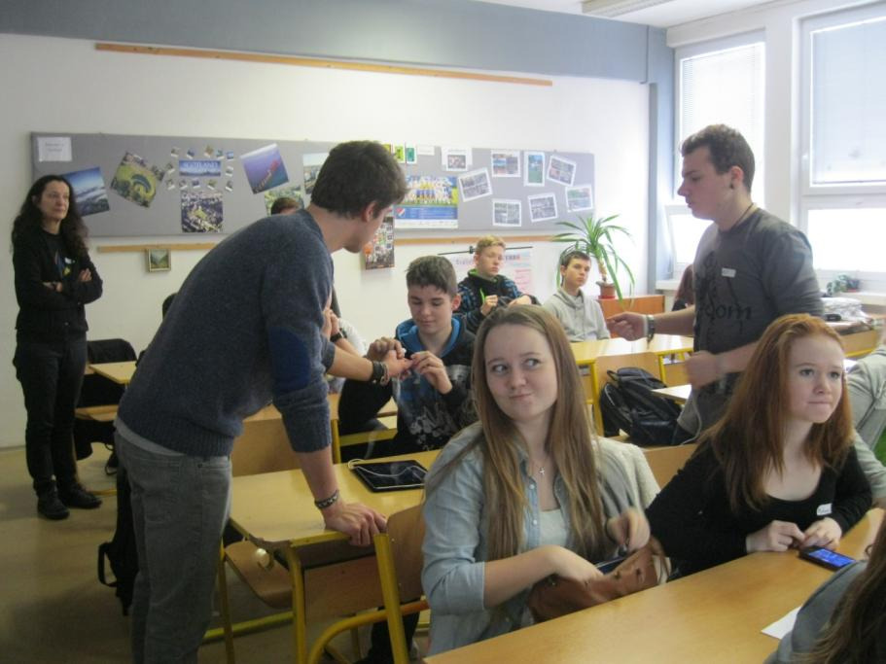
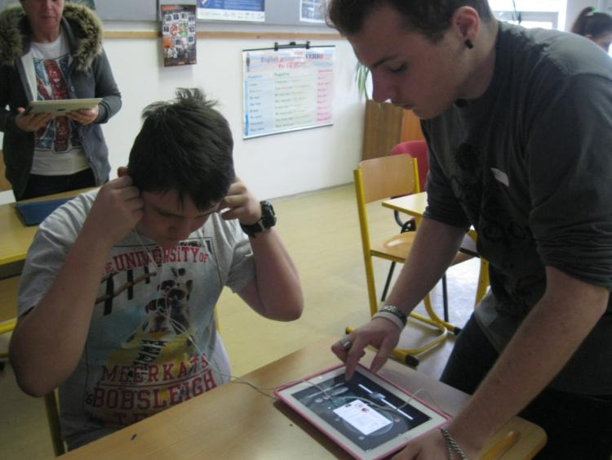
Italian Physics lesson about sound and waves

Slide 20
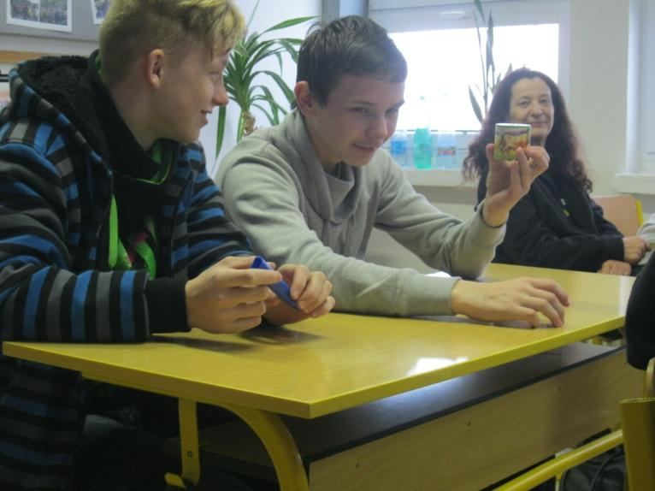
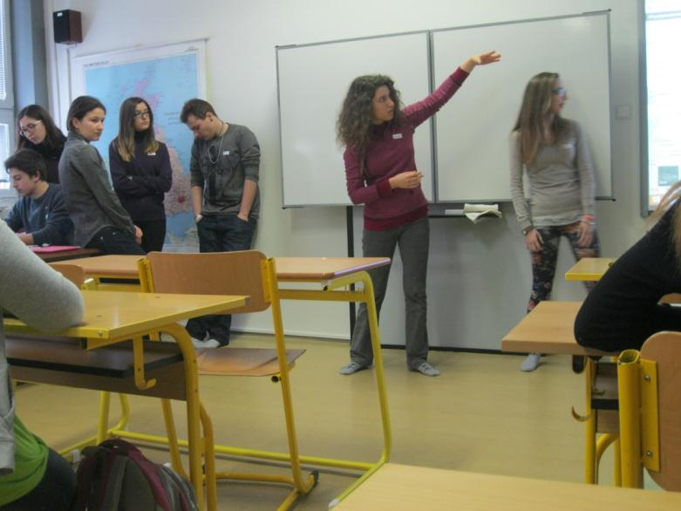
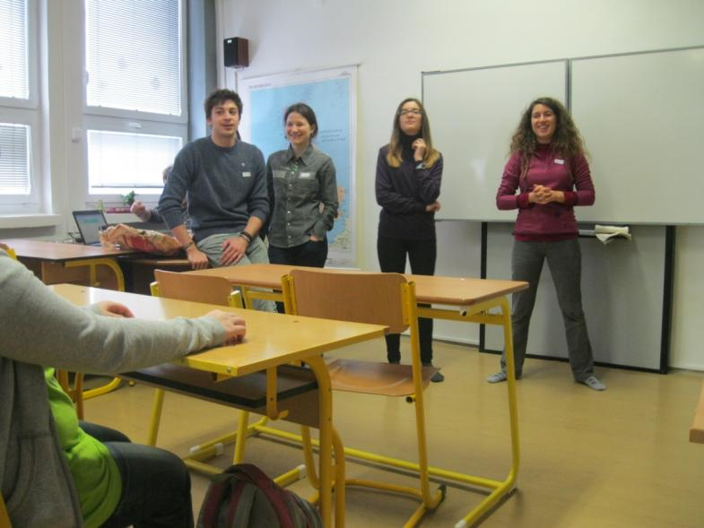
Italian team

Slide 21
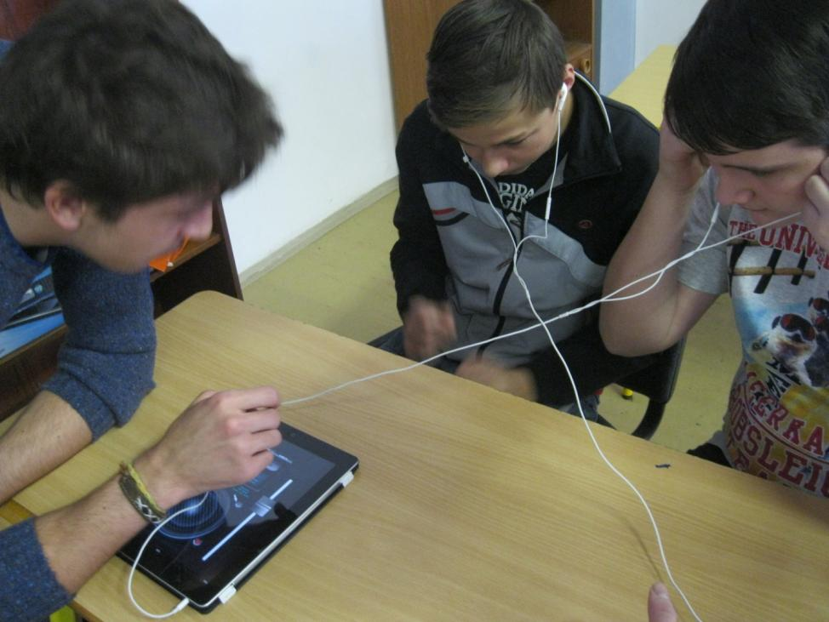
Italian Physics lesson Sound and waves
Class 8. is learning about sound and waves, it is part of their curriculum but we do not have this equipment.

Slide 22
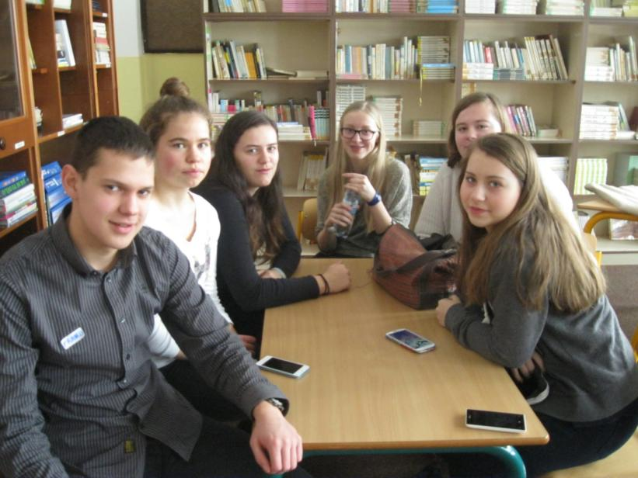
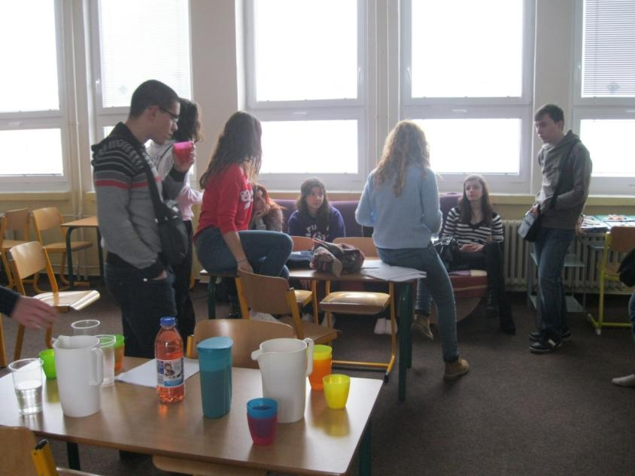
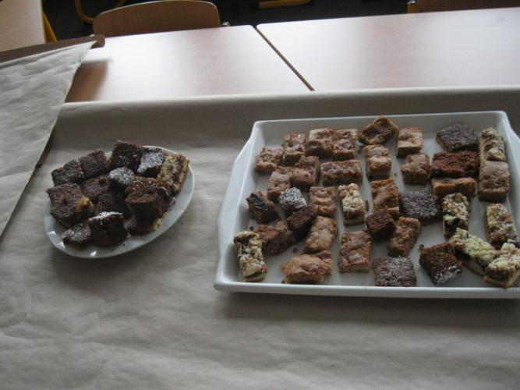
Break and snack

Slide 23
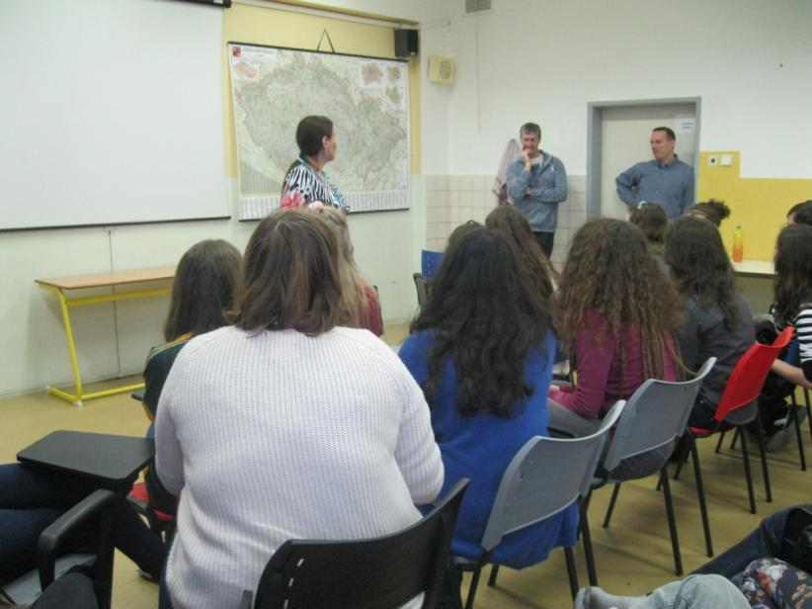
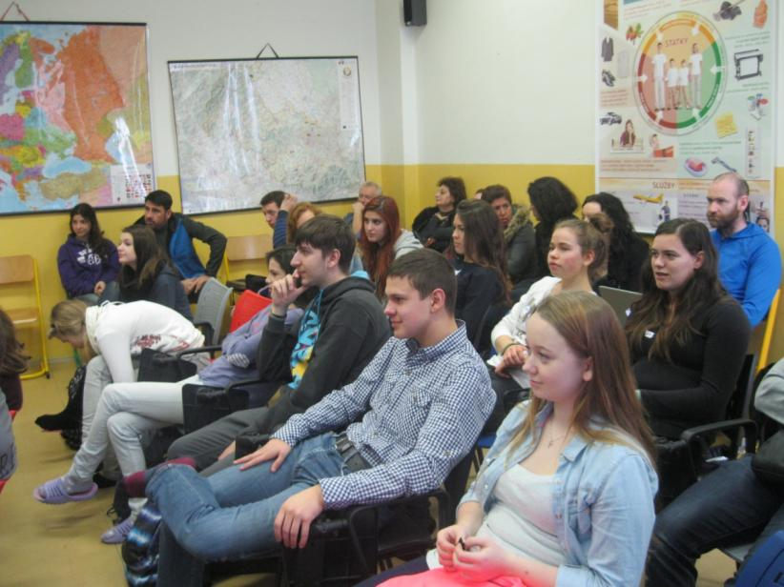
Evaluation and sharing after teaching lessons

Slide 24
Weather on our journey to the town hall

Slide 25
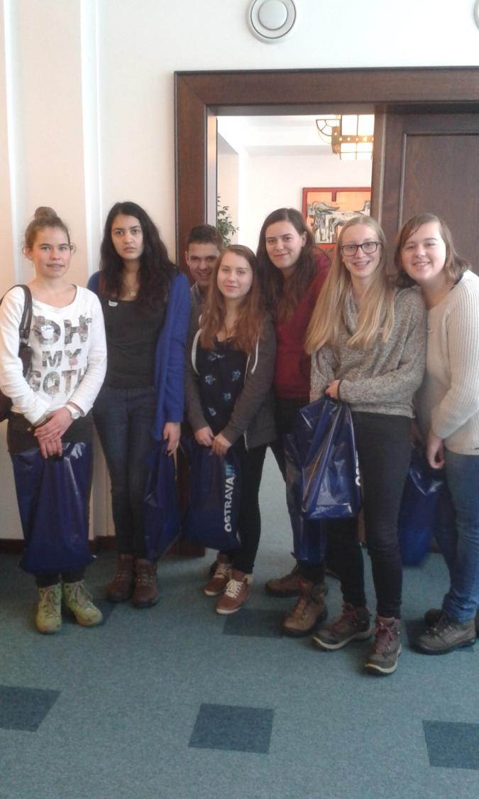
Ostrava town hall

Slide 26
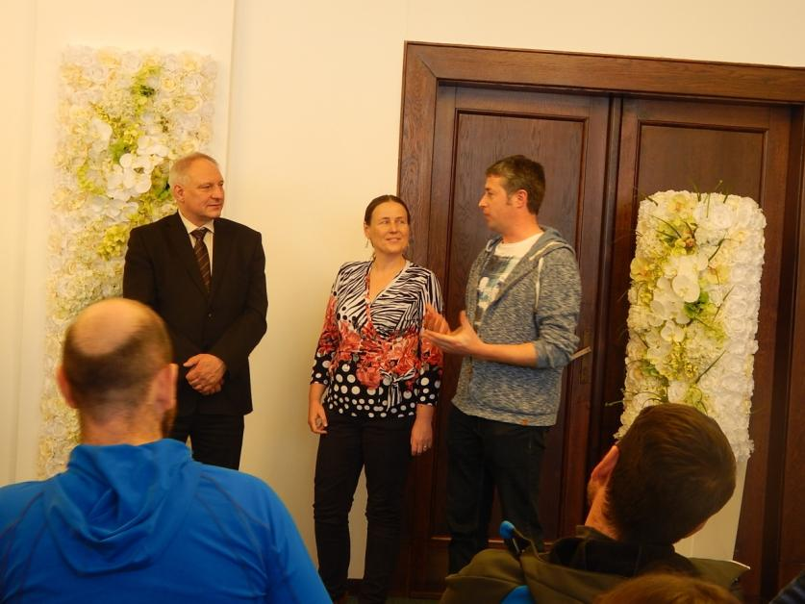
Meeting Ostrava mayor deputy Mr. Pražák in the Ceremonial Hall
Mrs. Szücsová in the left photo is the head of the Ostrava education department. Down is Mrs. Buroňová interpreting for Mr. Steven de Foyer from Belgium who is the international project coordinator.

Slide 27
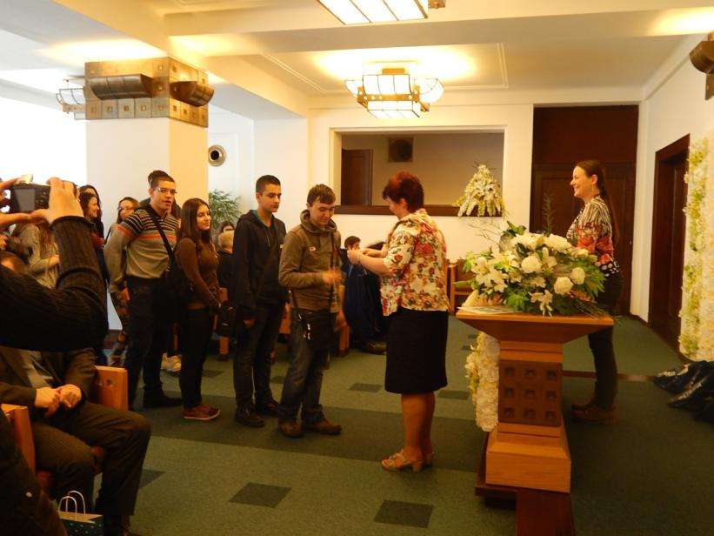
Meeting Ostrava mayor deputy Mr. Pražák in the Ceremonial Hall
Mrs. Szücsová gave to students and teachers little presents on behalf of the Ostrava city.

Slide 28
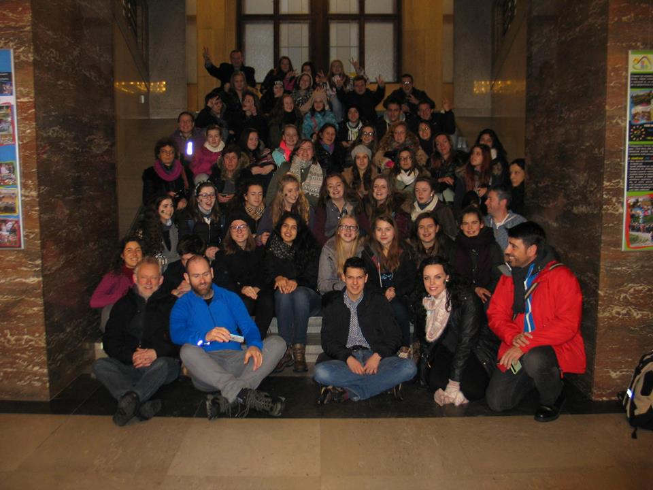
Meeting Ostrava mayor deputy
After the official part we took the group photo on the stairs, visited the watchtower and then we had fun riding the old lift without door which is called Paternoster.

Slide 29
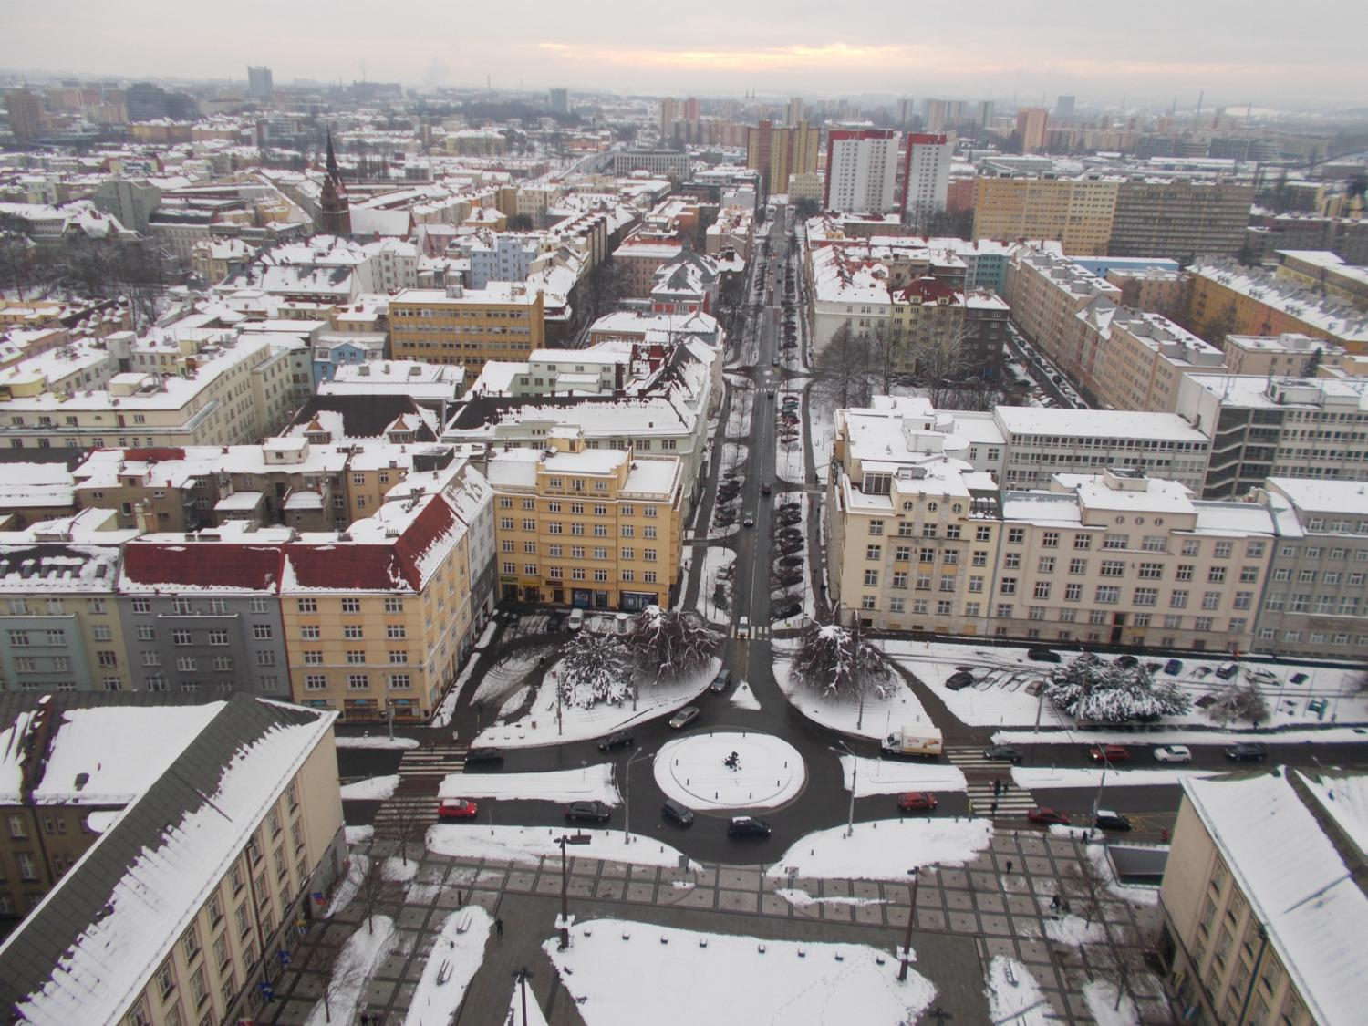
Ostrava from the town hall watchtower

Slide 30
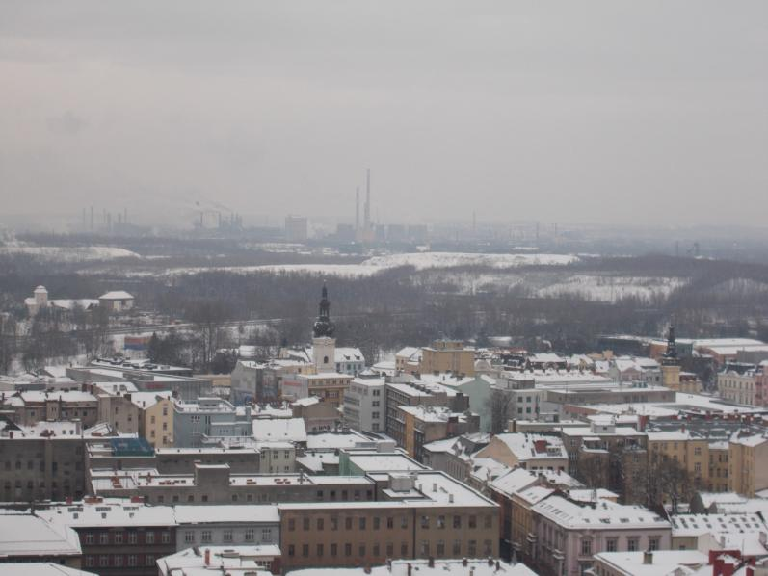
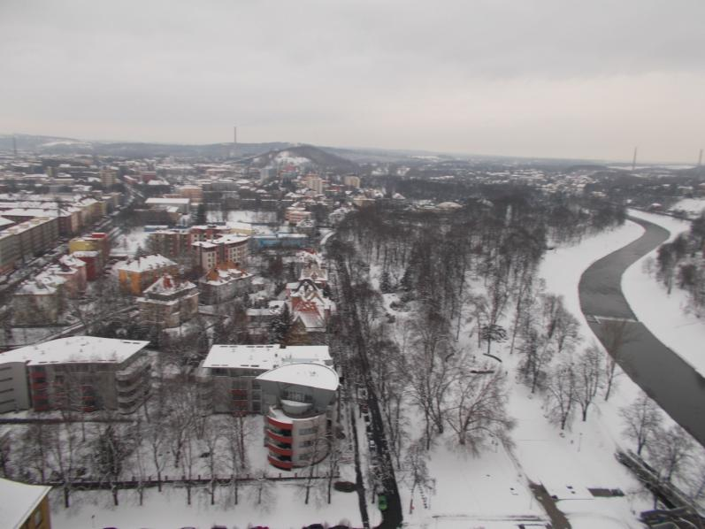
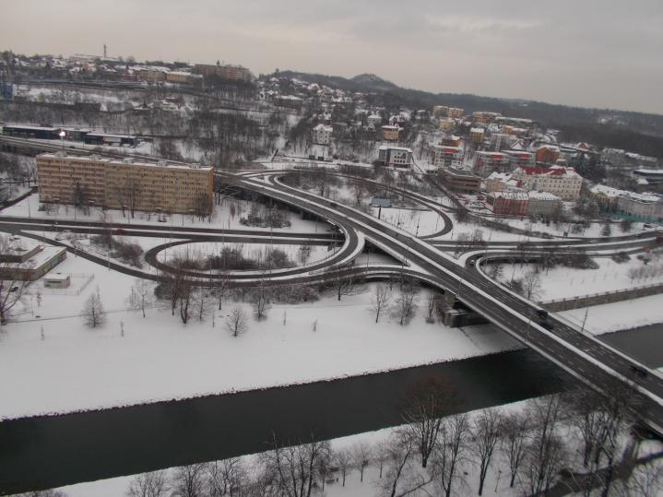
Ostrava from the town hall

Slide 31
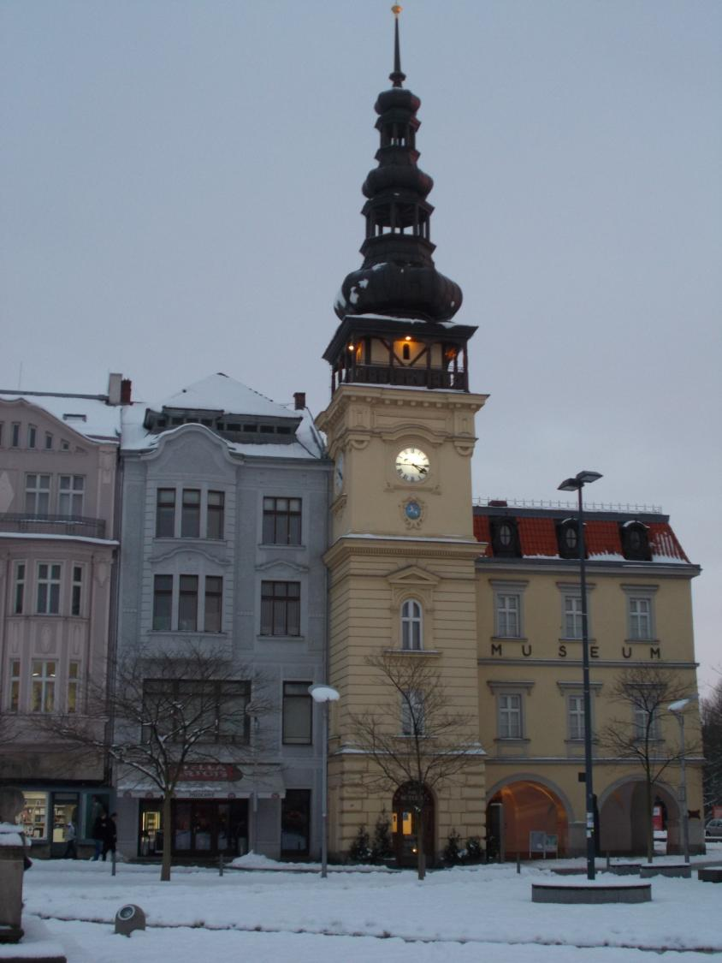
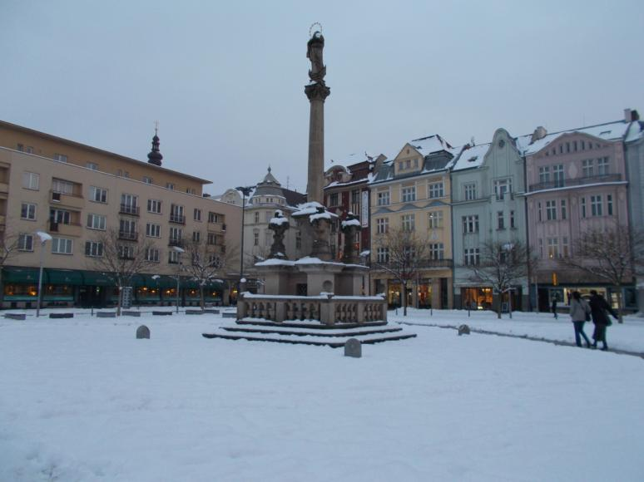
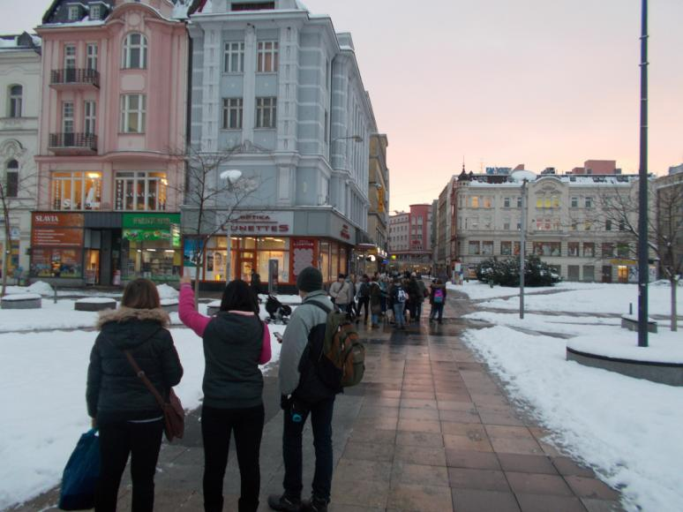
Ostrava centre: Masaryk Square

Slide 32
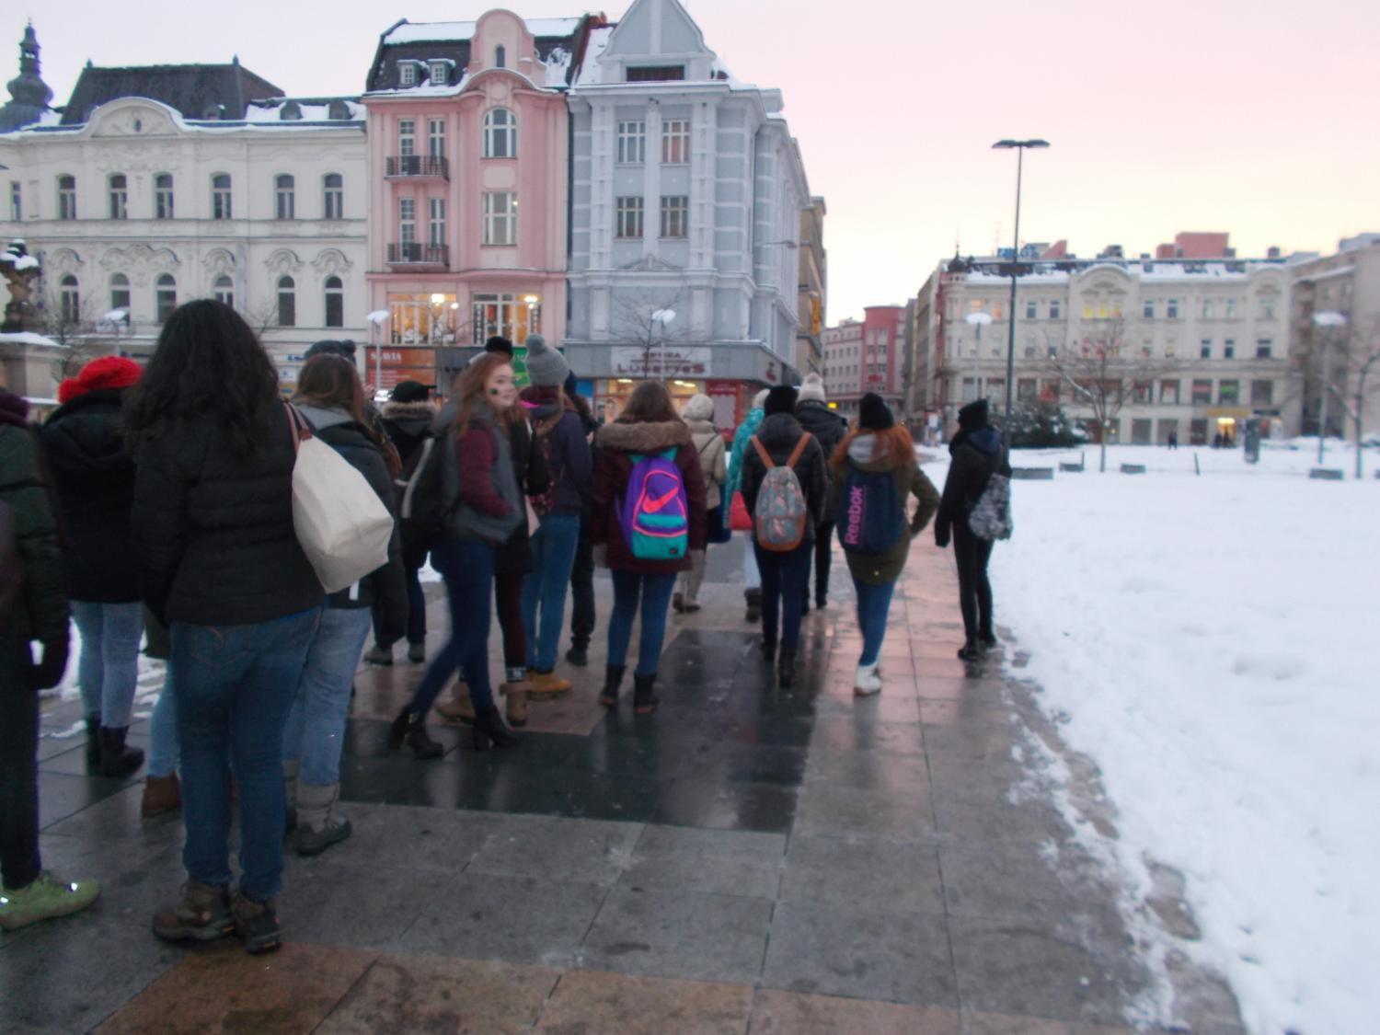
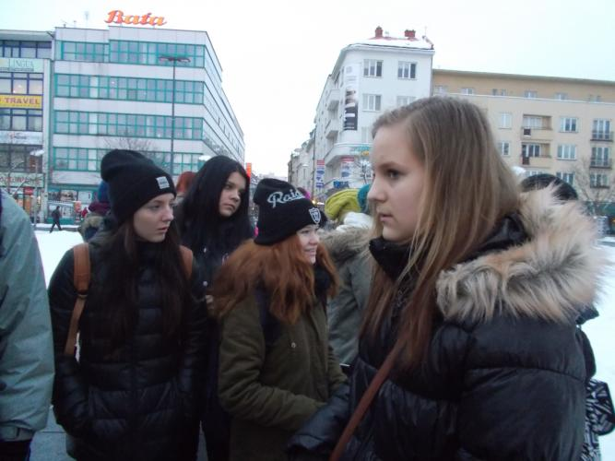
Ostrava centre: Masaryk Square

Slide 33
Shopping centre Karolina

