Slide 1
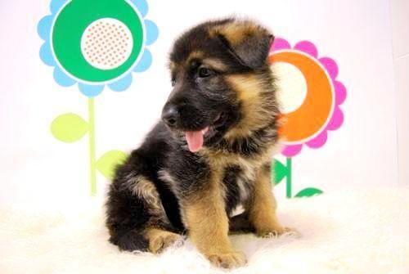
NOA ORGE DESCRIPTION
I’m Noa Orge.
I have 11 years.
I’m small.
I have bluish green eyes.
My hair is straight and fair.
My favourite food is hot dogs.
My favourite color is green.
I like play football and sleep.
My favourite animal is baby dog.
My favourite subject is artistic.

