Slide 1
That's the way I am

Slide 2
-My name is Lucía
-I am 11 years old
-I've got curly blonde hair and brown eyes
-I was born i the year 2003

Slide 3
-I like diving
And swimming

Slide 4
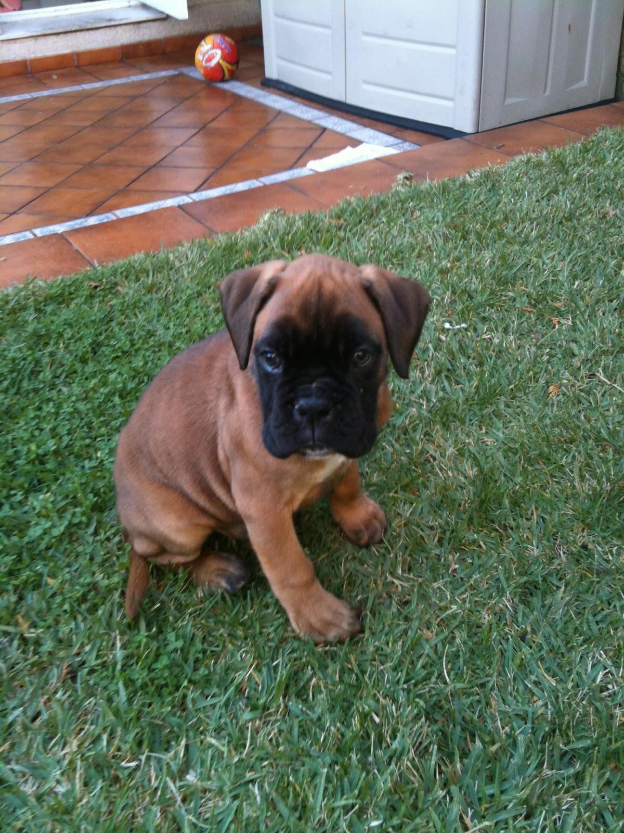
-My favourite colur is blue
-I have got a dog,
and its name is Titan
-I have a brother
-My favourite food
is sausages

Slide 5
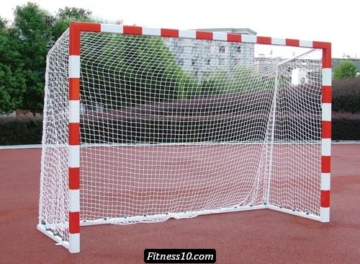
-I play hanball, It is
very funny

