Slide 1
That's the way I am

Slide 2
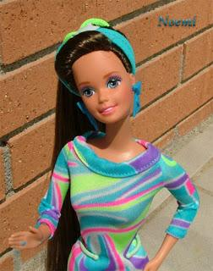
My name is Sara

Slide 3
I’m Spanish.
I have got brown hair and brown eyes.
I am funny

Slide 4
My favourite subject is art

Slide 5
I am short
I am 1.35 high

Slide 6
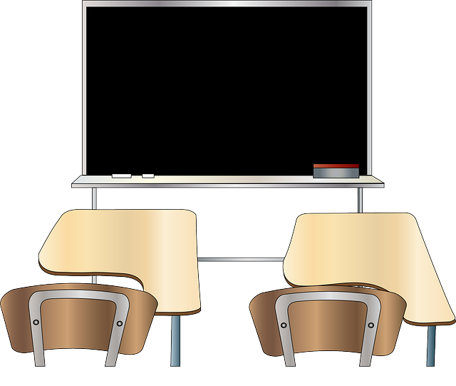
I go to ColeXio Alborada, IN VIGO

Slide 7
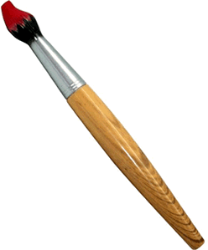
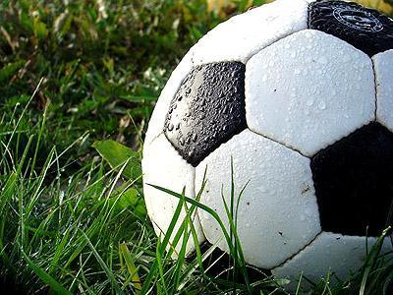
I like playING football
I like watchING TV
In my free time I like paintING

Slide 8
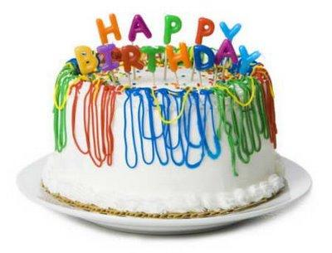
I am eleven years old

Slide 9
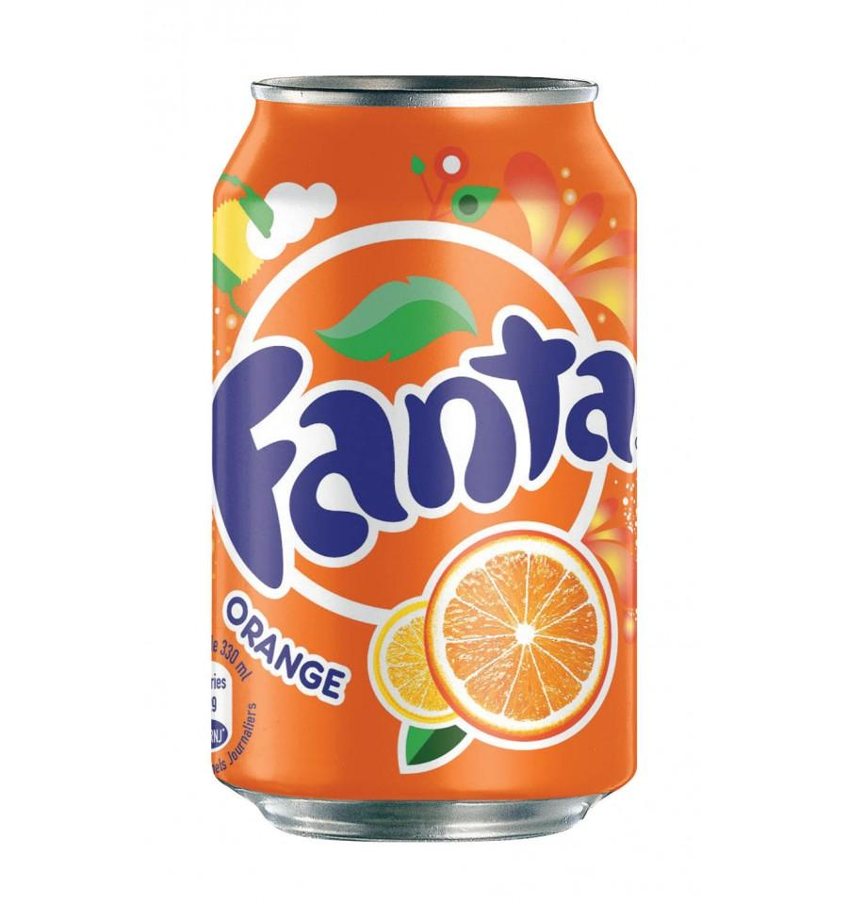
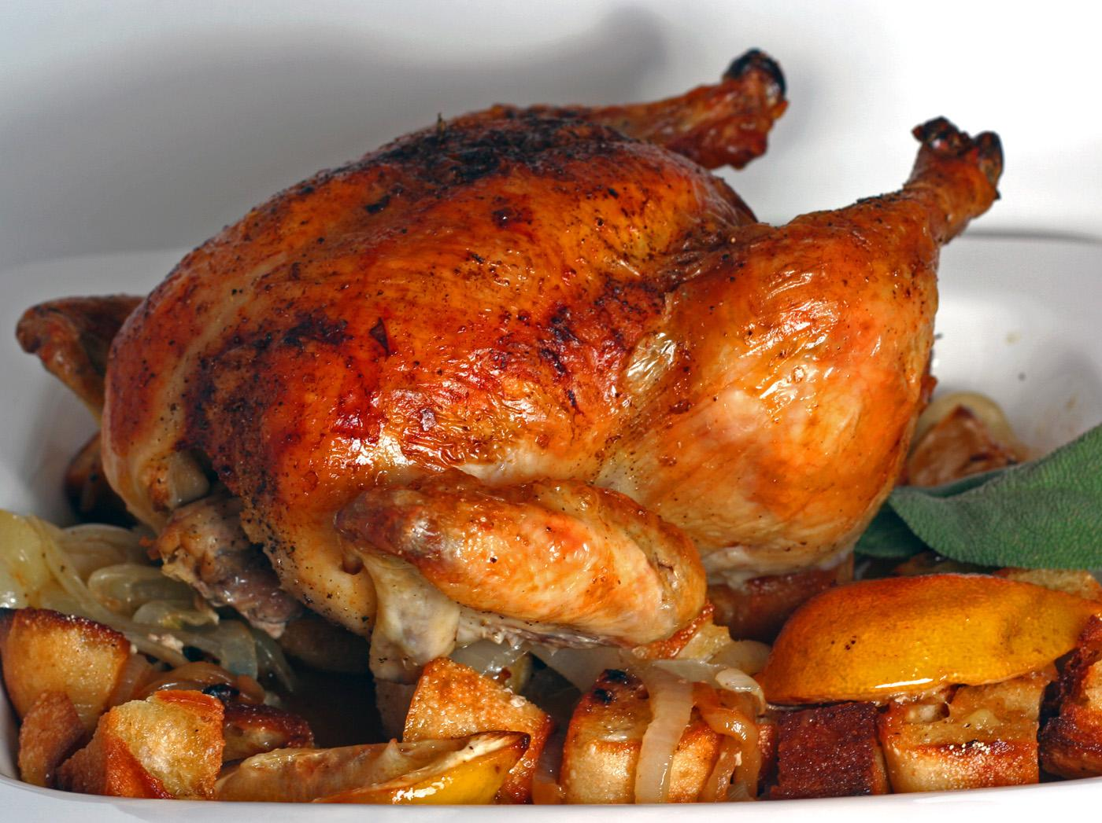
My favourite food is chicken
My favourite drink is fanta

Slide 10
I like rock and roll music

