Slide 1
Our School
Escola Tecnos
Terrassa (Barcelona)
March 2015

Slide 2
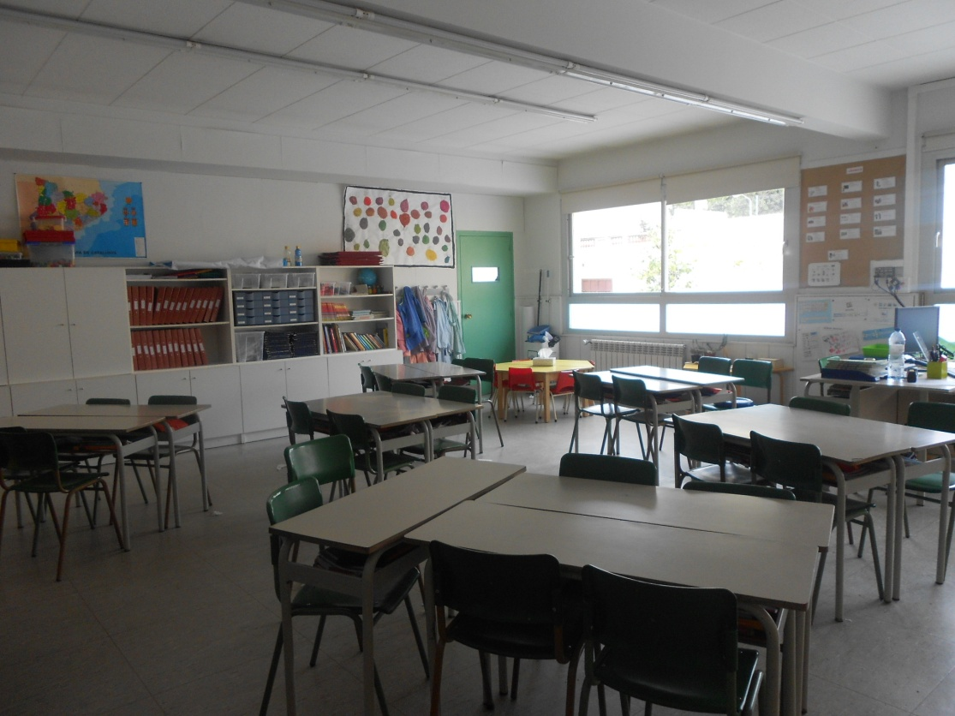
This is our CLASSROOM
Here we do a lot of activities: writing, reading, drawing, colouring, speaking,...

Slide 3
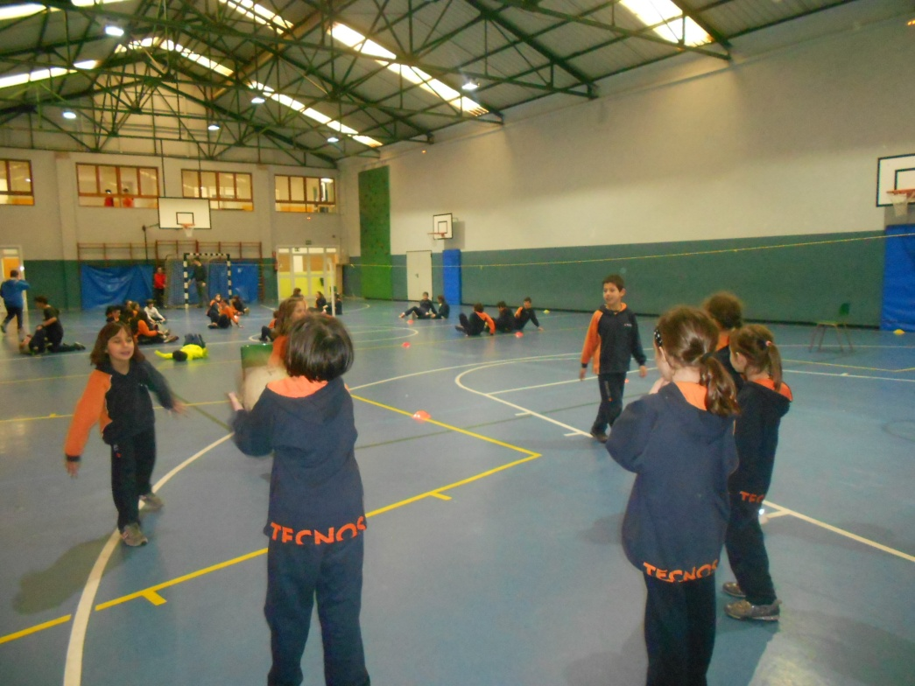
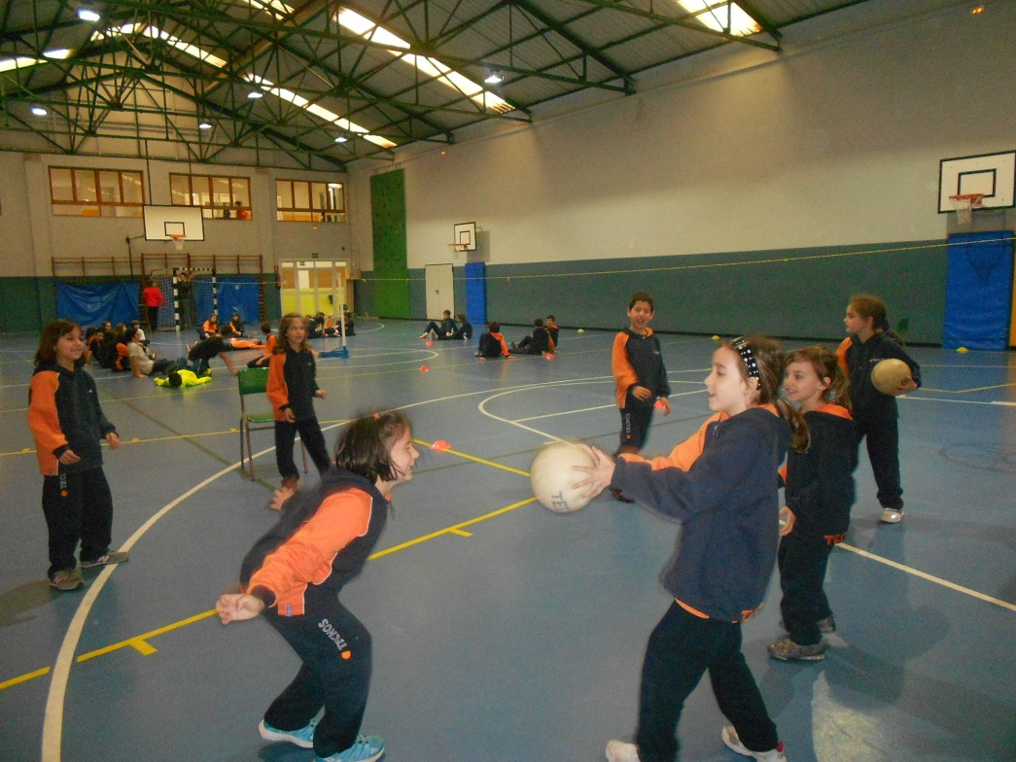
Here we play sports and games. We run, jump and do gymnastics.
This is our GYM

Slide 4
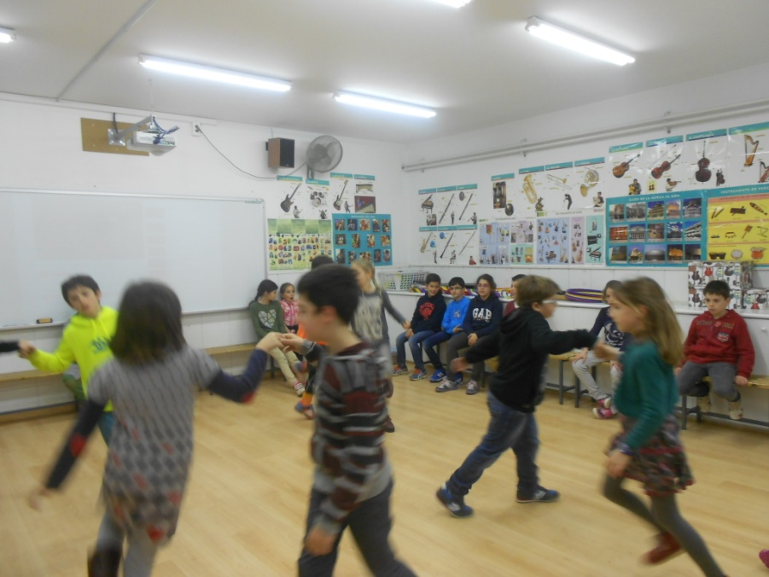
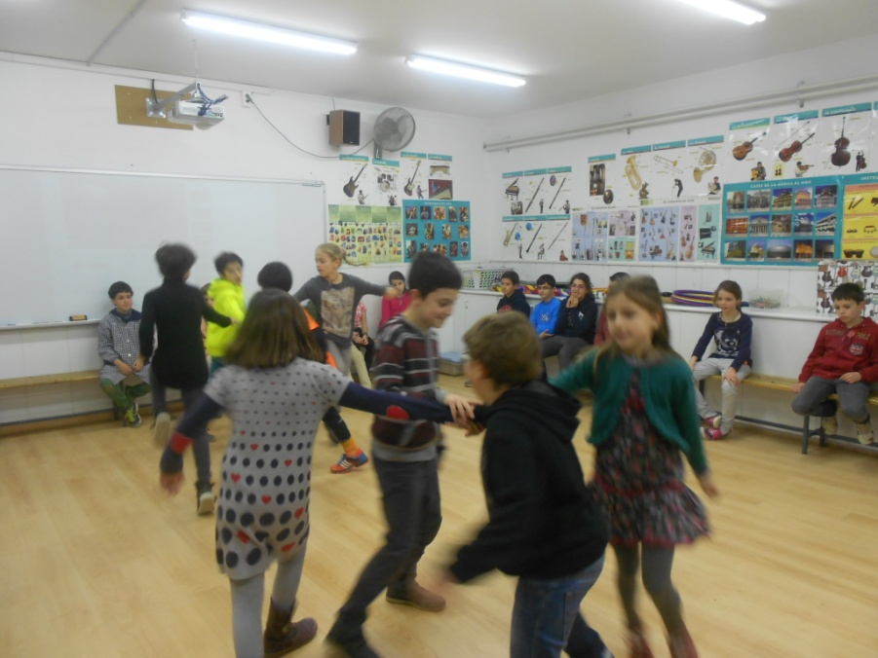
Here we dance, sing, play instruments and listen to music.
This is our MUSIC ROOM

Slide 5
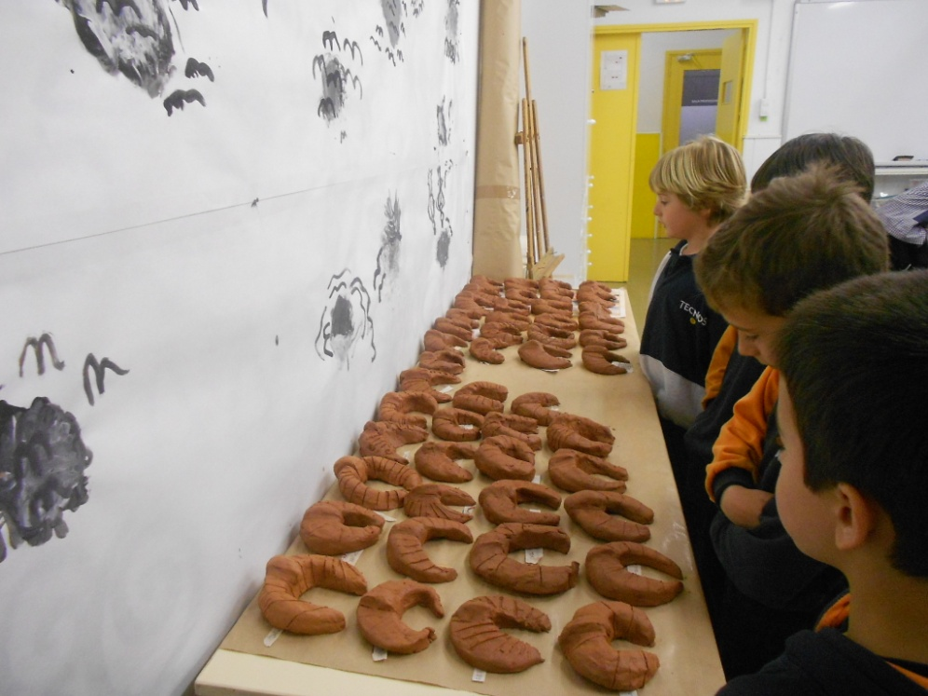
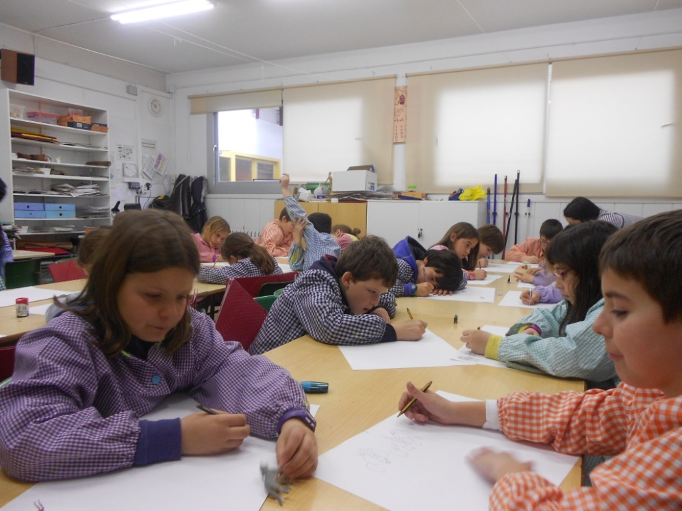
Here we draw, colour, make crafts, make clay, paint and create.
This is our ARTS & CRAFTS ROOM

Slide 6
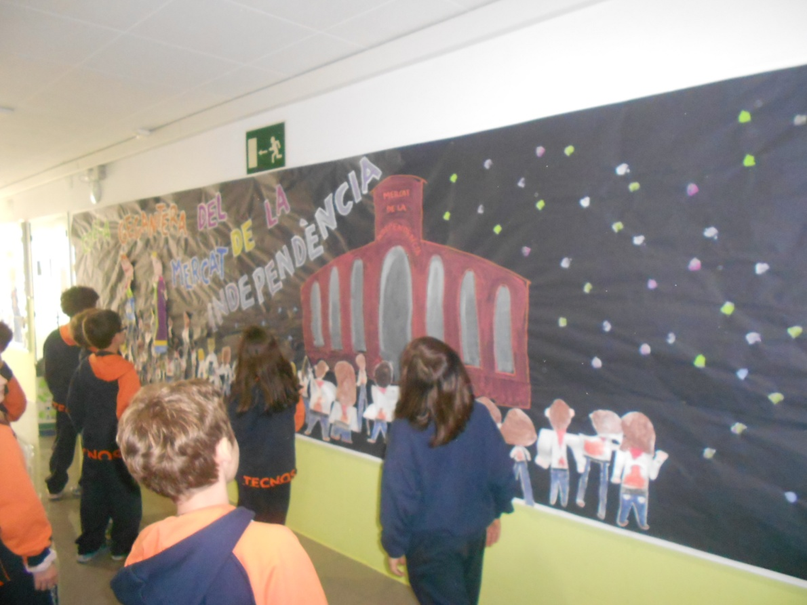
Here we put posters and activities up on the wall.
This is our CORRIDOR

Slide 7
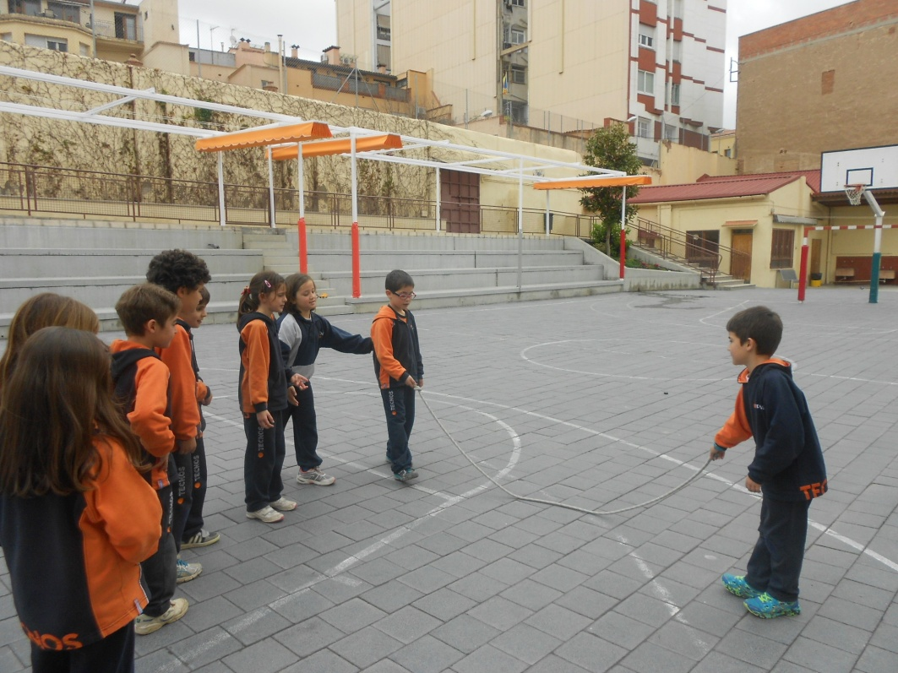
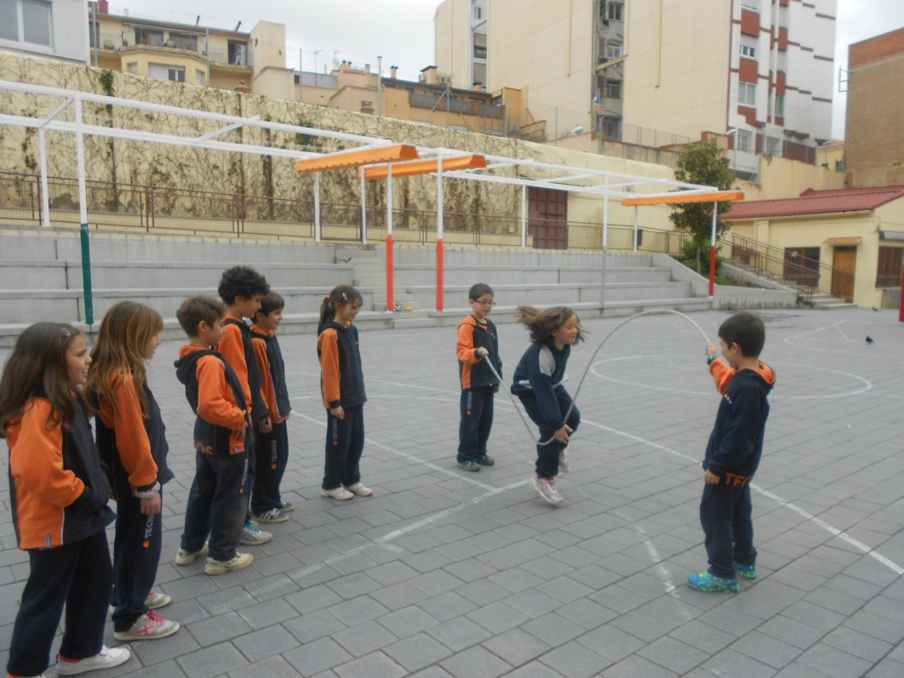
Here we play football, basketball and hopscotch. We go skipping and running. We have breakfast.
This is our PLAYGROUND

Slide 8
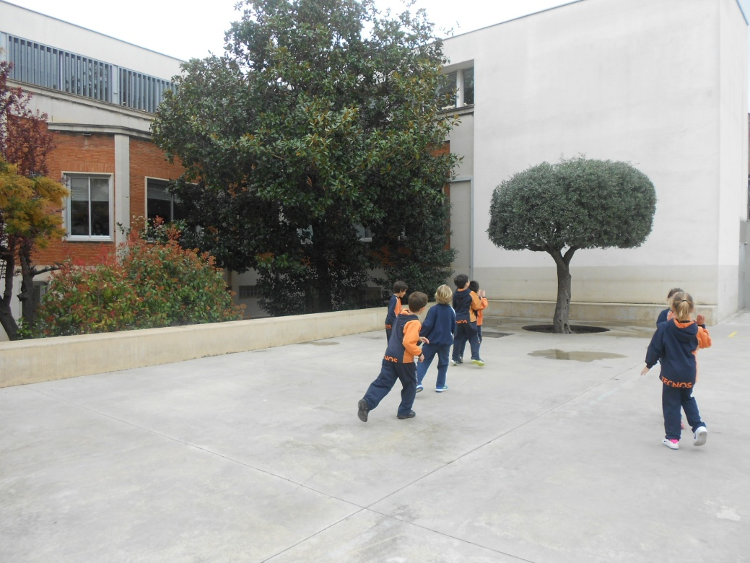
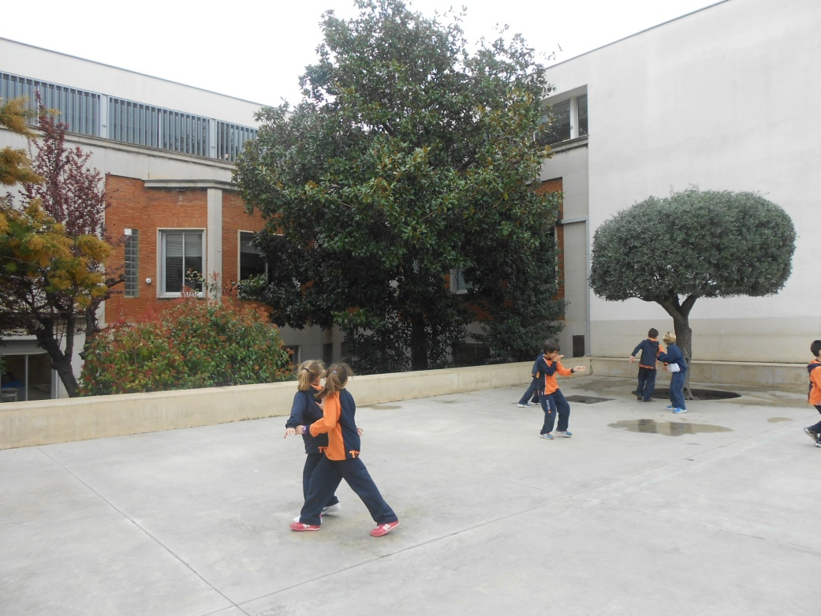
Here we play hide and seek and tag.
This is our PLAYGROUND

Slide 9
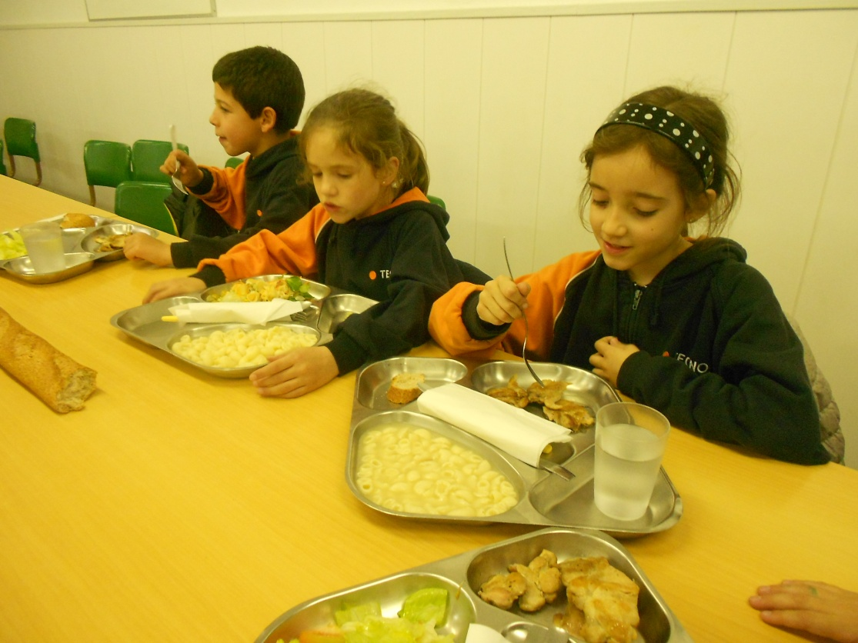
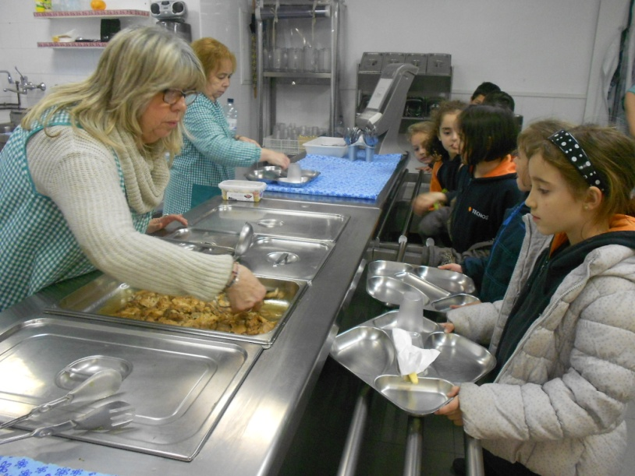
Here we have lunch.
This is our CANTEEN

Slide 10
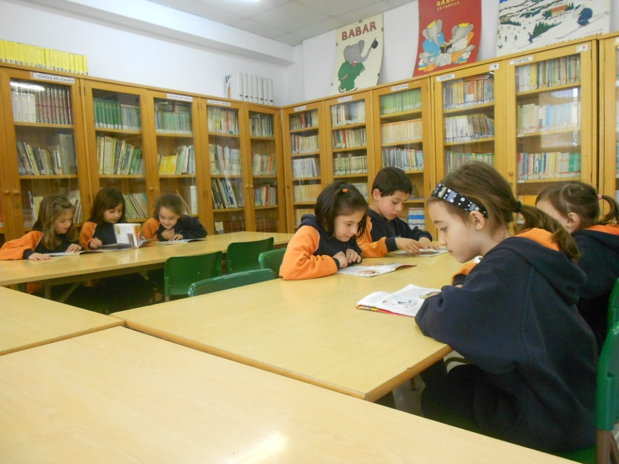
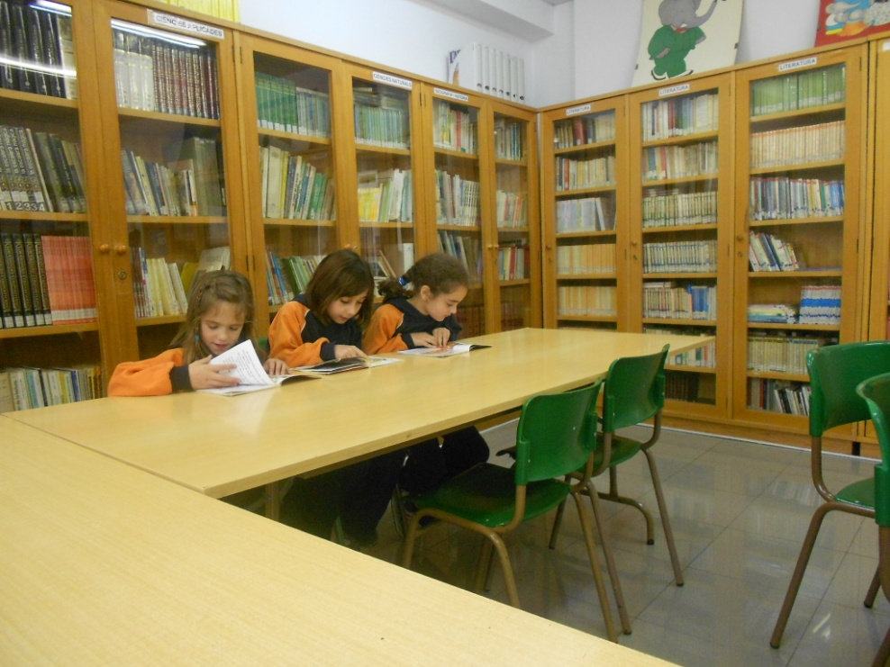
Here we read, study and borrow books.
This is our LIBRARY

Slide 11
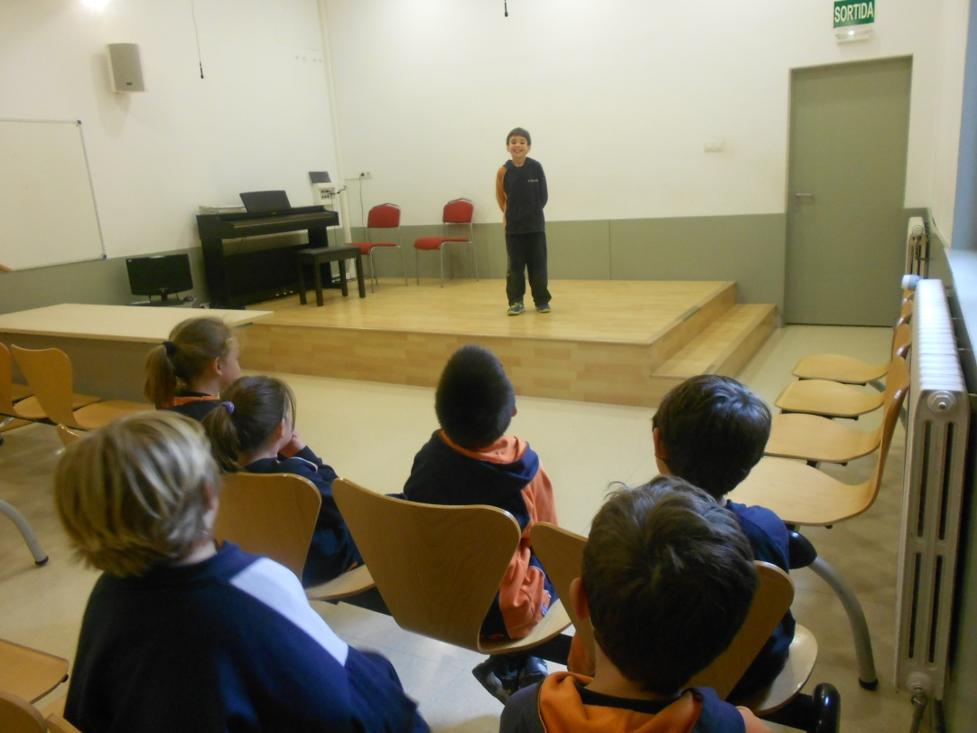
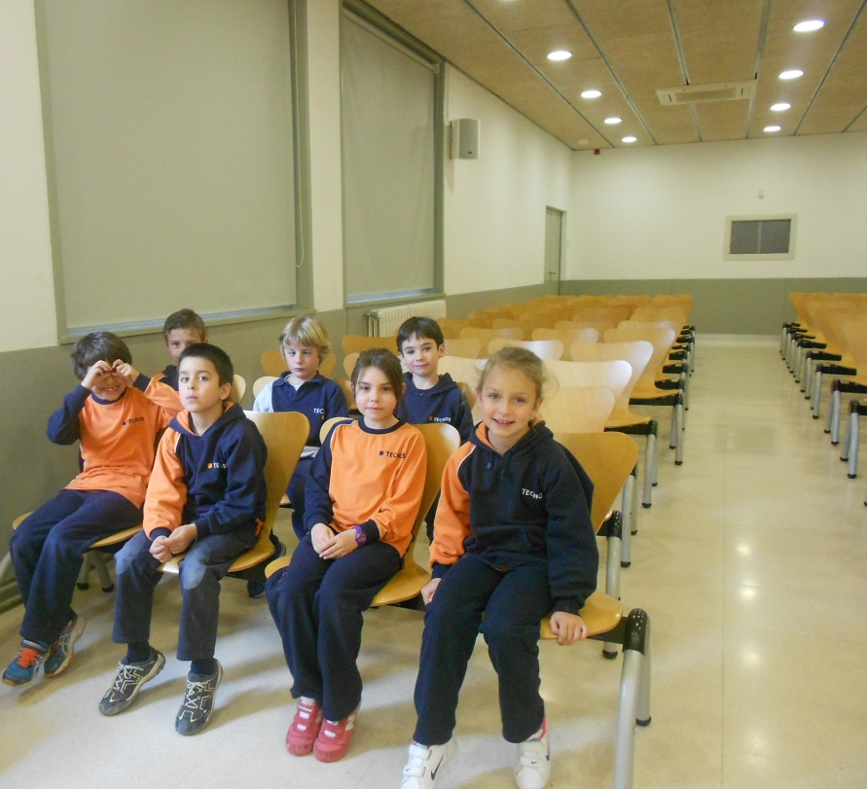
Here we watch shows, sing and dance.
This is our HALL

