Slide 1
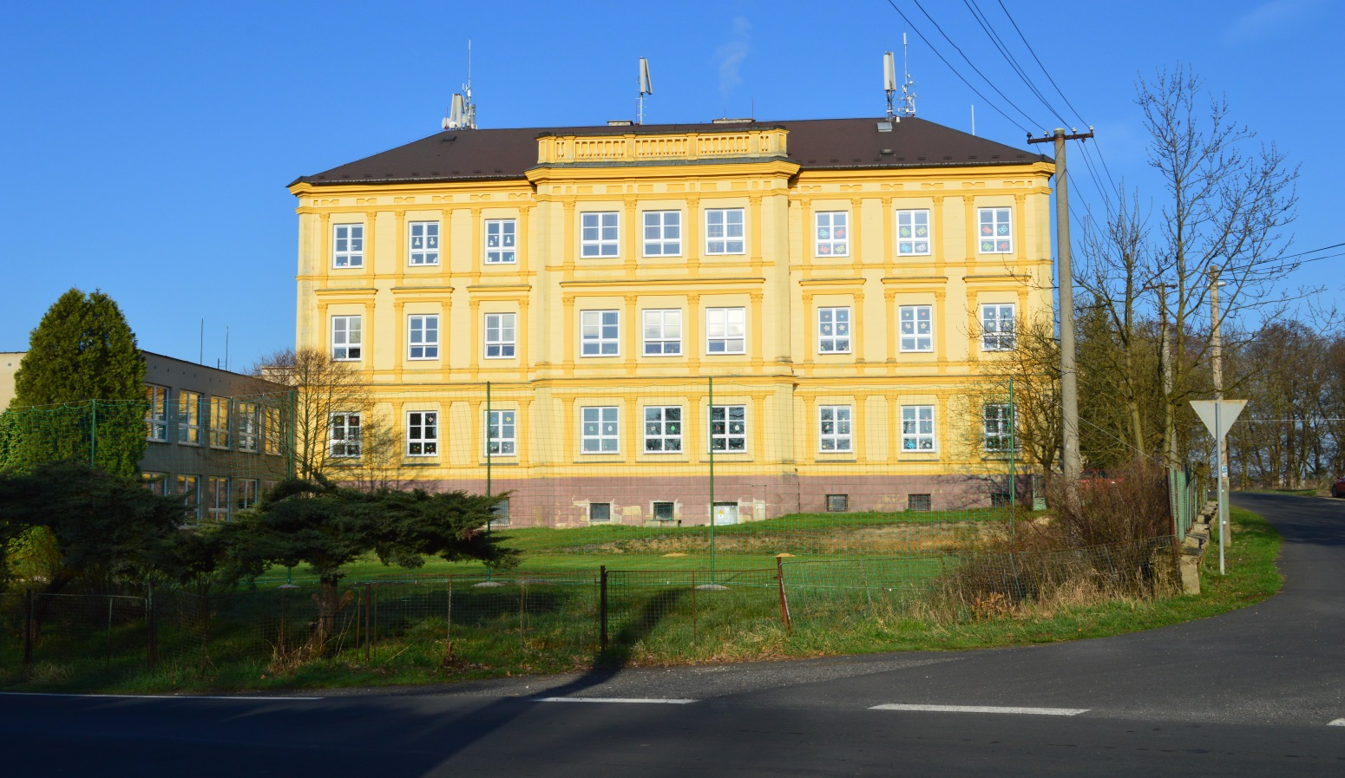
Our school
The primary school and the kindergarten, Hazlov,
our school was built as a villa in 1868.
Notes:
The primary school and the kindergarten, Hazlov. Our school was built as a villa in 1868.

Slide 2
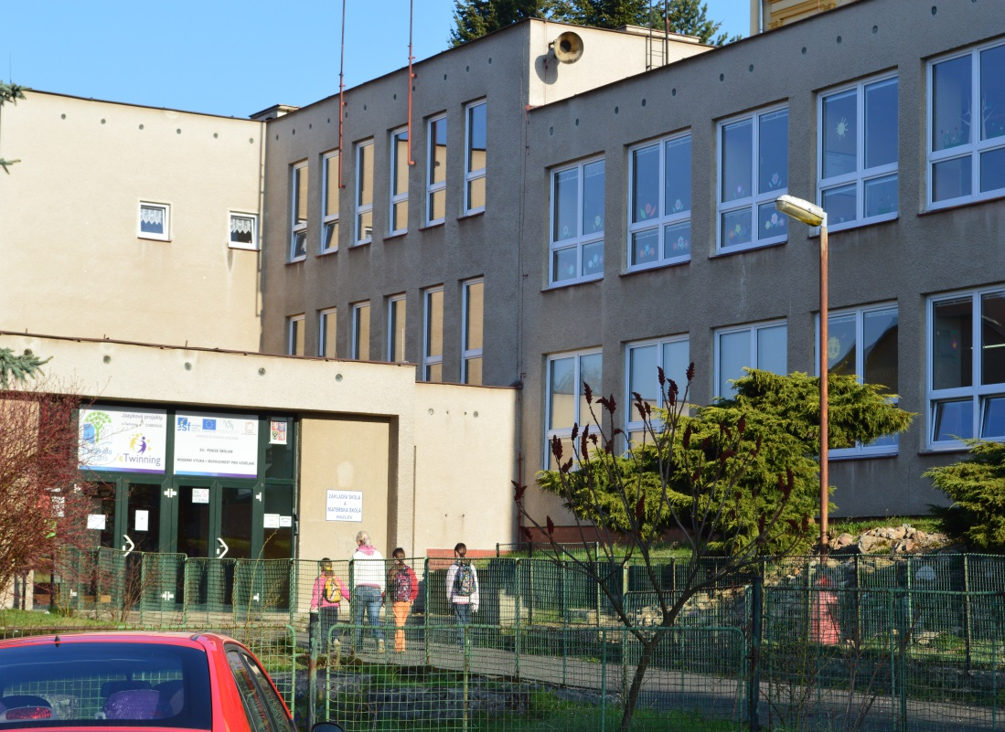
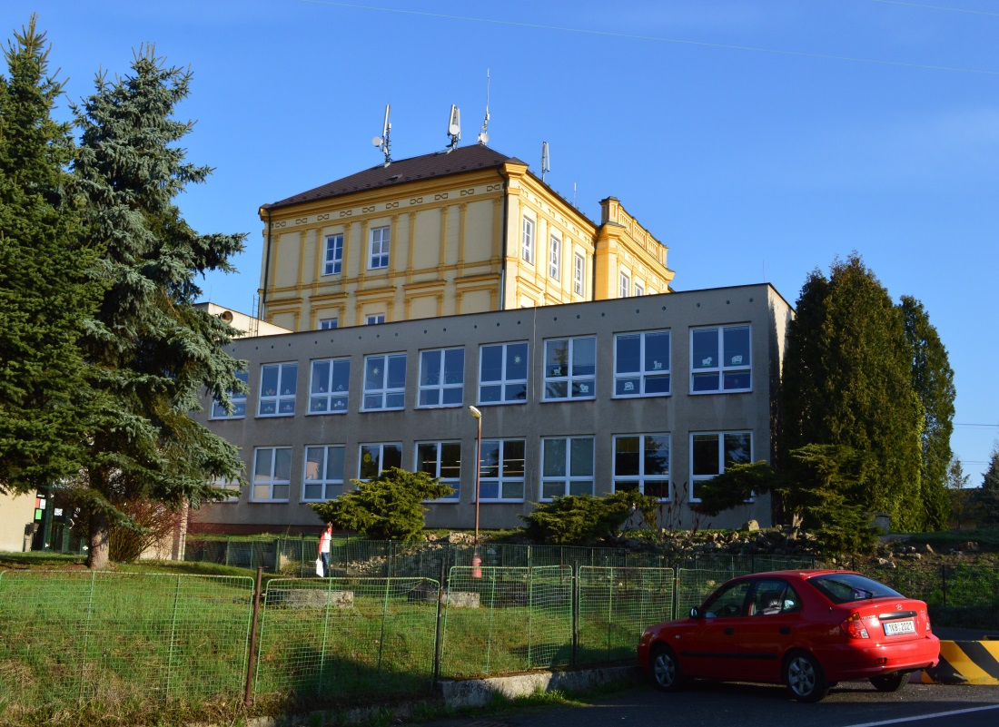
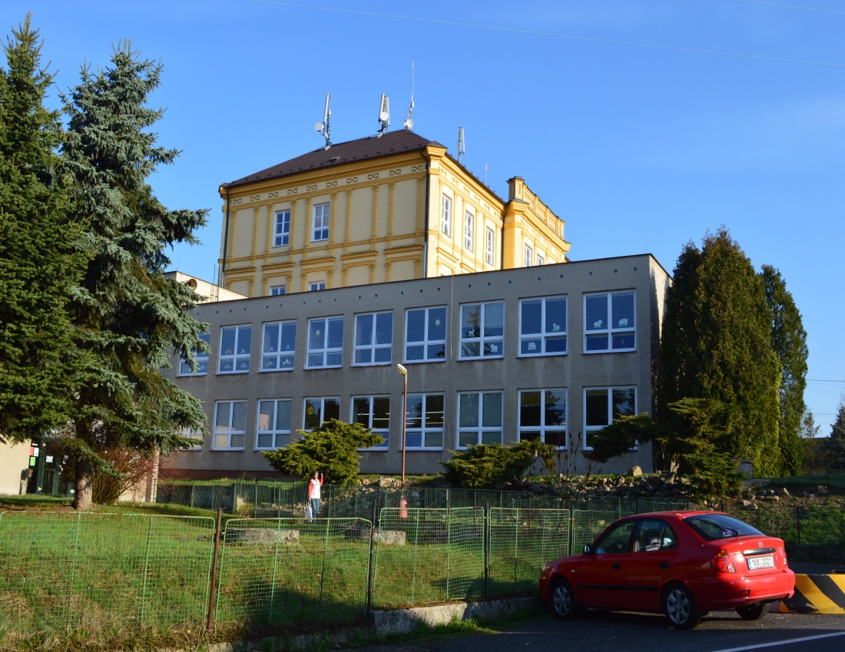
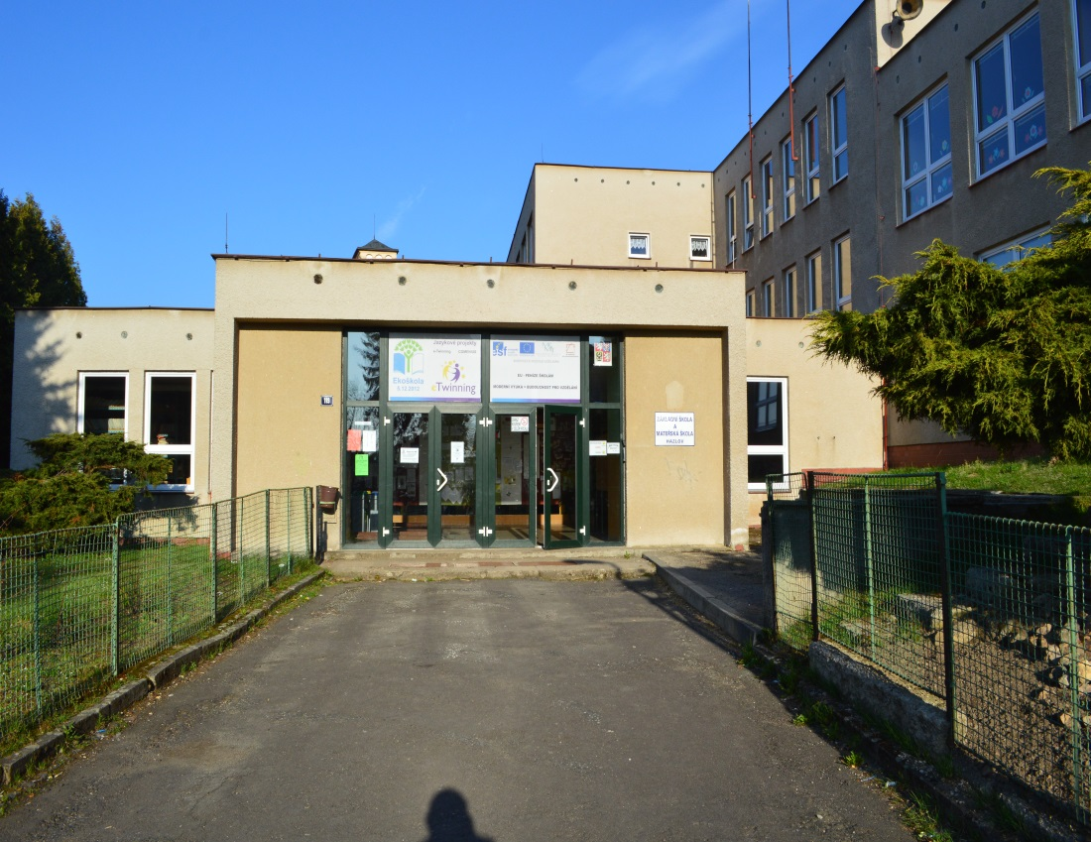
Notes:
It has got two parts the so-called new building and old building. There are the kindergarten, school canteen and classrooms for the youngest pupils.

Slide 3
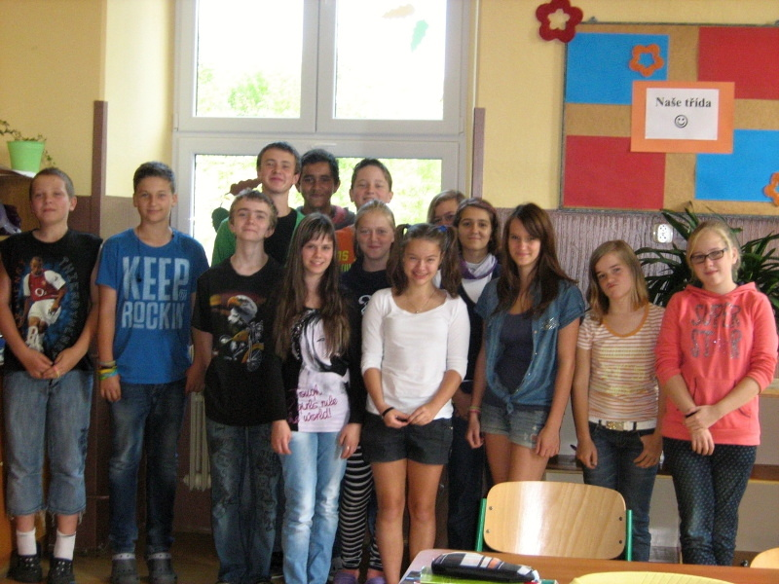
Vláďa a Vojta
Honza
Pavel
Dan
Dita a Adéla
Týna
Kačka
Kika
Jakub
Terka
Natka
Ivka

Slide 4
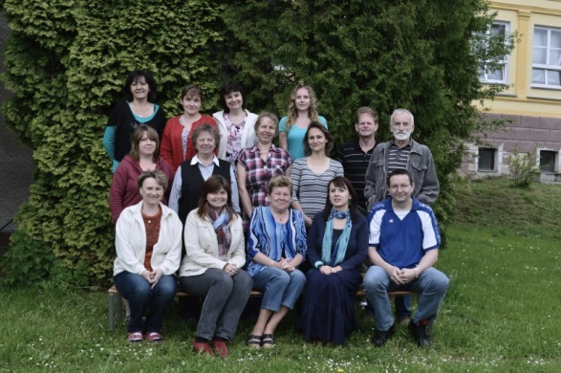
Our teachers
Maths, chemistry
History,
Geography
PE
PE
Czech la.
Physics, ICT
English,
Working activities
Notes:
There are our teachers.

Slide 5
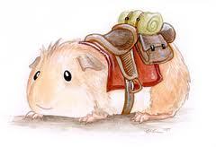
Our school obtained an international title „Ecoschool“ in December 2012
care of internal school environment
care of external school environment
waste sorting
care of animals – we have got a mini-zoo at school
energy saving
discussions about the environment
Earth Day
Notes:
Our school obtained an international title „Ecoschool“ in December 2012
What do we deal with? You can see it in following slides.

Slide 6
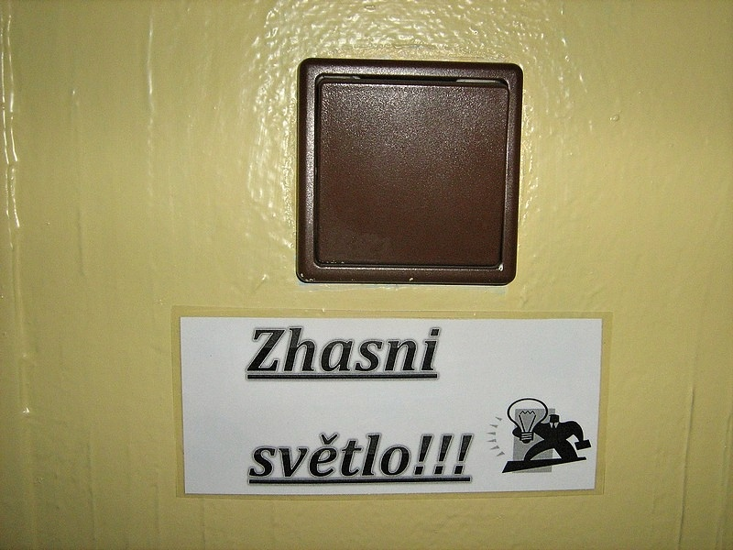
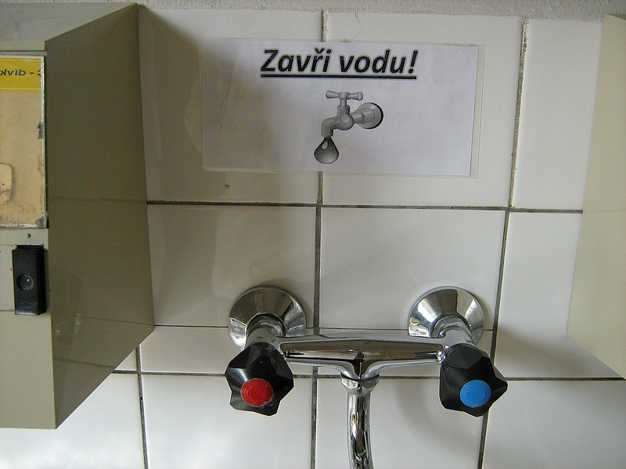
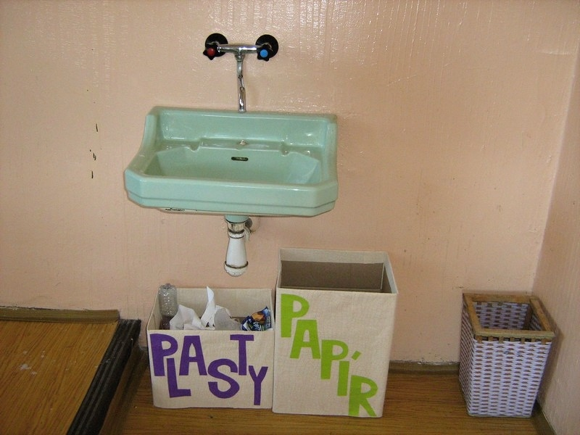
Turn off the light
Close water
Plastic
Paper

Slide 7
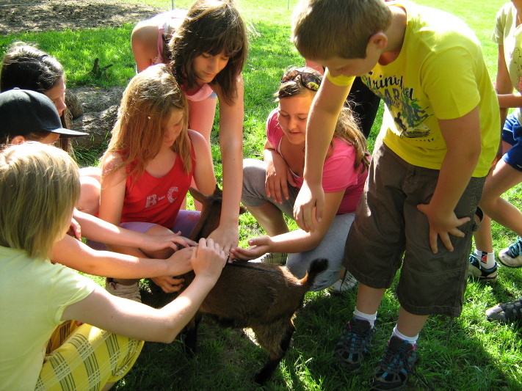
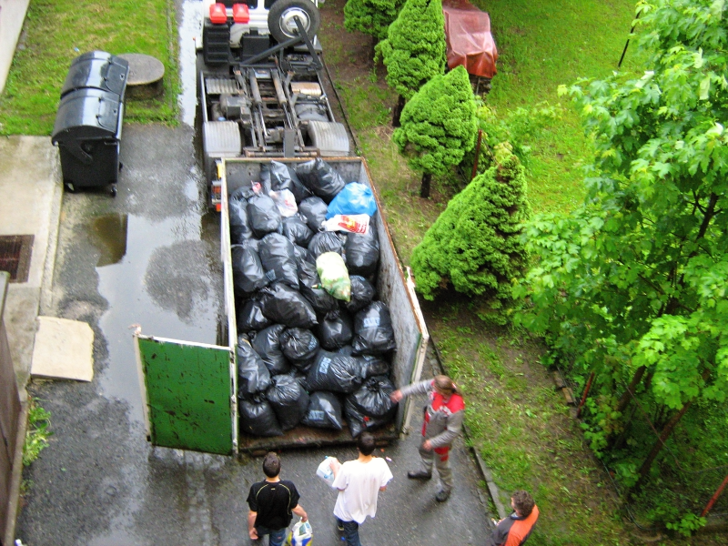
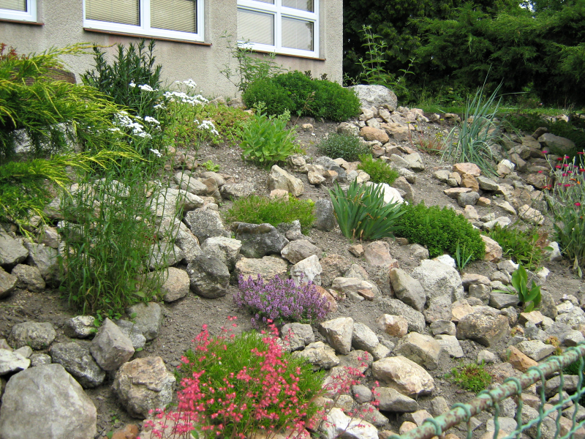
Visit an animal farm
Waste sorting
Maintaining school garden

Slide 8
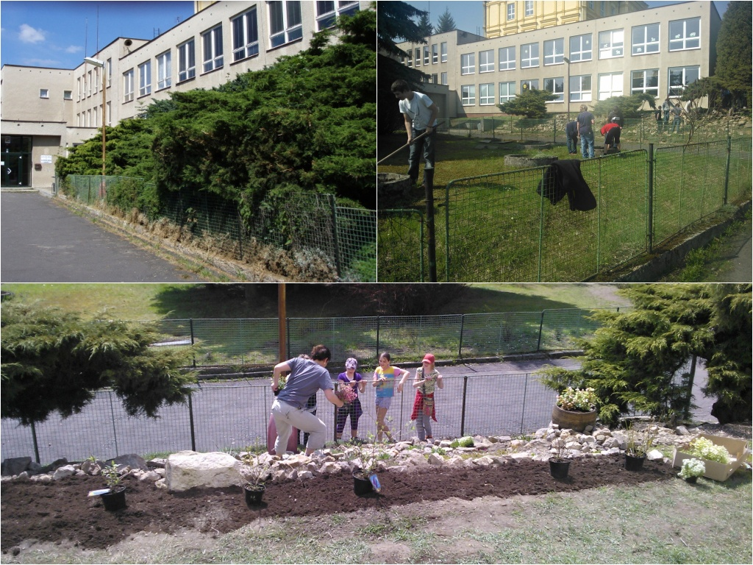
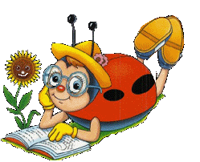
This slide shows a gradual change of our school garden.
Notes:
This slide shows a gradual change of our school garden.

Slide 9
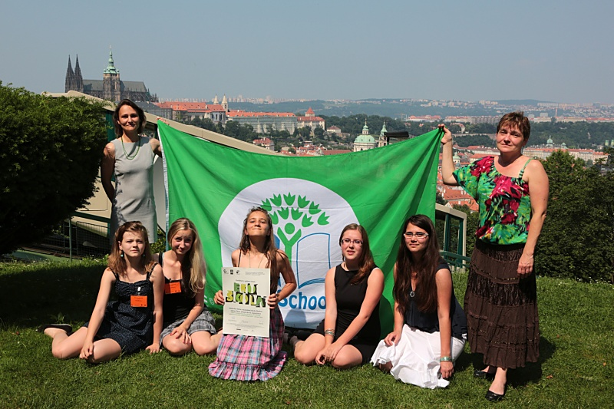
The flag and certificate of Ecoschool
Notes:
We were in Prague in June to take the flag and the certifikate of Ecoschool. This certifikate is valid only for two years so we have to work on the school envinroment to obtain the title again.

Slide 10
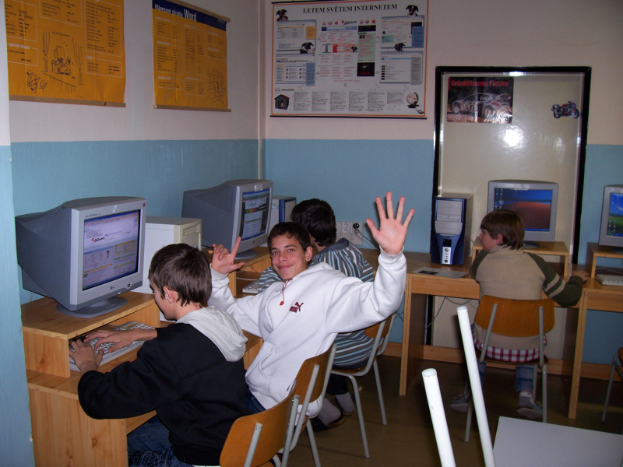
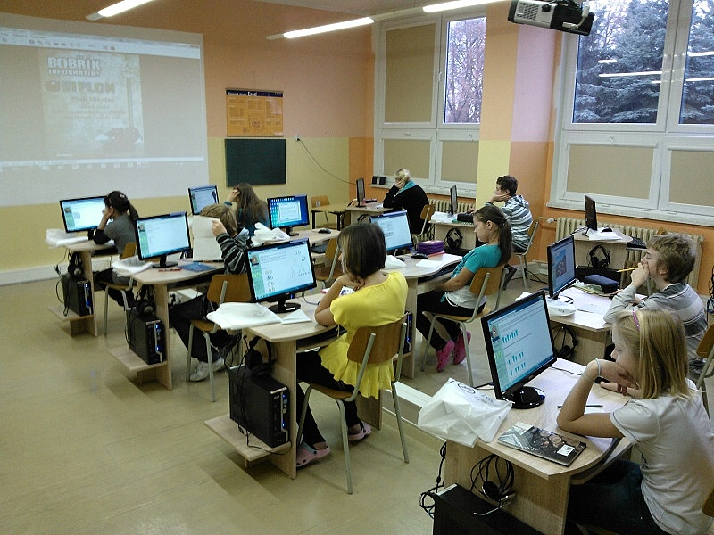
There was an old computer lab.
And this is our new one.
Notes:
Our new classrooms. Both are funded by the European Union. This is our computer lab.

Slide 11
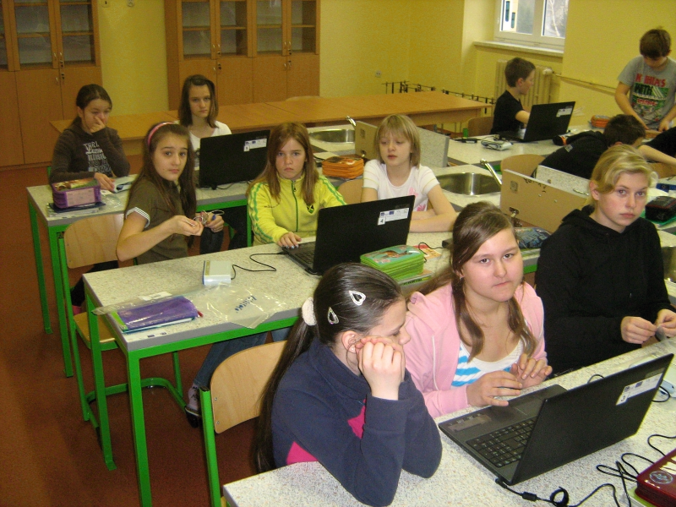
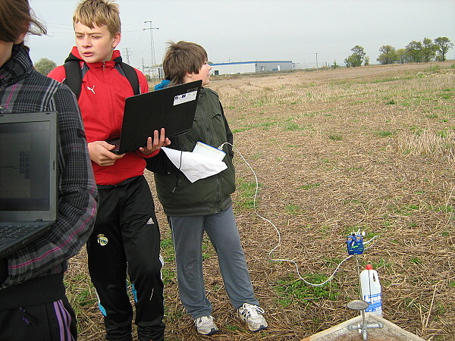
We learn to work with new equipments.
We measure soil humidity at the school farm.
Notes:
We have got a new natural science classroom. We learn physics, chemistry and biology here. We can work with digital measuring equipments.

Slide 12
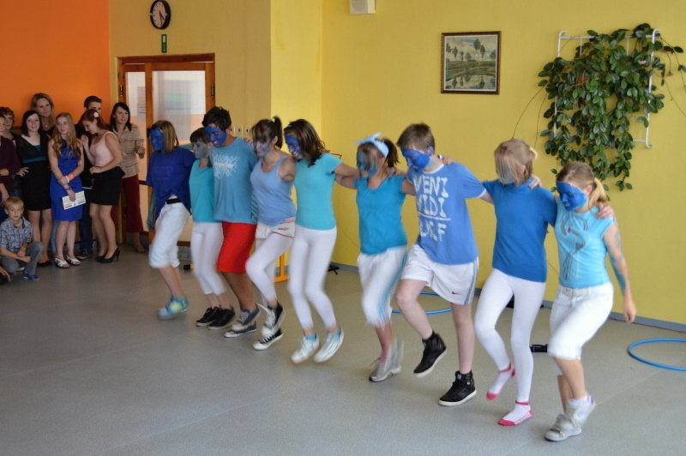
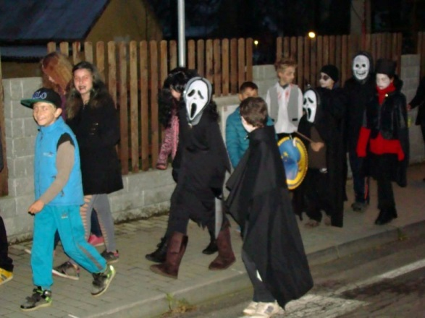
Our traditional events:
The school academy
Halloween
Notes:
Our traditional events: the school academy,halloween.

Slide 13
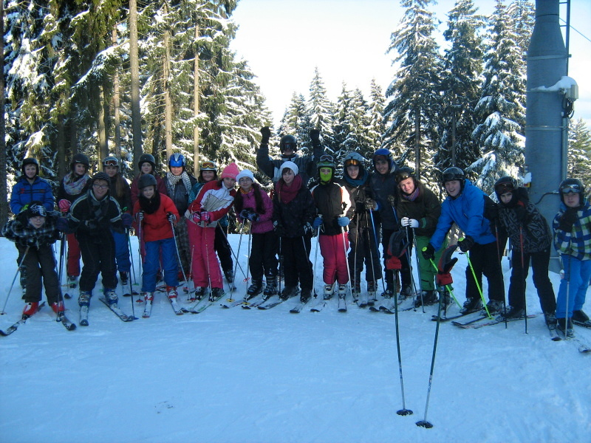
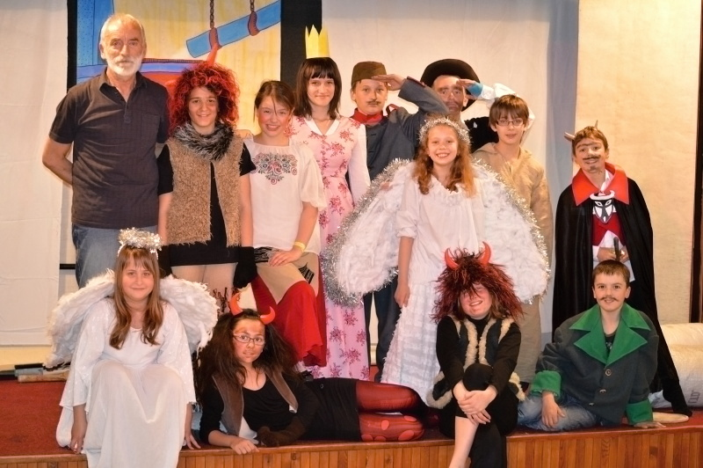
Ski training
The school theatre
Notes:
We have a ski training every year and it is for pupils of the 7th and 8th class. Our actors and actresses studied a story about a soldier and devils last year.

Slide 14
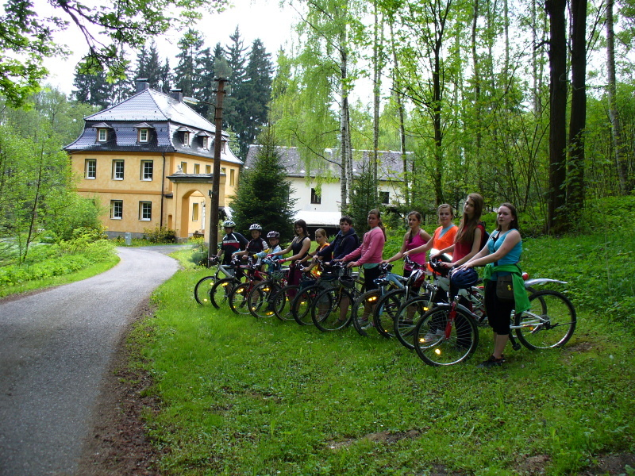
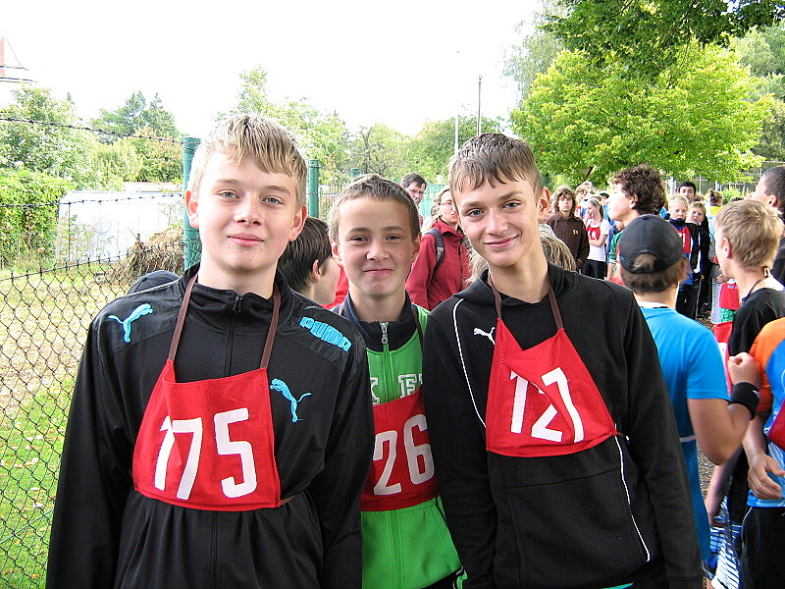
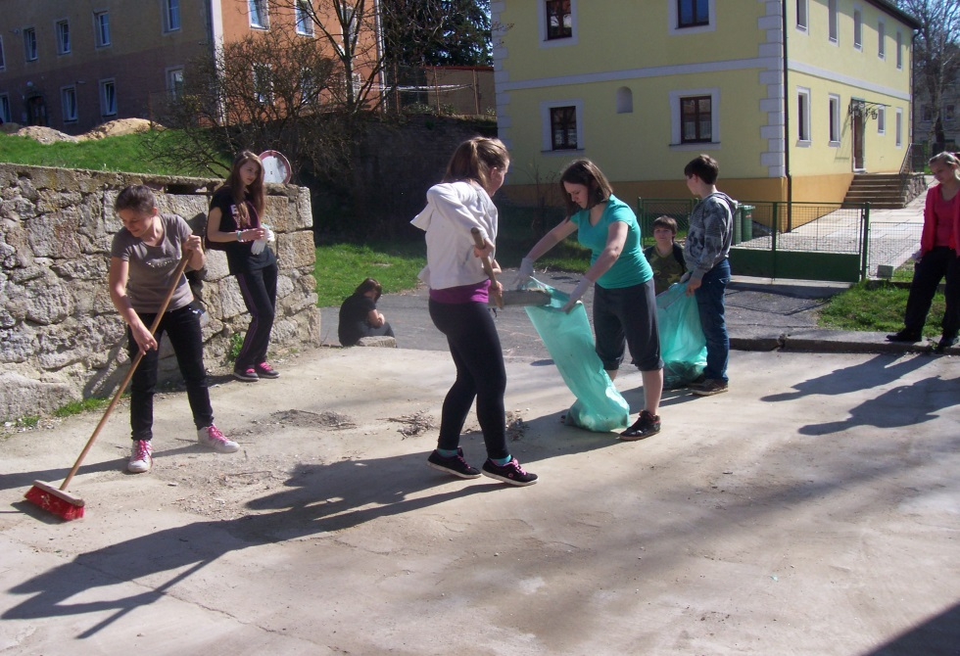
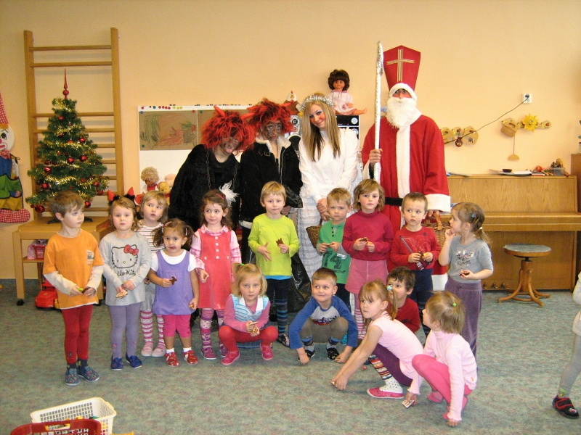
Cross-country
Sport games
Earth Day
Nicholas
Notes:
Earth Day is celebrated by cleaning around our school and in the village. Nicholas, angeles and devils are pupils of the 9th class.

Slide 15
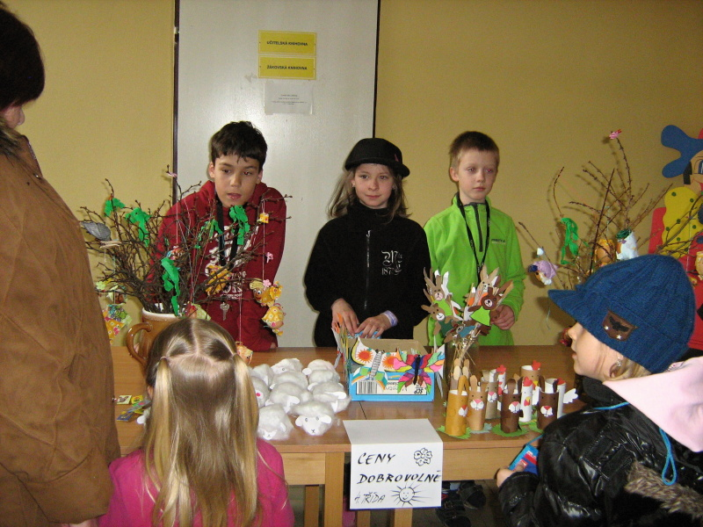
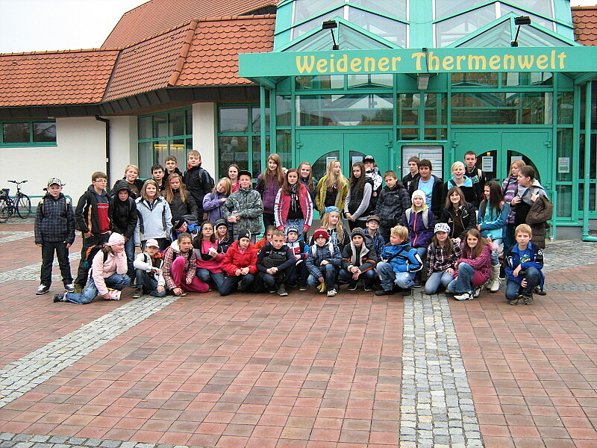
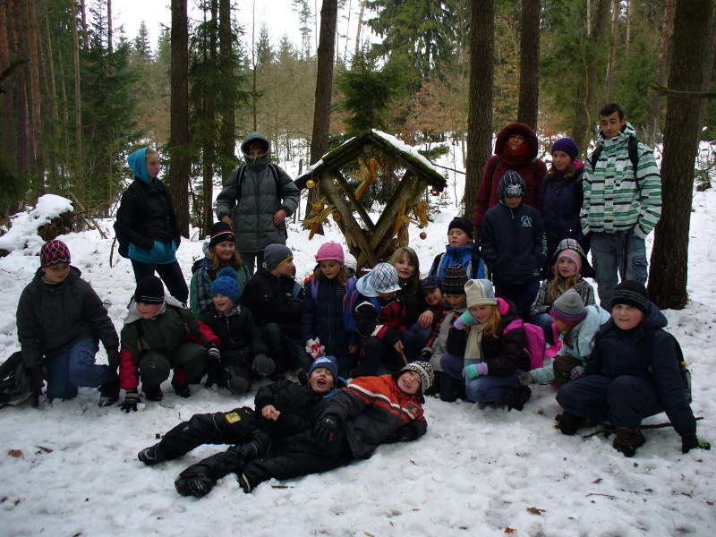
Easter fair
Feeding forest animals before Christmas
Swimming pool in Germany
Notes:
Easter fair, swimming pool in Germany, feeding forest animals before Christmas.

Slide 16
The END
Created: 8.A

