Slide 1
YOU ARE 10 YEARS OLD!
HAPPY BIRTHDAY!

Slide 2
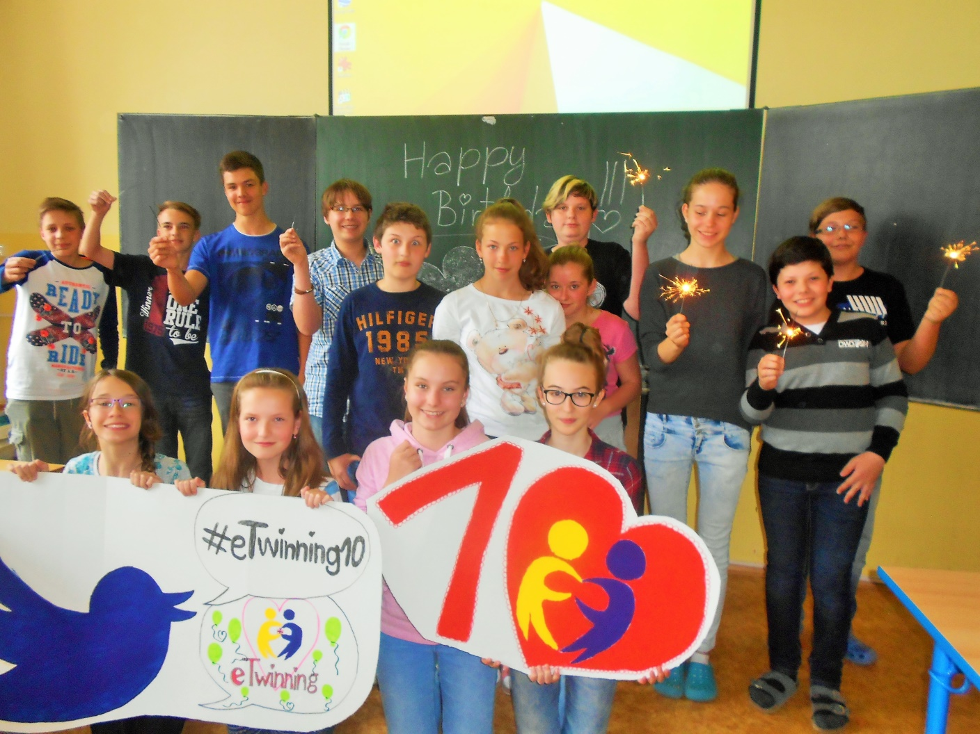
HAPPY BIRTHDAY ETWINNING!!!

Slide 3
WE ARE BREAKING DOWN THE WALLS
WE LOVE ETWINNING
´COS IT´S ALWAYS WINNING….
WE WANT TO LIVE IN PEACE
THAT´S THE ONLY THING WE PLEASE….

Slide 4
WE WOULD LIKE TO BE THE KEY TO PEACE

Slide 5
SO…JOIN US, PLEASE…

