Slide 1
FAIRTRADE TEA
Global problems and human rights are important topic for Europeans

Slide 2
The most common logo

Slide 3
WHAT IS FAIRTRADE
Fairtrade has two main purposes:
to eliminate child labour
and
to make sure that a farmer gets fair price for his product.
Notes:
Fairtrade has two main purposes: to eliminate child labour and to make sure that a farmer gets fair price for his product.

Slide 4
WHAT IS FAIRTRADE
Fair trade is fair selling and buying products
People from Africa, Asia, and Latin America get a chance to make living with their work
People work under conditions respecting human rights
The farmers are paid fair for their hard work
Farmers respect living environment
Their children can go to school
Notes:
Fairtrade has two main purposes: to eliminate child labour and to make sure that a farmer gets fair price for his product.

Slide 5
Tea is a cultural drink and has medical benifits
You can see the Fairtrade logo on the bottom right

Slide 6
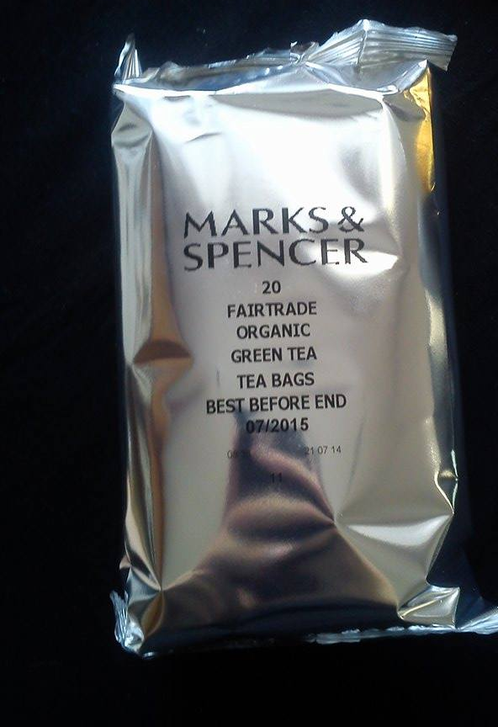
Some facts about tea
Tea is the second most spread drink on the Earth, after water. The drink is prepared from leaves.
Tea is part of culture but it has also medical effects on the body because it contains vitamins, minerals, anti-oxidants and even it is a cancer prevention.

Slide 7
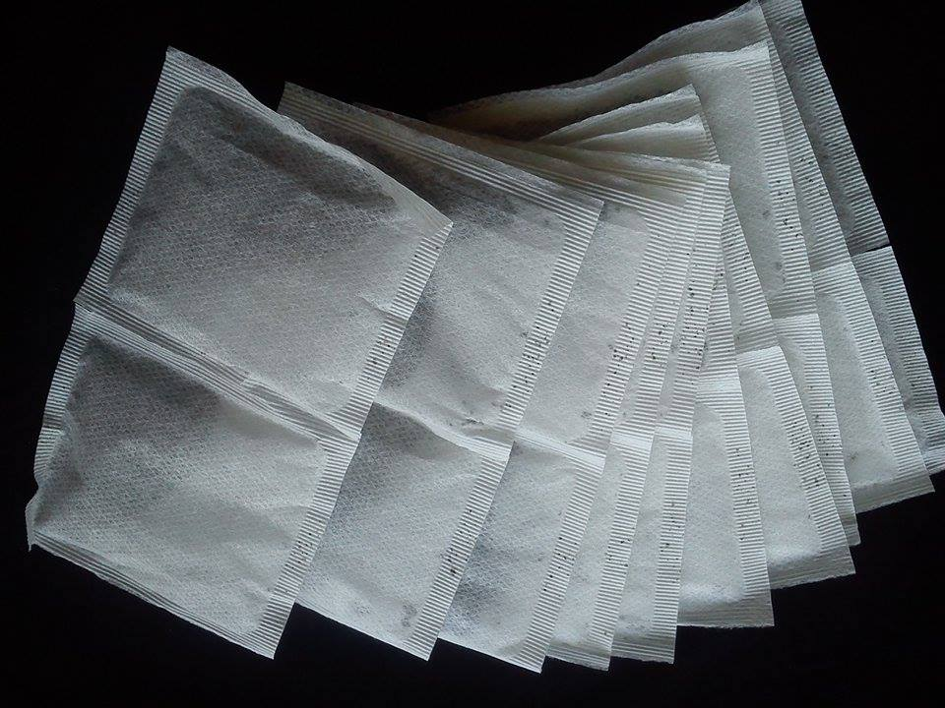
Good and quality tea helps to find the lost balance, encourages, strengthens, and energizes. These may be the reasons why the number of the tea-lovers is growing in the Czech Republic.
Tea is very closely connected with the human society
People drink tea for breakfast, when they meditate, relax, during cultural and social events, and it can also heal.

Slide 8
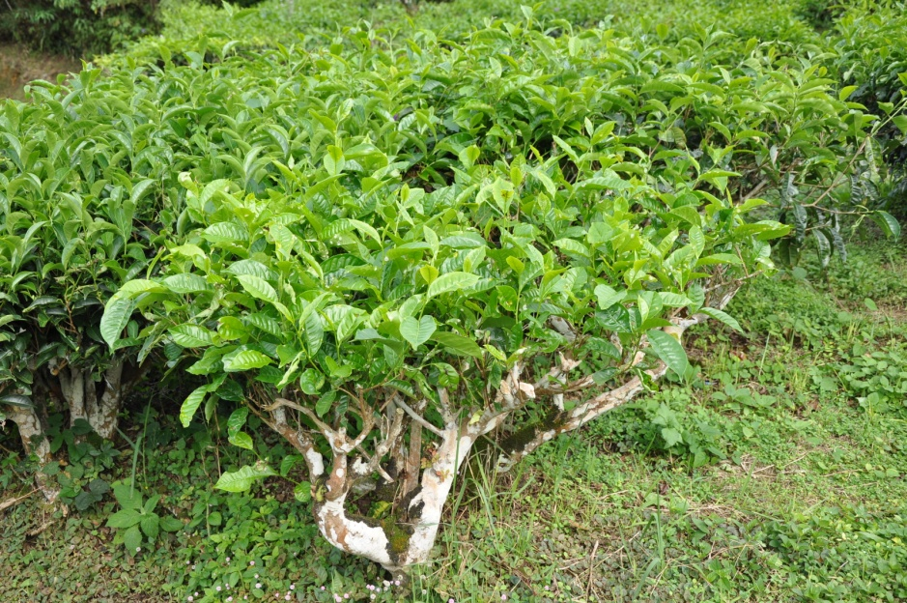
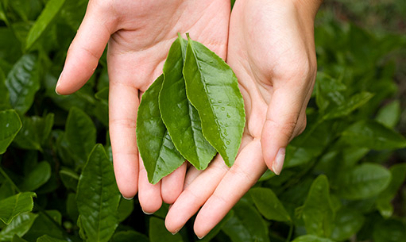
TEA HARVEST
TEA BUSH
TEA LEAVES
This is tea in its natural form, here you can see the tea leaves.

Slide 9
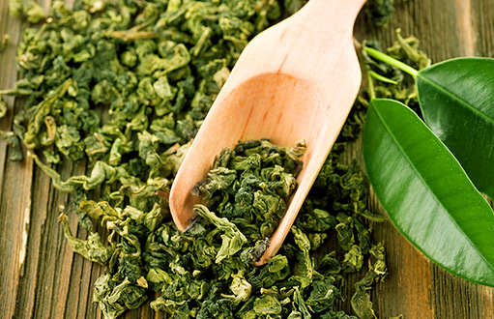
PROCEDURE for making tea
Harvest
Withering
Rolling
Fermentation
Roasting
Sorting
Quality control – tasting
Packing comes in two forms: loose and bagged

Slide 10
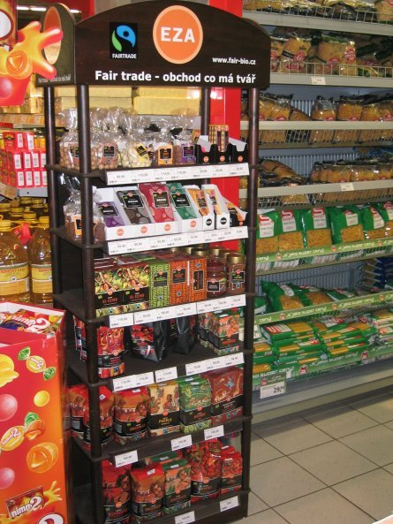
Faitrade products are sold in the Czech Republic in:
DM,
Marks & Spencer
Starbucks
Bio food
This a Fairtrade stand in the local supermarket.

Slide 11
Short quiz to sum up
What is Fairtrade?
Righteous shopping
Society of righteous people
2. Which drink is more consumed than tea?
Coca – cola
Water
Coffee
3. In which shop you can buy Fairtrade products in our country?
New Yorker
DM
Gate

Slide 12
Sources
www.google.com/images
http://www.chutnycaj.cz/pestovani-sklizen/
http://www.dtest.cz/clanek-3628/co-to-znamena-kdyz-je-vyrobek-fair-trade
http://www.fairtradecentrum.cz/caj/c-6/

Slide 13
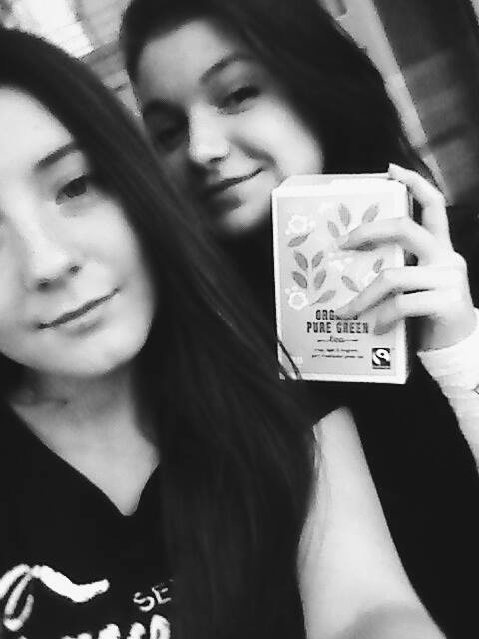
The end
Natálie Třeštíková a Michaela Hladká

