Slide 1
HOW ARE WE LEARNING WITH
7.B, ZŠ TGM Mnichovice

Slide 2
What are we learning with eTwinning?
We learn English.
We are working with some IT programmes, that we didn‘t know that they exist.
We can found new friends and some of us are writing with them from the fifth class to now.
We are enjoying using modern and new social sites like Skype and TwinSpace
And we are not learning ☺

Slide 3
WITH WHAT ARE WE LEARNING WITH eTWINNING ?
We use our school tablets and PCs
Sometimes we are learning in ,,Project days‘‘
We often work in small groups (3-5 children)

Slide 4
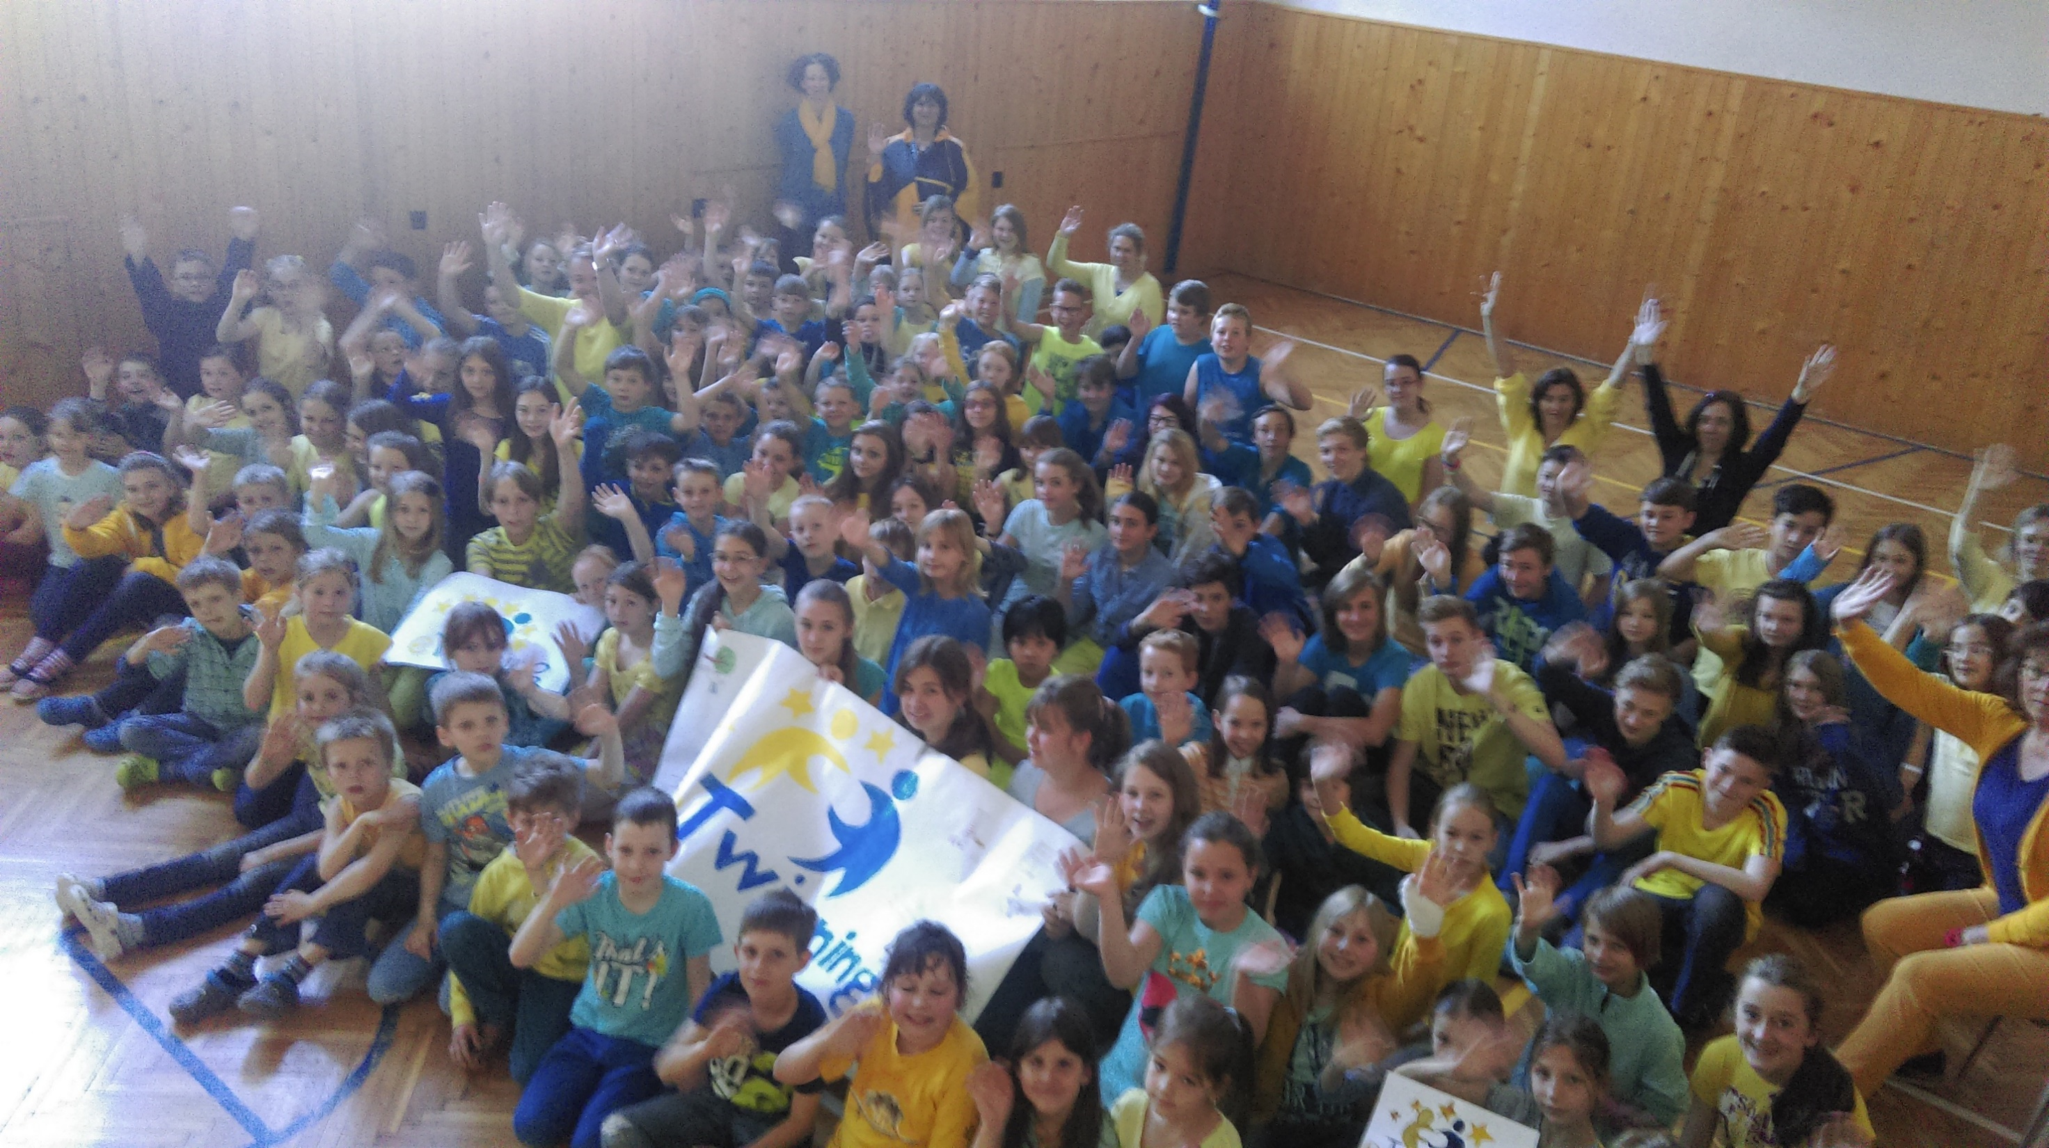
EFFECTS OF eTWINNING
We can better speak, write and understand English.
We have got lots of friends from other countries.
And they are great friends.
We have got lots of fun in the lessons.

Slide 5
1
0

