Slide 1
Střední průmyslová škola Otrokovice

Slide 2
Our school

Slide 3
Entrance

Slide 4
Our class
This is our class. We are 14 in class.
Experimentarium - experiments, exhibits

Slide 5
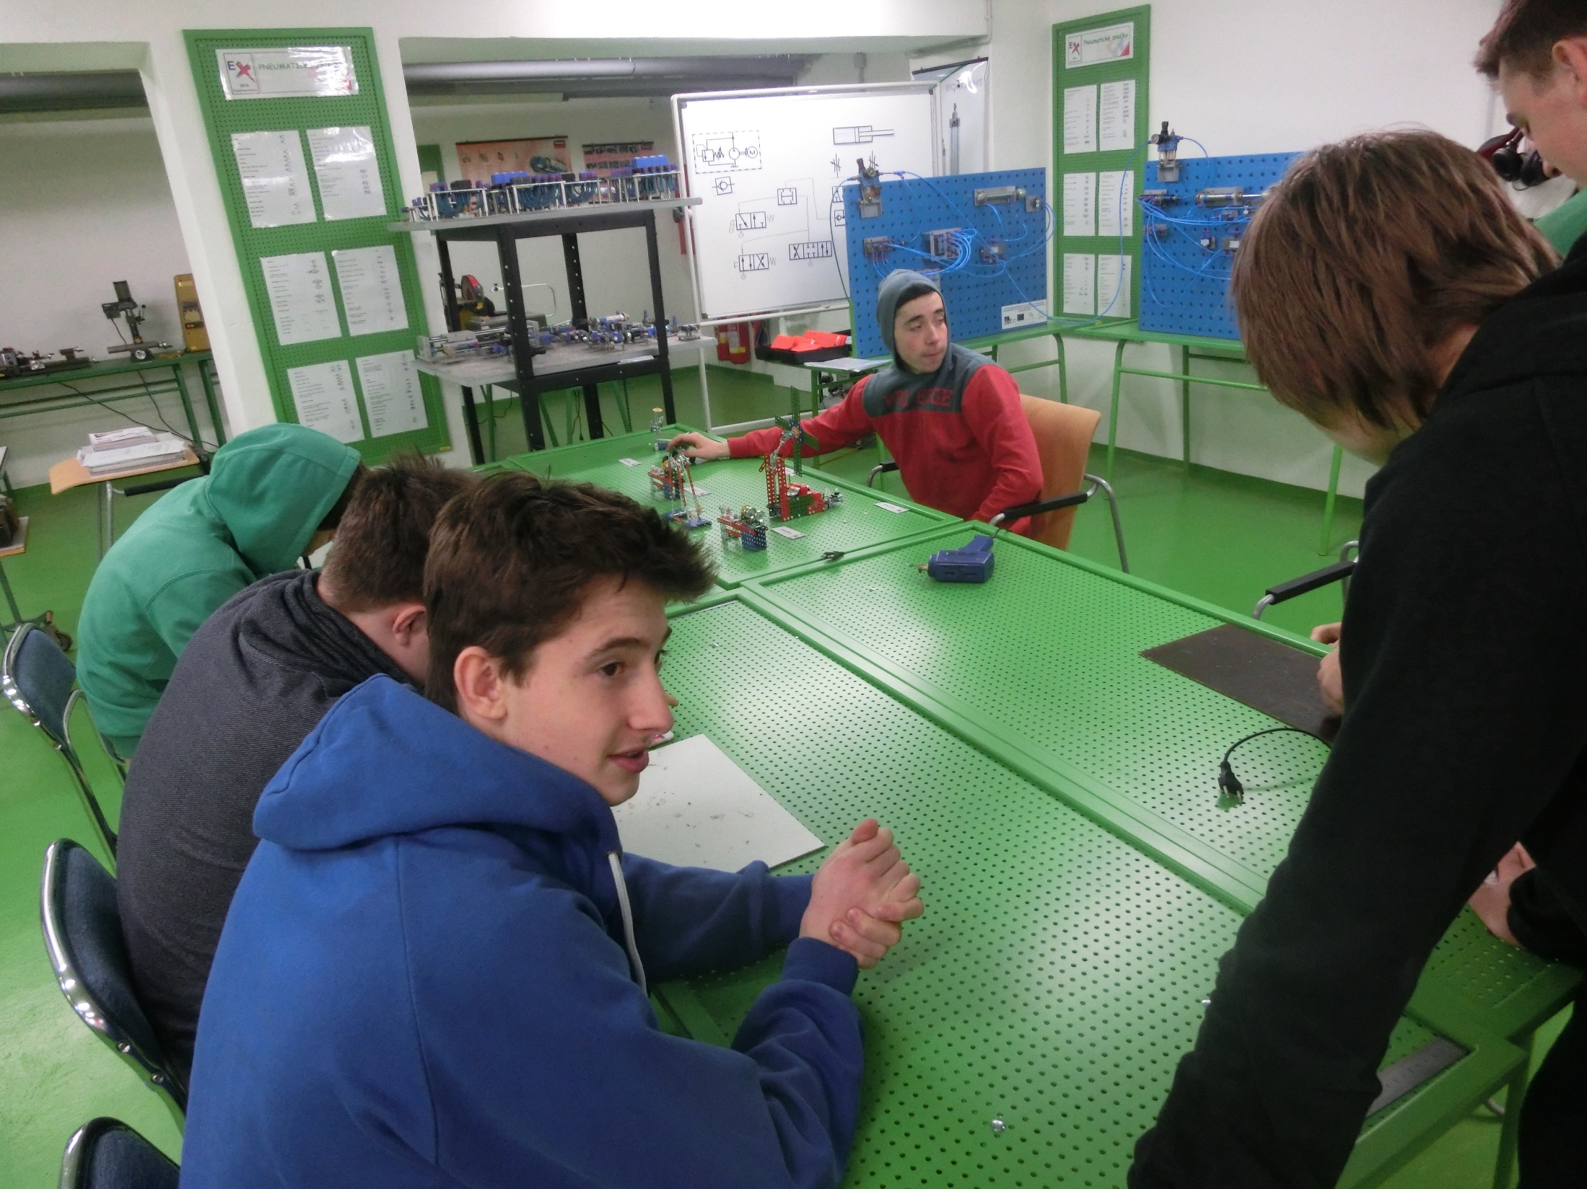

Slide 6
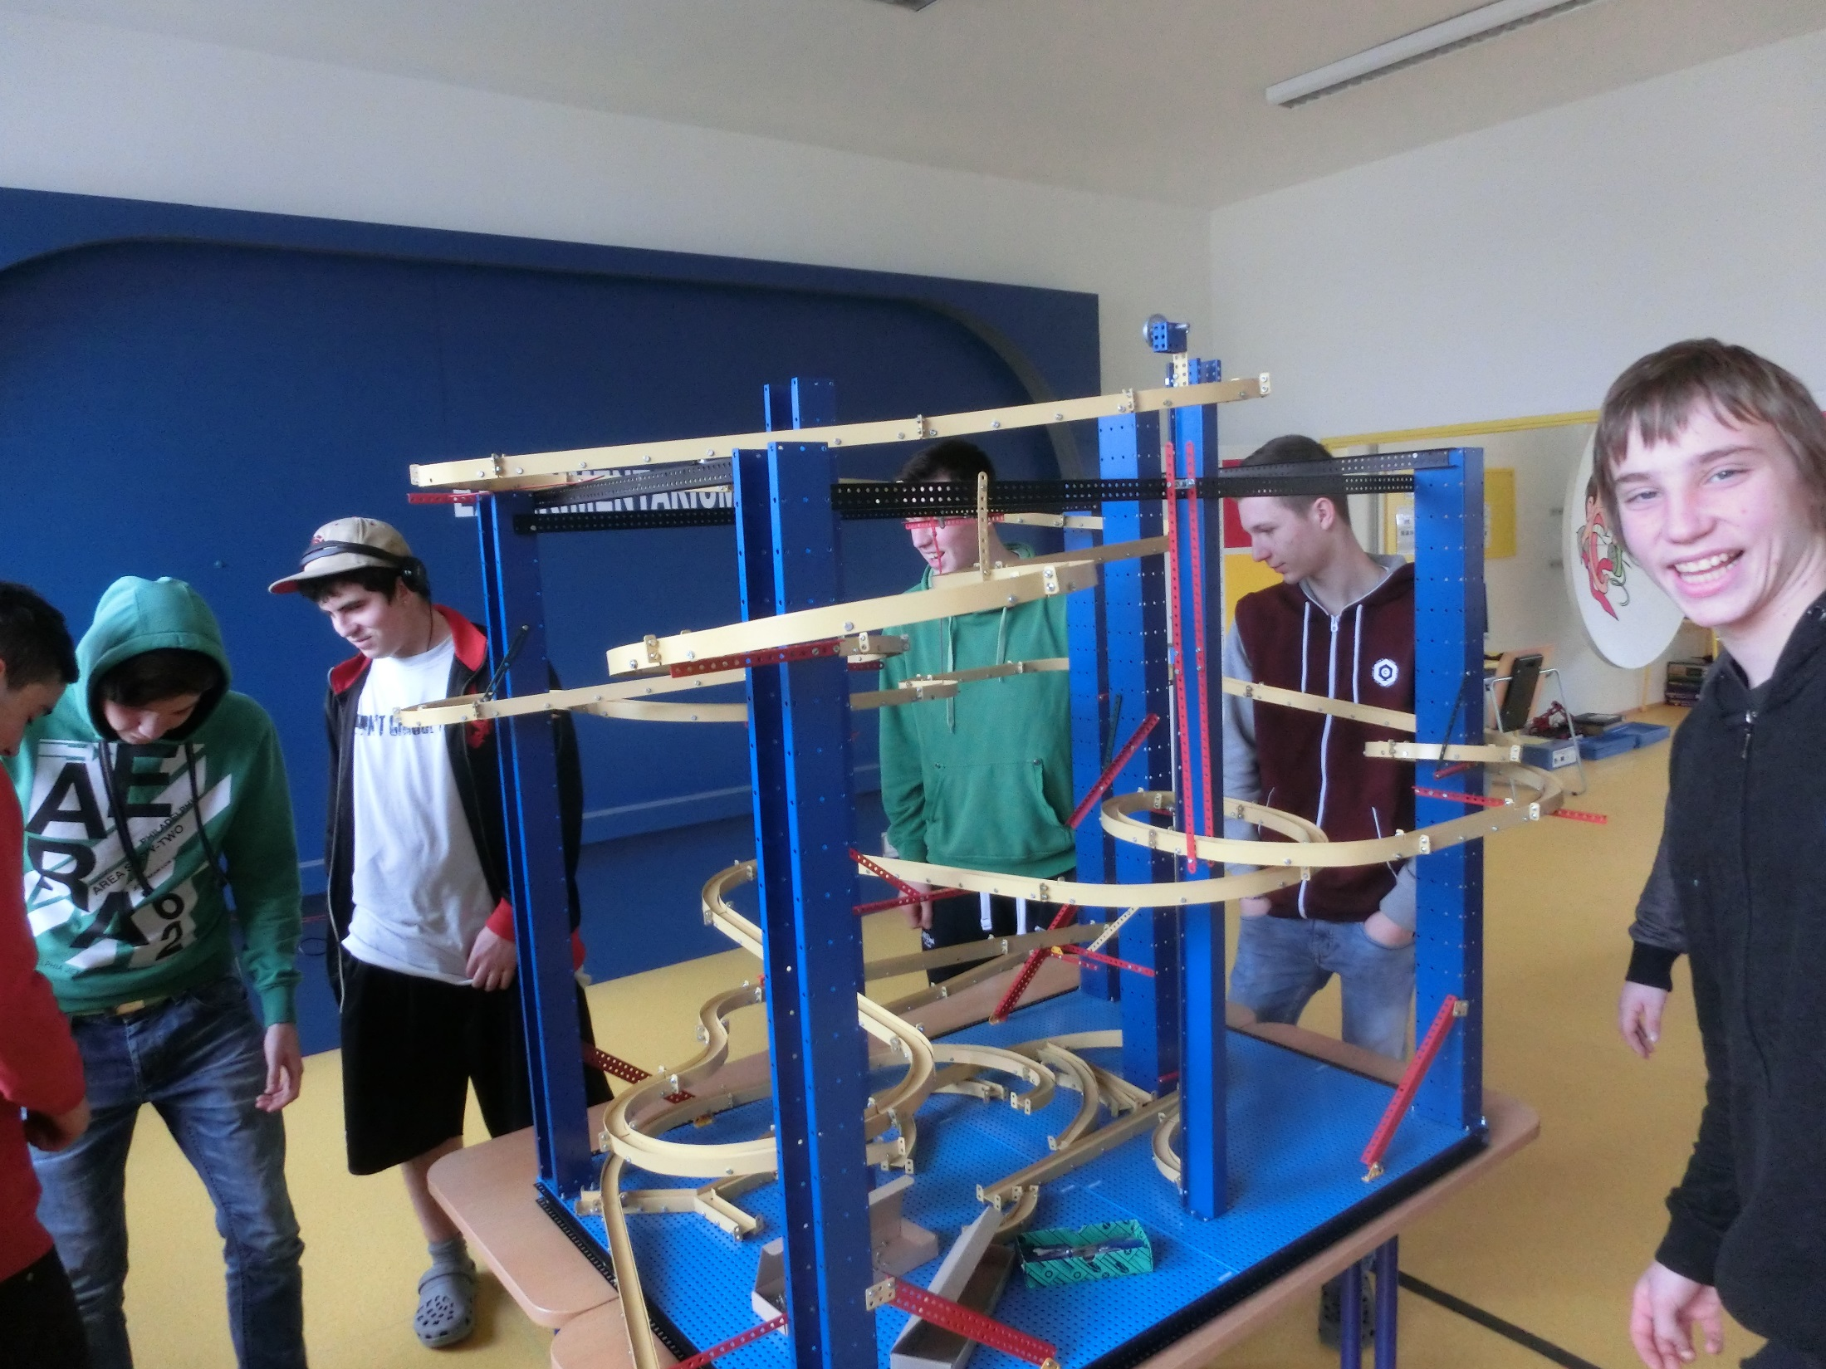

Slide 7
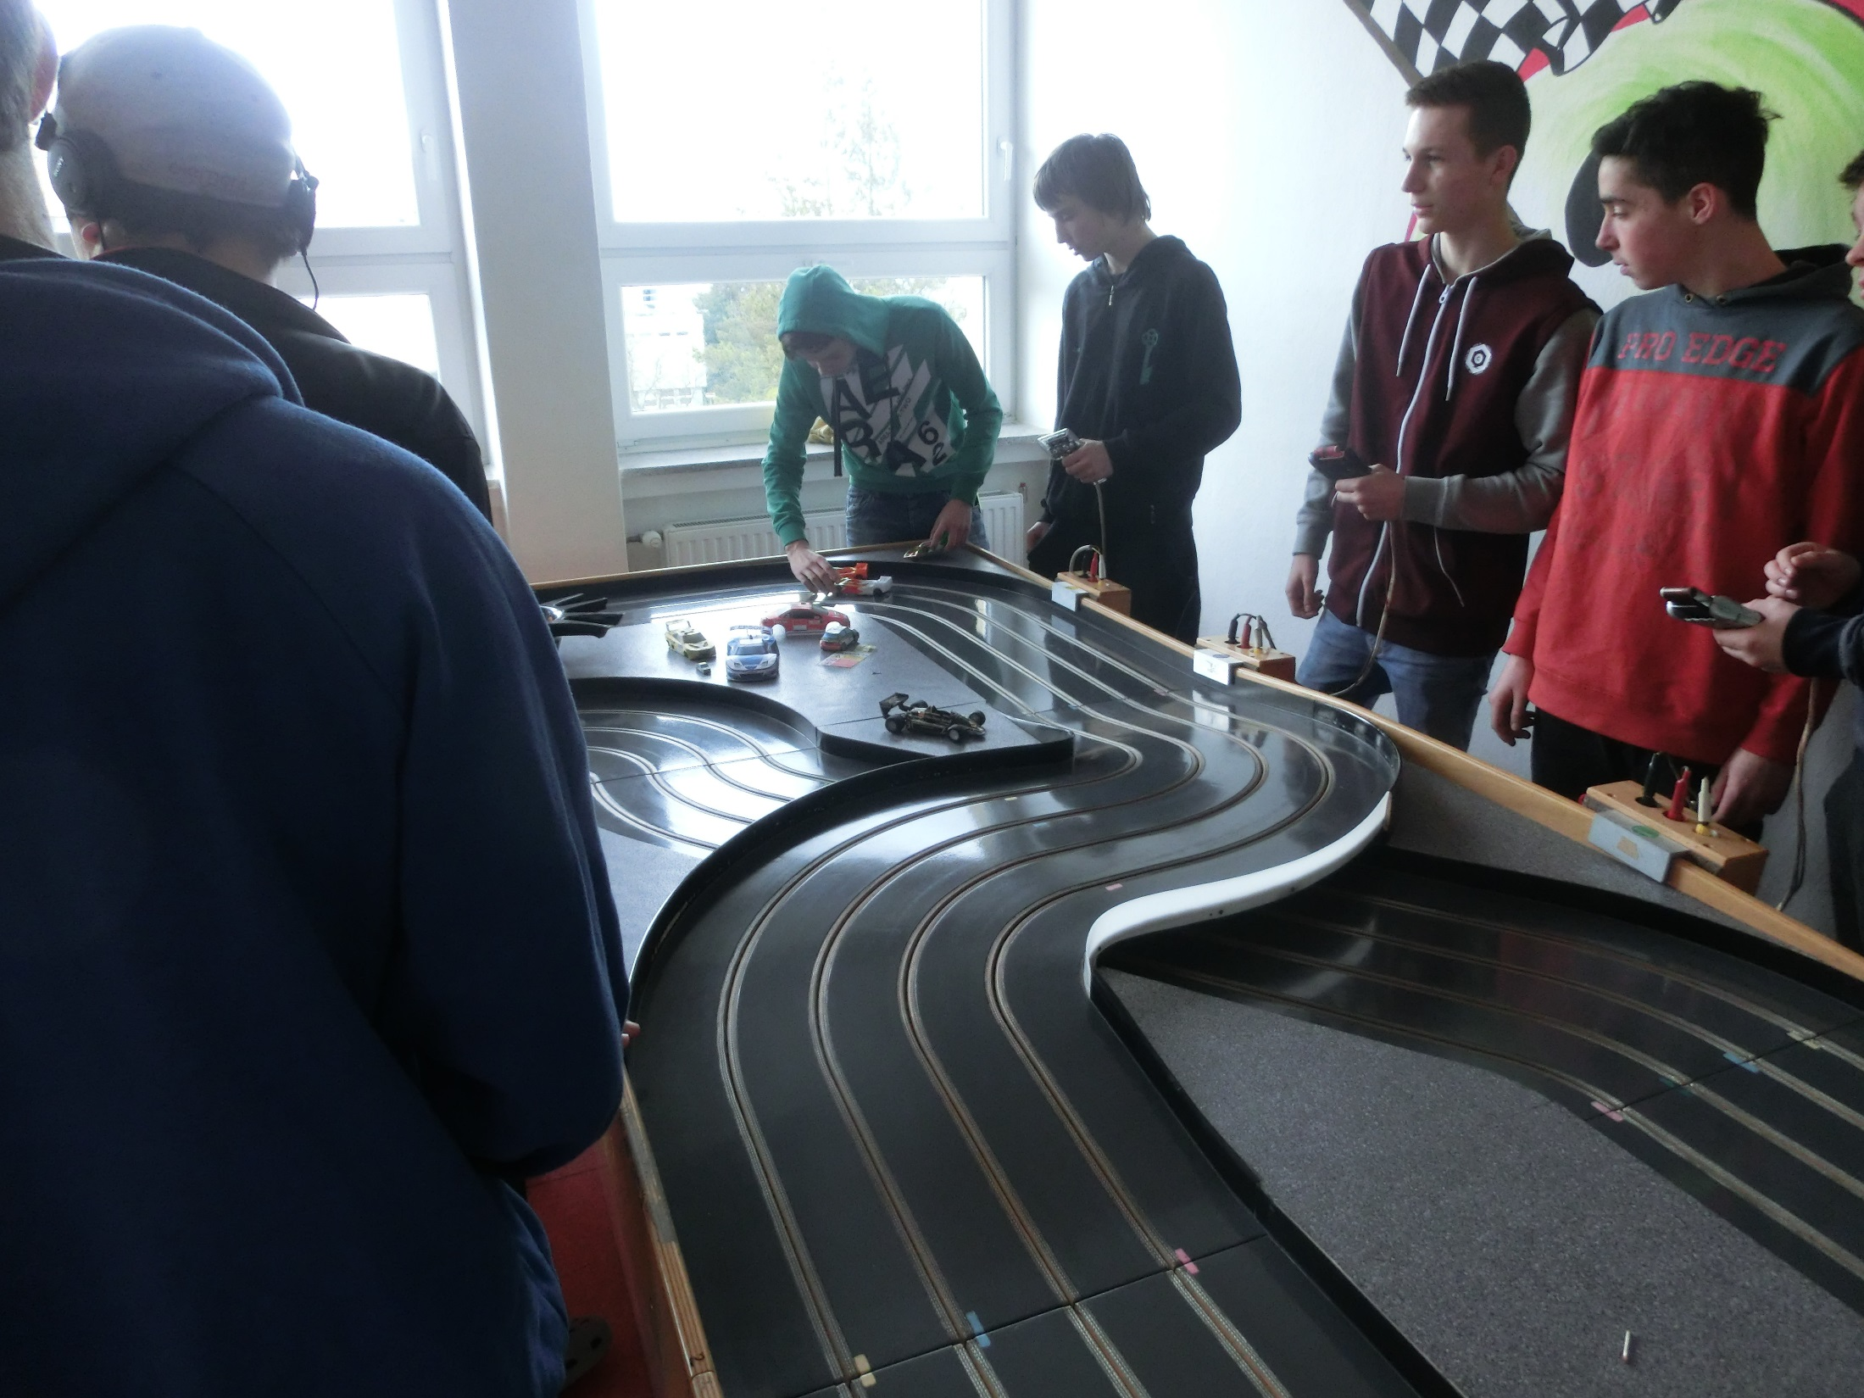

Slide 8
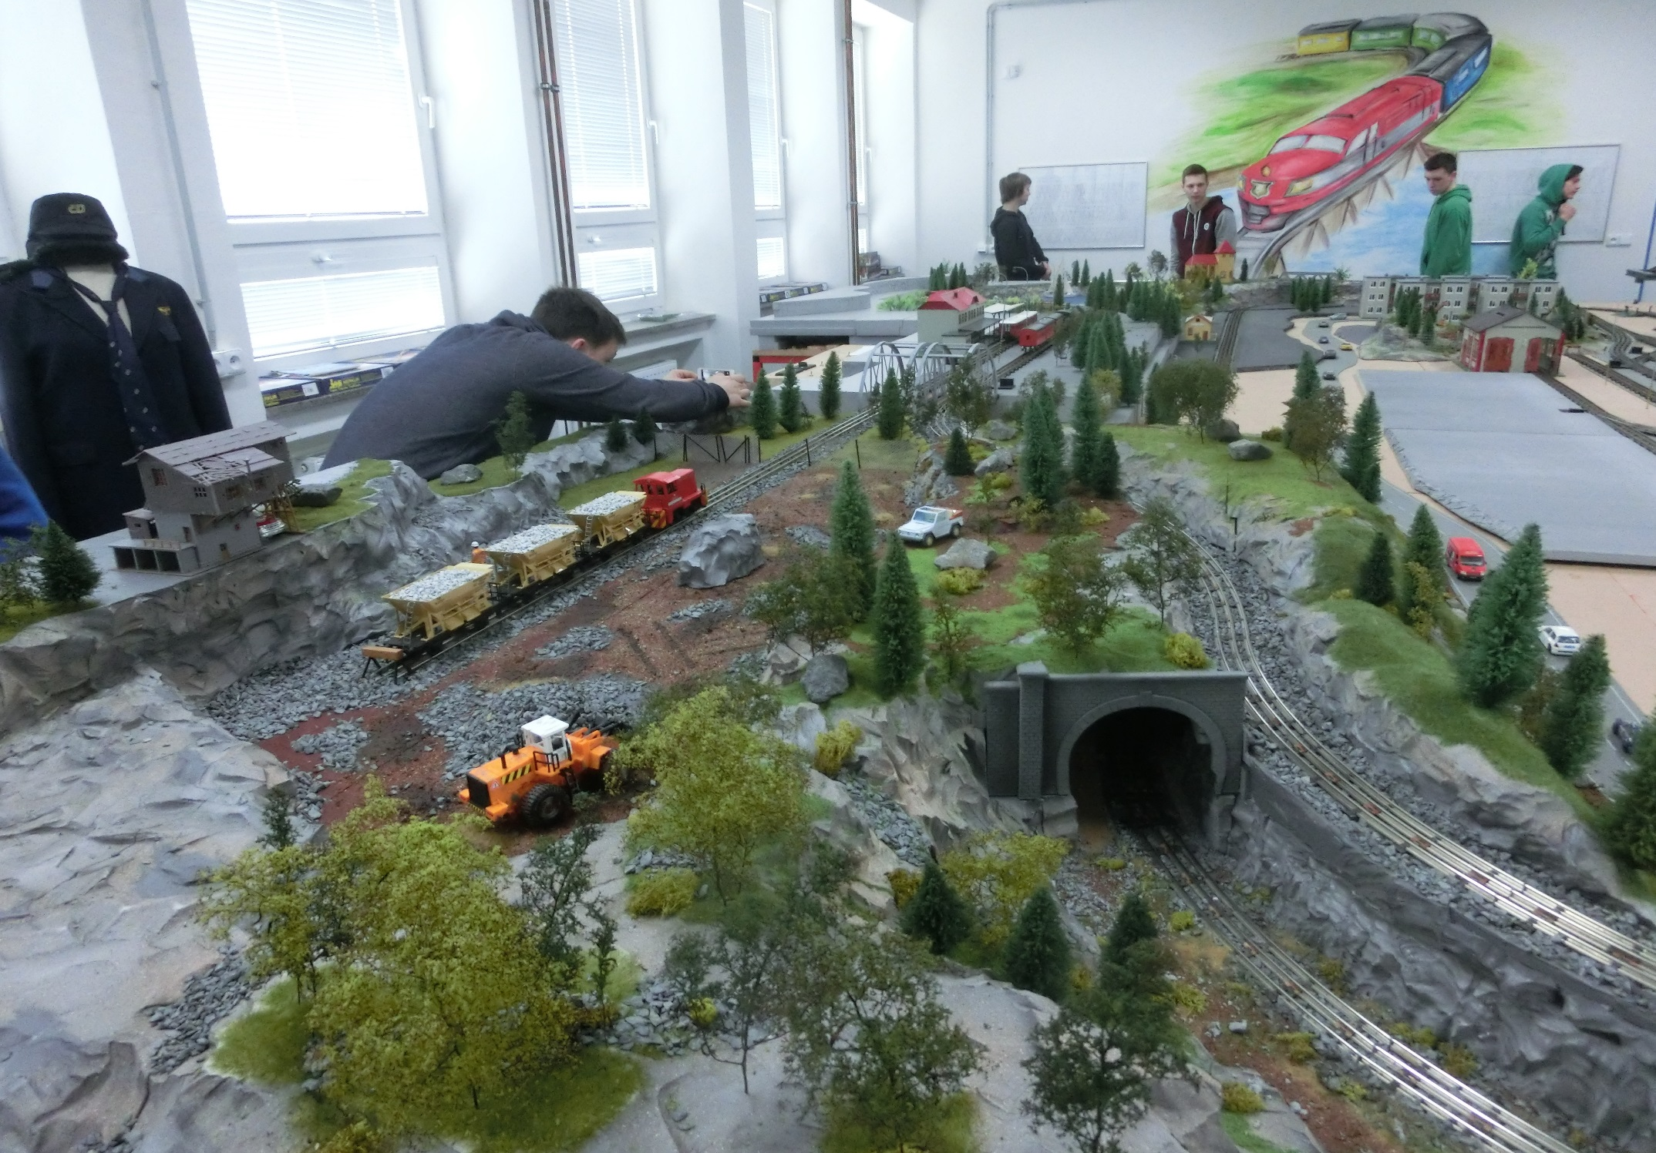
All photos has been taken in Experimentarium

Slide 9
Thanks for watching.

