Slide 1
Brno and our school

Slide 2
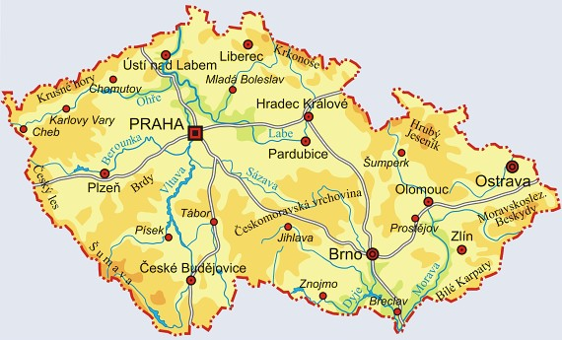

Slide 3
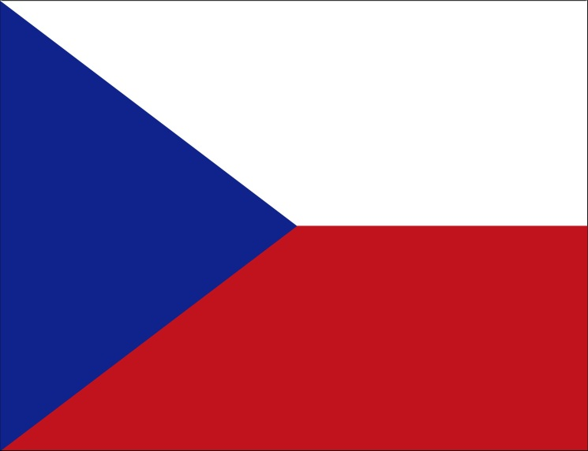
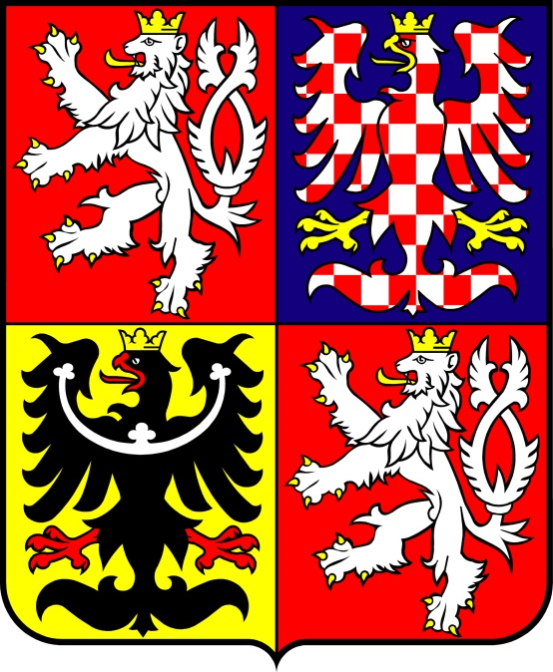
Basic Information
Brno is the centre of southern Moravia
It has the population of 400,000 and it is the second largest city in the Czech Republic.

Slide 4
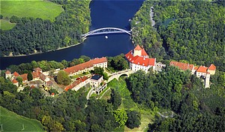
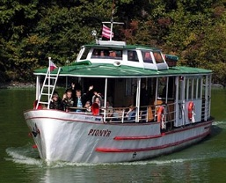
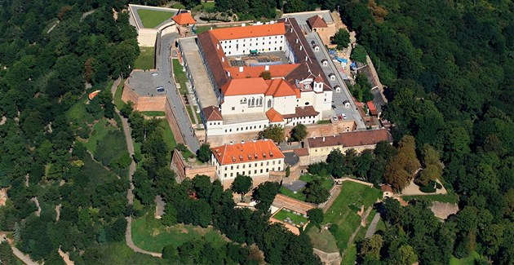
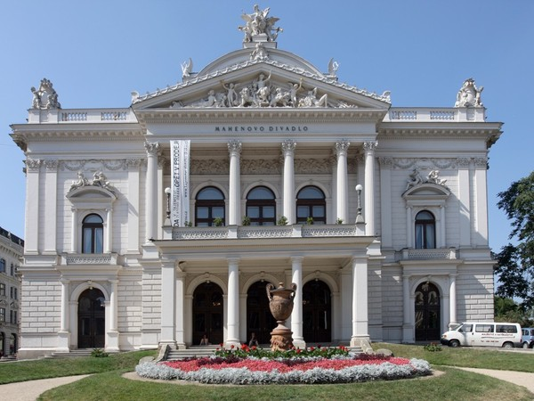
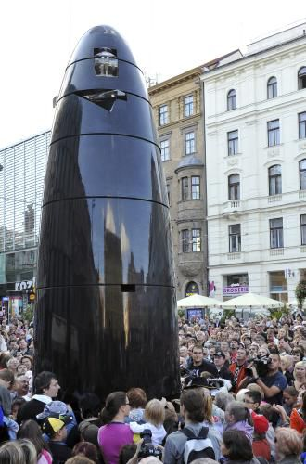
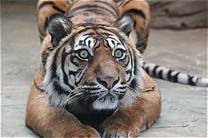

Slide 5
Petrov Cathedral
Špilberk Castle
Svoboda Square (public clock)
Mahen Theatre, Janáček Theatre
ZOO

Slide 6
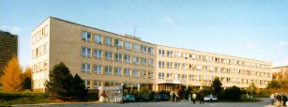
This is our school
A lot of branches
are studied here: IT, Electro, Ecology,
Social Welfare Administration
and Business and Economy

Slide 8
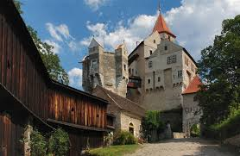
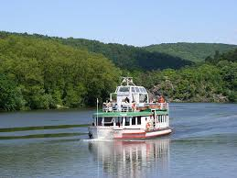
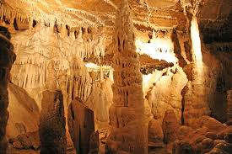
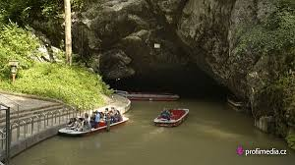
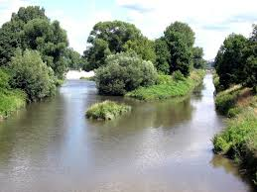

Slide 9
Brno Lake
Junction of two rivers (the Svratka and Svitava)
Pernštejn Castle
Moravian Karst (Macocha Abyss)

Slide 10
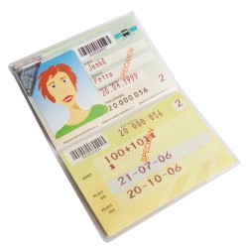
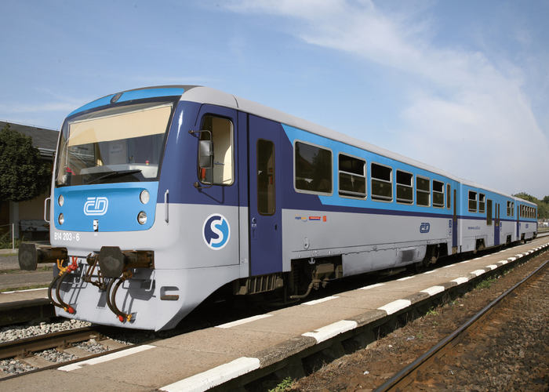
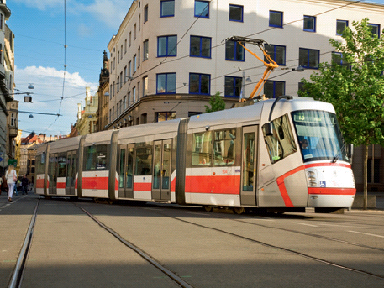
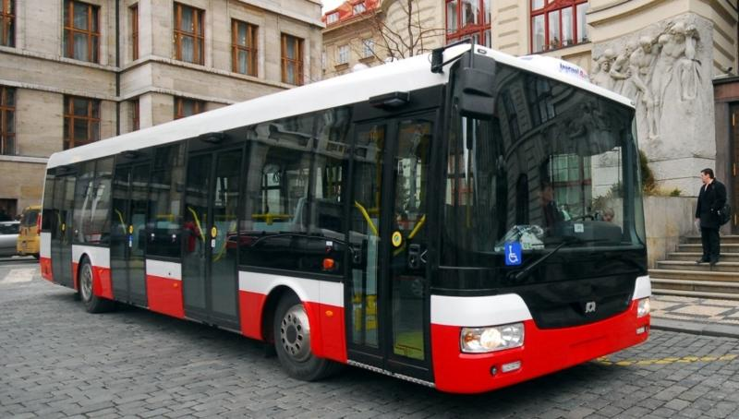
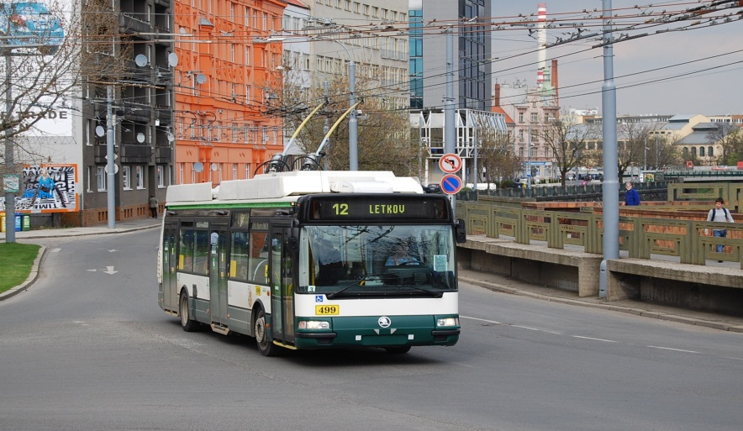
Transport
By public transport: trams, buses, trolley buses, trains

Slide 11
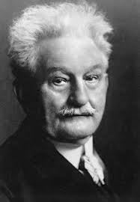
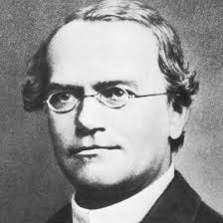
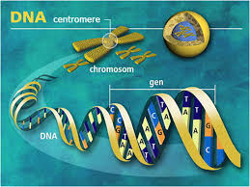
Other interesting facts:
Leoš Janáček, world known
composer lived here
Johan Gregorius Mendel, founder of genetics lived and
worked here

Slide 12
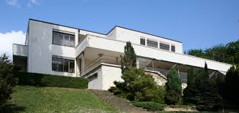
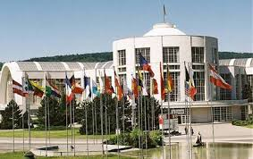
Villa Tugendhat – example of functionalist architecture
(UNESCO World
Heritage List)
Trade fairs

Slide 13
The End

