Slide 1
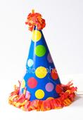
HAPPY BIRTHDAY!!!
10 YEARS!!!

Slide 2
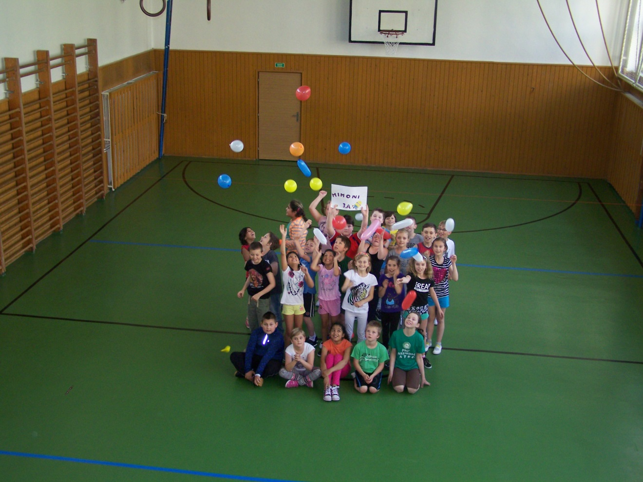
MIMONI 3.A
ZŠ Petra Bezruče 2000, Žatec

Slide 3
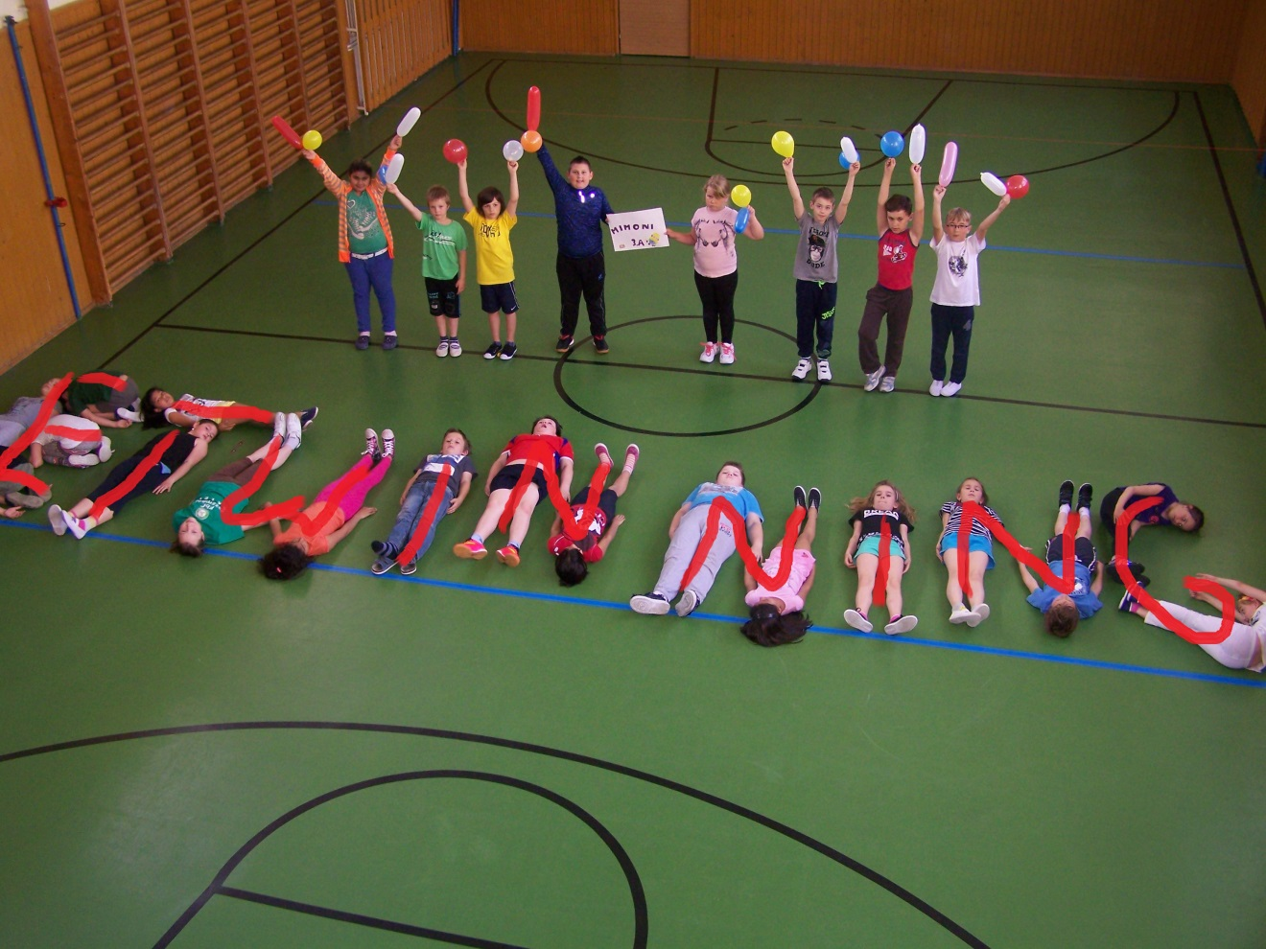
WISH YOU A HAPPY BIRTHDAY!!!

