Slide 1
Mr. Quick Comes
Latvian test in Ostrava

Slide 2
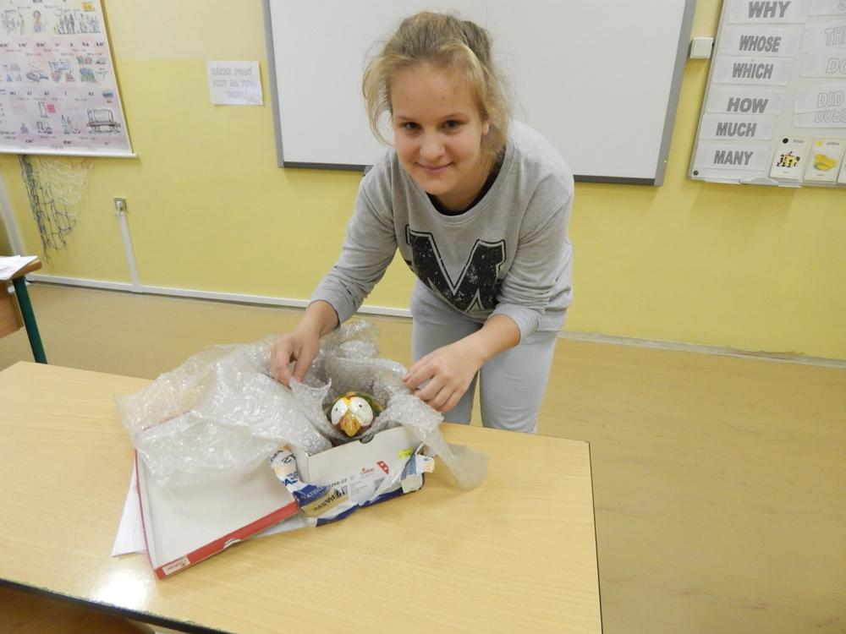
Mr. Quick arrived a little bit damaged.

Slide 3
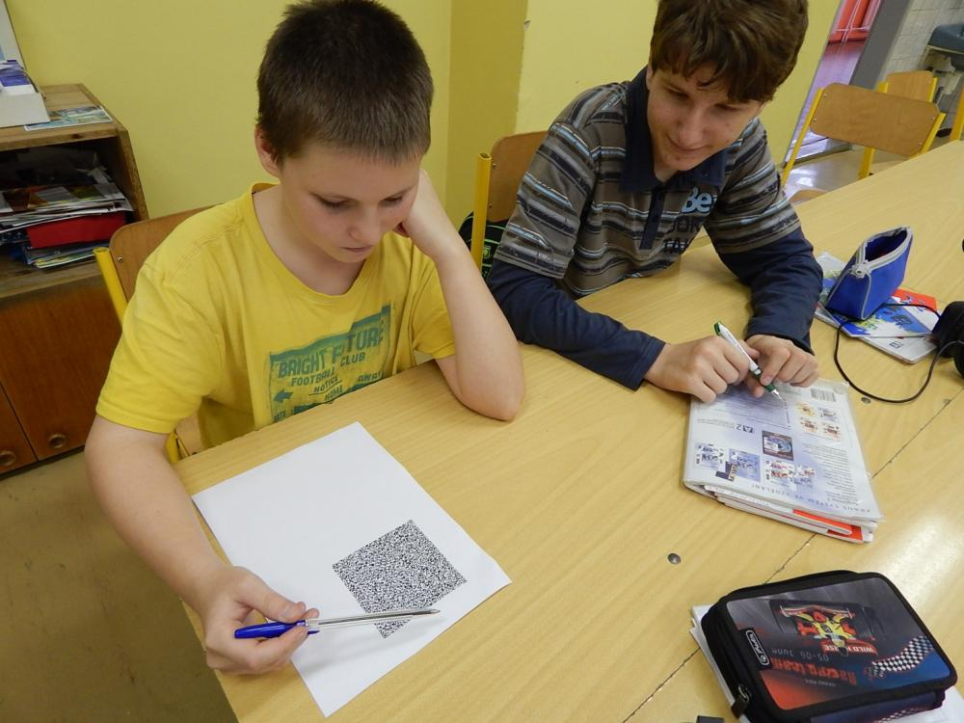
He brought a strange picture.

Slide 4
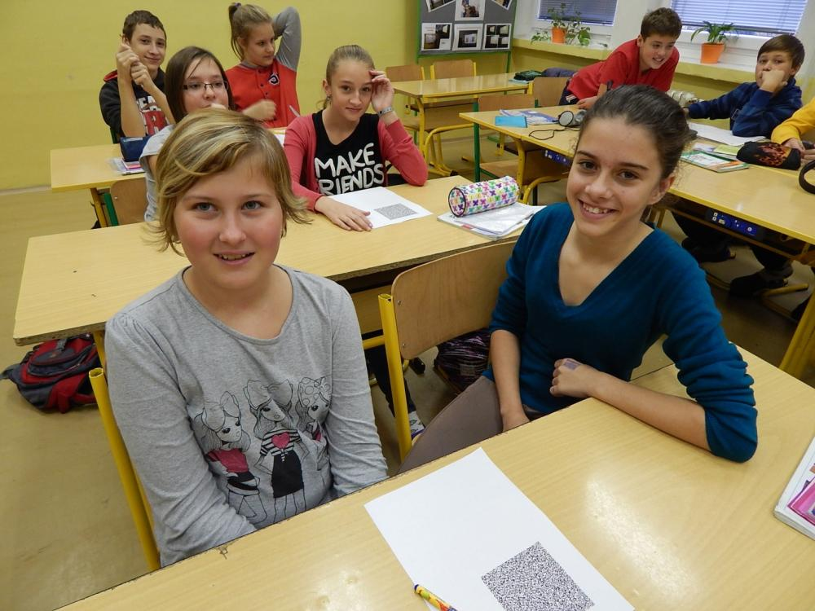
We know what this code means ☺

Slide 5
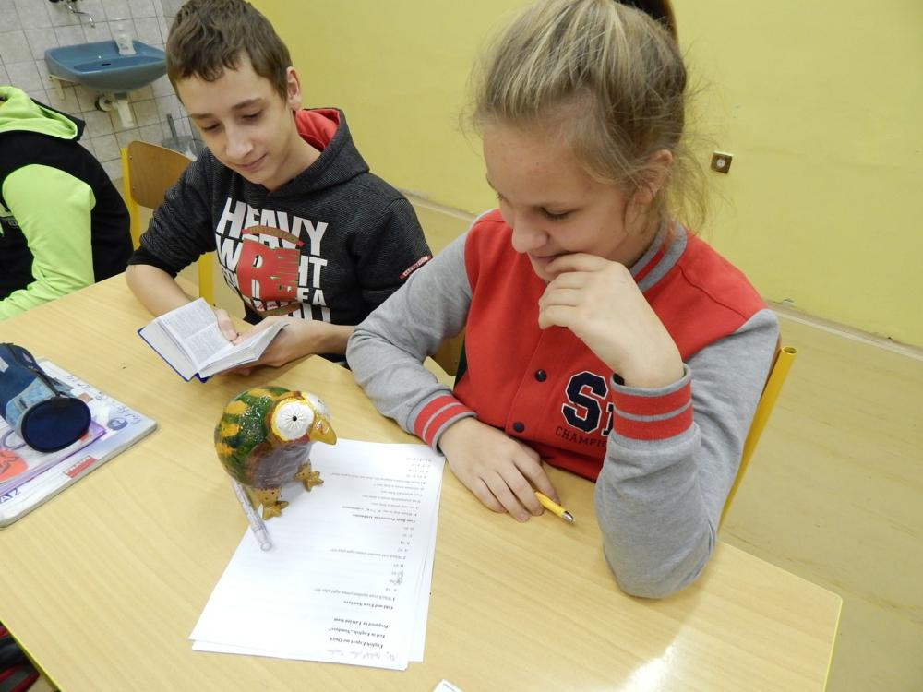
But the test is really difficult.

Slide 6
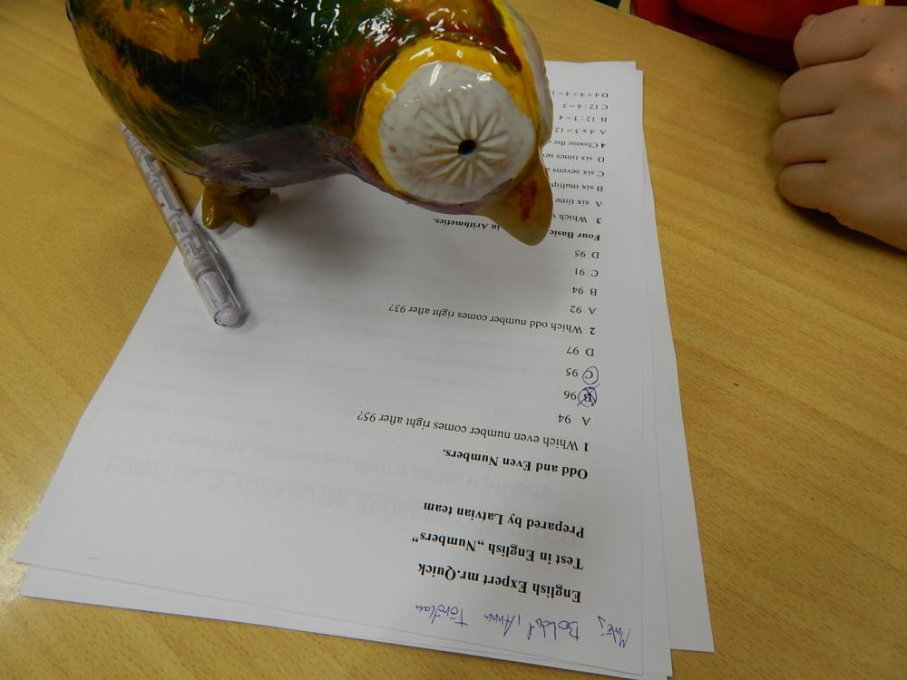
Mr. Quick comes to help.

Slide 7
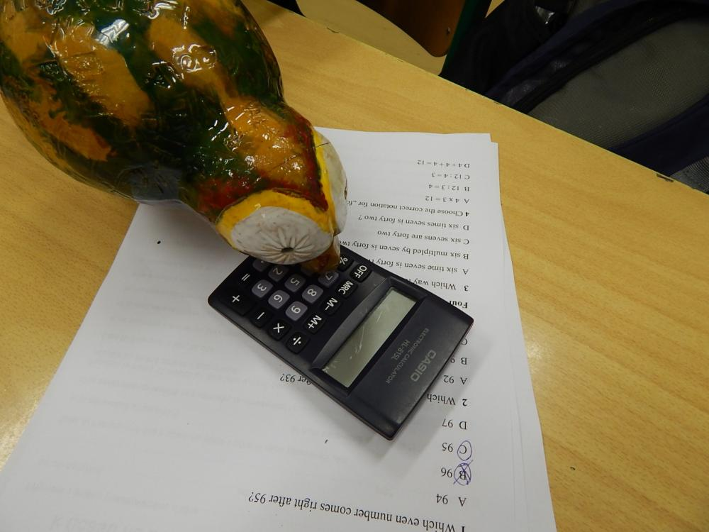
Now it is not difficult anymore.

Slide 8
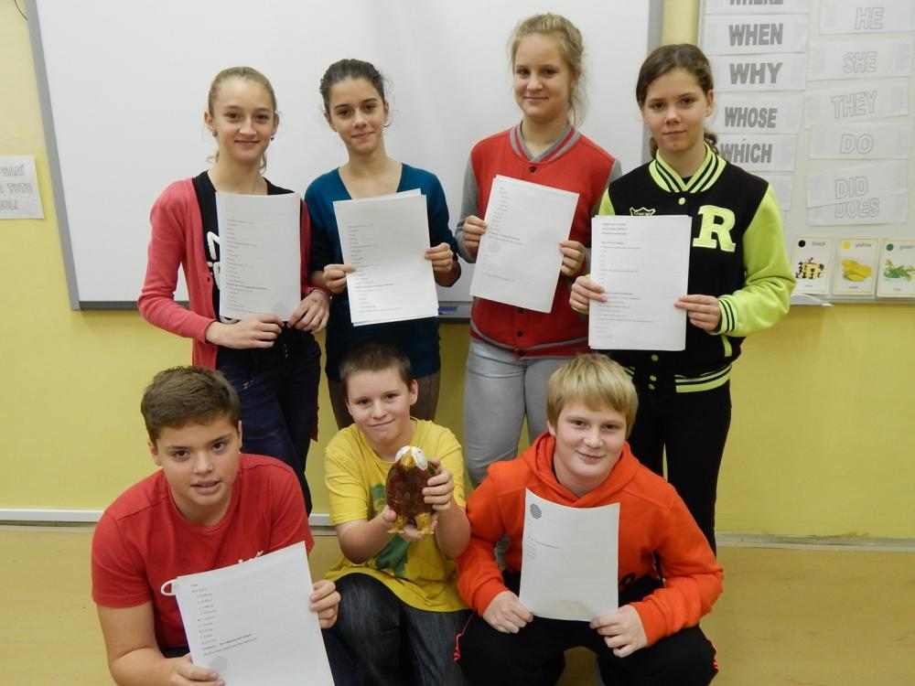
Captains of 6 teams with their results.

Slide 9
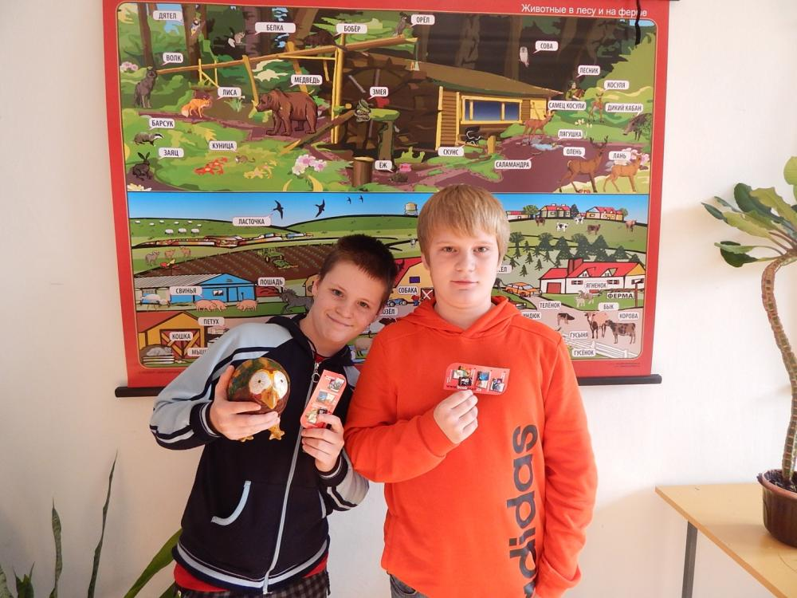
There were 2 teams with 14 points.
This team lost in the extra task.

Slide 10
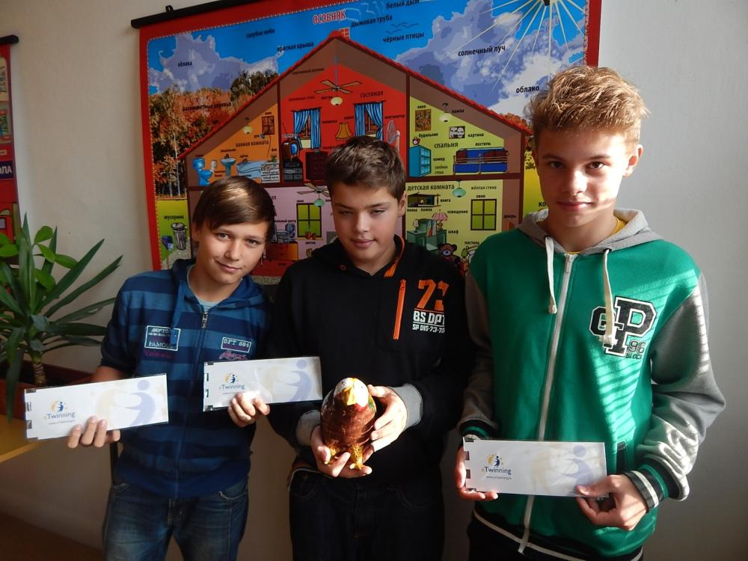
Winning team in the Latvian test.

