Slide 1
Hrajeme si s eTwinningem We are playing with eTwinning
SOŠ Blatná
Twobees
2015

Slide 2
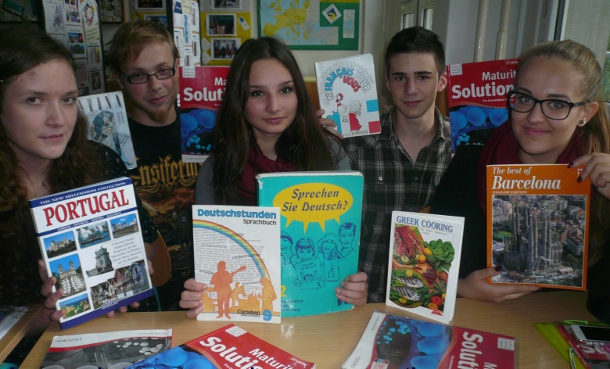
We introduce ourselves

Slide 3
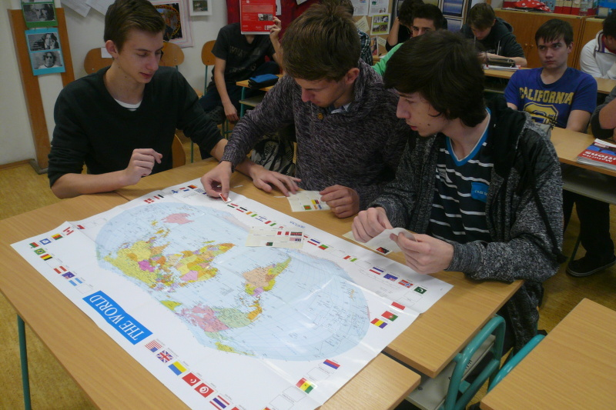
We are thinking

Slide 4
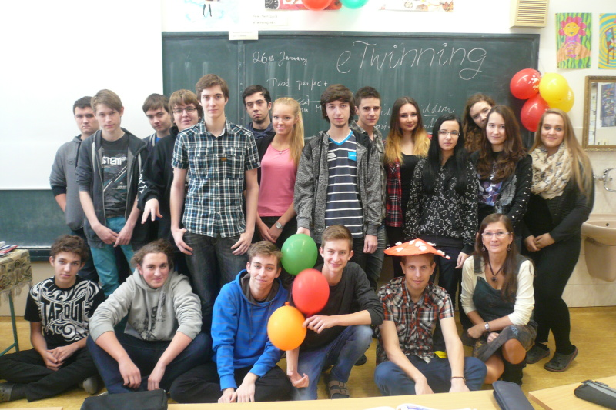
We celebrate eTwinning Day

Slide 5
How we study?

Slide 6
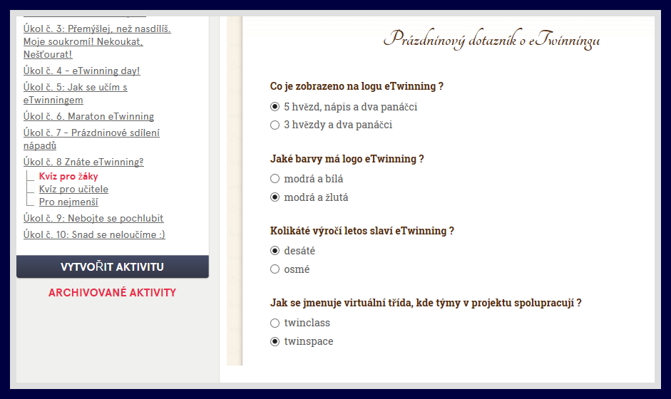
We know about eTwinning

Slide 7
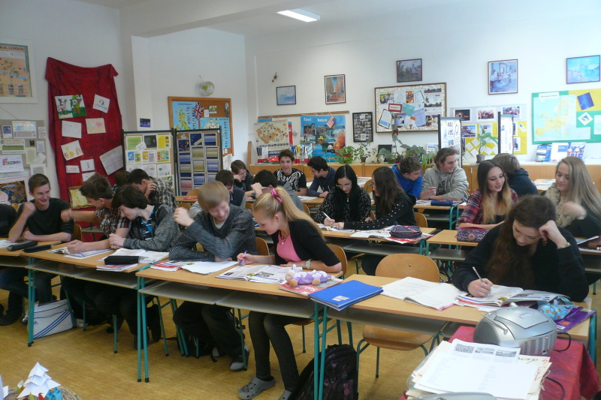
We share our experience

Slide 8
We are creative

Slide 9
Good luck for all etwinners!

