Slide 1
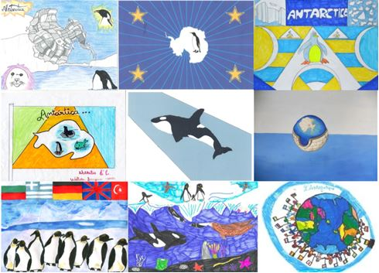
Antarctica Day 2021 – Flag Competition
Design a flag for Antarctica – what do you think their flag should look like?
The winning flag will be sent to Antarctic researchers and scientists who are visiting Antarctica this year. This is an exciting opportunity to have something you have designed go GLOBAL! Every school that enters will have a flag sent to Antarctica. This year 70 schools have entered.
An e-mail will be sent back to Kingsthorpe College with a photo and a certificate. The event will be documented on the UK Polar Network website and their social media feed. Mrs Sheriff is part of the UK Polar Network and she looks forward to receiving your flags to send on to the researchers and scientists!
Your flag should be colourful – avoid a white background as this won’t show up in front of the snow!
It can be hand drawn or drawn using a computer.
There will be a winner for each form and an overall winner!
Closing date : 15th November 2021
Flags to be returned to: Mrs Sheriff

Slide 2
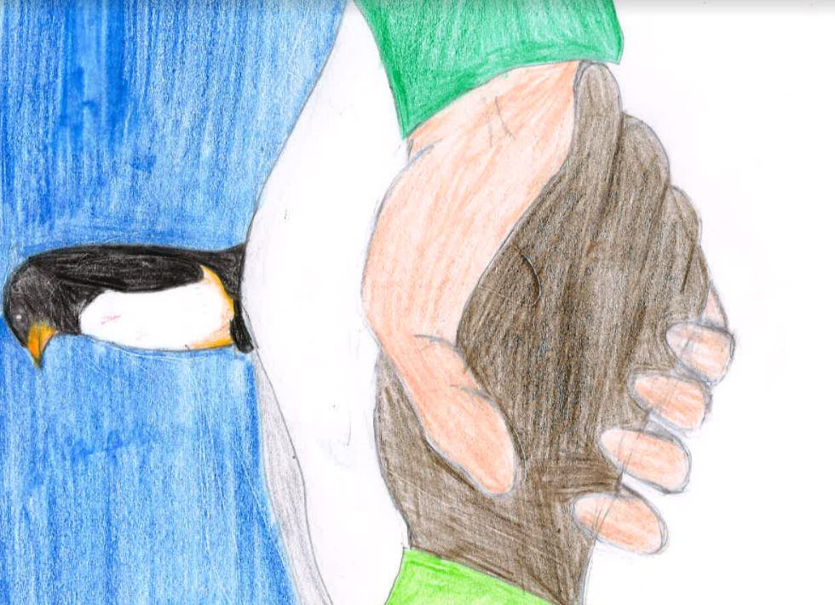
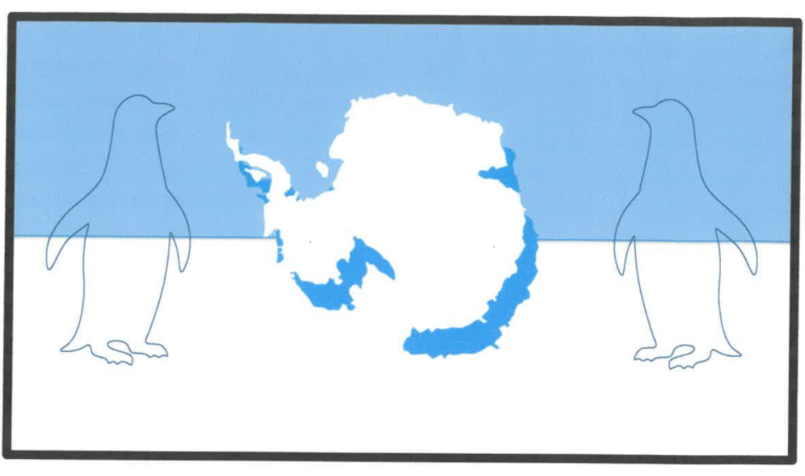
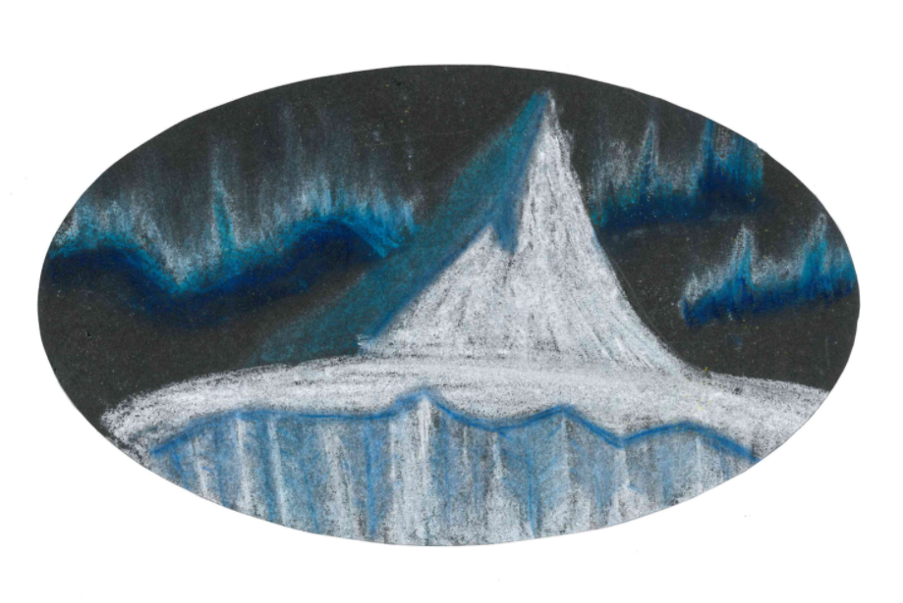
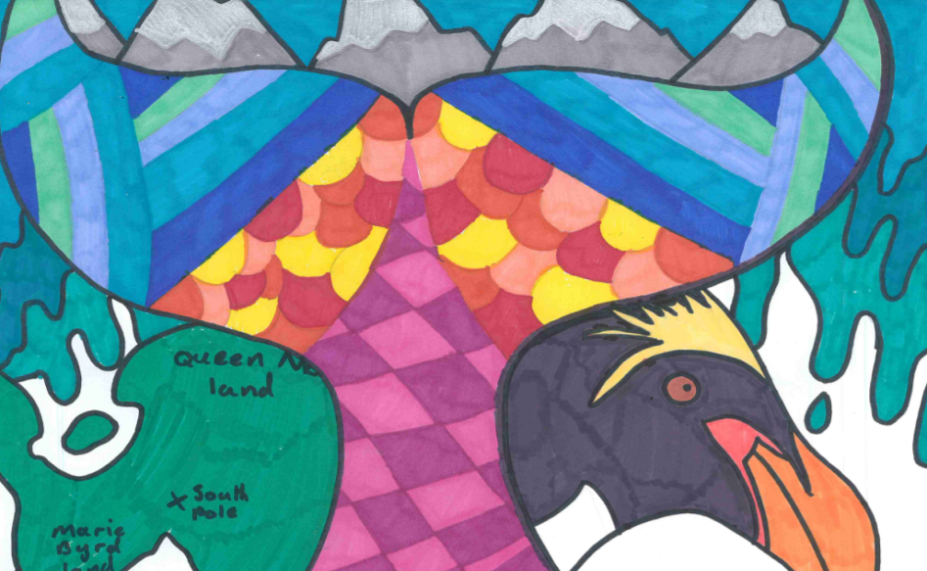
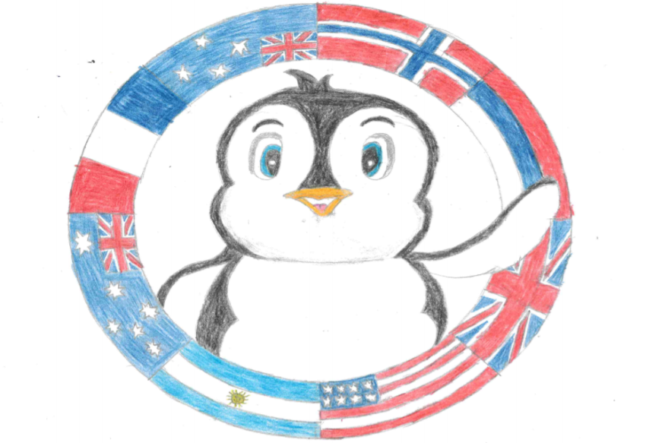
Inspiration – these flags went to Antarctica in 2019/2020

Slide 3
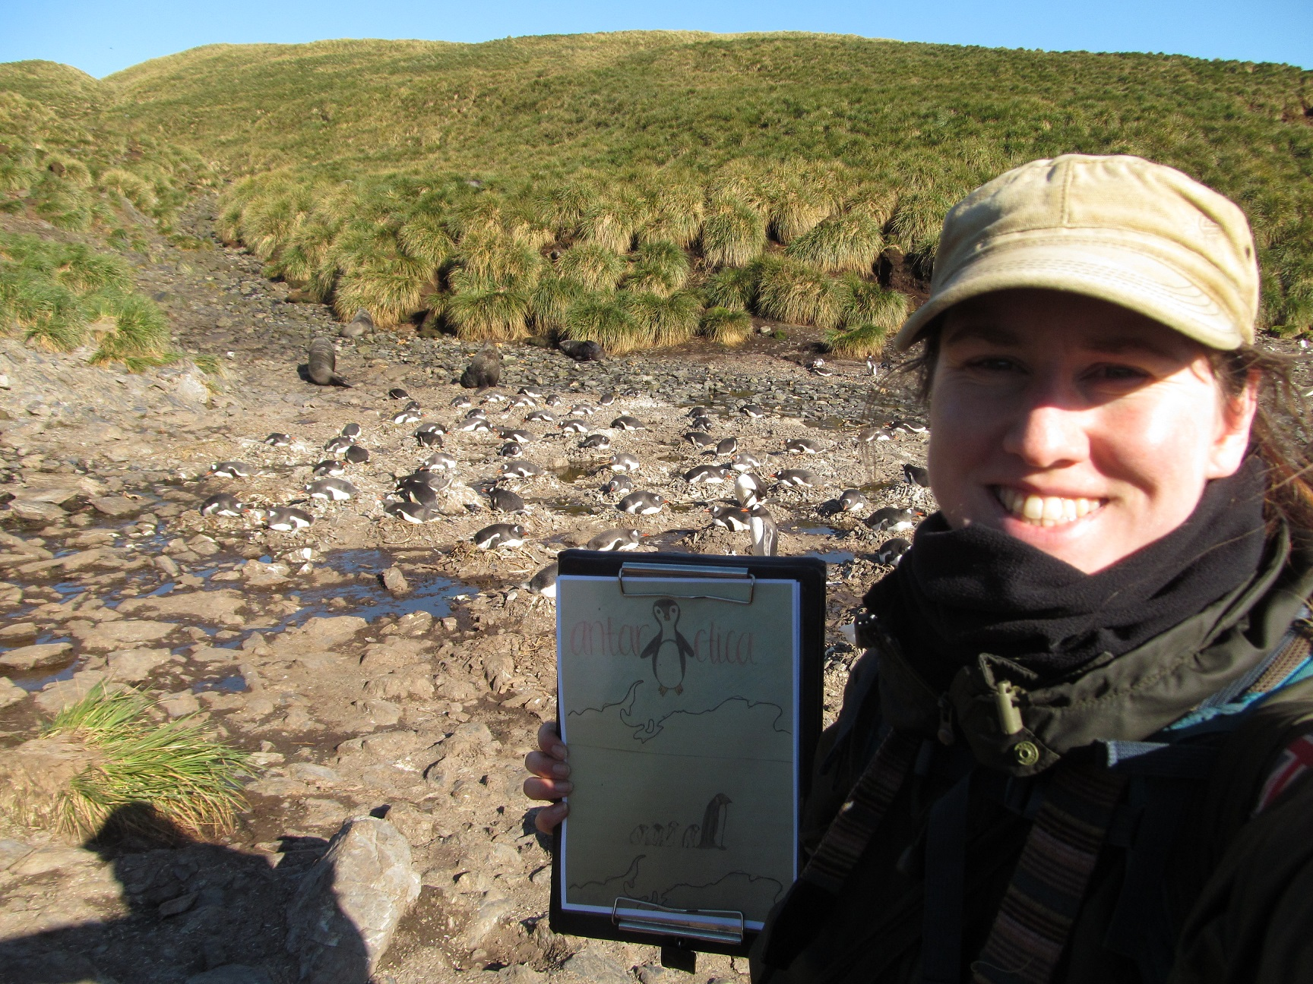
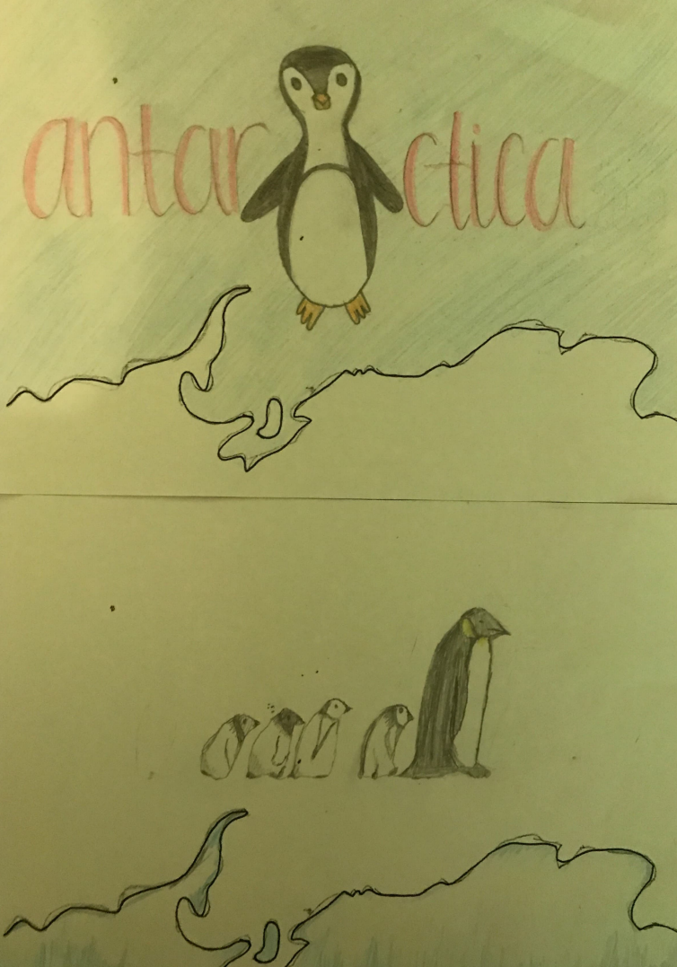
Kingsthorpe College Flag in Antarctica 2020

Slide 4
What could your flag include?
Wildlife such as penguins, seals, whales, fish and birds.
Flags from the countries that have signed the Antarctic Treaty.
Glaciers
Scientists
An outline of Antarctica
Top tips
Ensure your map is A4 in size.
Use bright, bold colours and solid colouring.
Avoid a white background.
Any lettering needs to be large.
Avoid anything to complicated – the best flags are simple!
Closing date: 15th November
Flags to be returned to: Mrs Sheriff in H6

