Slide 1
Antarctica Day Flags Project

Slide 2
Antarctica is the fifth largest continent of the world at 14 million square kilometres and is covered in a permanent continental ice. The ice is distributed in two major ice sheets, the East Antarctic and the West Antarctic, plus there’s shelf ice, extending over the sea water.
Map copyright: Woolwine-Moen Group

Slide 3
Unlike the Arctic, which at its centre is an ocean, Antarctica is a landmass that is surrounded by the Southern Ocean. A permanent, massive ice sheet on Antarctica covers 98% of the continent and is containing the major freshwater reserves of the globe.
Photo by Peter Prokosch UNEP GRID Arendal Photo Library

Slide 4
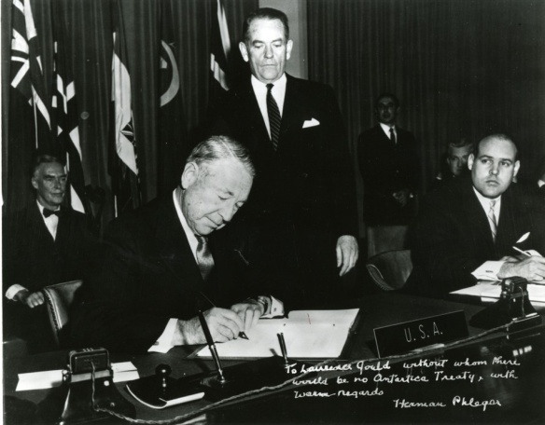
HISTORY
62 years ago, on 1st Dec. 1959 - 12 Nations signed the Antarctic Treaty, setting aside 10% of the Earth,
“ forever to be used exclusively for peaceful
purposes in the interest of mankind.”
It was the first nuclear-arms agreement. Nuclear weapons cannot be used in Antarctica.
The first institution to govern all human activities in an international region with no sovereign jurisdiction.
As a legacy to the 50th Anniversary of the Antarctica Treaty, OUR SPACES initiated Antarctica Day in 2010.

Slide 5
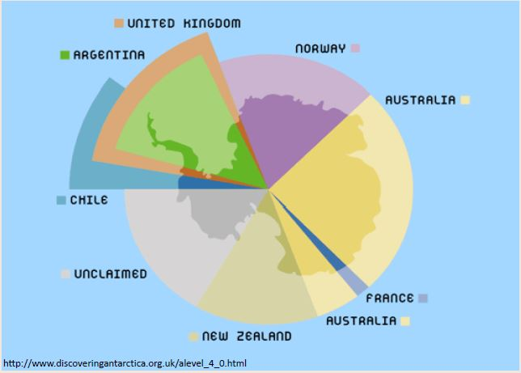
All territorial claims to Antarctica were set aside by the Antarctic Treaty

Slide 6
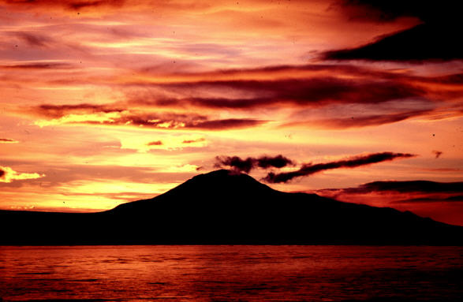
Article VI
1959 ANTARCTIC TREATY
Preamble Interest of all Mankind
Article I Peaceful Purposes Only
Article II Freedom of Scientific Investigation
Article III International Cooperation in Scientific Investigation
Article IV No Basis for Asserting, Supporting or Denying Claims
Article V No Nuclear Explosions or Radioactive Waste Disposal
Article VI Area of Application South of 60º South Latitude
Article VII Freedom of Access and Inspection by Designated Observers
Article VIII Jurisdiction by the Contracting Parties over their own Nationals
Article IX Consulting and Recommending Measures of Common Interest
Article X Consistent with Charter of the United Nations
Article XI Resolve Disputes by Peaceful Means
Article XII Antarctic Treaty Modifications and Amendment
Article XIII Accession and Ratification
Article XIV Official Languages and Depository Government
Notes:
The Antarctic Treaty has 14 articles and was signed by 12 Nations in 1959.

Slide 7
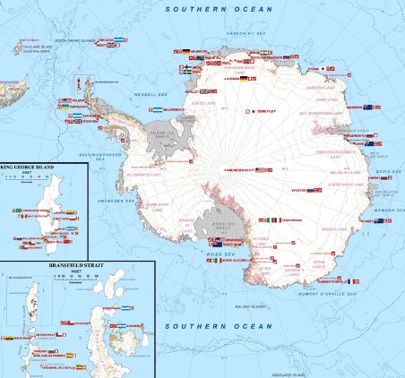
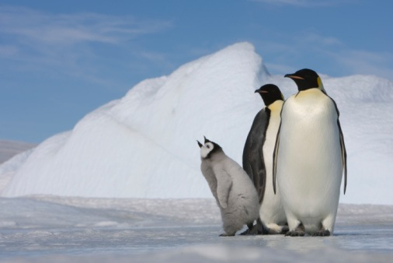
30 countries all signatories to the Antarctic Treaty operate seasonal and year-round research stations on the continent.
Notes:
http://en.wikipedia.org/wiki/Research_stations_in_Antarctica

Slide 8
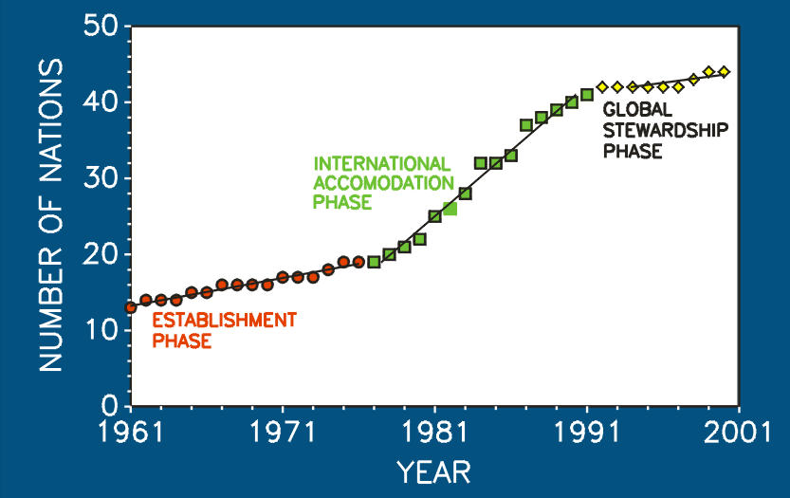
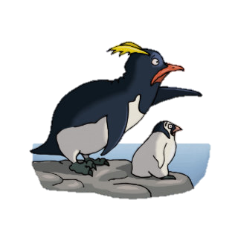
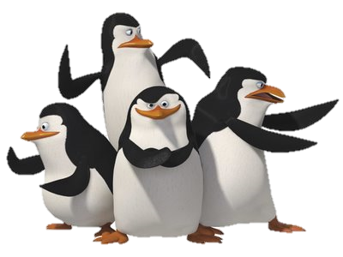
The number of nations Signatory to the Antarctic Treaty increased from the 12 original to 52 nations in 2015!

Slide 9
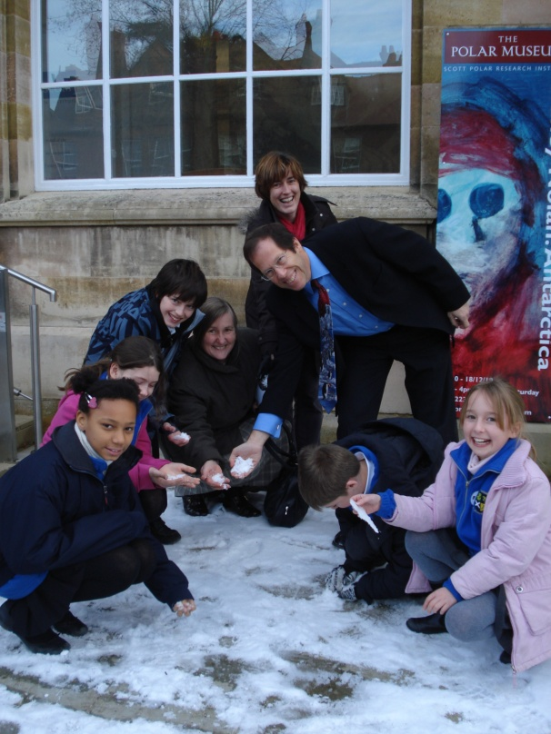
GOALS OF OUR PROJECT
To teach about Antarctica as a place on our planet where nations work together sharing their scientific research to peacefully manage 10% of the earth
To create flag designs for Antarctica, reflecting student’s interests and inspiration
To connect classroom activities with scientists and educators in Antarctica

Slide 10
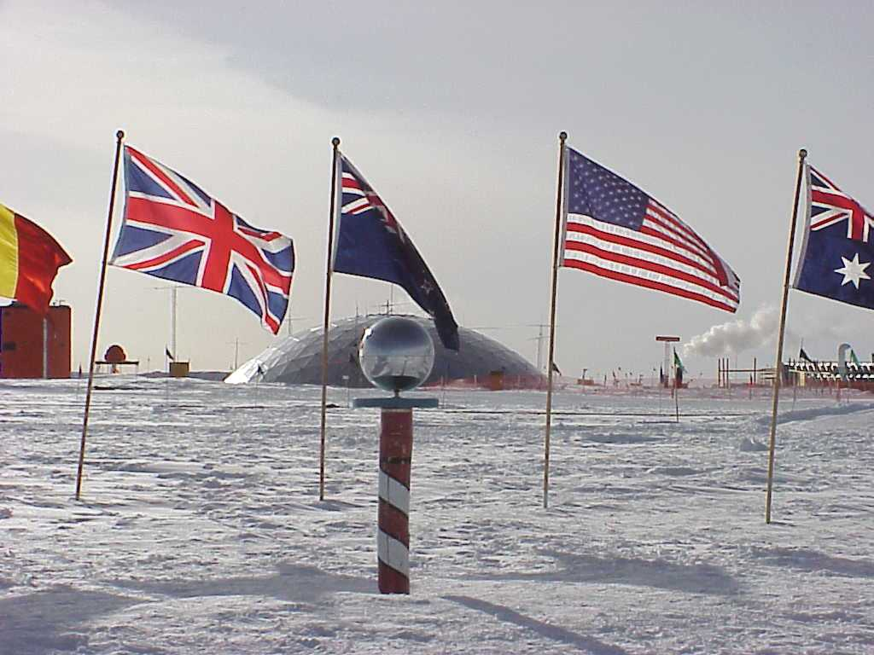
National flags are flown in Antarctica at the Ceremonial South Pole (shown). There is also a Magnetic South Pole and Geographic South Pole

Slide 11
Three Basic Principles of Flag Design
Keep it simple
The flag should be so simple that a child can draw it from memory.
Use meaningful symbolism
The flag’s images, colours, or patterns should relate to what it symbolizes.
Use 2–3 basic colours
Limit the number of colours on the flag to three, which contrast well and come from the standard color set.

Slide 12
What could you include on your flag?

Slide 13
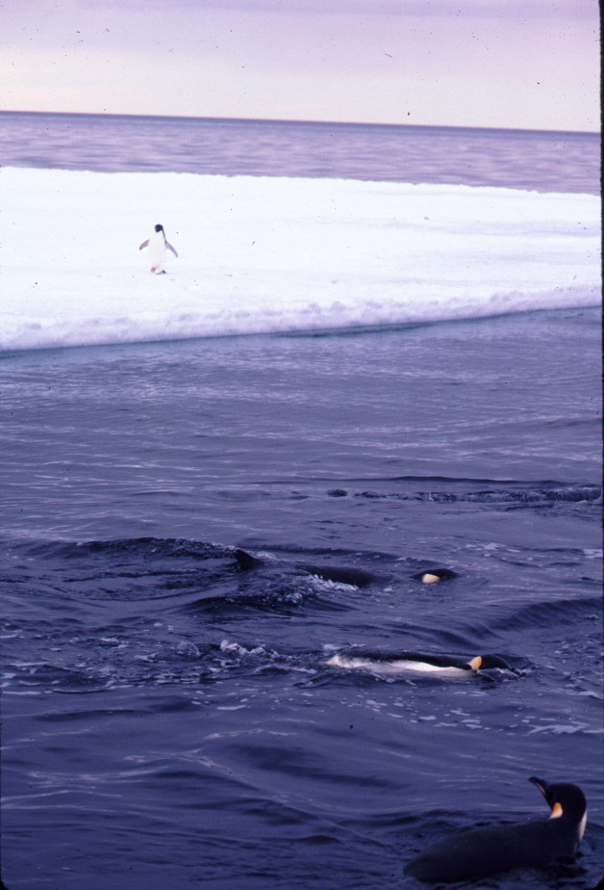
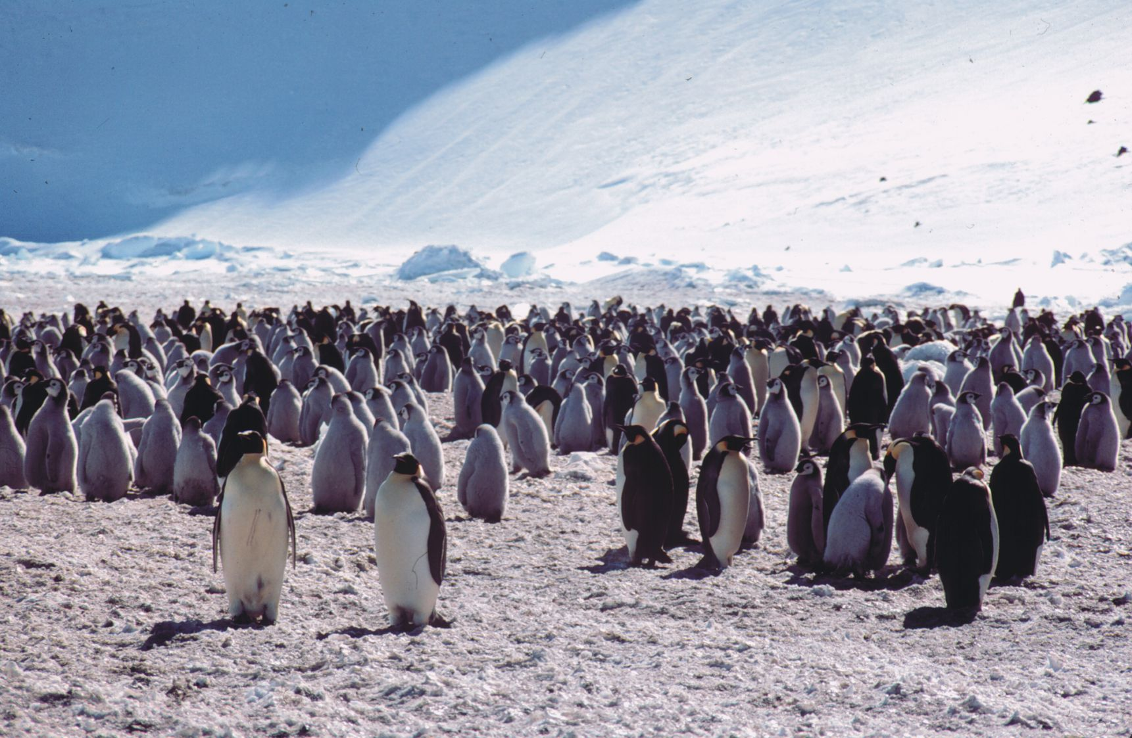
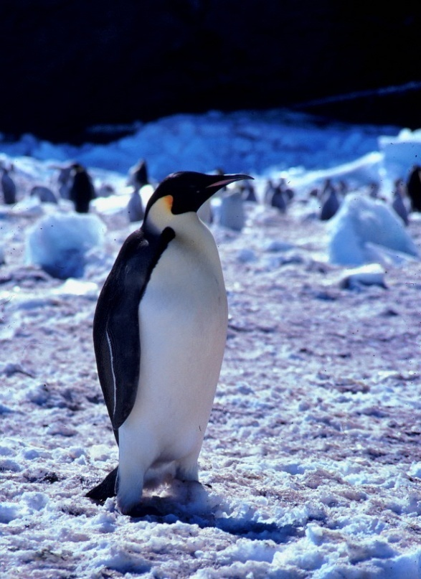
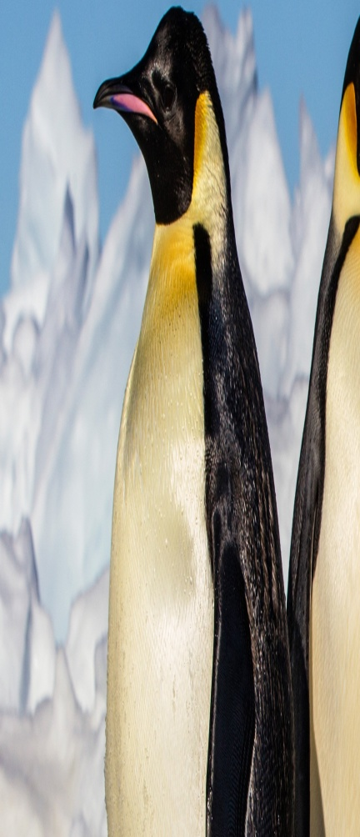
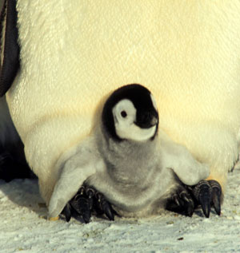
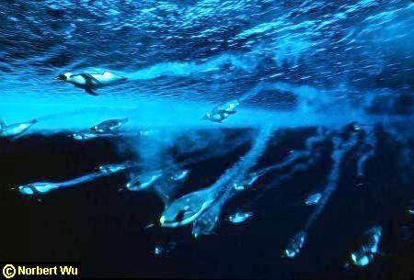
EMPEROR PENGUIN
Aptenodytes forsteri
http://www.antdiv.gov.au/

Slide 14
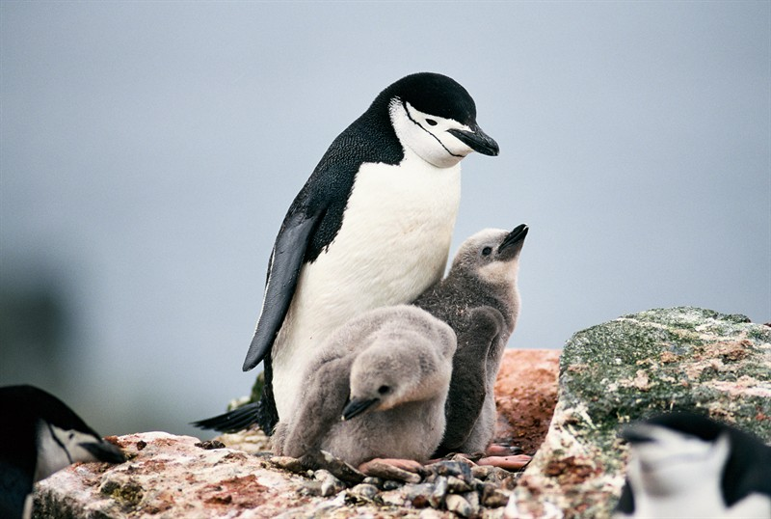
The small Chinstrap penguin forage near the shore for crustaceans, krill and fish and they use strong flippers and feet to crawl or jump up steep slopes. Unlike other Penguins, the Chinstrap Penguin does not preferentially feed the stronger of it's chicks and ensures that both are well-fed and cared for. Photo by Peter Prokosch Antarctic Penninsula

Slide 15
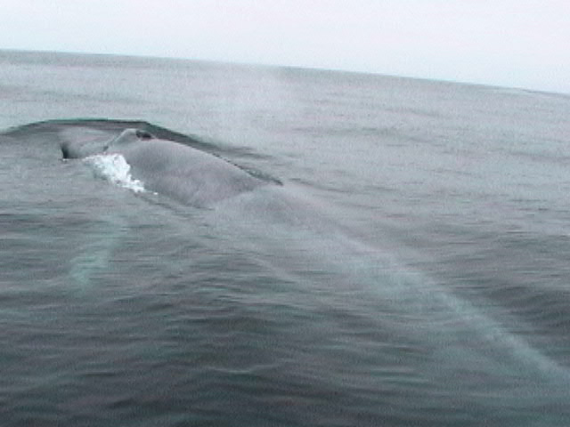
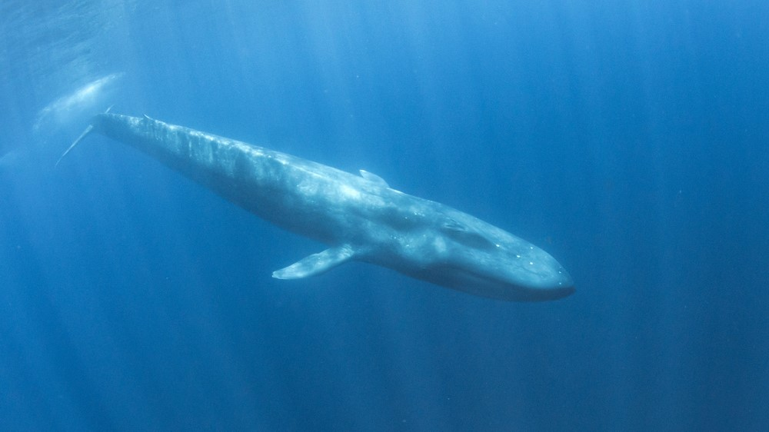
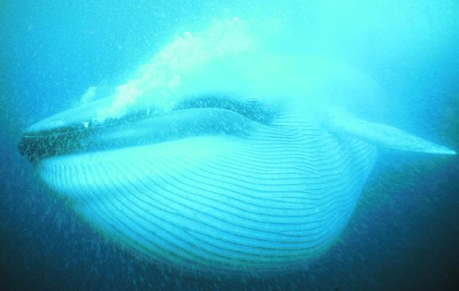
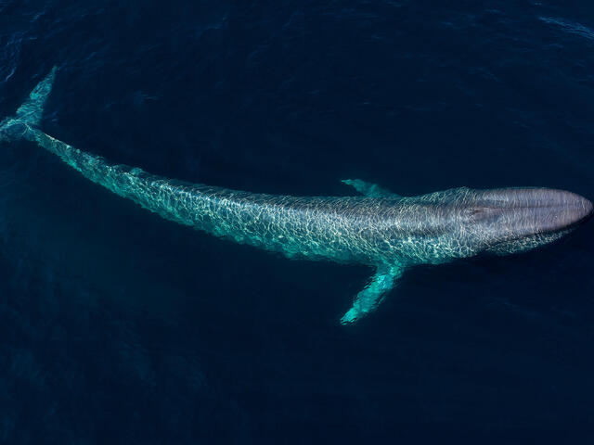
BLUE WHALE
Balaenoptera musculus
http://oregonstate.edu/
http://www.nhm.org/
Notes:
From Big to small –The Blue whale feeds by filtering water with krill and other plankton through baleen.

Slide 16
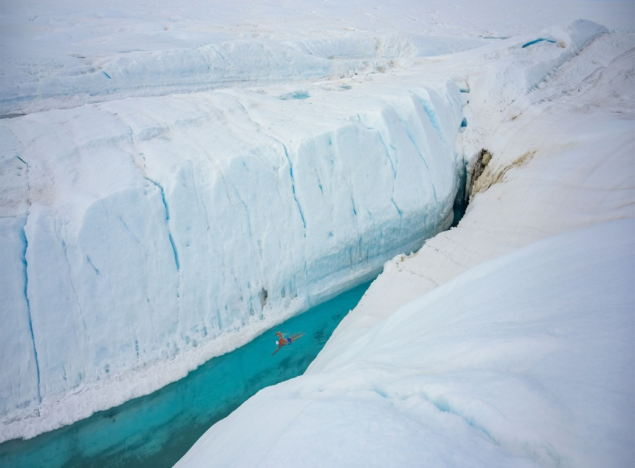
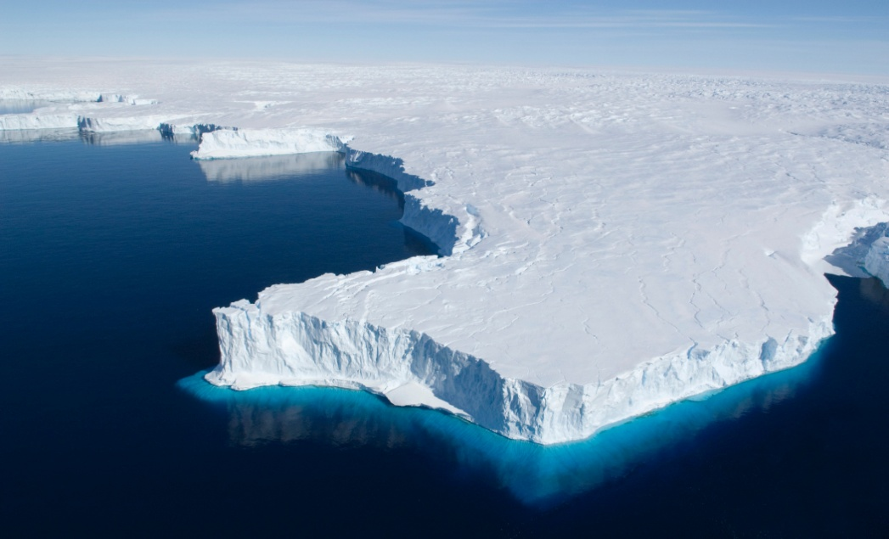
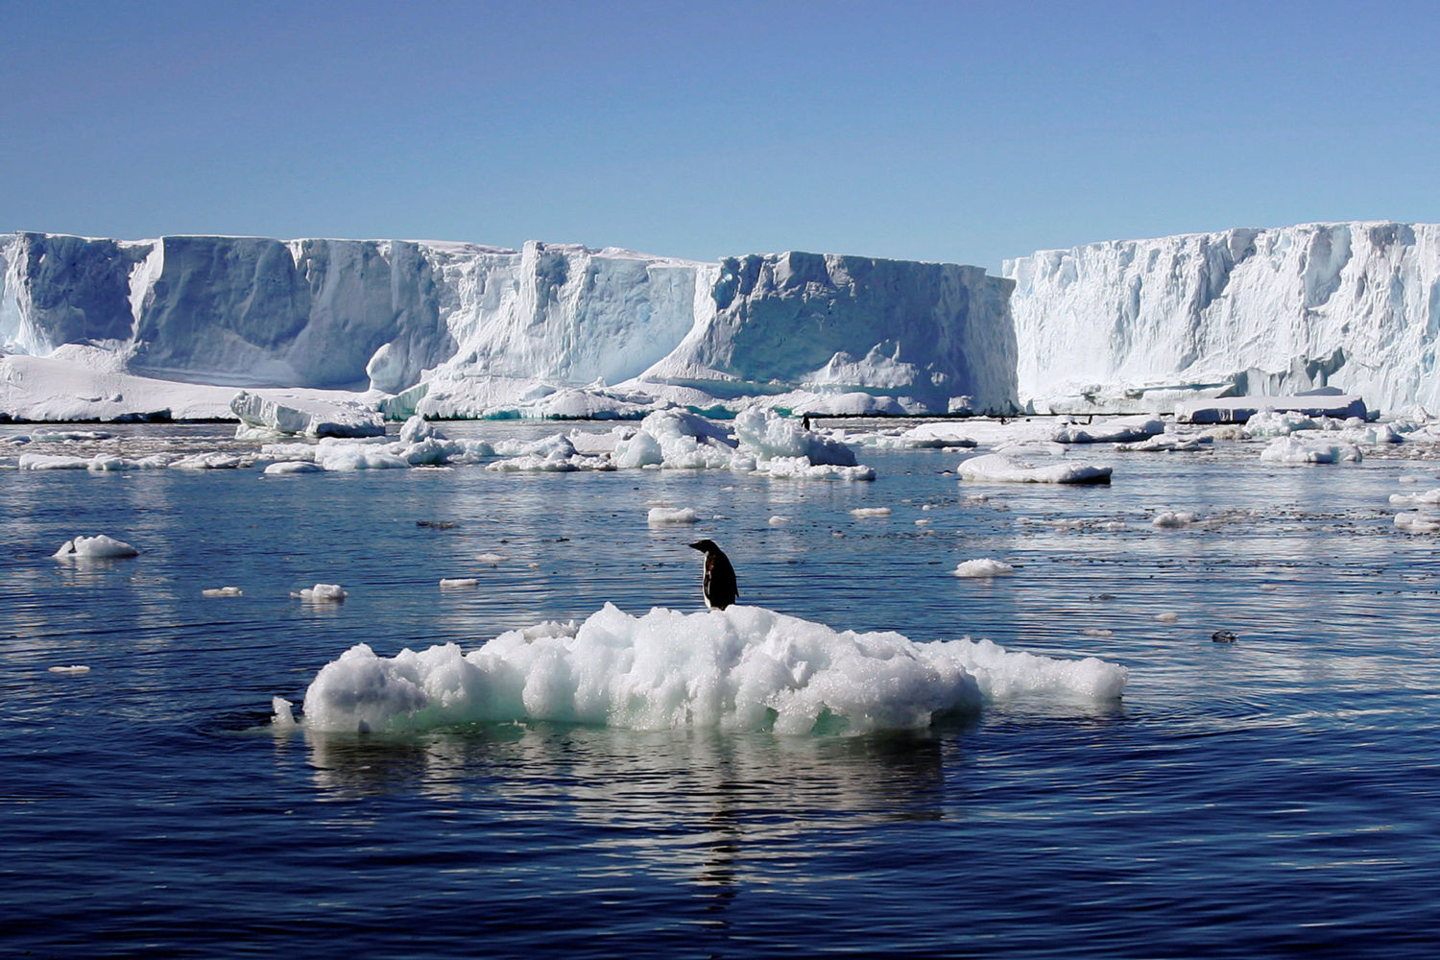
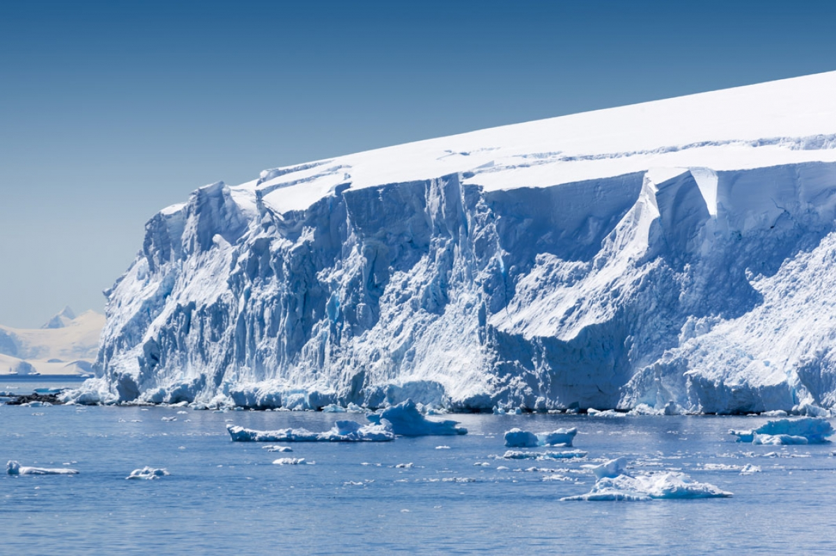
Antarctic Glaciers

Slide 17
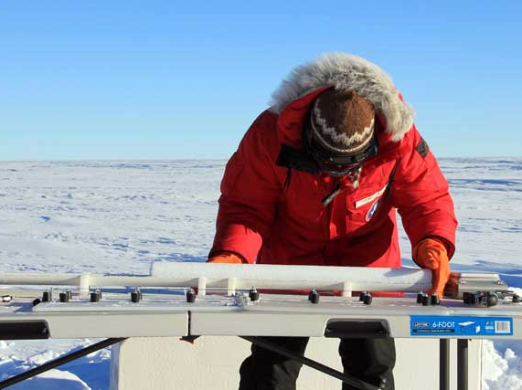
Antarctic Paleoclimatology
(Paleo = old) + (climat = climate) + (ology = the study of)
Using ice and sediment cores from Antarctica and the surrounding Continental shelf, scientists have learned a LOT about what Earth used to be like!
Photo Lora Koenig, USAP Photo Library

Slide 18
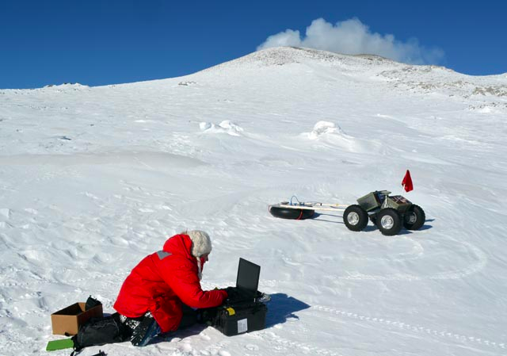
Antarctic Volcanology
One of only 5 long-lasting lava lakes in the world, Mount Erebus is a unique natural laboratory where we can study the dynamics of Planet Earth!

Slide 19
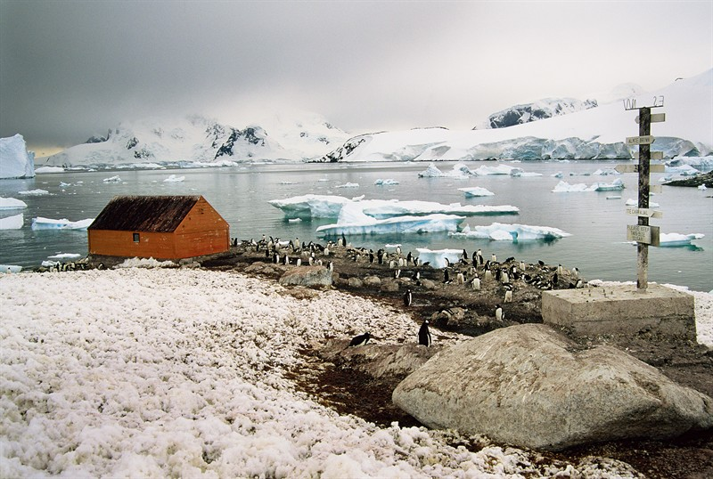
Gentoo Penguins at the Chilean Station. Breeding colonies are made up of hundreds of birds and are usually located a couple of kilometres from the sea. Photo by Peter Prokosch Chilean Station

Slide 20
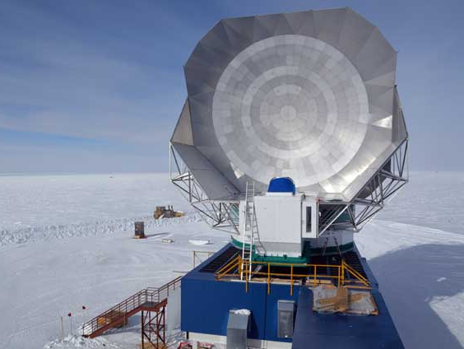
Antarctic Astronomy
The Antarctic is an ideal place to put a telescope! As a very high and very dry continent, atmospheric distortion are relatively small.
Photo Peter Rejcek USAP Photo Library

