Slide 1
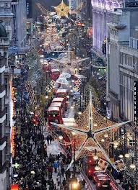
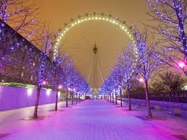
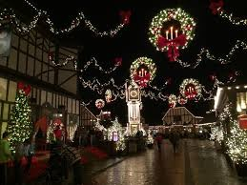
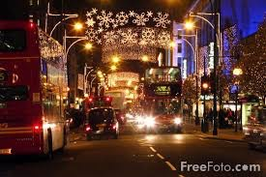
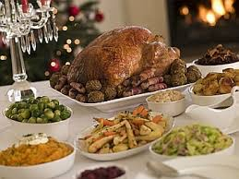
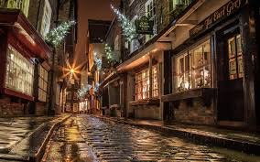
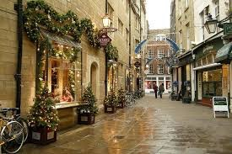
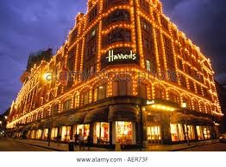
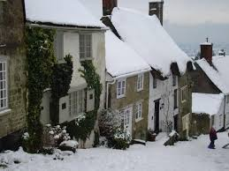
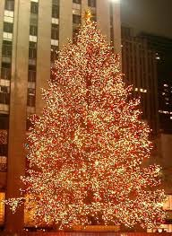
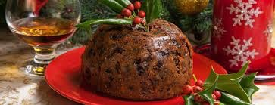
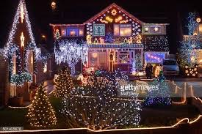
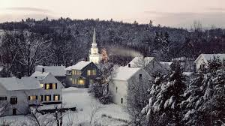
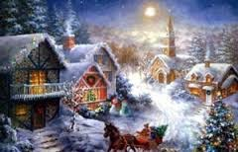
CHRISTMAS
IN THE UK

Slide 2
Christmas Trees
and
Families
In England families usually spend Christmas together, most families have a Christmas tree in their house and they decorate the tree together. A Christmas tree can be put up in December until the new year and then it is taken down. Family is very important when it is Christmas.
Most towns, villages and cities are decorated with Christmas lights over Christmas. Often a famous person switches them on. The most famous Christmas lights in the UK are in Oxford Street in London.

Slide 3
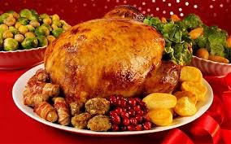
Christmas Eve is celebrated the night before Christmas on the 24th of December, most people watch Christmas movies and stay at home with friends and family. On Christmas Day the whole family gathers at one house and everyone celebrates by giving each other gifts and sometimes singing Christmas Carols. Traditional Christmas dinner is also important in The UK. It is usually eaten around lunch time.
Turkey, peas, carrots, roasted potatoes with gravy and stuffing are all part of a traditional Christmas dinner. Sometimes roast beef is used instead of Turkey. Even though lot of people dislike them, brussel sprouts are often part of the dinner. A British favourite for the dinner are “pigs in blankets”, they are small sausages wrapped in pieces of bacon.

Slide 4
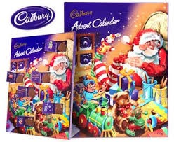
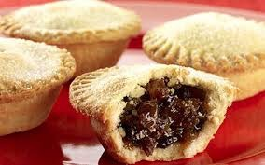
Another English tradition for Christmas is Christmas pudding. Christmas pudding is a cake made with dried fruits and nuts, spices and a lot of alcohol. Sometimes people but a silver coin in the cake and whoever finds it is believed to be lucky for a year.
Chocolate is also very popular around Christmas time. Advent calendars are used by children and adults too. An advent calendar is a thin box with 24 or 25 small paper doors, one door for every day of December until Christmas Day. Behind every door there is a small piece of chocolate. Mince Pies are also famous, made withdrew fruit and nuts, they don’t have any meat in them.

Slide 5
Christmas Carols are an important part of Christmas, some are very well known and will be sang at churches on Christmas Eve and Christmas day.
Christmas Cards are usually sent in the mail to friends and family that live far away or are given with presents. They usually have a Merry Christmas message inside of them.
In The Uk it doesn’t snow very often but everyone wants snow for Christmas. We call it a “White Christmas” and it is mentioned in many Christmas songs and movies. Scotland and the north of England have White Christmases more commonly than the rest of The UK. There are a lot of classic traditions for the UK but most families have their own, the most important part is being with the people you love.

