Slide 1
A STORY ABOUT REFUGEES
Savel’s red dress
Author: Marina Michaelidou Kadi

Slide 2
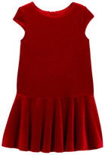
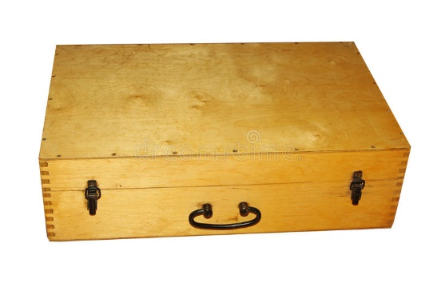
Lesson Plan Grade level: 1-4th Length of time: 40 minutes
Objectives & Outcomes
Through theatre techniques, students get to know the meaning of the word refugee (as a consequence of war) and the difficulties the refugees have to encounter when forced to leave their home and move into another country.
Materials Needed
A wooden box or a suitcase with a red dress, colored pencils, sketchbook, a teddy bear, photos of a family and a house (any other item suggesting they belong to a girl leaving will do)
A piece of paper big enough to draw a girl’s outline/figure
Post-it papers
A red cloth
A small paper depicting a suitcase

Slide 3
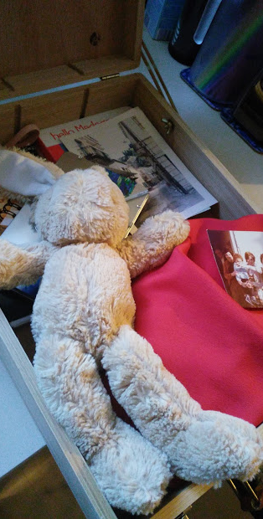
Procedure
Opening to Lesson
The children are sitting in a circle on a carpet or pillows and introduce their selves to the team by telling their name and something they like which starts with the first letter of their name (e.x. I am Zoe and I like going to the Zoo)
The wooden box is presented to the kids. What might it have inside? The teacher opens it and calls 7 children (the number of children has to match the number of the items). For example, anyone whose name starts with an A or an S can pick up an item and stand in line. The children describe what they have in their hands and everyone tries to guess who they might belong to, what is that person like or what does she like, why did that person pack these things etc. The word refugee is mentioned, noted and explained.
Body of Lesson
Introducing the main character
The teacher shows (power point presentation) the picture of the girl (from the book cover) and introduces Savel, a girl who had to leave from her country with her parents because of war. Savel is only taking with her the red dress her grandmother gave to her.
Still images
The next picture from the book shows Savel and her mom leaving. The children in pair create a still image, using their bodies and faces to express mom’s and Savel’s thoughts and feelings. When the teacher touches their head, the children give voice to their thoughts/feelings.
Role in the wall
In a big piece of paper the teacher, with the help of a girl laying down on the paper, draws the outline of Savel. They look at the picture showing Savel in the new country scared and alone, wearing her red dress and write on a post-it paper her feelings. Each child reads aloud the word/words he/she wrote and place the pos-it on Savel’s figure/outline.

Slide 4
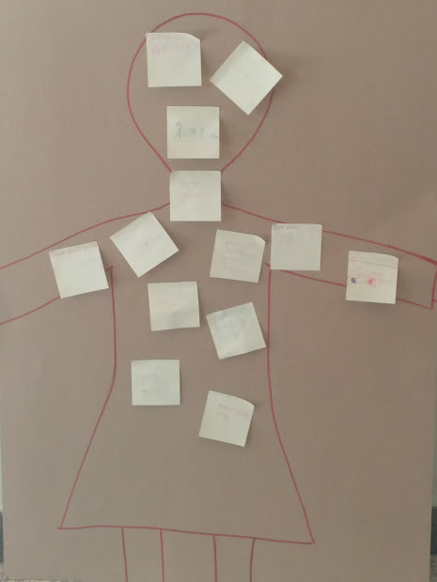
Narration
The teacher tells them that Savel’s dad found a new job. Is that good or bad news for the family? Why do they need money for? If you and your family went into another country with almost nothing what would you need to buy?
Taking a role
The children in Savel’s school approach her. What are the saying to her? Imagine you are Savel’s classmate. What would you say to her?
The circle of conscience
Savel (played by a girl wearing a red cloth) passes through the circle of the children. As she passes by, the children whisper in her ear an advice (ex. go play with them Savel, you will feel better etc).
Closing
Savel leaves behind her red dress because now it’s too small for her and goes to the park to play with the other children. How does she feel? (The last picture of the book, presenting a smiley Savel, is colorful, while the previous pages were black and white except from the red dress)
The children look at pictures showing refuges from Syria and other countries who had to flee their homes and resort to another country, many of them losing their life in the prosses.
Assessment & Evaluation
Students have a discussion about the story, the refugees and how they would treat people like Savel coming in their country, neighborhood or school.
They also write down on a paper depicting a suitcase only one thing they could take with them (like Savel and her red dress) if they had to leave their home (not an electronic one) and explain why they chose the particular object.

Slide 5
Notes:
Η ιστορία ενός κοριτσιού που αναγκάζεται να φύγει από τη χώρα της…

Slide 6
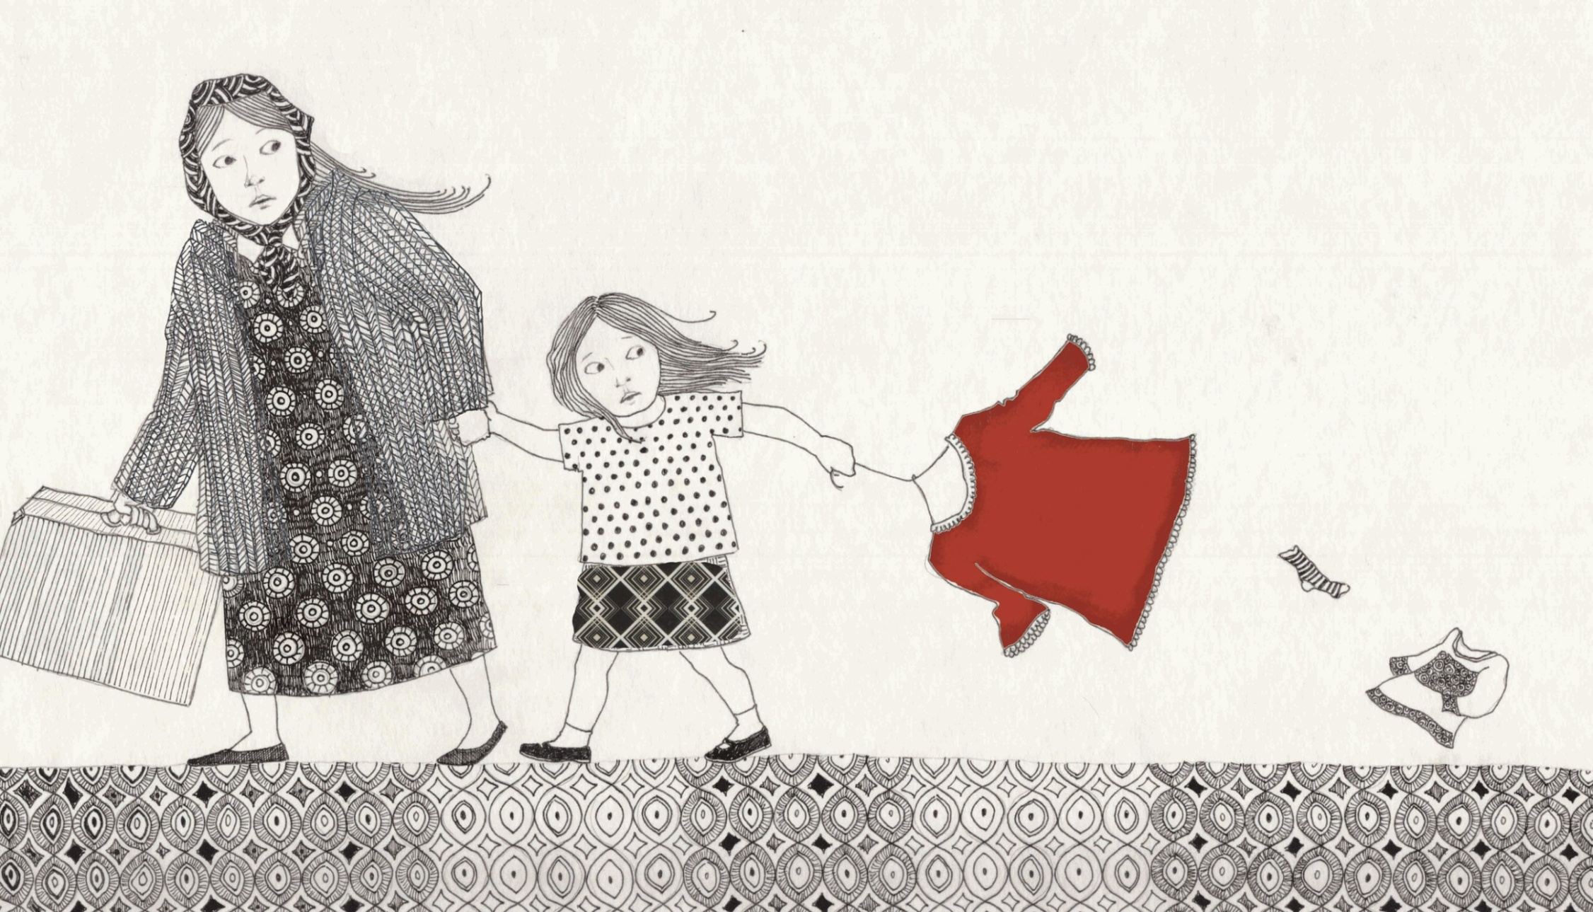

Slide 7
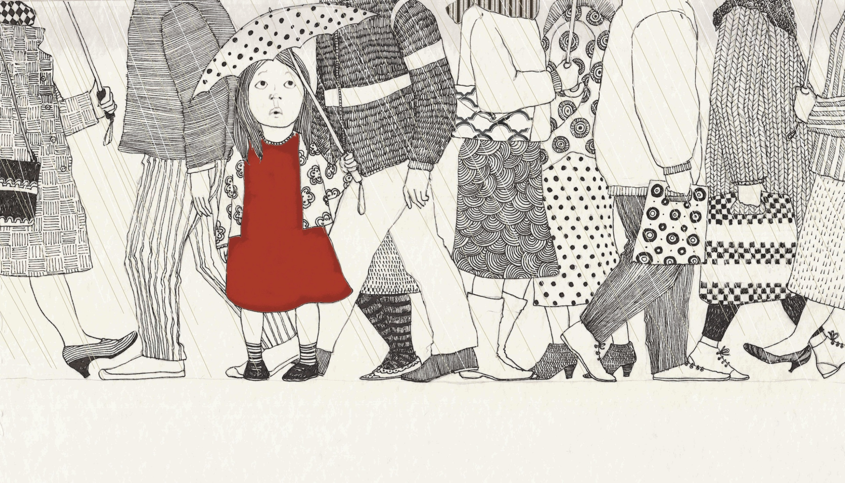

Slide 8
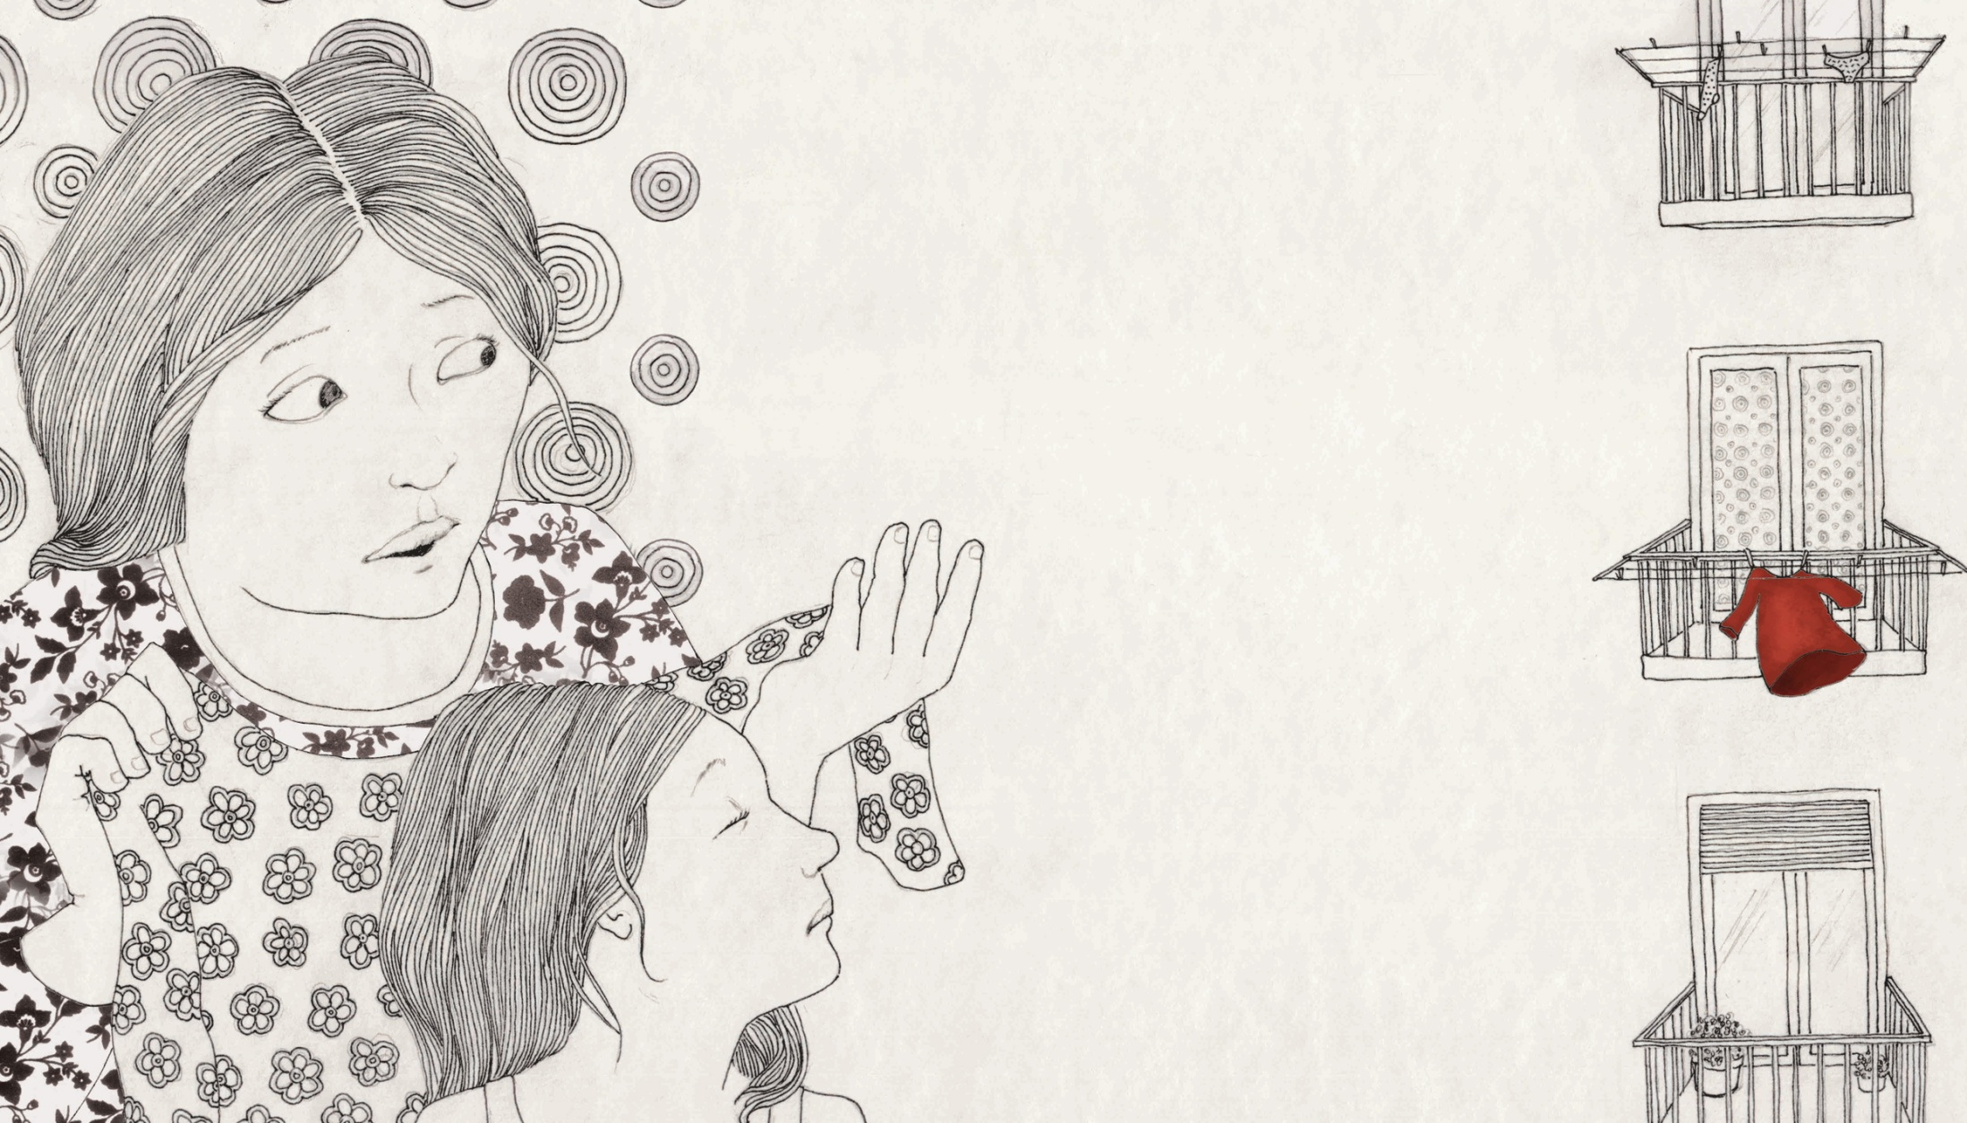

Slide 9
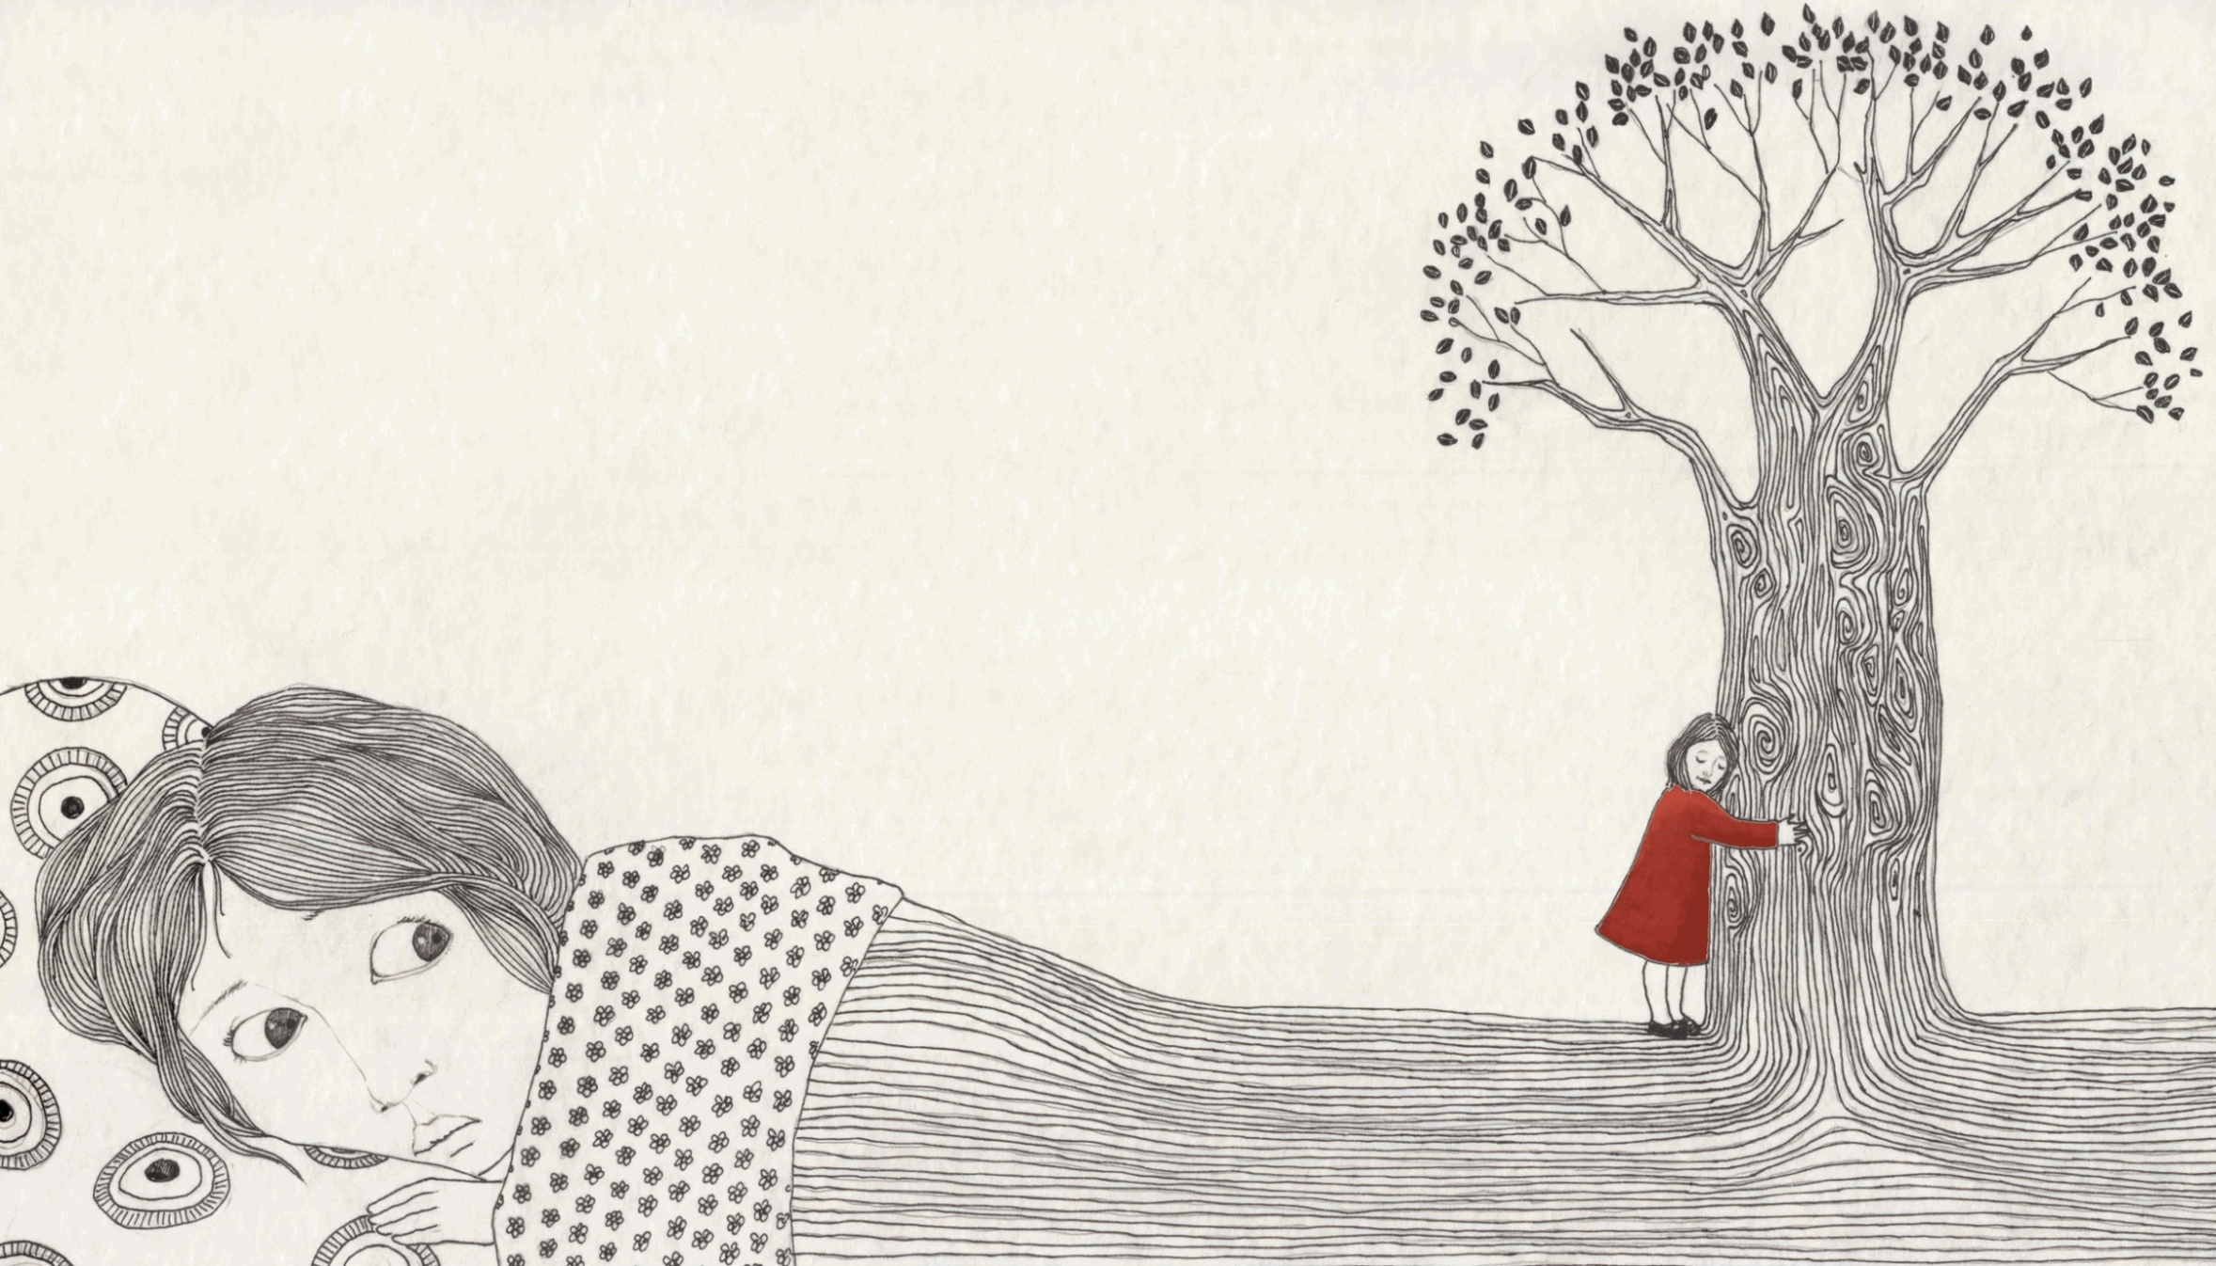

Slide 10
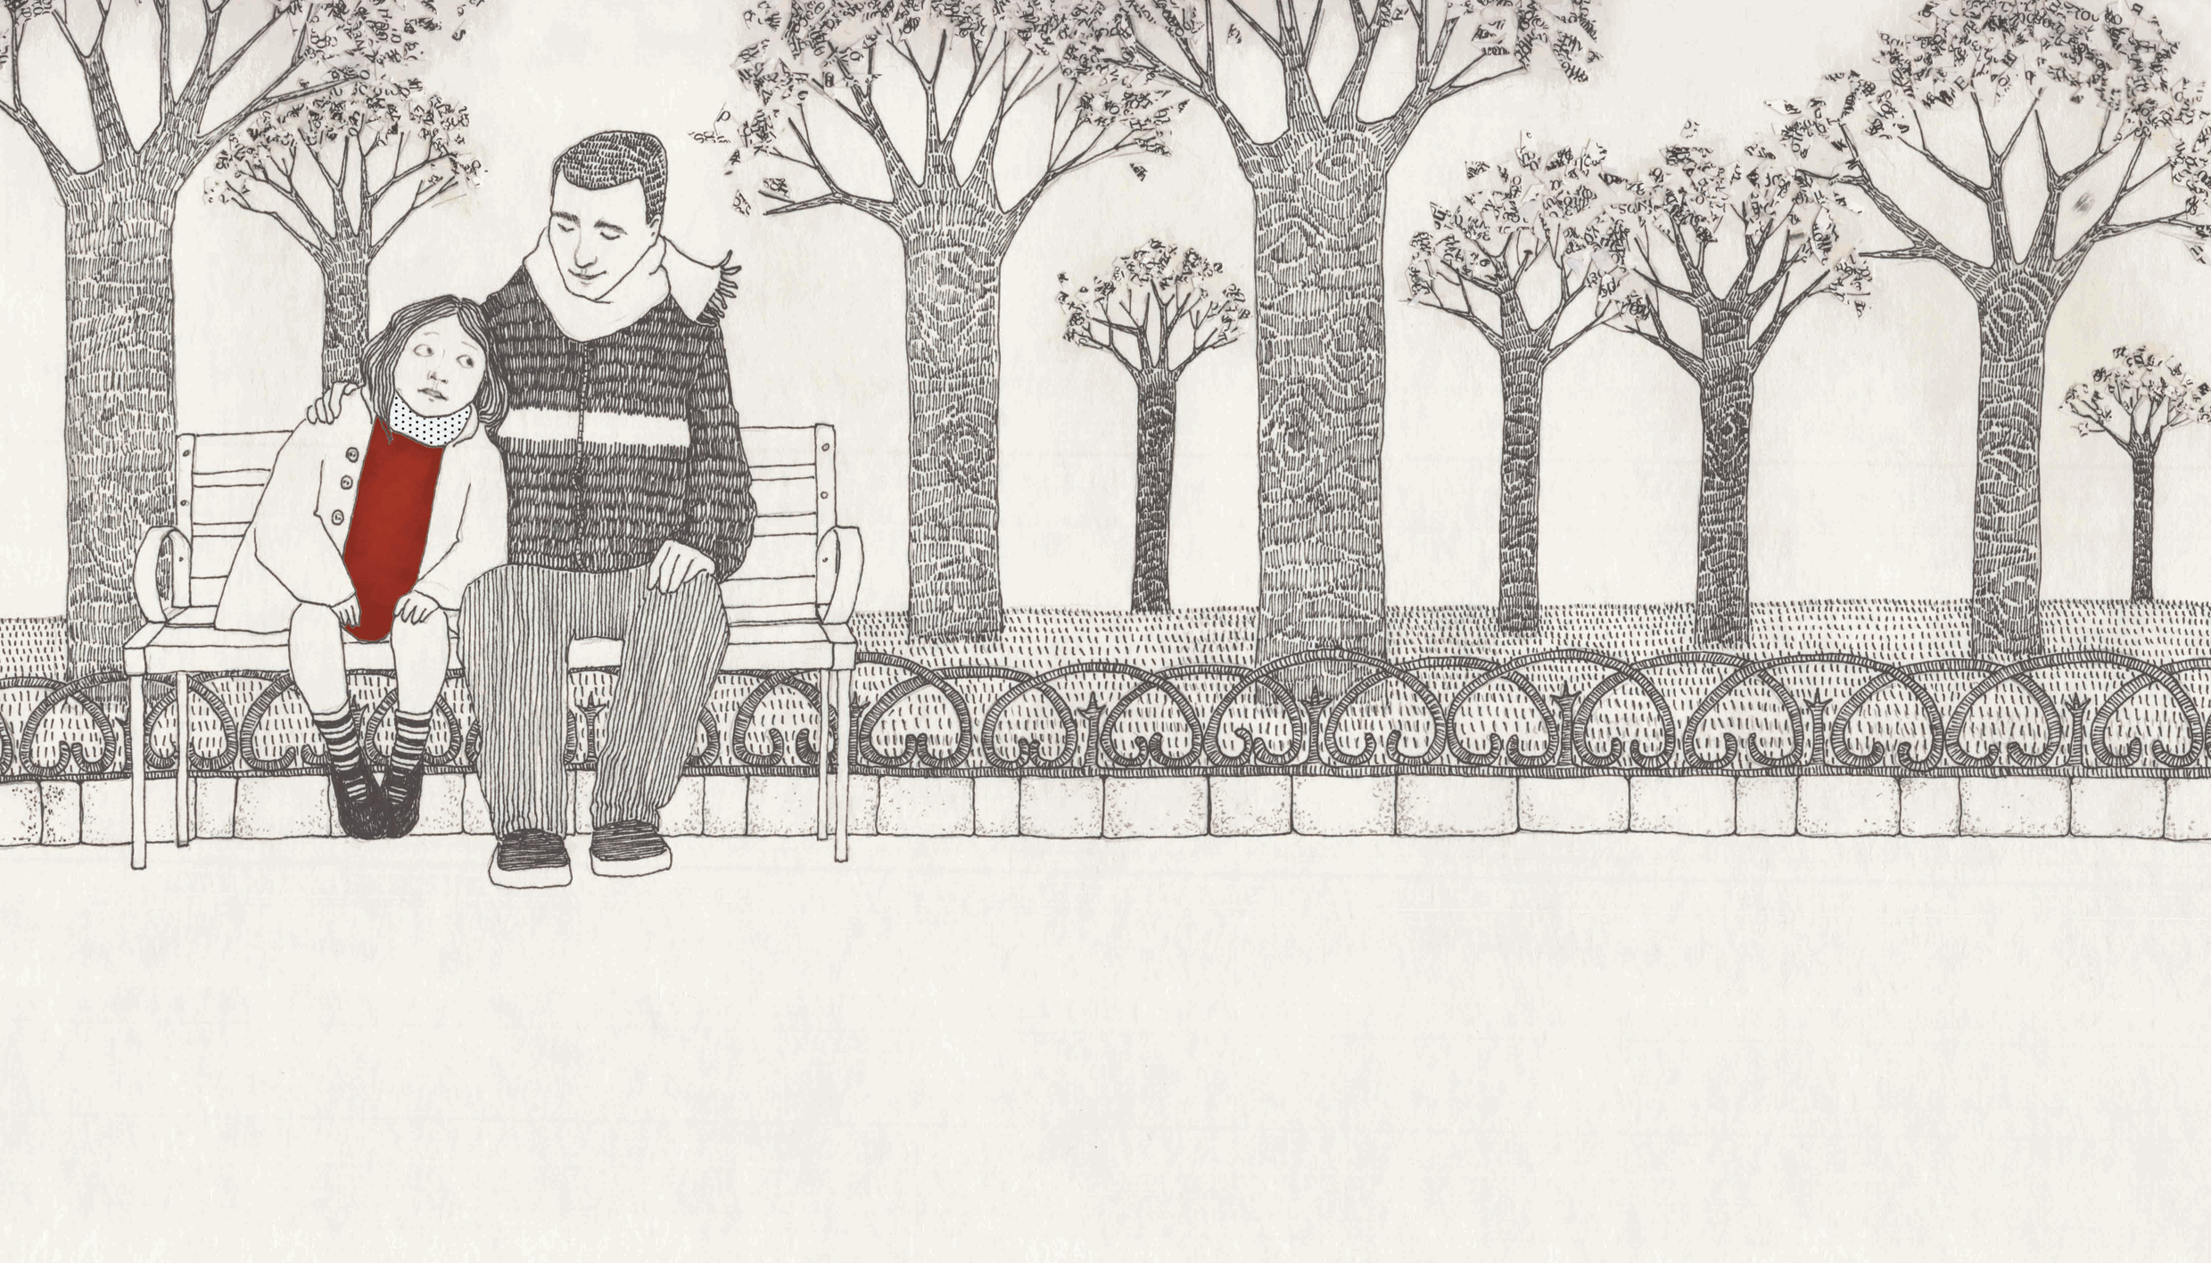

Slide 11
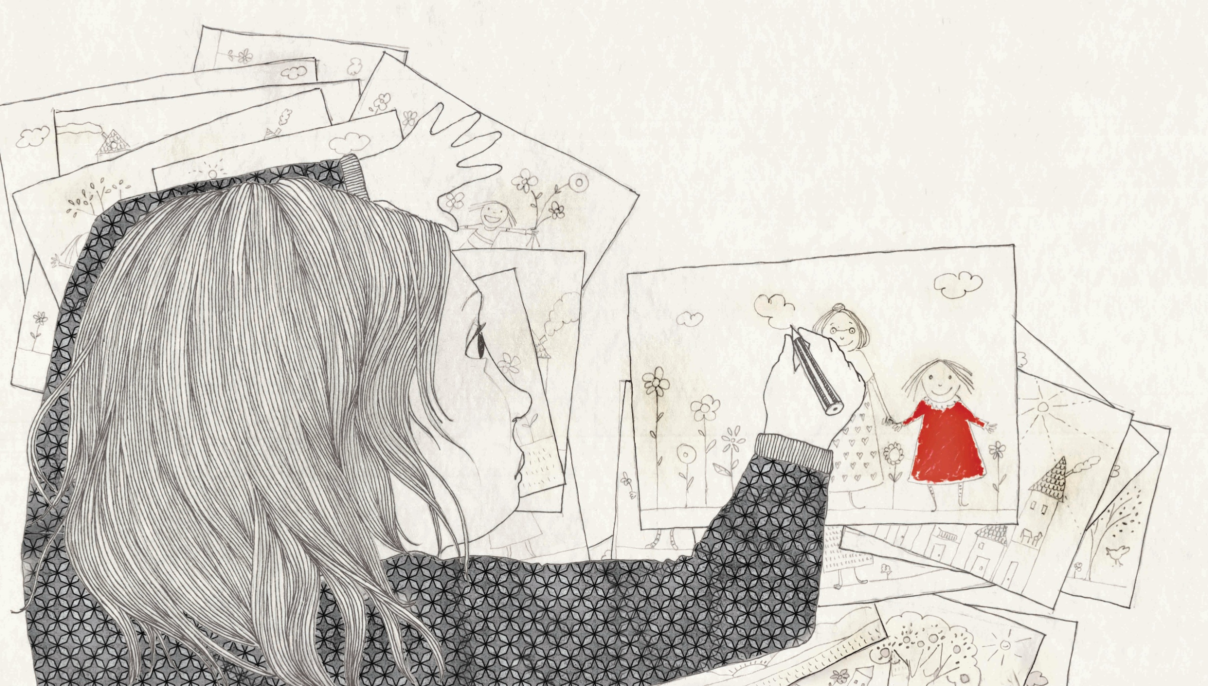

Slide 12
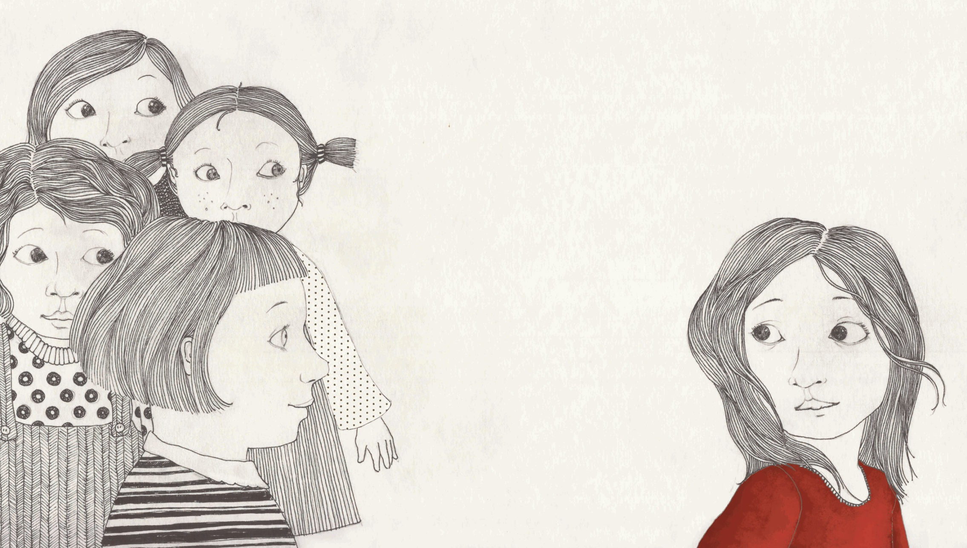

Slide 13
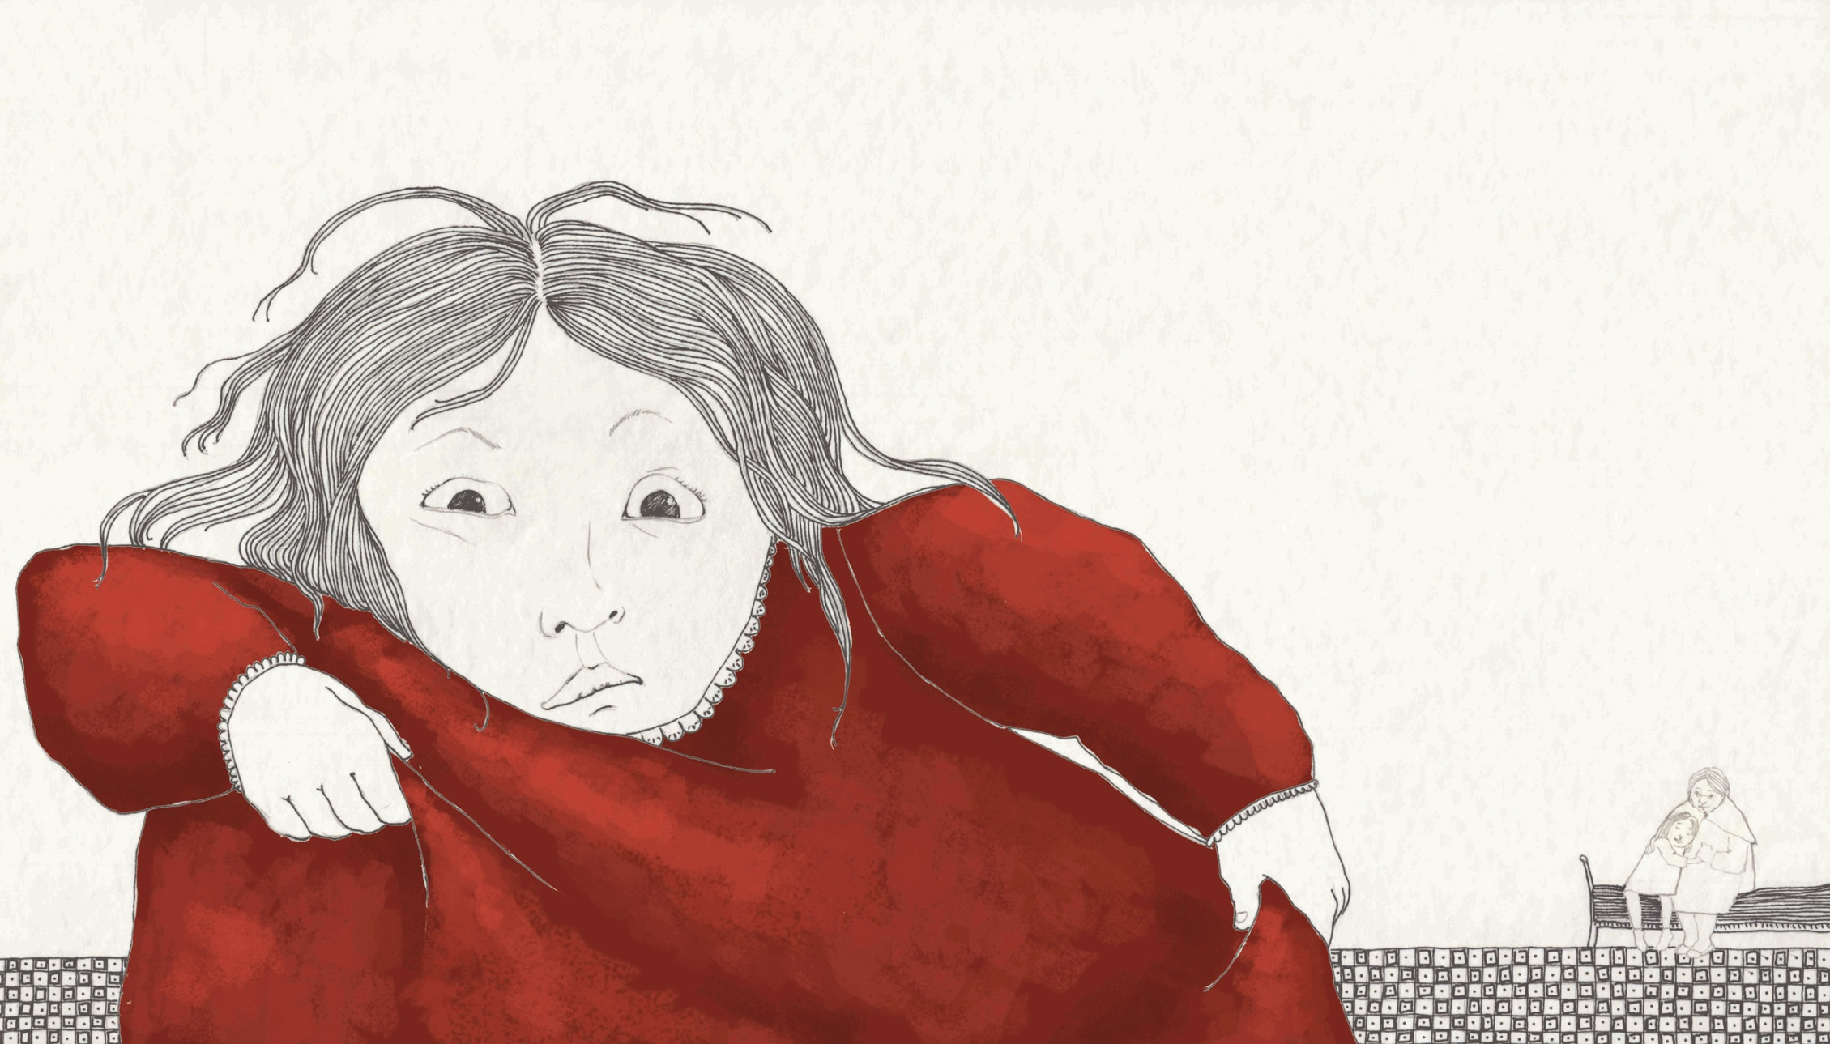

Slide 14
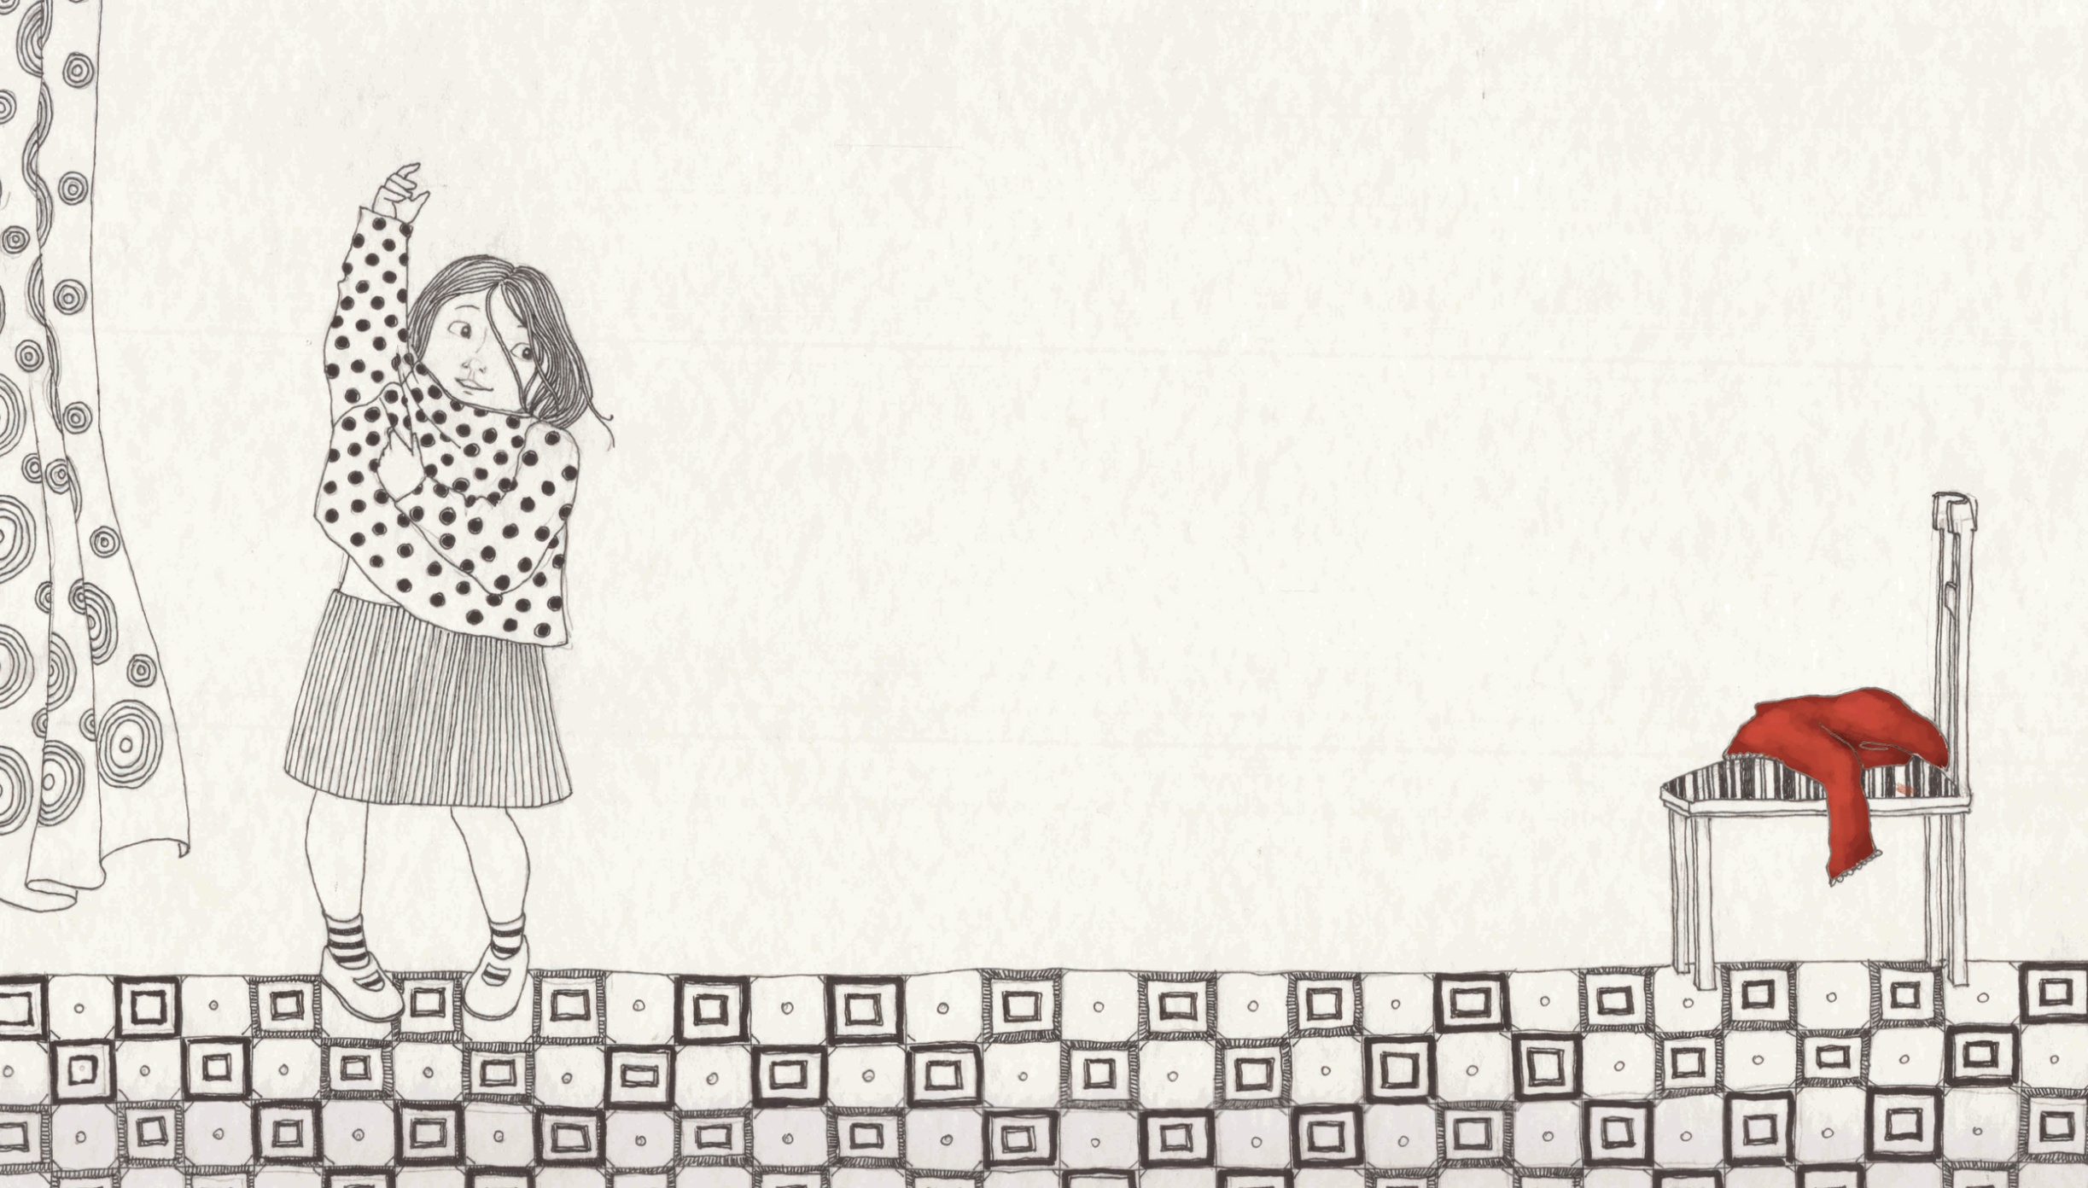

Slide 15
