Slide 1
What else ?

Slide 2
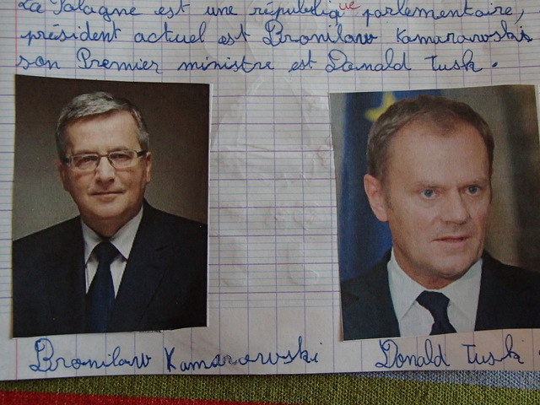
Poland is a democracy. The president (currently Bronisław Komorowski), is elected by popular vote every five years.

Slide 3
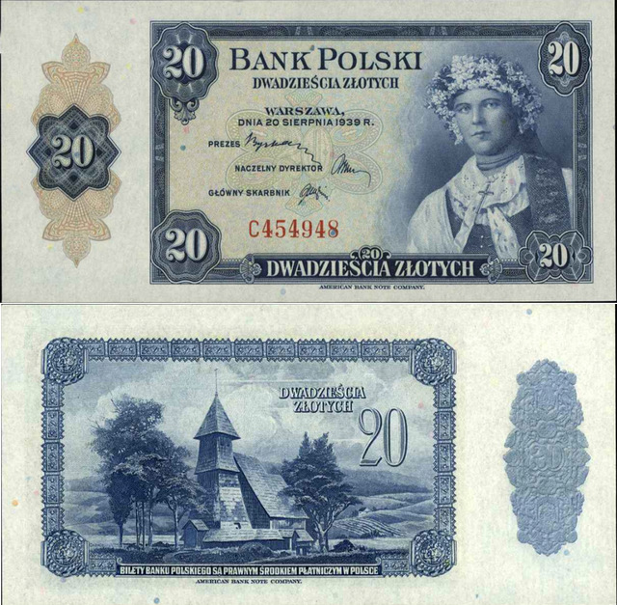
The currency is the Złoty

Slide 4
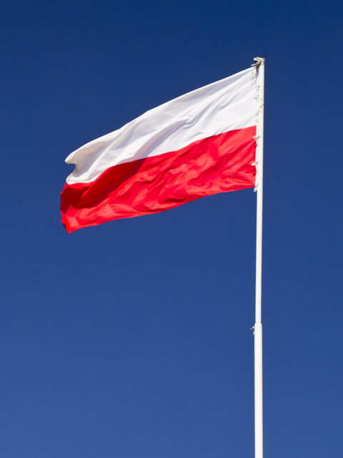
The flag of Poland is white and red

Slide 5
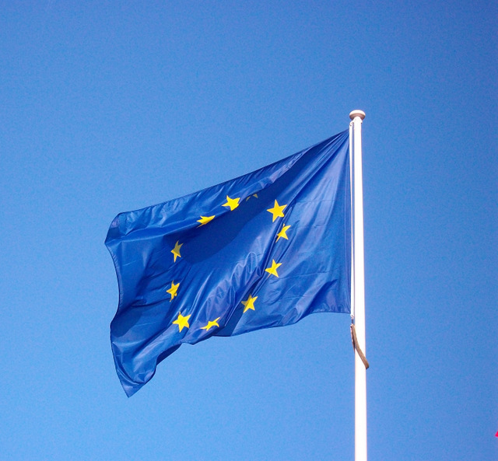
Poland is a member of European Union for 10 years.

Slide 6
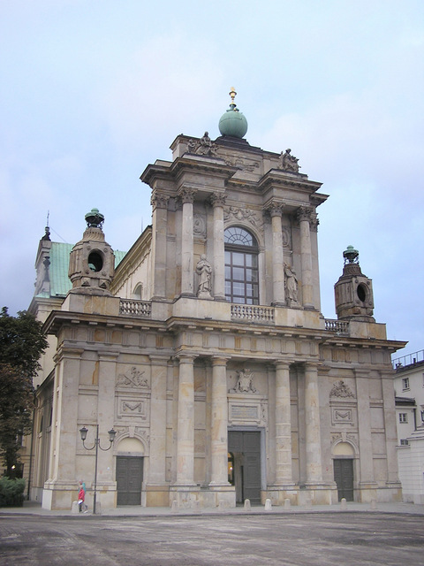
A lot of people are Catholics.

Slide 7
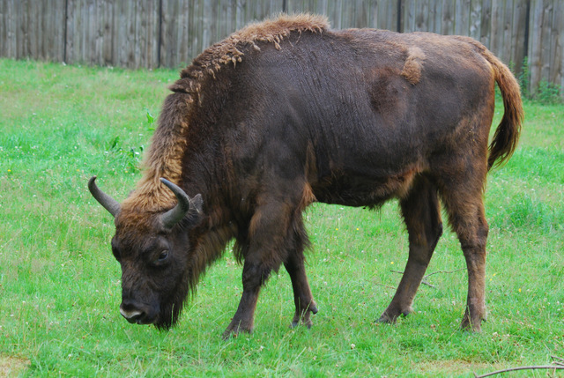
There are a lot of bisons in Poland
There are also bears and wolves.

