Slide 1
What do you eat in Poland ?

Slide 2
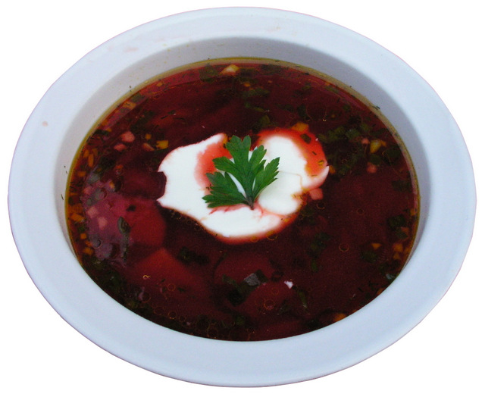
Borscht

Slide 3
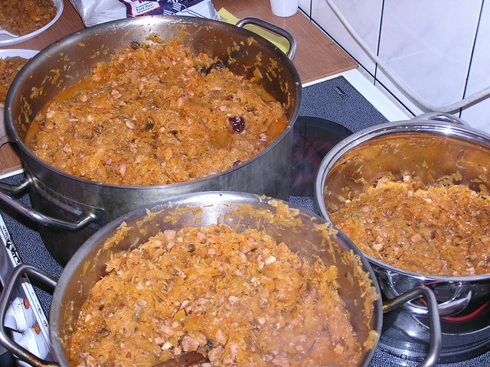
Bigos

Slide 4
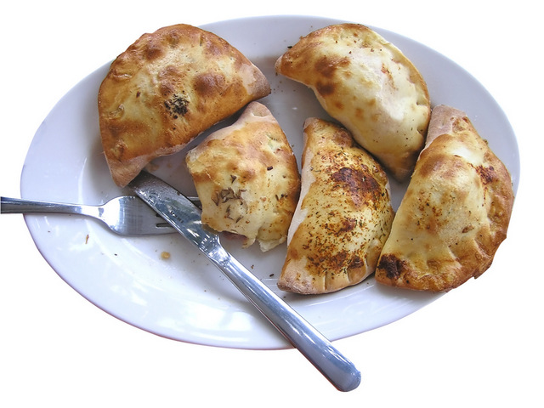
Pierogis

Slide 5
Makowiec

Slide 6
Yummy !!

