Slide 1
Cyberbullying

Slide 2
What is cyberbullying?
Examples of cyberbullying
How to prevent cyberbullying?

Slide 3
What is cyberbullying?

Slide 4
What is Cyberbullying?
Cyberbullying is bullying that takes place using electronic technology.
Examples of cyberbullying include mean text messages or emails, rumors sent by email or posted on social networking sites, and embarrassing pictures, videos, websites, or fake profiles.

Slide 5
Effects of Cyberbullying
Use alcohol and drugs
Skip school
Experience in-person bullying
Be unwilling to attend school
Receive poor grades
Have lower self-esteem
Have more health problems

Slide 6
Examples of cyberbullying

Slide 7
Cyberstalking
Cyberstalking is a form of online harassment in which the perpetrator uses electronic communications to stalk a victim. Cyberstalking is considered more dangerous than other forms of cyberbullying because it generally involves a credible threat to the safety of the victim.

Slide 8
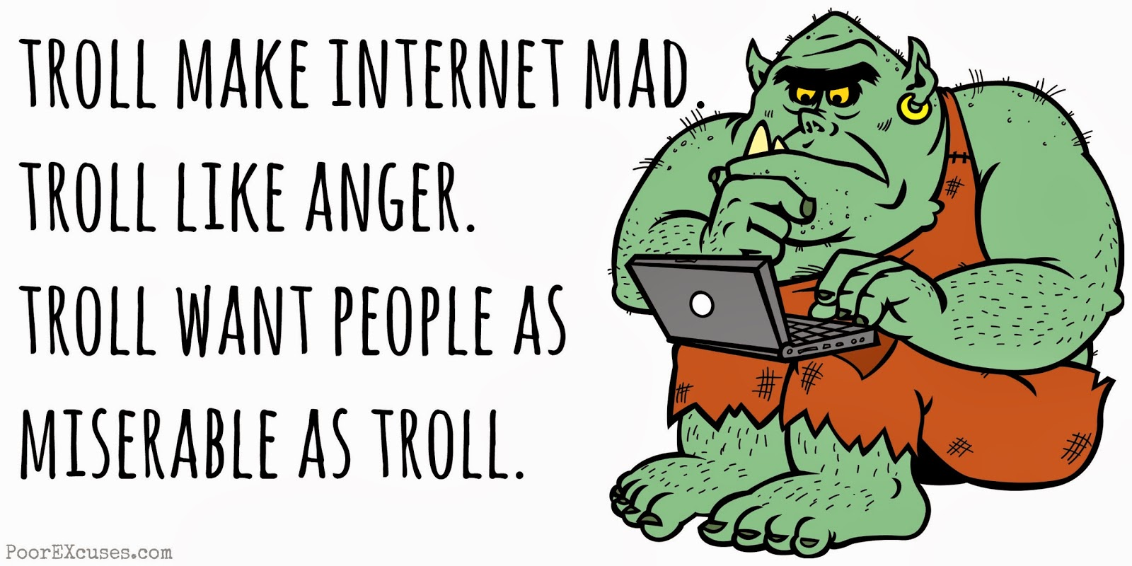
Trolling
Internet trolls intentionally try to provoke or offend others in order to elicit a reaction. Trolls and cyberbullies do not always have the same goals: while some trolls engage in cyberbullying, others may be engaged in comparatively harmless mischief.

Slide 9
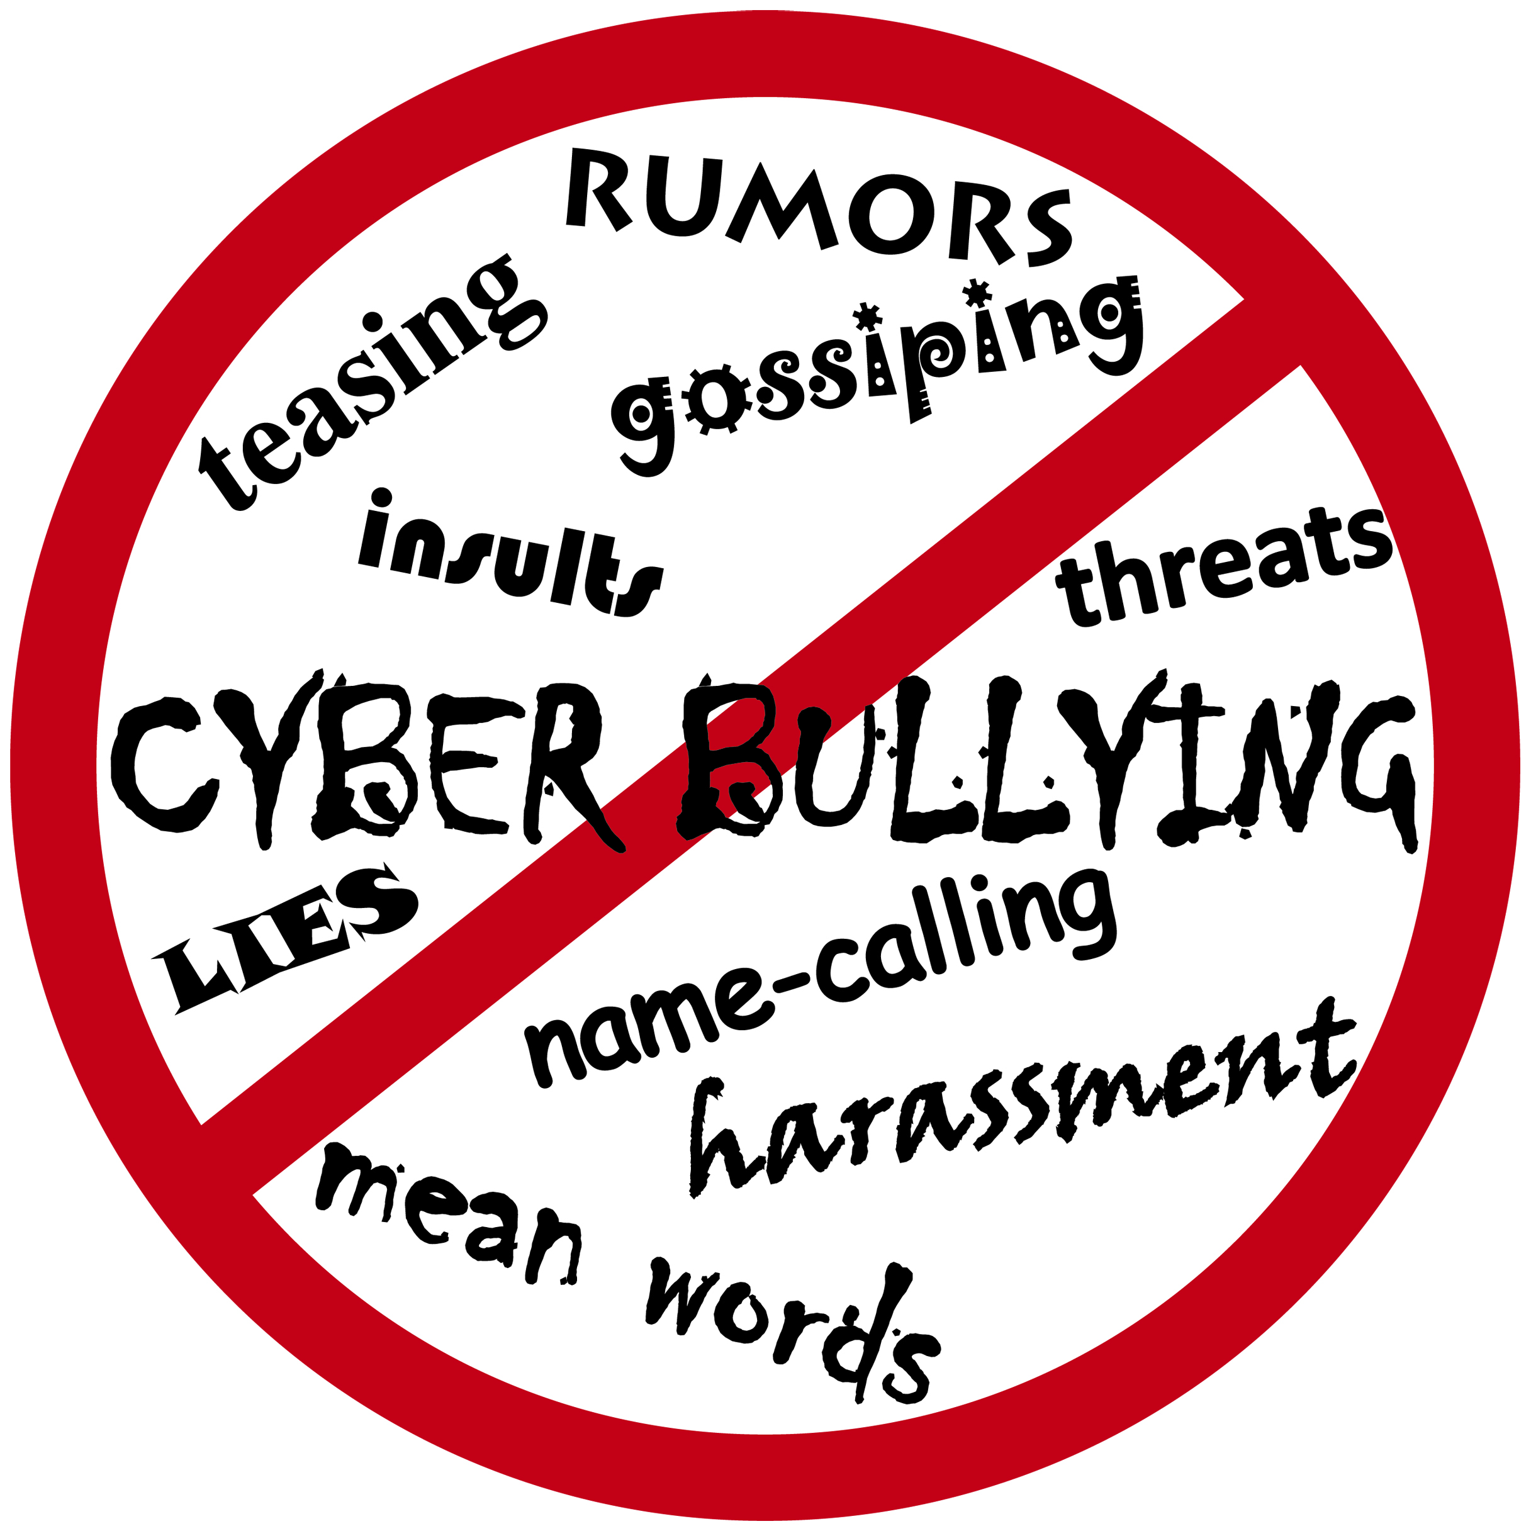
Why Cyberbullying is Different?
Kids who are being cyberbullied are often bullied in person as well. Additionally, kids who are cyberbullied have a harder time getting away from the behavior. Cyberbullying can happen 24 hours a day, 7 days a week, and reach a kid even when he or she is alone.

Slide 10
How to prevent cyberbullying?

Slide 11
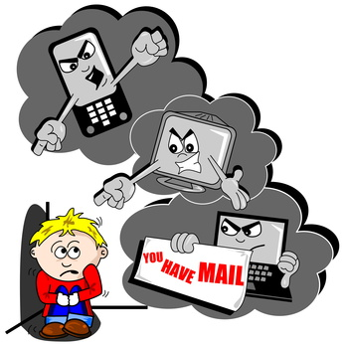
Protection
There are laws that only address online harassment of children or focus on child predators as well as laws that protect adult cyberstalking victims, or victims of any age. Currently, there are 45 cyberstalking (and related) laws on the books.

Slide 12
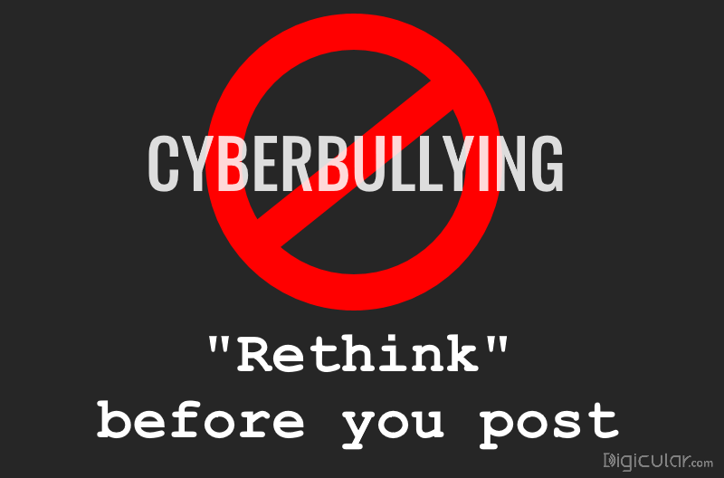
Tena
Martina
Gabrijela
8th grade
OŠ Vladimira Nazora Pribislavec, Croatia eTwinning project Digital Citizenship January – February 2017
Sources:
https://www.stopbullying.gov/cyberbullying/what-is-it/
https://en.wikipedia.org/wiki/Cyberbullying

