Slide 1
Cyberbullying

Slide 2
What is cyberbullying?
Examples of cyberbullying
How to prevent cyberbullying?

Slide 3
What is cyberbullying?

Slide 4
Cyberbullying or cyberharassment is a form of bullying or harassment using electronic forms of contact. Cyberbullying has become increasingly common, especially among teenagers.

Slide 5
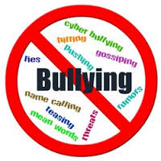
Definitions
A frequently used definition of cyberbullying is "an aggressive, intentional act or behavior that is carried out by a group or an individual, using electronic forms of contact, repeatedly and over time against a victim who cannot easily defend him or herself."

Slide 6
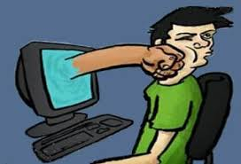
Methods
Cyberbullying involves repeated behavior with intent to harm.
Cyberbullying is perpetrated through harassment, cyberstalking, denigration, impersonation, and exclusion.

Slide 7
Examples of cyberbullying

Slide 8
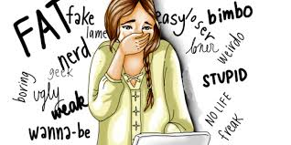
Age
Adults
Children report negative online behaviors occurring from the second grade.
According to research, boys initiate negative online activity earlier than girls do.
Stalking online has criminal consequences just as physical stalking.
A target's understanding of why cyberstalking is happening is helpful to remedy and take protective action to restore remedy.

Slide 9
Trolling
Internet trolls intentionally try to provoke or offend others in order to elicit a reaction.
Trolls and cyberbullies do not always have the same goals: while some trolls engage in cyberbullying, others may be engaged in comparatively harmless mischief.

Slide 10
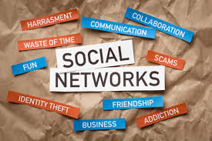
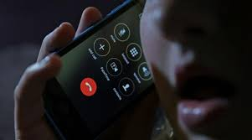
In social media
In gaming
Cyberbullying can take place on social media sites such as Facebook, Myspace, and Twitter.
By 2008, 93% of young people between the ages of 12 and 17 were online.
Of those who reported having experienced online harassment in a Pew Research poll, 16% said the most recent incident occurred in an online game.

Slide 11
How to prevent cyberbullying?

Slide 12
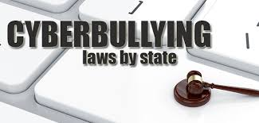
Law enforcement
A majority of states have laws that explicitly include electronic forms of communication within stalking or harassment laws.

Slide 13
School
The safety of schools is increasingly becoming a focus of state legislative action.
There was an increase in cyberbullying enacted legislation between 2006 and 2010.
Initiatives and curriculum requirements also exist in the UK and Australia.

Slide 14
Protection
There are laws that only address online harassment of children or focus on child predators as well as laws that protect adult cyberstalking victims, or victims of any age.
Currently, there are 45 cyberstalking laws on the books.

Slide 15
Cyberbullying is dangerous!

Slide 16
OŠ Vladimira Nazora Pribislavec, Croatia eTwinning project Digital Citizenship January – February 2017
Petar N.
Patrik K.
Matija P.
8th grade
Sources:
https://www.stopbullying.gov/cyberbullying/what-is-it/
https://en.wikipedia.org/wiki/Cyberbullying

