Slide 1
TRZEJ DETEKTYWI
THE THREE DETECTIVES

Slide 2
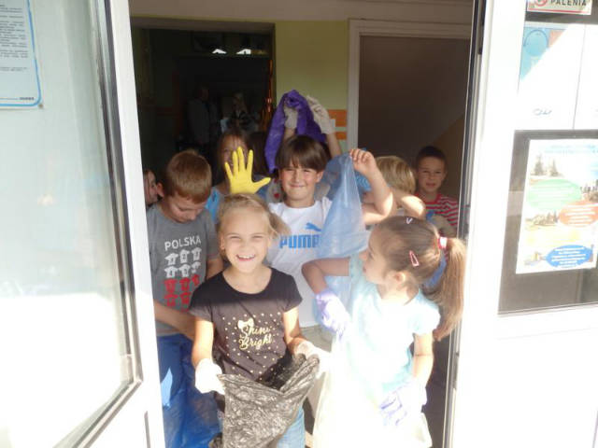
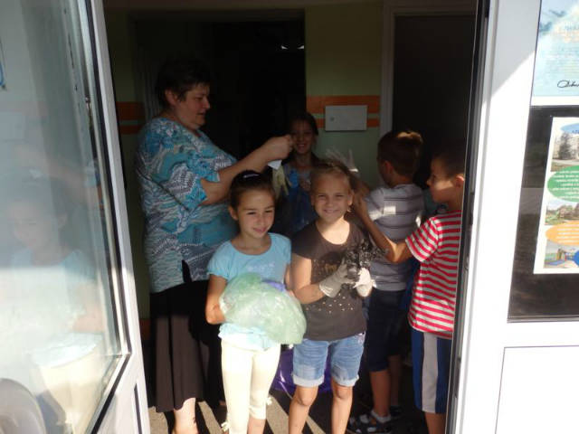
Klasa 2 – Class 2
Here we go to tidy
the WORLD!
16.09.2016

Slide 3
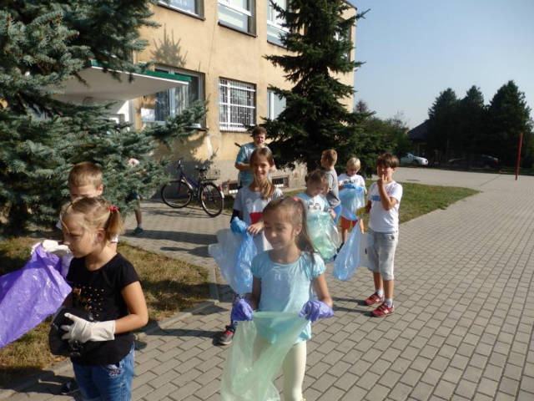
Class 2a girls: Iga, Natalka, Kamila, Martynka, Julka, Wiktoria, Łucja boys: Kuba, Filip, Fabian, Mikołaj

Slide 4
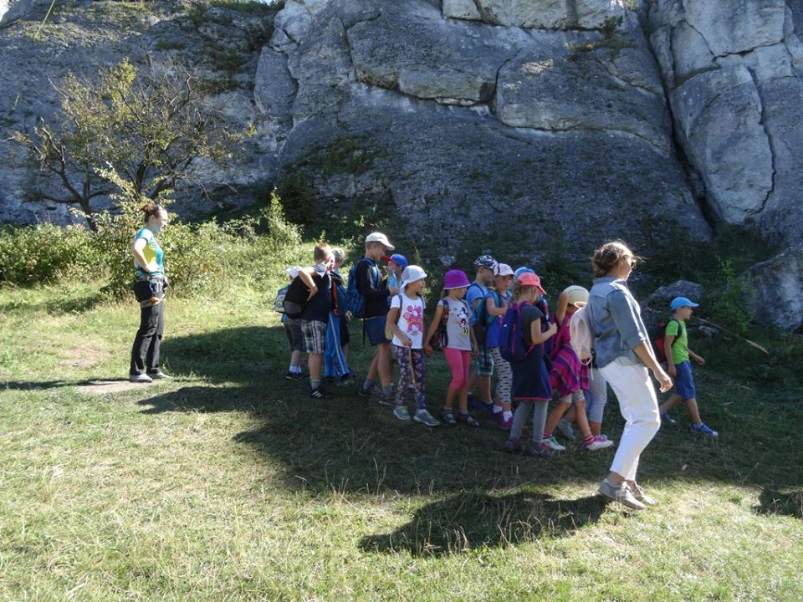
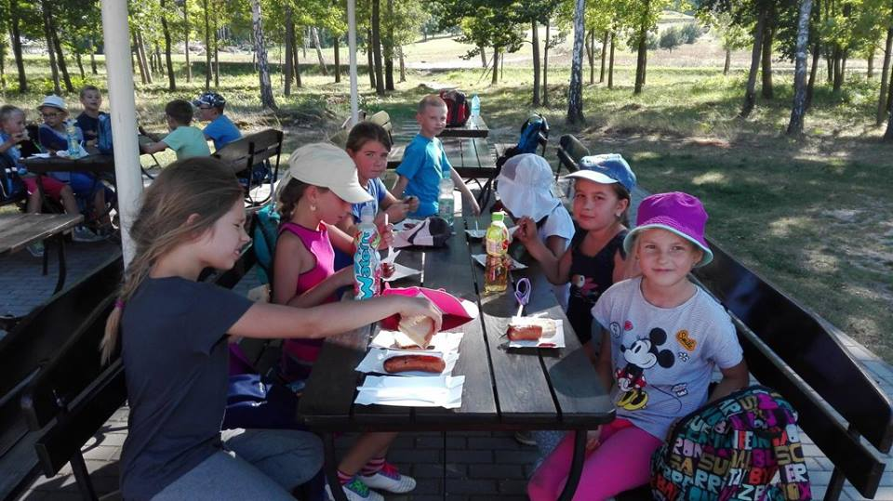
Klasa 3 – Class 3
Here we are on a trip to the fields
Olsztyn 22.09.2016

Slide 5
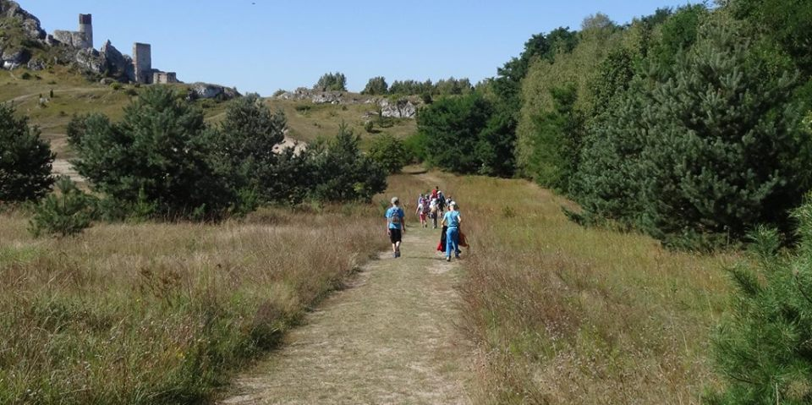
Class 3 girls: Marysia, Weronika U., Roksana, Julka, Weronika N. boys: Wiktor, Przemek, Marek, Krystian, Filip, Mikołaj, Dominik

Slide 6
In September, we found out who is the … of us. the tallest, the fastest…
We were making some measurements, races and voting.
You can take a look at the results on the following pages.

Slide 7
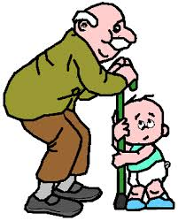
Martynka is the youngest in the group. Mikołaj is the oldest.
old young

Slide 8
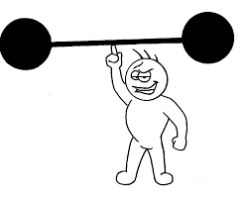
Filip is the strongest.
strong

Slide 9
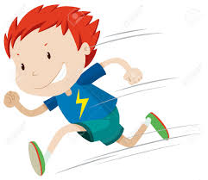
Mikołaj is the fastest of the boys.
fast

Slide 10
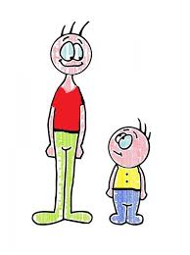
Wiktoria is the shortest. Iga is the tallest.
tall short

