Slide 1
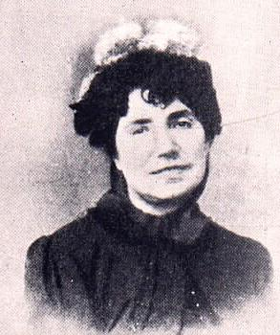
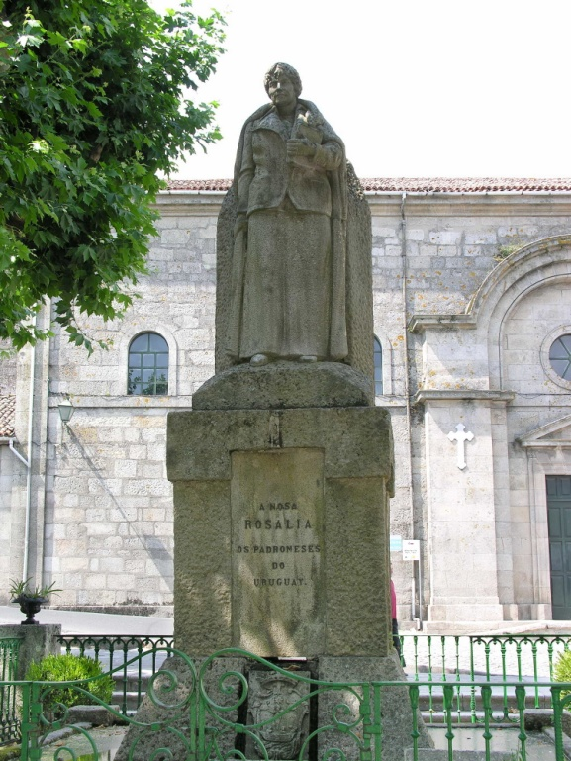
Rosalia De Castro’s poems
Rosalia De Castro’s statue

Slide 2
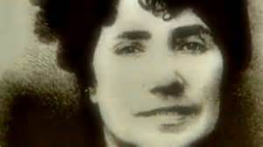
Rosalia De Castro’s works
Rosalia De Castro was a Galician romantic writer and poetress, who wrote in the Spanish and Galician languages.
This is the list of her works:
Galician poetry: Cantares gallegos (1863) and Follas novas (1880).
Galician prose: Contos da miña terra I (1864).
Spanish poetry: La Flor (1857) , A mi madre (1863), En las orillas del Sar (1884).
Spanish prose: La hija del mar (1859), Flavio (1861), El cadiceño (1863),Ruinas (1866), Las literatas (1866), El caballero de las botas azules (1867) , El primer loco (1881) , El domingo de Ramos (1881) , Padrón y las inundaciones (1881).

Slide 3
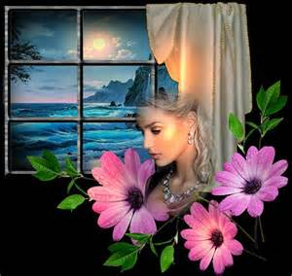
Negra sombra (llevadas de “Follas novas”)
Cando penso que te fuches, negra sombra que me asombras, ó pé dos meus cabezales tornas facéndome mofa.
Cando maxino que es ida, no mesmo sol te me amostras, i eres a estrela que brila, i eres o vento que zoa.
Si cantan, es ti que cantas, si choran, es ti que choras, i es o marmurio do río i es a noite i es a aurora.
En todo estás e ti es todo, pra min i en min mesma moras, nin me dexarás nunca, sombra que sempre me asombras.
Black shadow (from “Follas novas”)
When I think you have run away, your dark shadow startles me, and you come back on foot at my bedside surprising me.
When I imagine you have gone away, you appear in the sun itself, you’re the star shining, the wind whistling.
If they sing it’s you who is singing, if they cry you are the one who cries, you’re the murmur of the river, you’re the night and the sunrise.
You’re in everything and you’re all for me. you live in me. Never leave me, shadow that always startles me.

Slide 4
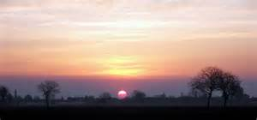
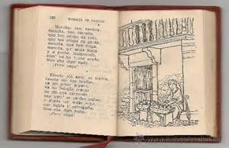
La canción que oyó en sueños el viejo
A la luz de esa aurora primaveral, tu pecho vuelve a agitarse ansioso de glorias y de amor. ¡Loco...!, corre a esconderte en el asilo oscuro donde ya no penetra la viva luz del sol. Aquí tu sangre torna a circular activa, y tus pasiones tornan a rejuvenecer... huye hacia el antro en donde aguarda resignada por la infalible muerte la implacable vejez. Sonrisa en labio enjuto hiela y repele a un tiempo; flores sobre un cadáver causan al alma espanto; ni flores, ni sonrisas, ni sol de primavera buscaron cuando tu vida llegó triste a su ocaso.
The song which the old man
heard in his dreams
In the light of this spring sunrise, your breast
starts longing for glories and for love. Crazy ...! Run and hide yourself in the dark nursery school where the alive sunlight doesn’t arrive yet.
Here your blood circulates actively again, and your passions are young again... It goes away to the cavern where
the implacable old age
awaits the infallible death .
Smile freezes and shows up at the same time
on your dry lip ; flowers on a corpse cause the soul to be scared; no flowers, no smiles, no spring sun searched when your life arrived sad to his sunset.

Slide 5
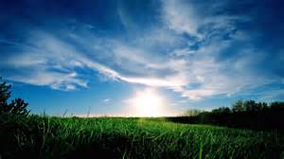
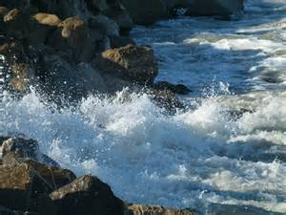
HORA TRAS HORA, DÍA TRAS DÍA
Hora tras hora, día tras día, Entre el cielo y la tierra que quedan Eternos vigías, Como torrente que se despeña Pasa la vida. Devolvedle a la flor su perfume Después de marchita; De las ondas que besan la playa Y que una tras otra besándola expiran Recoged los rumores, las quejas, Y en planchas de bronce grabad su armonía. Tiempos que fueron, llantos y risas, Negros tormentos, dulces mentiras, ¡Ay!, ¿en dónde su rastro dejaron, En dónde, alma mía?
HOUR AFTER HOUR, DAY AFTER DAY
Hour after hour, day after day, Between the sky and the Earth that remains Eternal sentries, Like a stream which flows passes life.
Give the flower its perfume After it has withered; From the waves which kiss the sand And one after the other, kissing it, breathe Pick up the noises, the pains, And into the iron record its melody. Past times, tears and smiles, Black pains, sweet lies, Ahi! Where did they leave their rakes, Where, my soul?

