Slide 1
ERASMUS + MOBILITY IN ROMANIA
‘’DEVELOPING ABILITIES TO SOCIALIZE – TEACHING AND LEARNING NEW PERSPECTIVES BY SHARING’’
PRESENTATION OF THE CITY AND
THE COUNTY
THEORETICAL TRAINING FOR THE STUDY VISIT
THE PROJECT FOR OUR STUDY VISITS AT TURDA SALT MINE, ALBA CITADEL AND SIBIU
12-16.10.2015

Slide 2
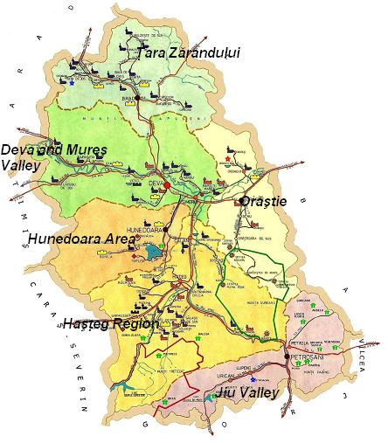
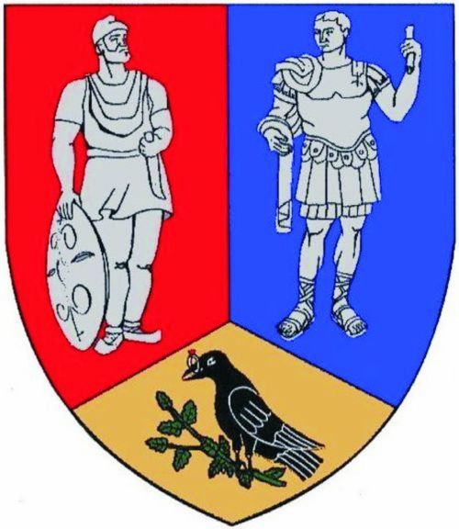
The county of Hunedoara
The County of Hunedoara is located in the central-western part of Romania, in the historical region of Transylvania on the Mures River.

Slide 3
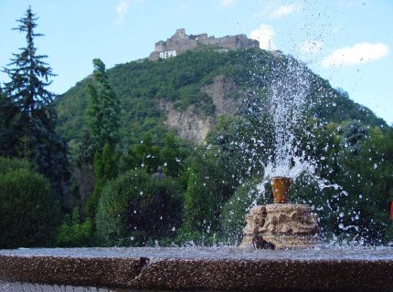
Deva

Slide 4
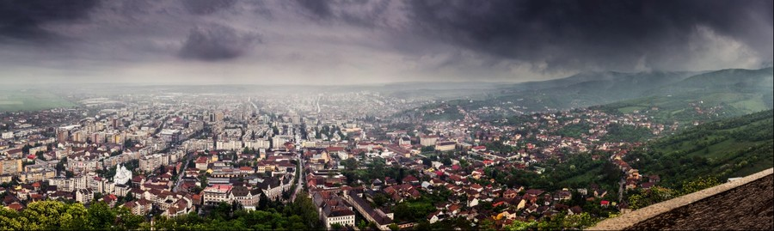
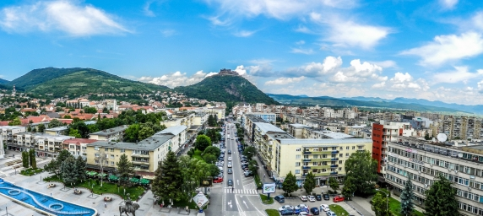
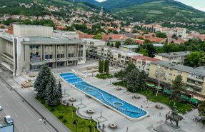
Deva is the capital city of the Hunedoara County. Although the first evidence of Deva dates from 1269, numerous artifacts, mostly preserved in Hunedoara County Museum, shows that the area dates from Neolithic. The etymology of Deva is "dava“, which means ‘fortress’ or ‘castle’.

Slide 5
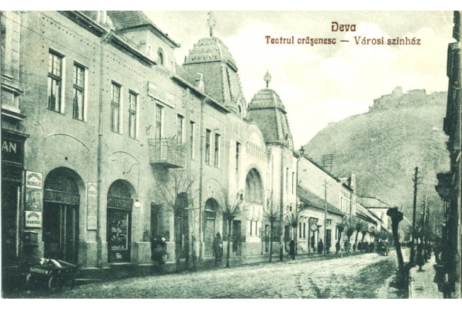
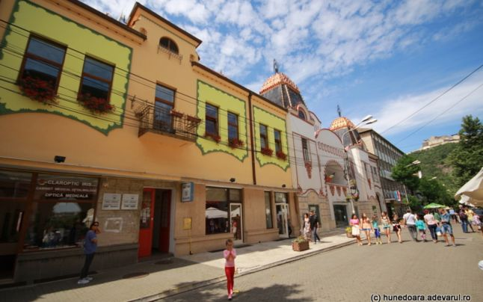
The Old City Center of Deva
Deva has an important architectural area. Along the city's pedestrian street and adjoining streets, there are another representative buildings specific for other eras. The most important of these buildings are the Palace Court, the “Decebal “National College, the Revue Theatre of Deva, the former headquarters of the National Bank, the City Hall, and "Regina Maria " National Pedagogical College. They are known as the Old Center.

Slide 6
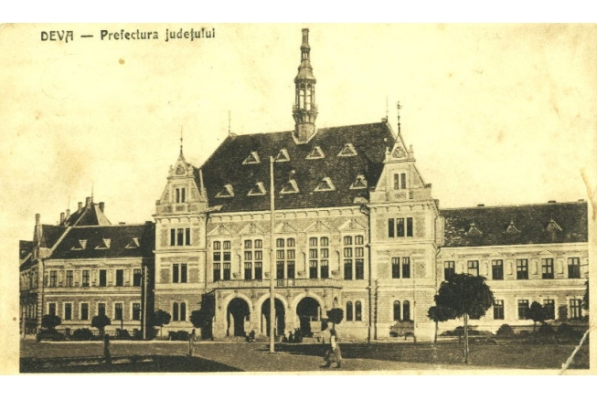
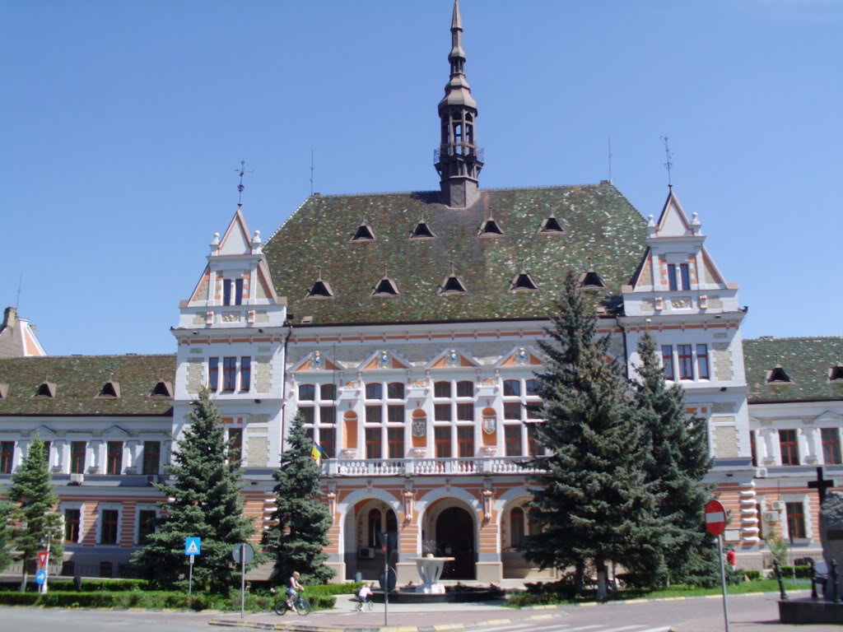
Hunedoara County Prefecture
Hunedoara County Prefecture is a historical monument, built in eclectic style, designed by Ignác Alpár. Today it is the headquarter of the prefecture and the Hunedoara County Council, the building was classified as a historical monument.

Slide 7
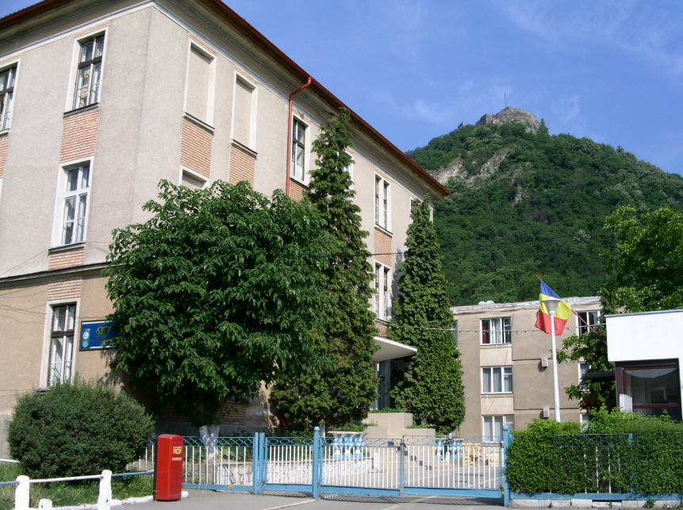
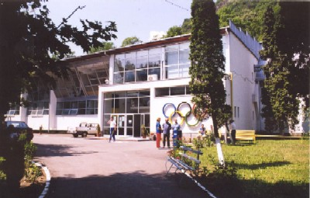
“Cetate Deva" National Sports College
On September 1st ,1978 the General School No. 7 was founded. It is known by the entire world because of the generations of gymnasts as Nadia Comaneci, Ecaterina Szabo, Daniela Silivaş and many others. The school has changed many names: between 1991-1993, High School of Physical Education and Sports, in 1993 it is named the Sports School Group and since 2003, the official name is "Cetate Deva" National Sports College.

Slide 8
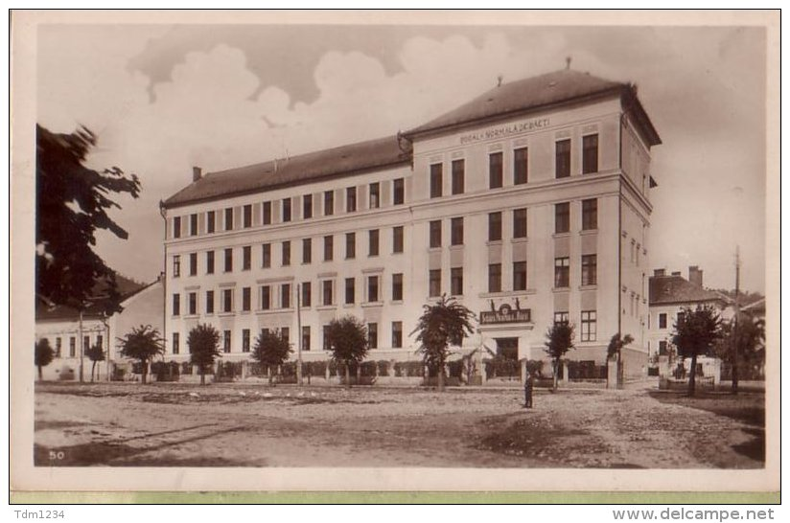
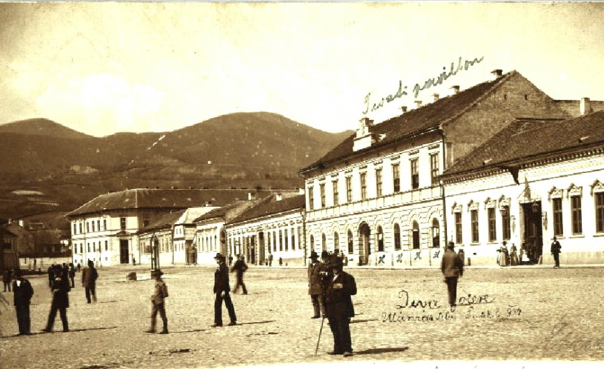
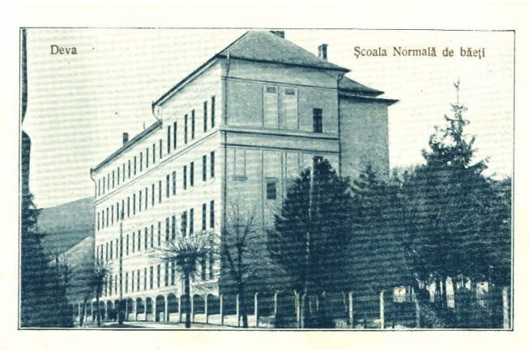
“Regina Maria" National Pedagogical College
The State School for training teachers was created in 1870. The school had three classes each having 8 students, as a total 24 per school.

Slide 9
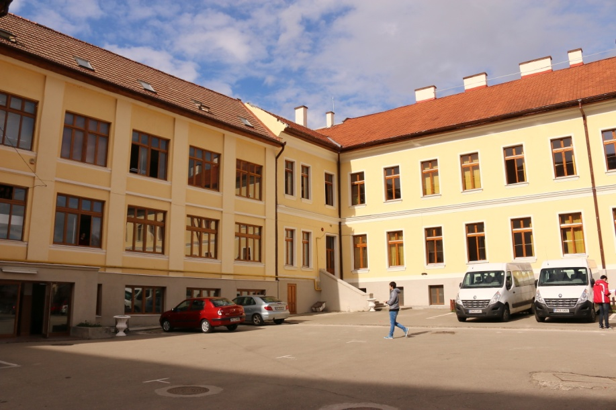
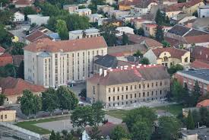
“Regina Maria" National Pedagogical College
Over time, the school has been changing its name and structure. In 2008 the Pedagogical High School "Sabin Dragoi" and The Elementary School “Regina Maria“ were merged, 7 years later, the entire institution changed its name into “Regina Maria” National Pedagogical College, due to the involvement of Queen Maria construction of a building of the college (1937-1938).

Slide 10
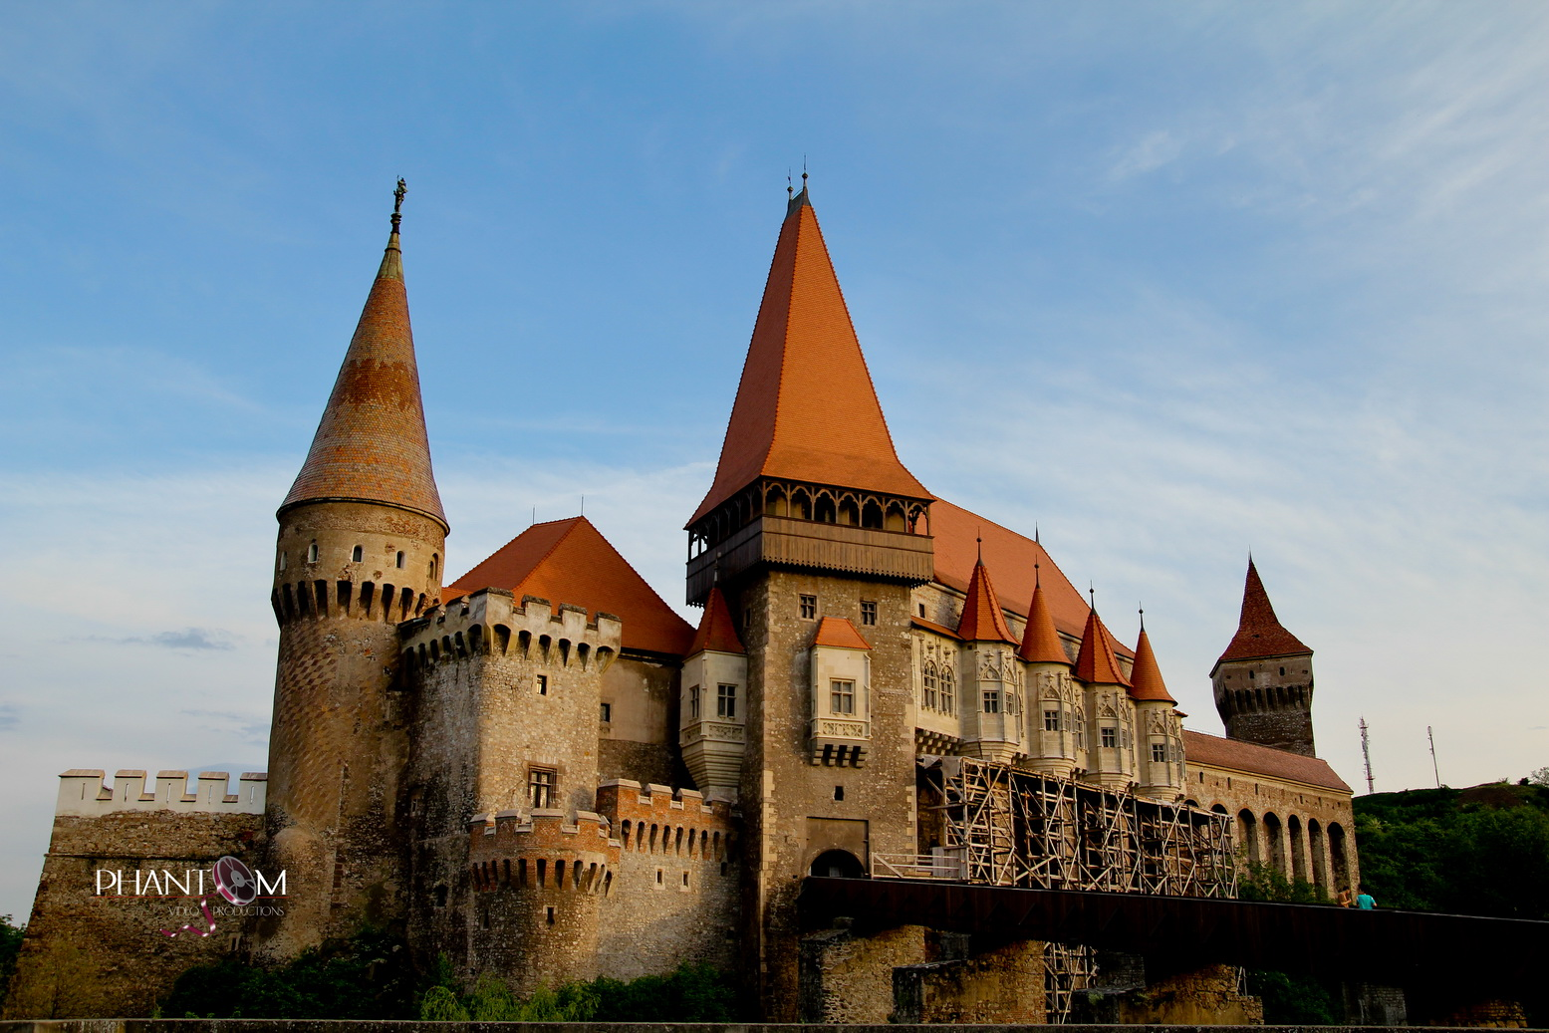
The Hunedoara Castle

Slide 11
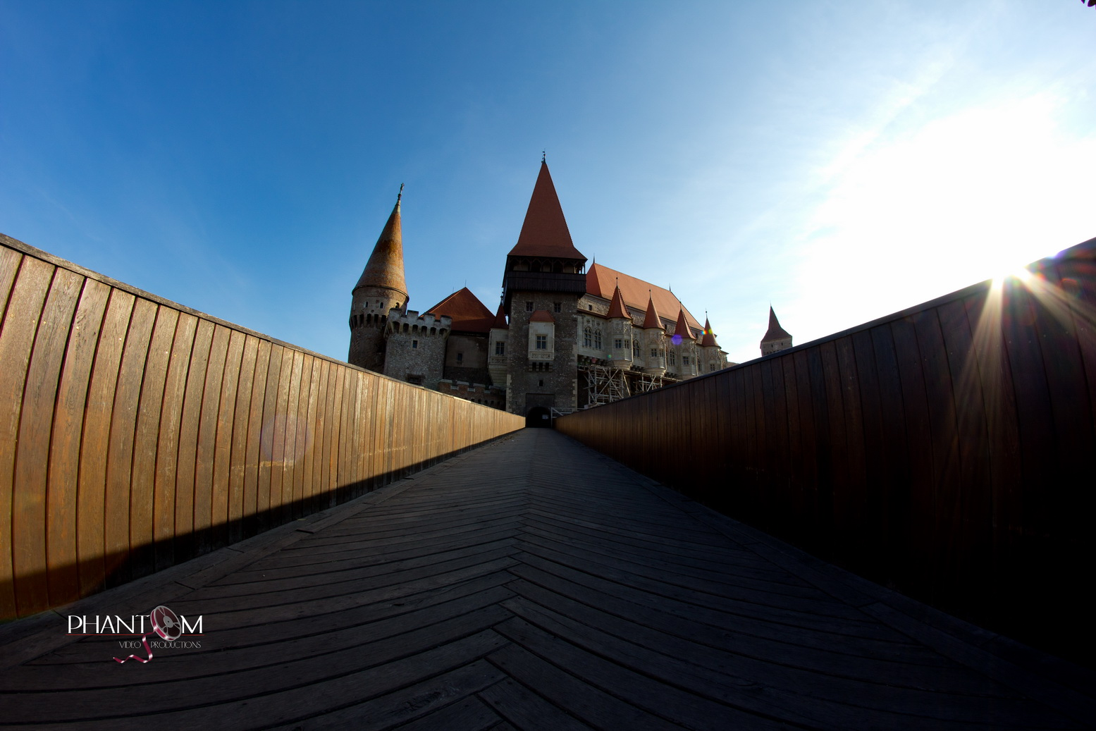
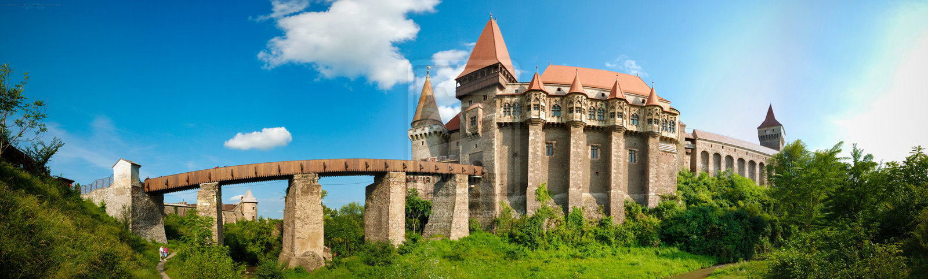
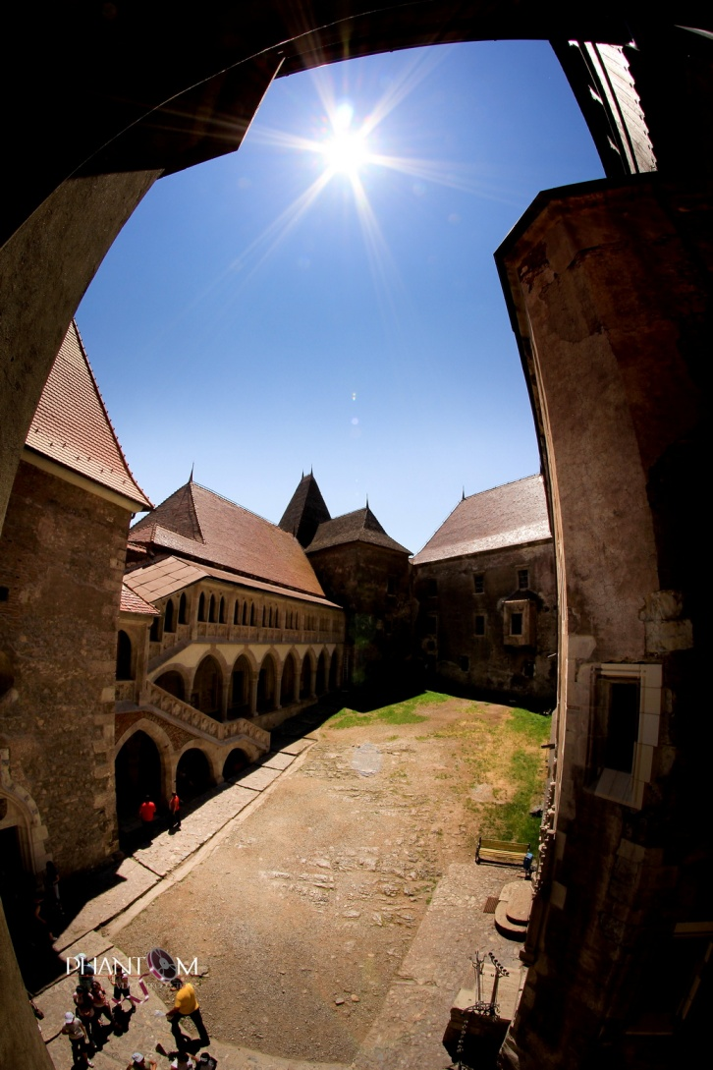
The Hunedoara Castle is a Gothic-Renaissance castle in Hunedoara. Huniad Castle was built by King Carol Robert of Anjou.
The current castle is the result of a fanciful restoration campaign undertaken after a disastrous fire and many decades of total neglect. It has been noted that modern "architects projected to it their own wistful interpretations of how a great Gothic castle should look".

Slide 12
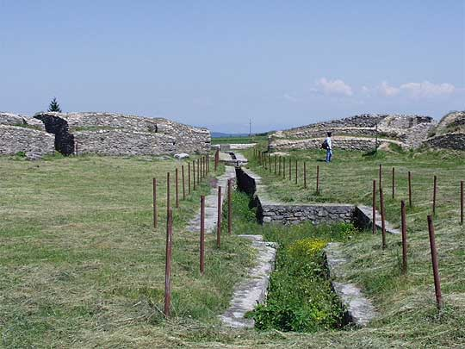
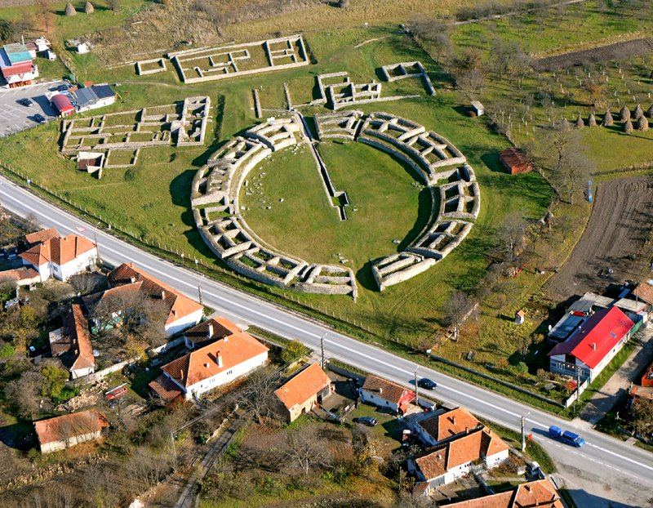
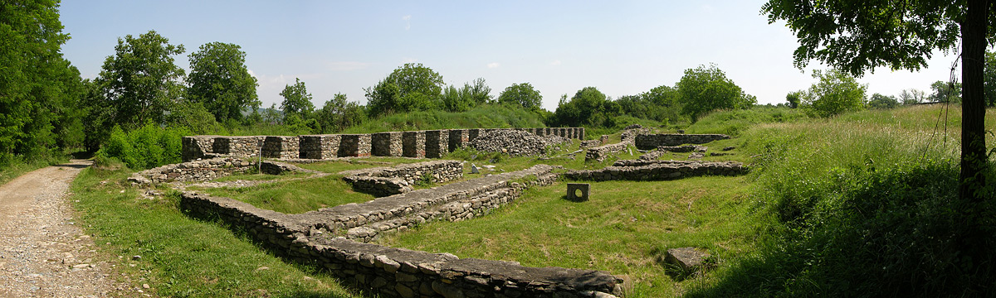
Ulpia Traiana Sarmisegetuza
This is a city in Roman Dacia, founded by the first governor of the province, Terentius Scaurianus, between 108 and 110. During the reign of Emperor Hadrian the city had also got the name of Sarmizegetusa, borne by the capital of the Dacian Kingdom of Decebalus.

Slide 13
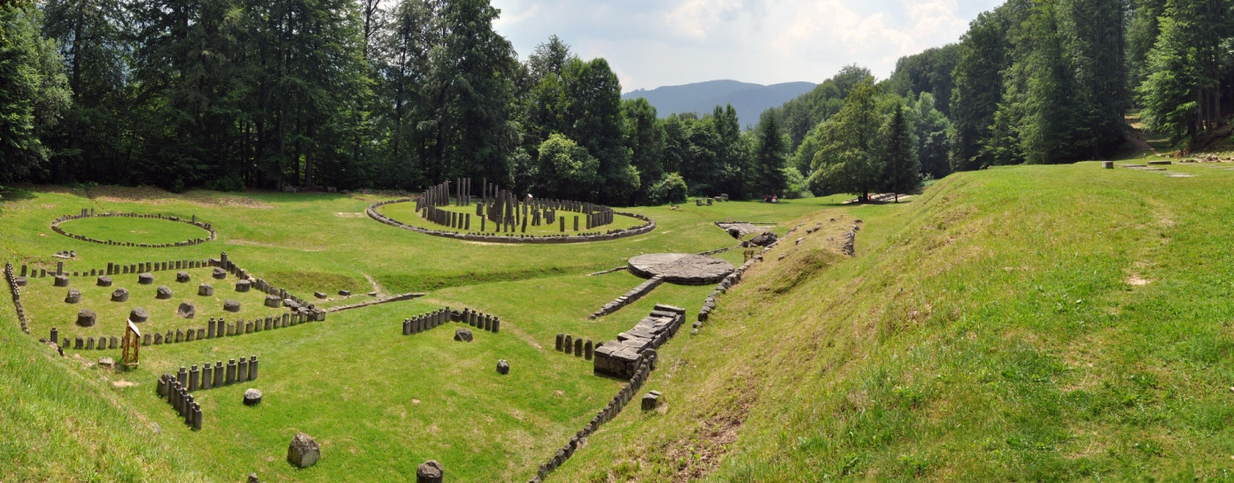
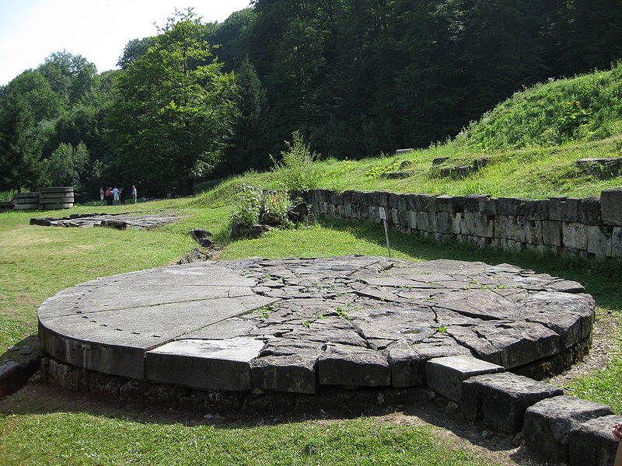
Sarmizegetusa Regia
Sarmizegetusa Regia was the capital and the most important military, religious and political center of the Dacians.
Erected on top of a 1,200 meter high mountain, the fortress was the core of the strategic defensive system in the Orăştie Mountains, comprising six citadels. Sarmizegetusa Regia was the capital of Dacia prior to the wars with the Roman Empire.

Slide 14
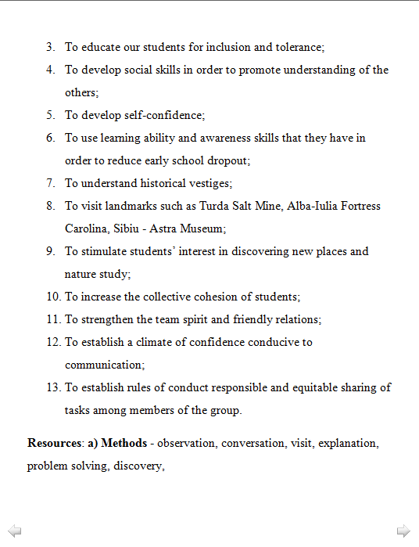
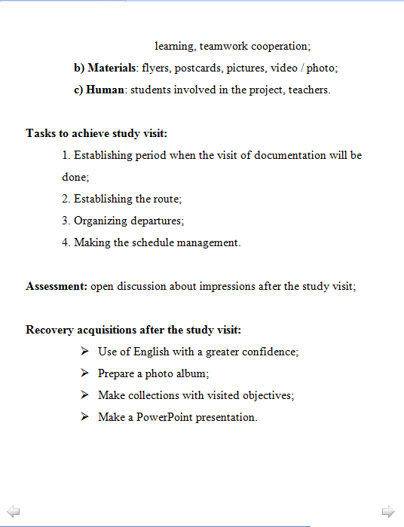
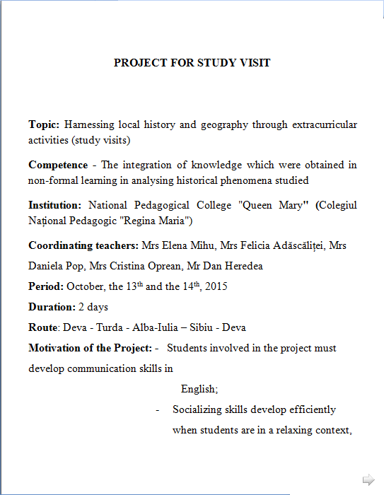
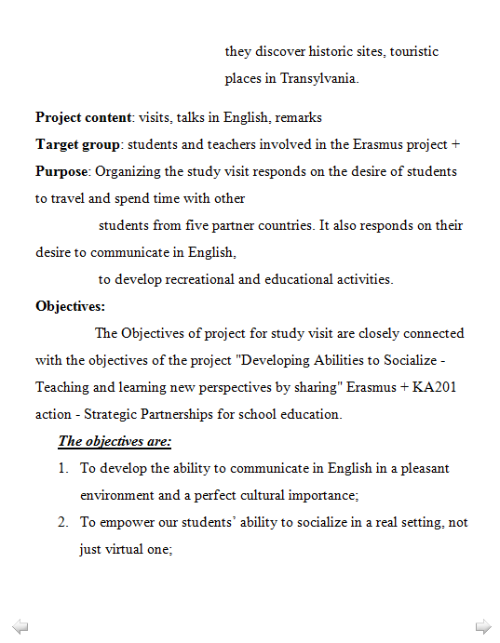
Project for study visit

Slide 15
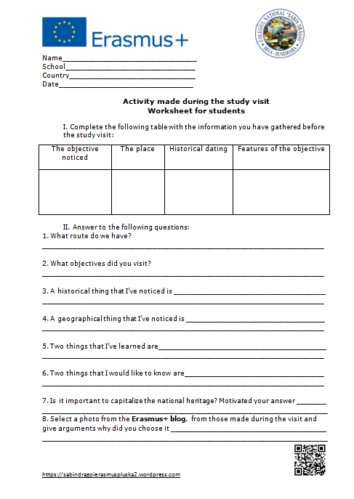
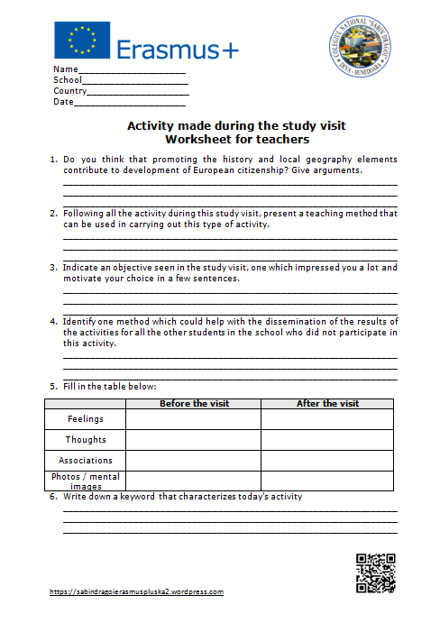
Worksheets for students and teachers

Slide 16
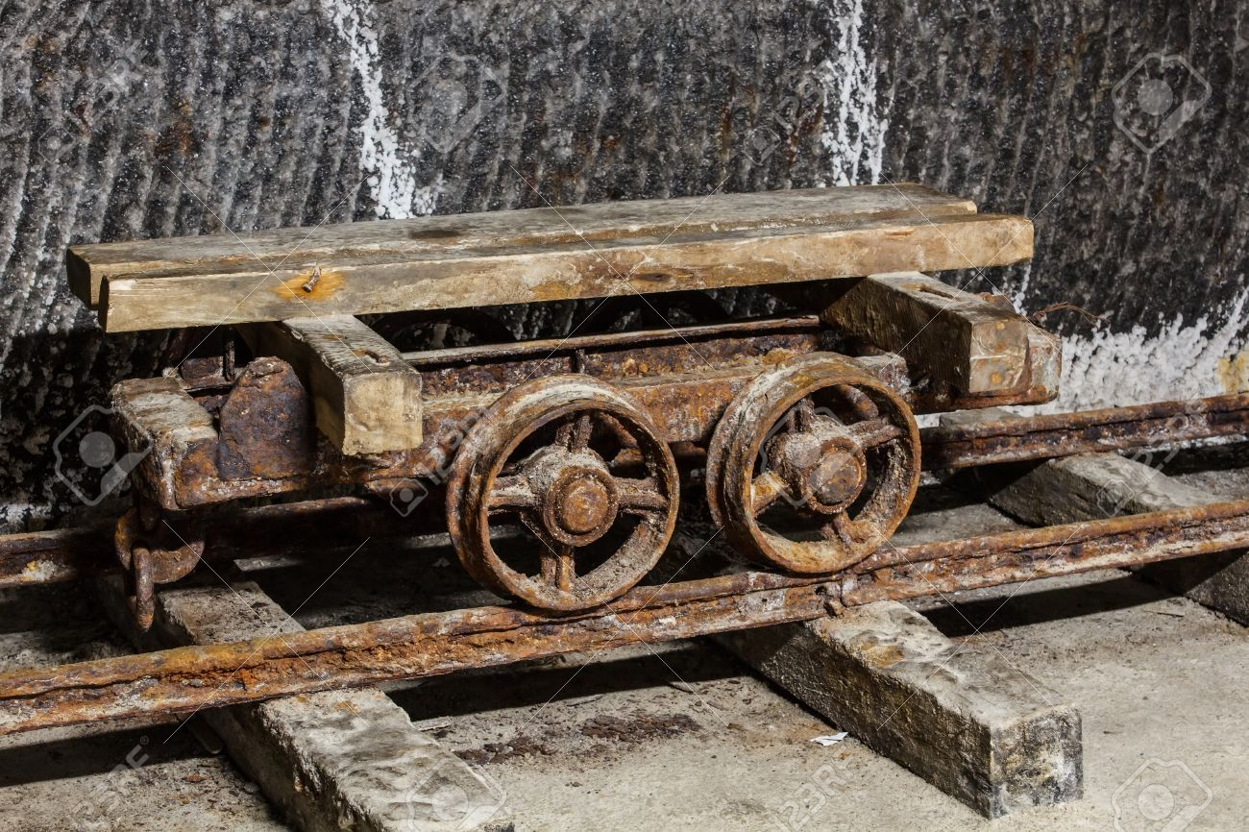
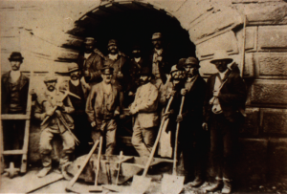
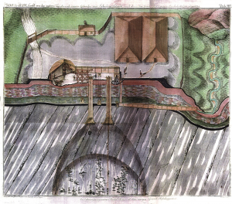
Turda Salt mine
The first document that speaks about the existence of the Turda salt mines dates from 1271. In1932 the salt mine was closed due to low productivity.

Slide 17
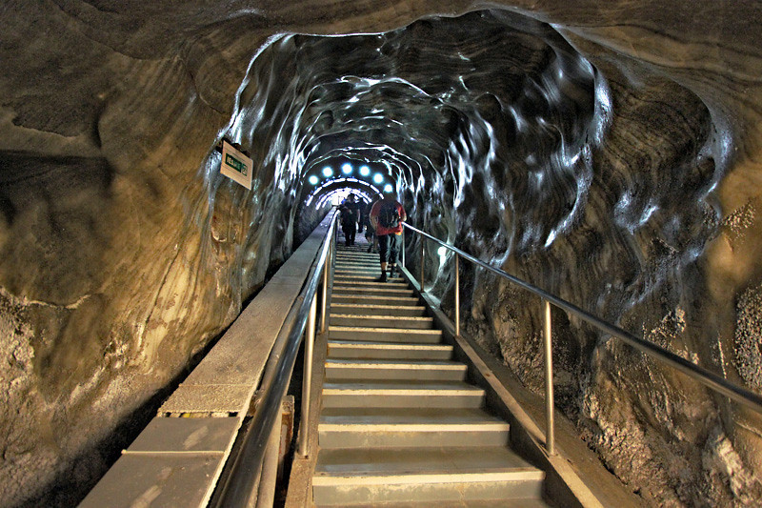
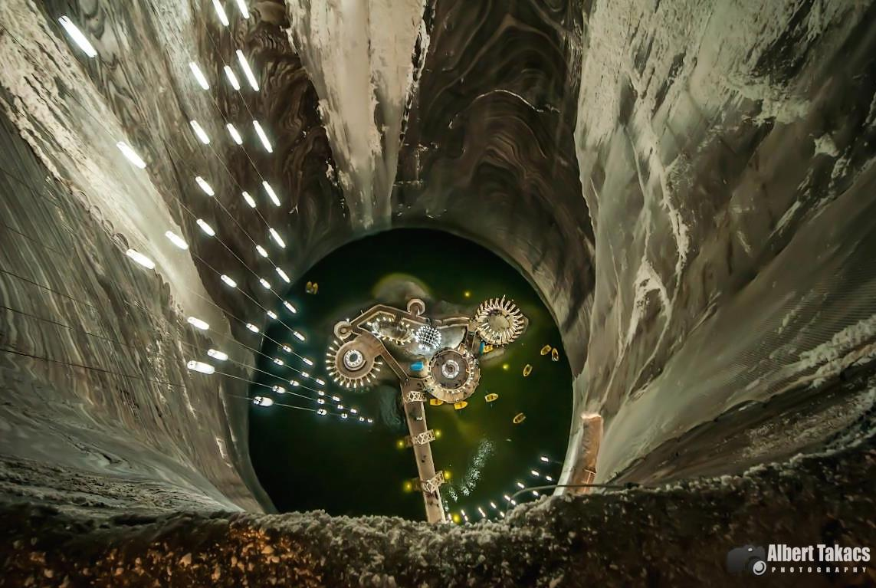
Turda Salt mine
In1992 it was reopened to the public, as a tourist landmark. In 2008 the salt mine enters into a comprehensive process of modernization. The excellent state of conservation made Turda salt mine an European or even global tourist attraction.

Slide 18
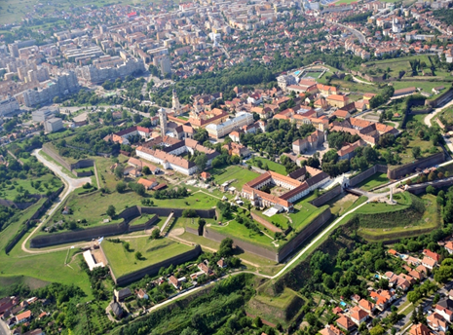
The Citadel of Alba Iulia
The initial settlement called Apulum was the oldest and the largest castrum on Romania’s territory, built by the Romans in the 2nd century A.D. In 1599 Mihai Viteazul unified at Alba Iulia for the first time the three provinces of Romania, it was the site of the proclamation of Transylvania’s unification with Romania(1918) and the coronation place of Ferdinand I of Hohenzollern (1922).

Slide 19
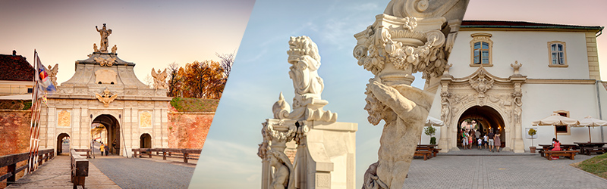
The Citadel of Alba Iulia
In recent years Alba Iulia citadel was fully restored, with beautiful walls and gates, nice statues and great restaurants and cafés. During the day there are some live shows, like battlefield scenes and the changing of the guard at noon.

Slide 20
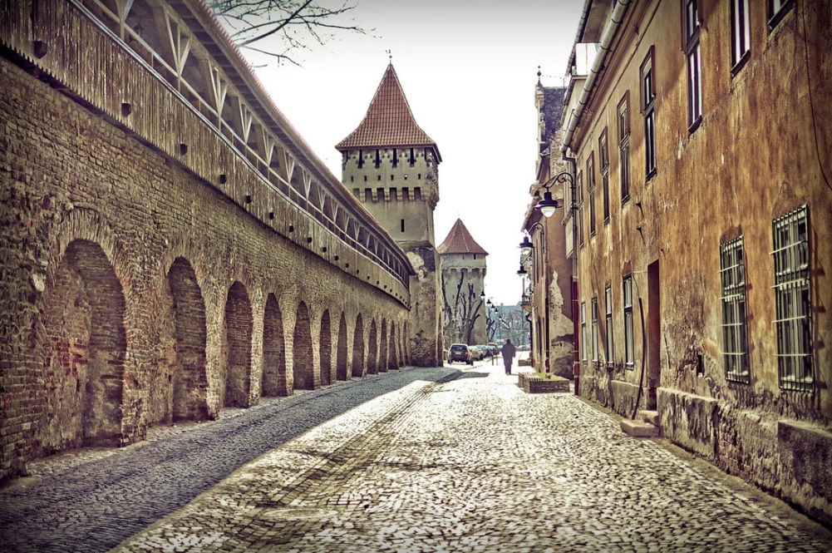
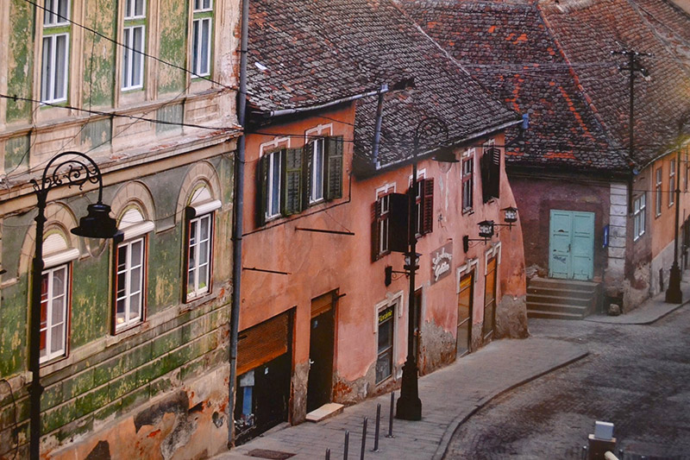
The city of Sibiu
The first official record referring to the Sibiu area comes from 1191. In the 14th century, it was already an important trade centre. During the 18th and 19th centuries, the city became the second and later the first most important centre of Transylvanian Romanian ethnics.

Slide 21
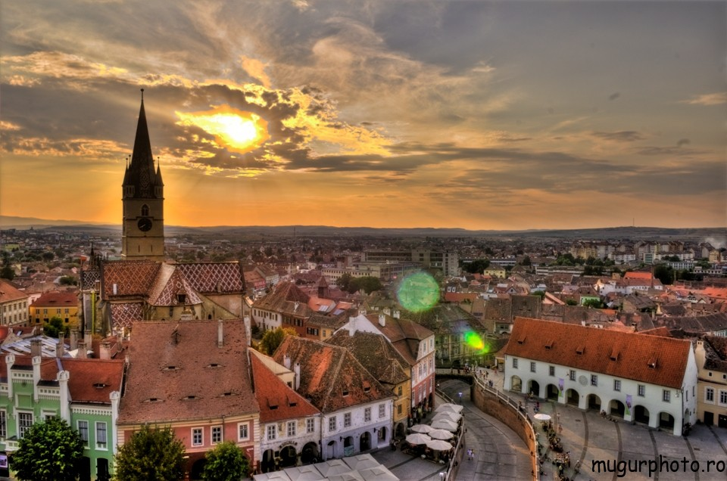
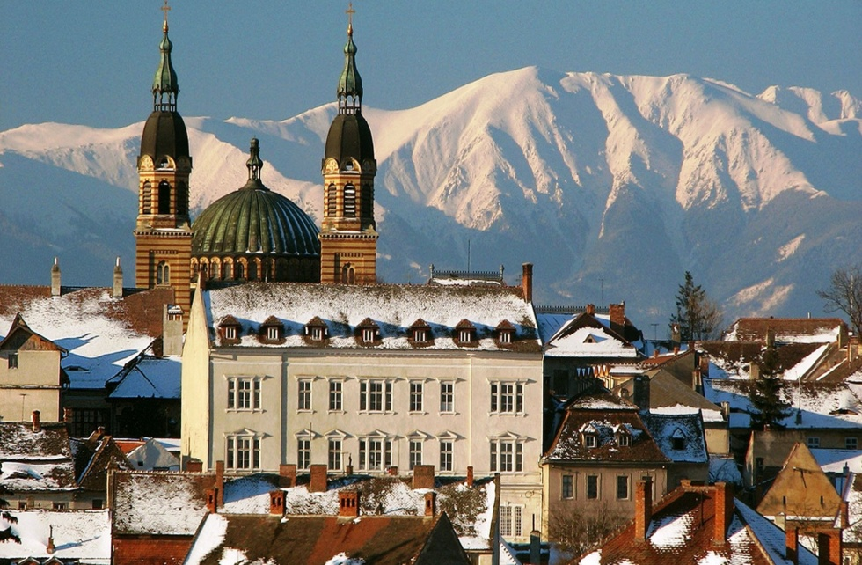
The city of Sibiu
Sibiu is one of the most important cultural centres of Romania and was designated the European Capital of Culture for the year 2007. The old city of Sibiu was ranked as "Europe's 8th most idyllic place to live" by Forbes.

Slide 22
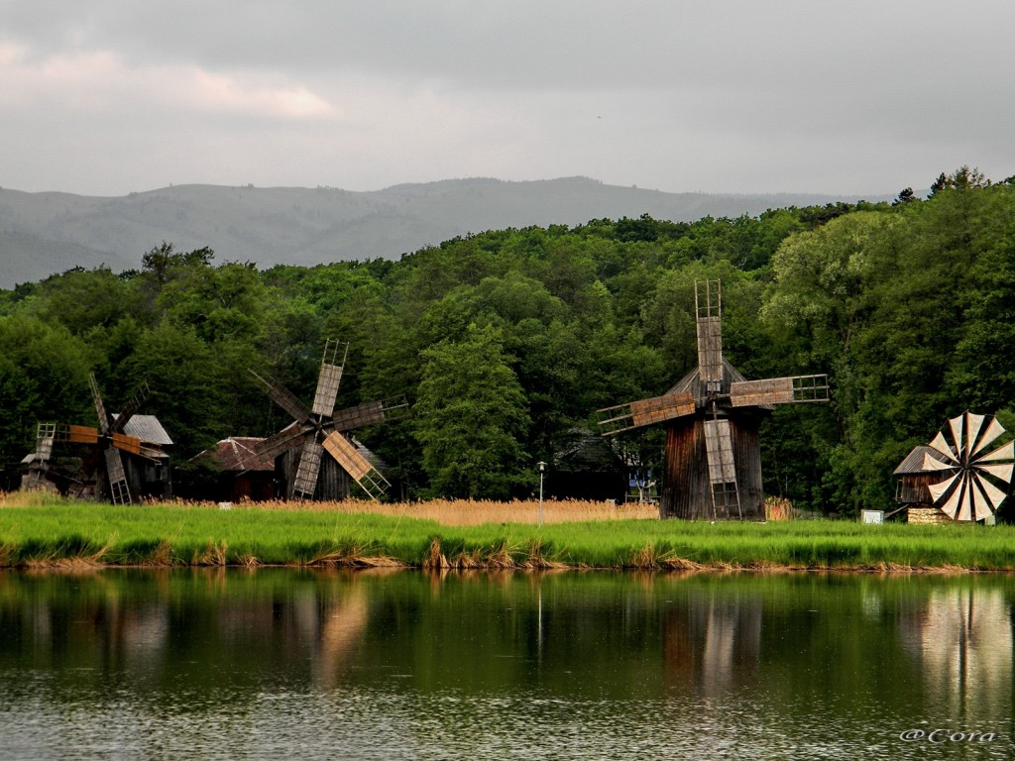
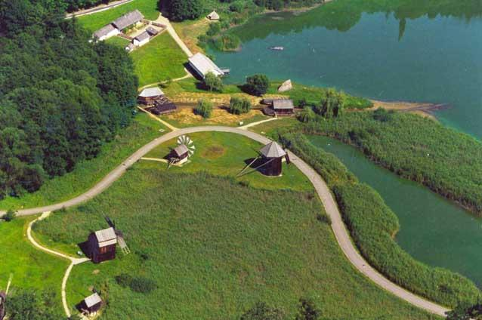
“ASTRA” National Museum Complex
Located in the center of Romania, The `ASTRA` National Museum Complex is the most important ethno-museum institution in Romania. It was created under the auspices of the Transylvanian Association for Romanian Literature and – which was an institution founded in 1861.

Slide 23
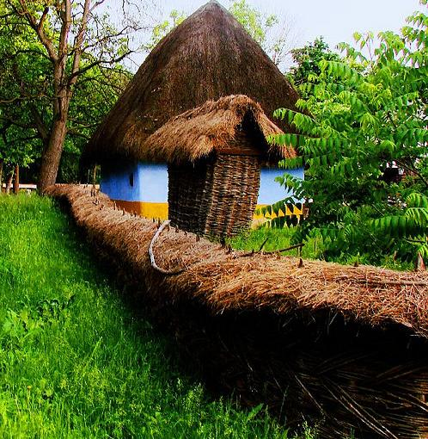
“ASTRA” National Museum Complex
Formerly known as the Association Museum - opened its first exhibition on the 19th of August, 1905. Reorganized under this structure after 1990, the `ASTRA` National Museum Complex has four museum units of ethnographic profile in its structure.

Slide 24
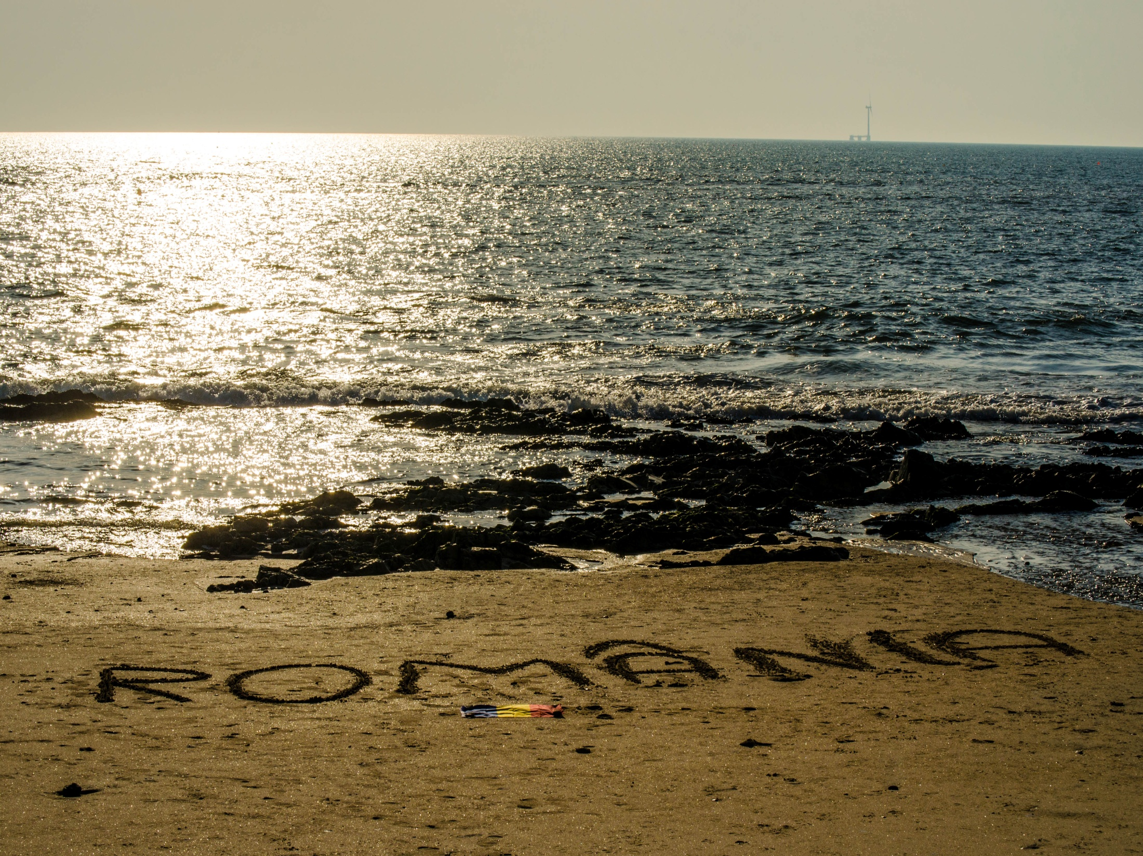

The end!

