Slide 1
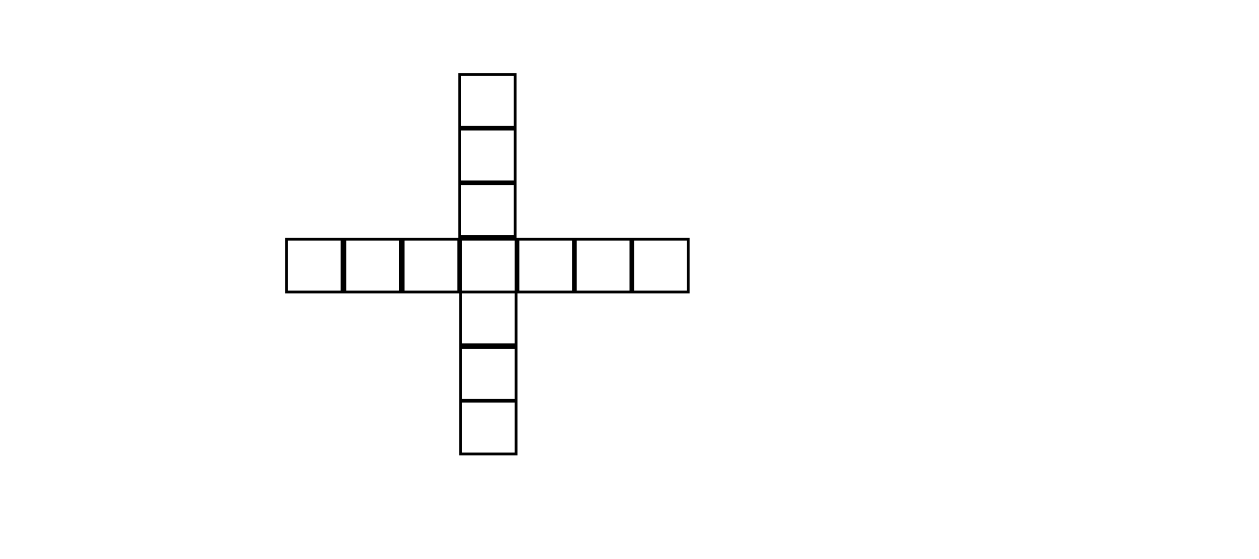
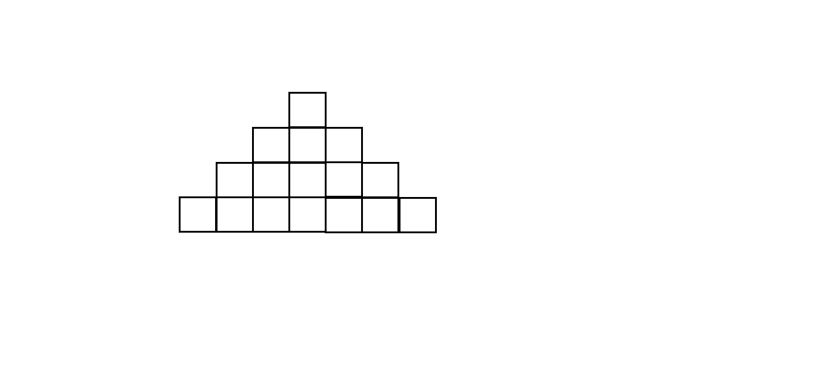
The tower
How many cubes needed to build the tower in the picture?

Slide 2
The tower
How many cubes are needed to build a similar tower that is 12 cubes high?

Slide 3
The tower
How many cubes are needed to build a similar tower that is n cubes high?

Slide 4
The tower
Make your own similar task and solve it !
Duong, Gabriel and Simon
Vasaskolan
Kalmar

