Slide 1
End of Term Quiz July 2015 produced by year 8 – maths group Enjoy and try hard !!

Slide 2
The year in Maths
There are 10 questions
1 point for each correct answer
There is an extra quiz at the end. Looking at famous logos.
Good luck.

Slide 3
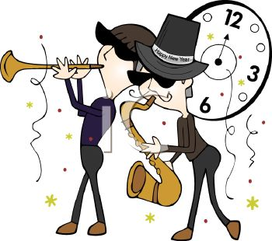
The year in Maths
Question 1:
The last day of school will be on Friday July 17th.
On what day of the week was January 1st 2015?
By James and Sophie

Slide 4
The year in Maths
Question 2:
If you add up all the digits in the year 2013,
you get 2 + 0 + 1 + 3 = 6.
When was the last year all the digits added
up to 6?
By Ryan and Becky

Slide 5
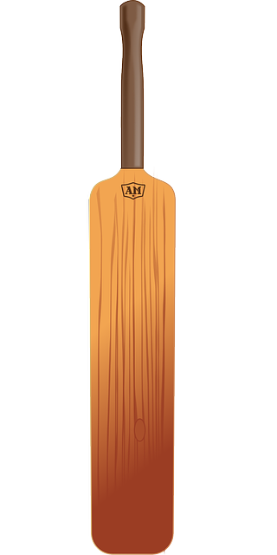
The year in Maths
Question 3:
In cricket, The Ashes between England and Australia are taking place this summer. If a match starts at 11.00am. They play for 2 hours, then have lunch for 40 minutes. They then play for 2 hours 30 minutes and have tea for 25 minutes. Finally they play for 1 hour 45 minutes before stopping for the day. What time do they stop playing?

Slide 6
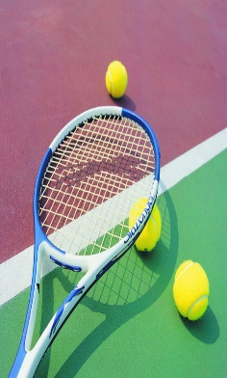
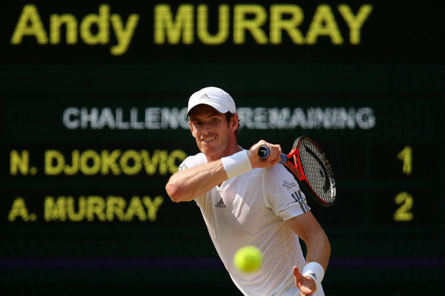
The year in Maths
Question 4:
Andy Murray became the first British man to win Wimbledon since 1936. The tournament wasn’t played between 1939 and 1945 because of World War 2. How many tournaments were played without a British man winning one?
By Danny and Katie

Slide 7
The year in Maths
Question 5:
It takes Mr Clarke 4 minutes to mark a Class Book. He has 28 pupils in his class. He takes a break of 9 minutes every time he finishes marking 7 books. If Mr Clarke starts marking at 5:30pm, what time will he finish marking the last book?

Slide 8
The year in Maths
Question 6:
Mr Brown lives 8.7 miles from school. He drives to and from school every day. How many miles does he drive every week?
By Grace and Alex

Slide 9
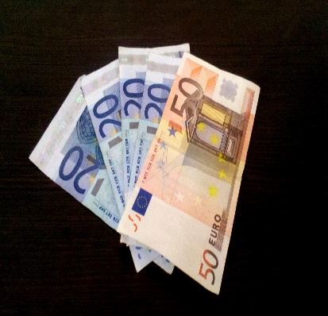
The year in Maths
Question 7:
Mrs Bellard is going on holiday to Spain. She needs to change some money into Euros. For every pound she changes, she receives 1.2 Euros. If she changes £500, how many Euros will she get?

Slide 10
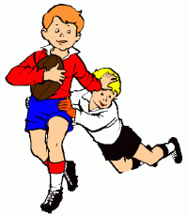
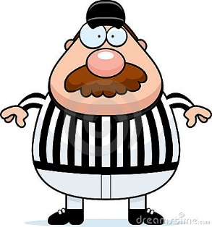
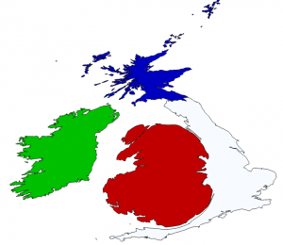
The year in Maths
Question 8:
The British and Irish Lions rugby team won their series against Australia in 2013. Each rugby match is 80 minutes long. They played 3 matches. In each match, the referee added on 10% extra for injury time. How many minutes of rugby were played in total?
By Ben and Joe

Slide 11
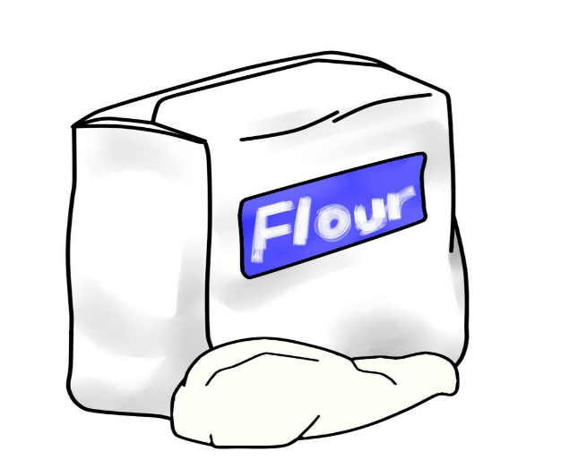
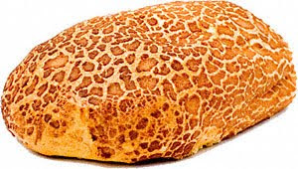
The year in Maths
Question 9:
Miss Preston is baking bread. She uses 250g of flour for each loaf. If she uses 3.5kg of flour in total, how many loaves did she bake?
By Sarah and Taylor

Slide 12
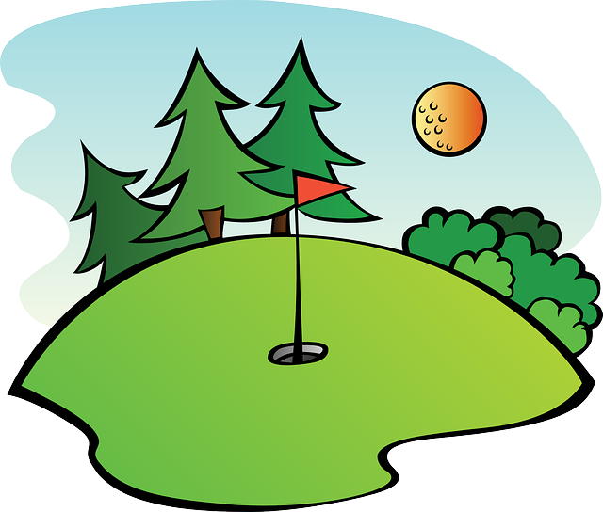
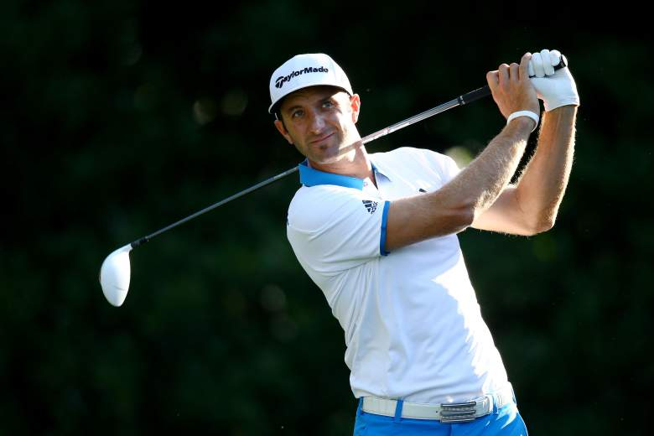
The year in Maths
Question 10:
A few weeks ago, Jordan Spieth won the Masters Golf tournament. The golf course has 18 holes, and he played it once a day for four days. Each hole on average is 300 yards long. How far did Jordan walk over the four days?

Slide 13
The year in Maths - Answers
Thursday
2004
6:20pm
70 tournaments
7:49pm
87 miles
600 Euros
264 minutes
14 loaves
21,600 yards

Slide 14
Picture round
This round is a little extra:
Logos – Name the company or product that each logo represents.
One point for each.

Slide 15
Picture round - Logos
1. | 2. | 3.
4. | 5. | 6.
7. | 8. | 9.

Slide 16
Picture round – Logos Answers
McDonalds
Mercedes-Benz
Walls
Cadbury Dairy Milk (half a mark if you just put Cadbury)
Gucci
Xbox
Yahoo!
Domino’s Pizza
Nike

