Slide 1
Tarptautinis eTwinning seminaras “Artimesnis šeimos ir mokyklos bendradarbiavimas: skaitmeninių technologijų vaidmuo” Guimarães, Portugalija

Slide 2
KOMANDA IŠ LIETUVOS

Slide 3
https://www.youtube.com/watch?v=dkG00Czb4ho#t=12

Slide 4
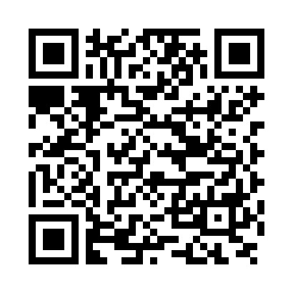
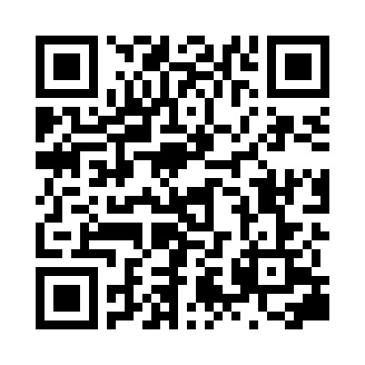
QRCode Reader
For Android
https://play.google.com/store/apps/details?id=me.scan.android.client&hl=en
For IPad & IPhone
https://itunes.apple.com/en/app/qr-code-reader-and-scanner/id388175979?mt=8

Slide 5
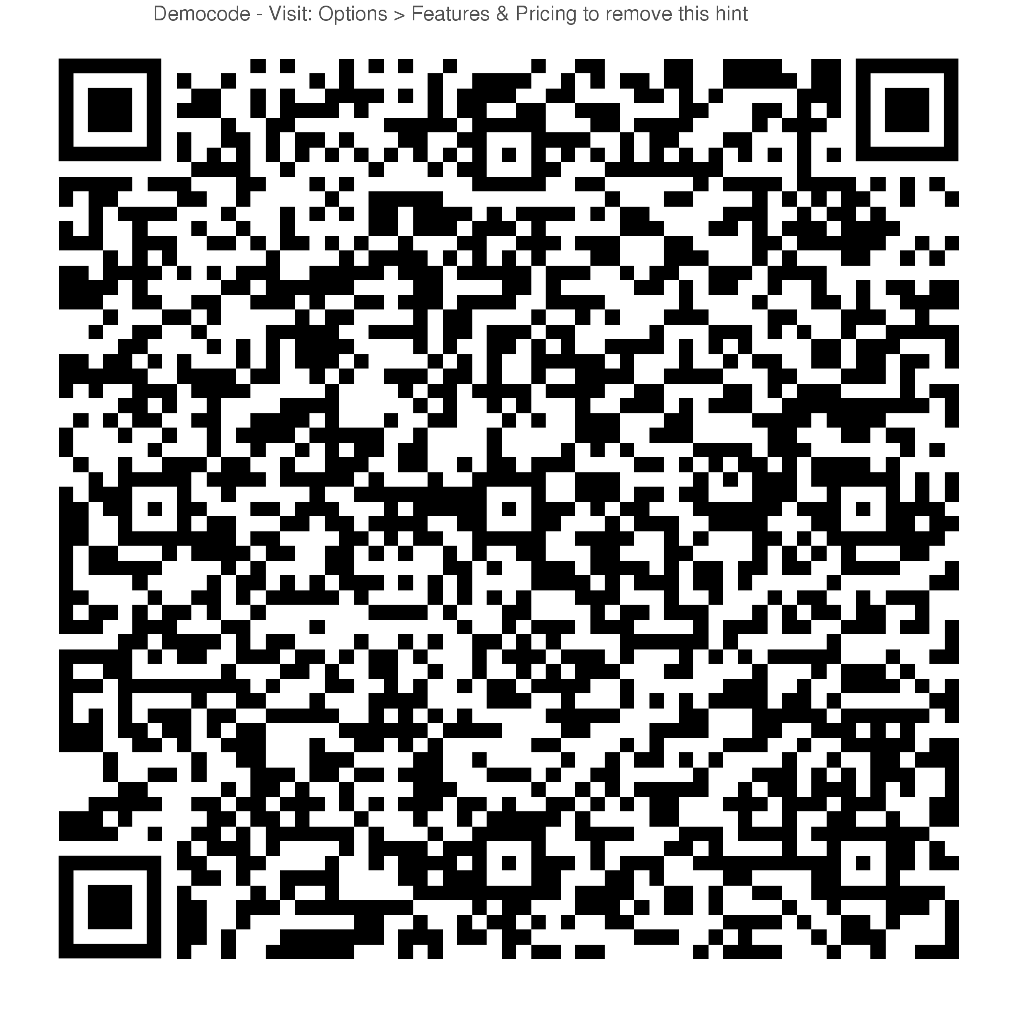

Slide 6
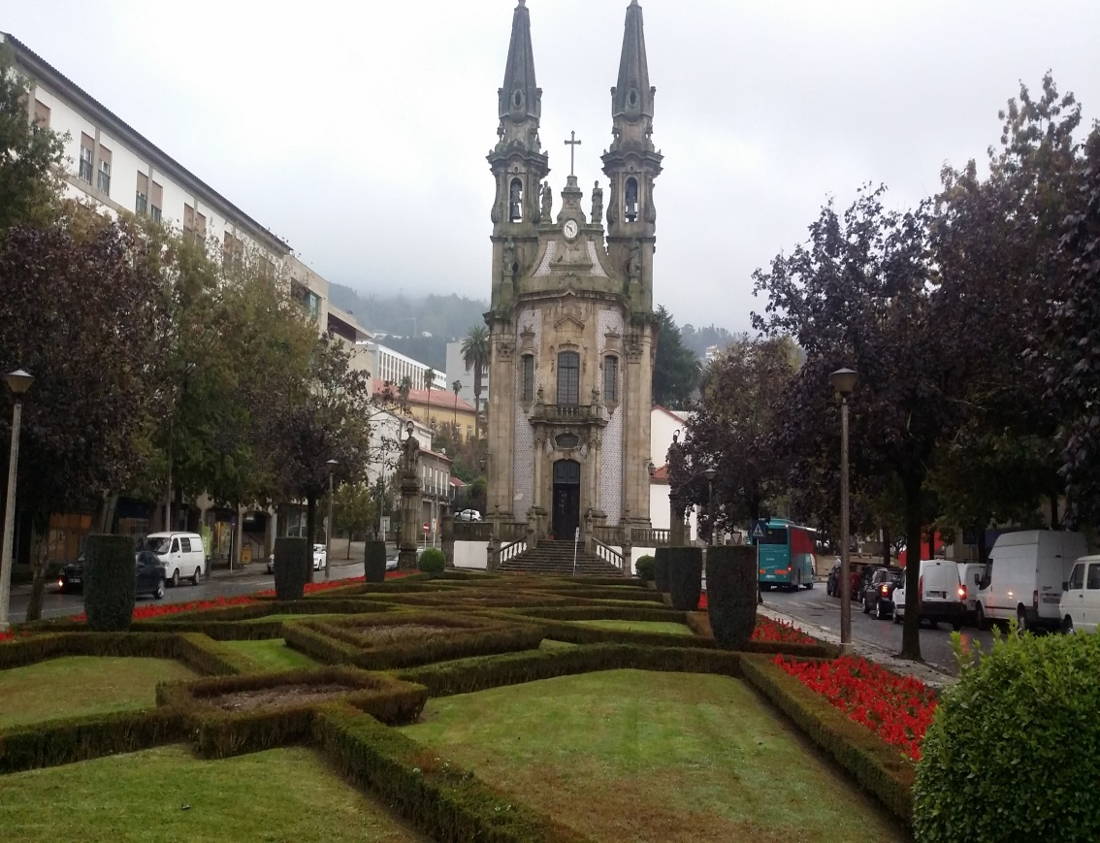
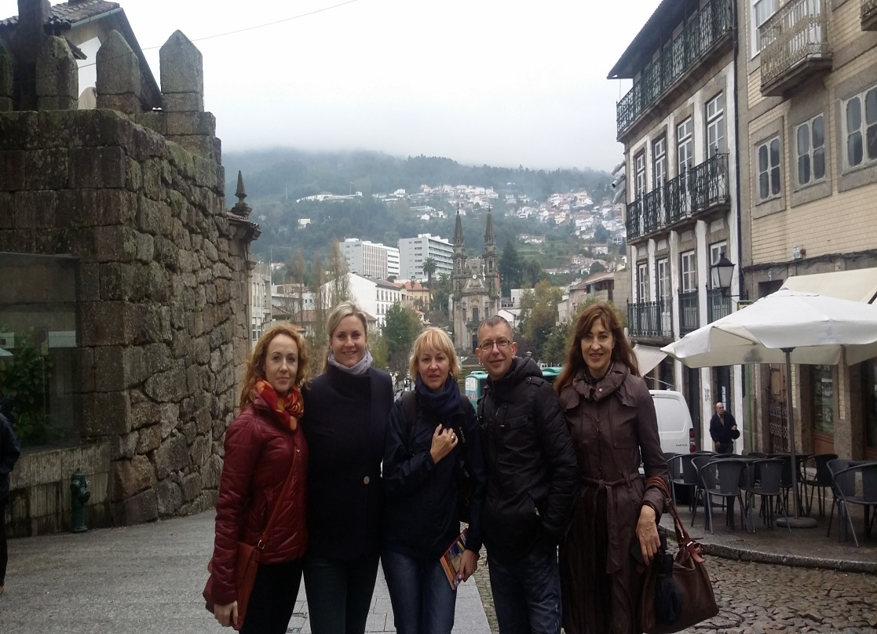

Slide 7
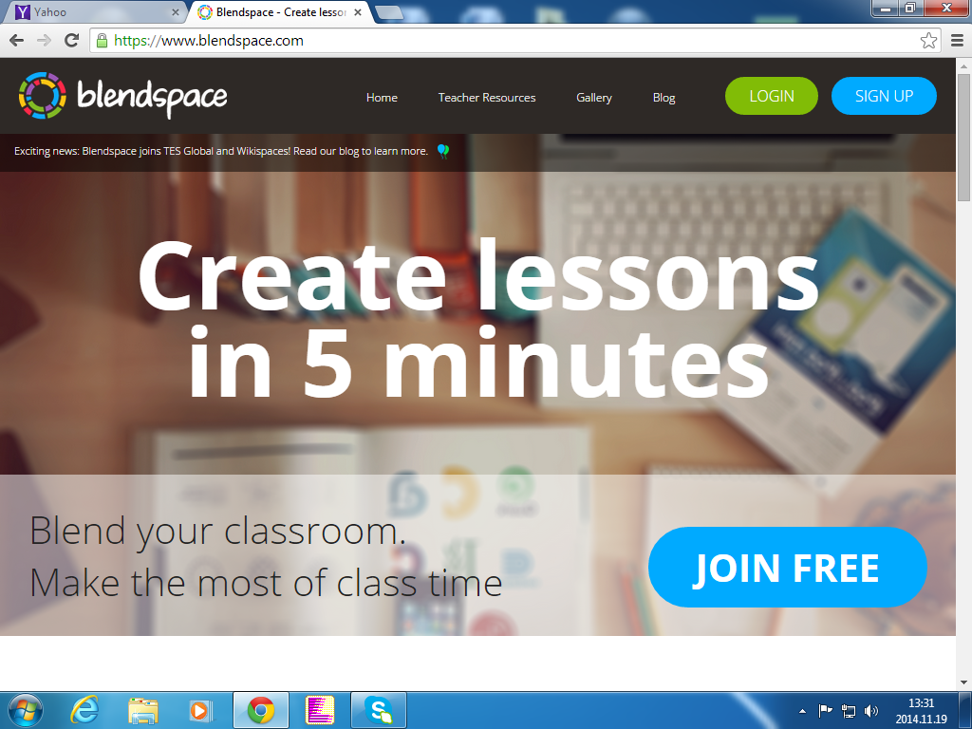

Slide 8
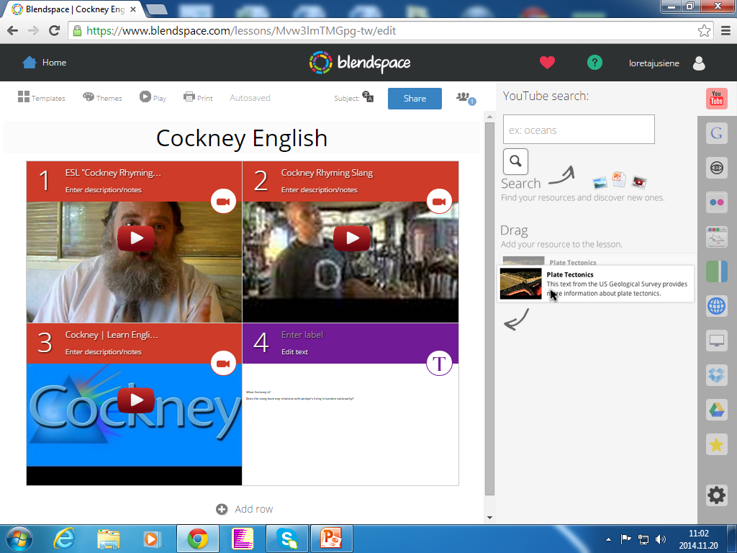

Slide 9
ThingLink
For Android
https://play.google.com/store/apps/details?id=com.thinglink.android&hl=en
For IPad & IPhone
https://itunes.apple.com/us/app/thinglink/id647304300?mt=8

Slide 10
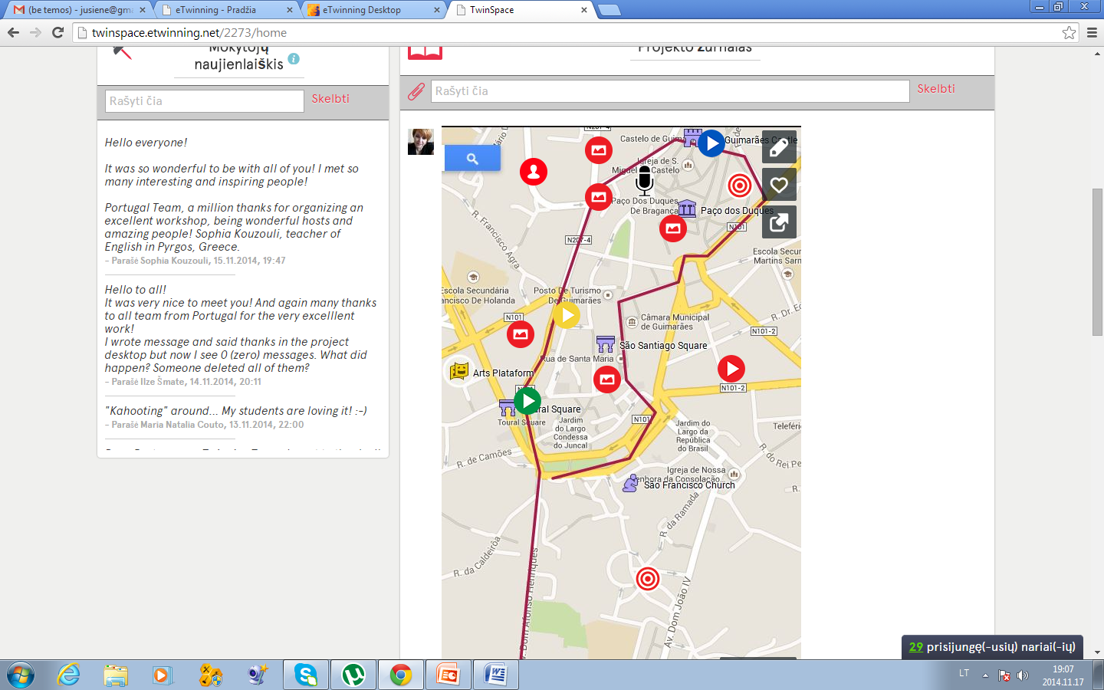

Slide 11
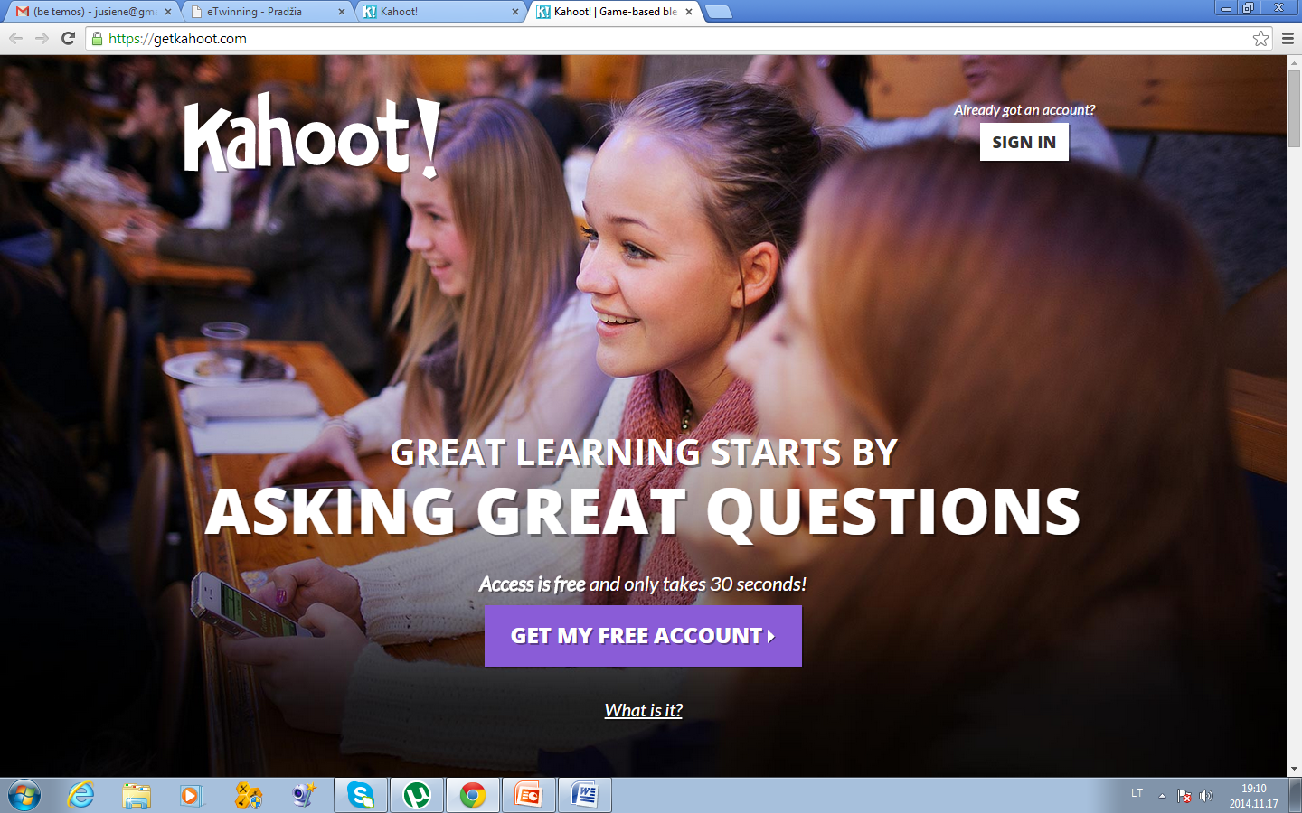

Slide 12
Above and Beyond

