Slide 1
II. Osnovna škola ČAKOVEC

Slide 2
School
Entrance
Hall
2nd floor
Classroom
Gym
Backyard

Slide 3
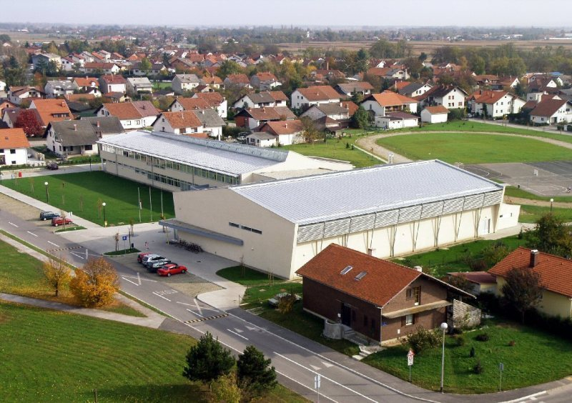
This is the whole school.

Slide 4
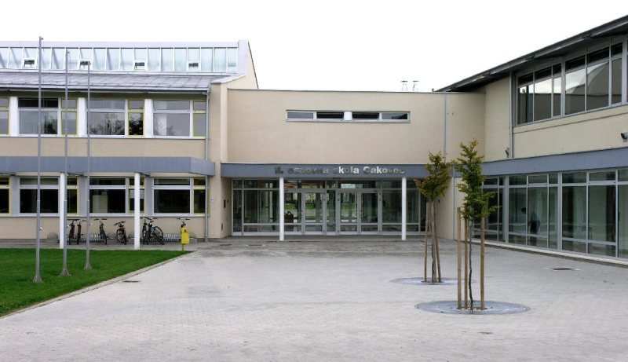
This is the school entrance.

Slide 5
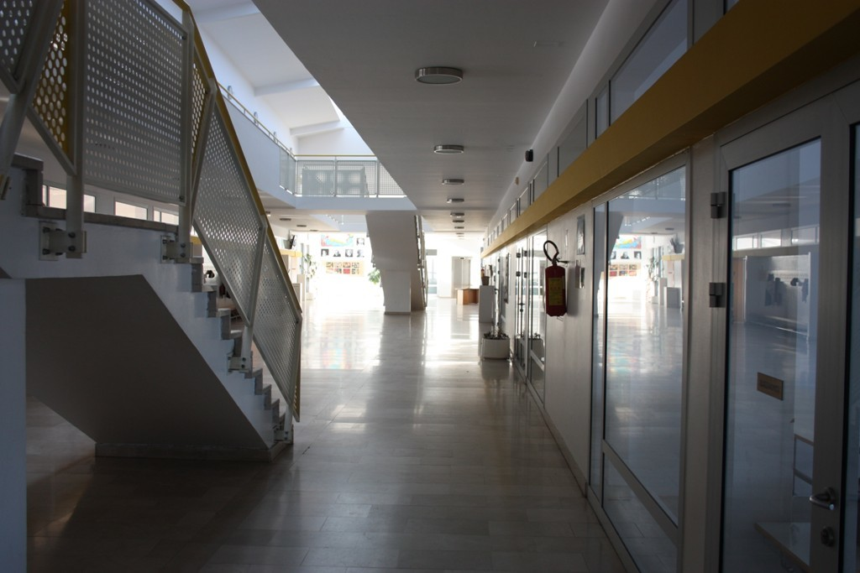
This is the school hall.

Slide 6
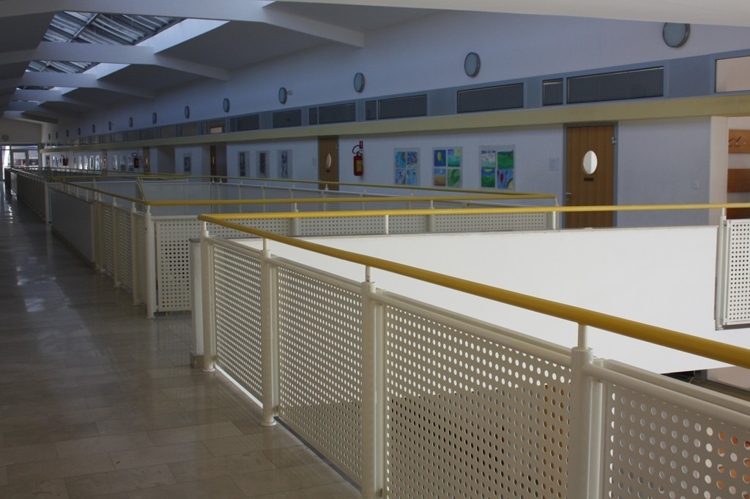
This is the upper part where the higher grades are.

Slide 7
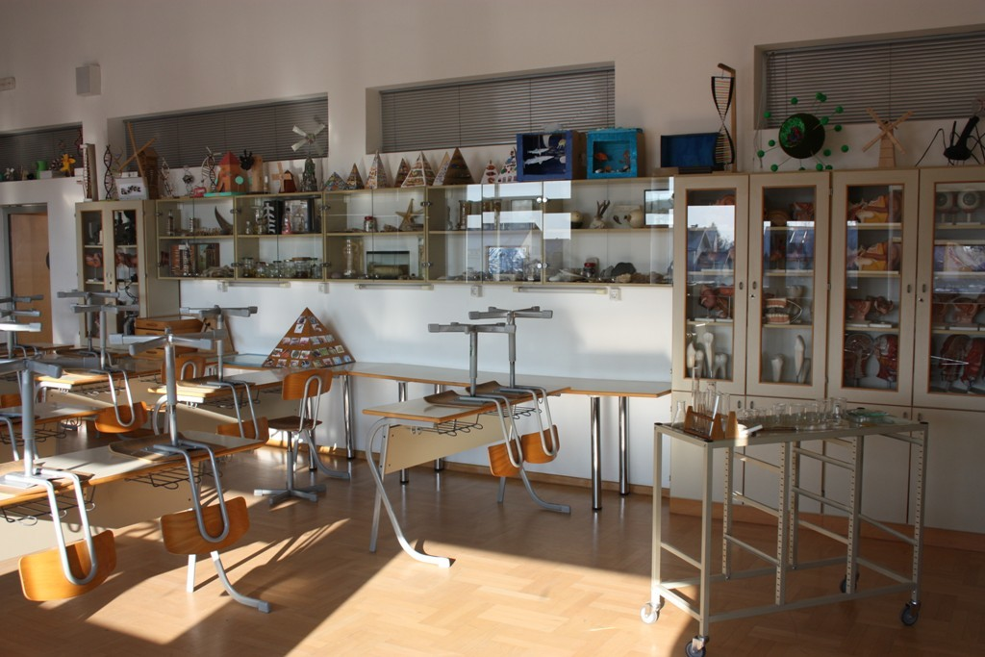
This is the biology and chemistry classroom.

Slide 8
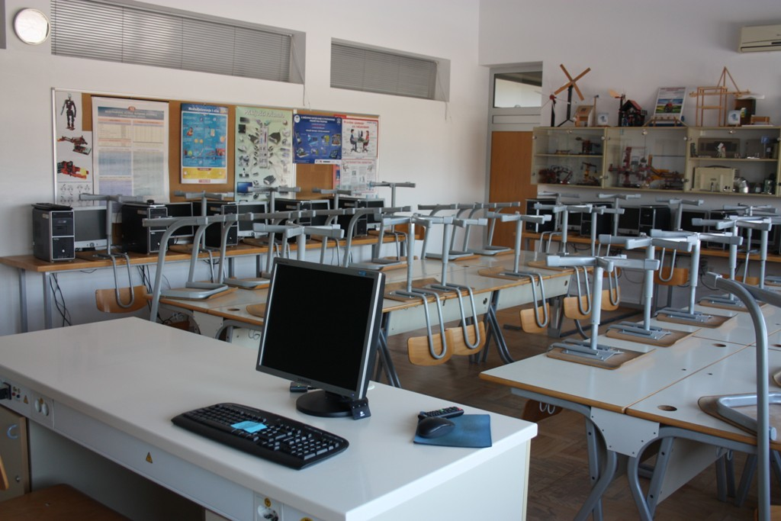
This is the Tehnical Education and Physics classroom.

Slide 9
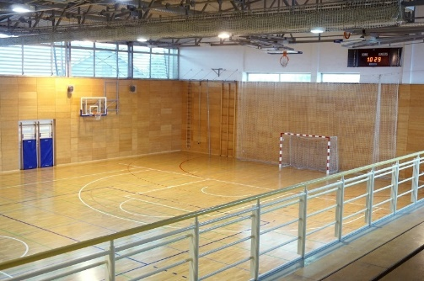
This is the school gym where we have PE classes.

Slide 10
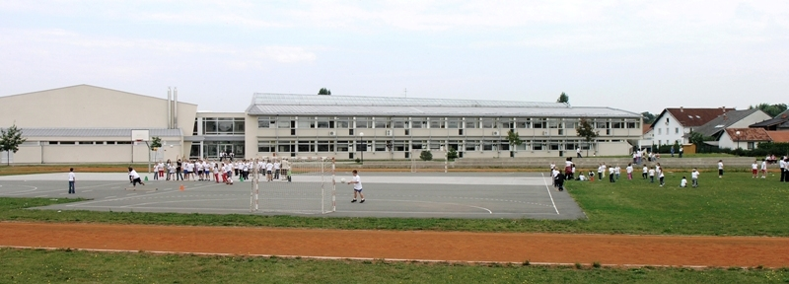
Our school also has a backyard.

Slide 11
The end!
For the eTwinning project: „Sharing our culture with stories and games using Scratch”
27.1.2017
Made by: Vedran Knežević 8.B

