Slide 1
Our school
II. osnovna škola Čakovec

Slide 2
Our school
The school outside
The school library
The hallway
The sports hall
Technology classroom
The biology classroom
Author

Slide 3
The school outside
Next photo

Slide 4
The school outside

Slide 5
The school outside
Back

Slide 6
The school library

Slide 7
The school library
Back

Slide 8
The hallway

Slide 9
The hallway

Slide 10
The hallway
Back

Slide 11
The sports hall

Slide 12
The sports hall
Back

Slide 13
Technology classroom
Next

Slide 14
Technology classroom
Next

Slide 15
Technology classroom
Back

Slide 16
The biology classroom

Slide 17
The biology classroom
Back
Author

Slide 18
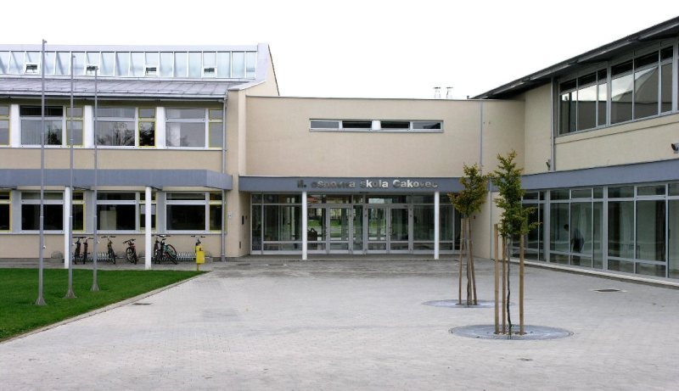
Thanks for watching
I hope you liked the little tour around our school!
eTwinning project Sharing our culture with stories and games using Scratch
Made by: Iris Todorović 8.b

