Slide 1
II. osnovna škola Čakovec, Hrvatska II. Elementary School Čakovec, Croatia

Slide 2
School from above
Entrance
Entrance hallway
First floor
Second floor
School library
Sports hall
Sports park

Slide 3
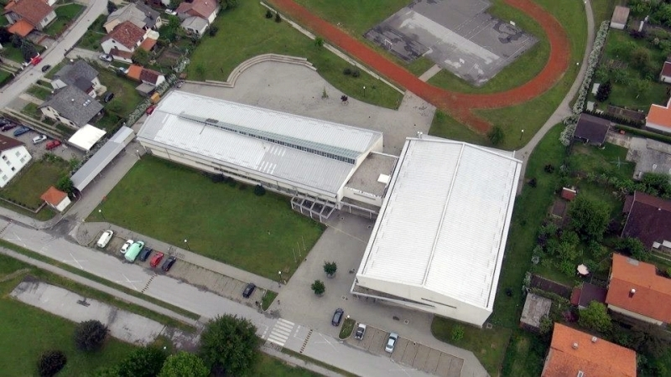

Slide 4
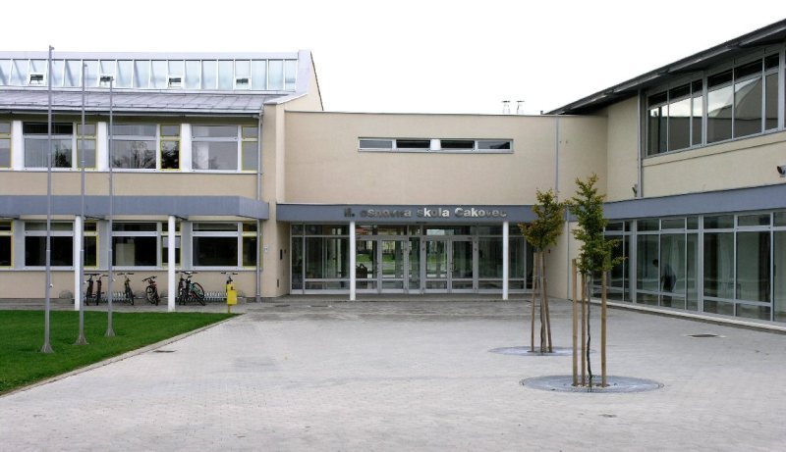

Slide 5
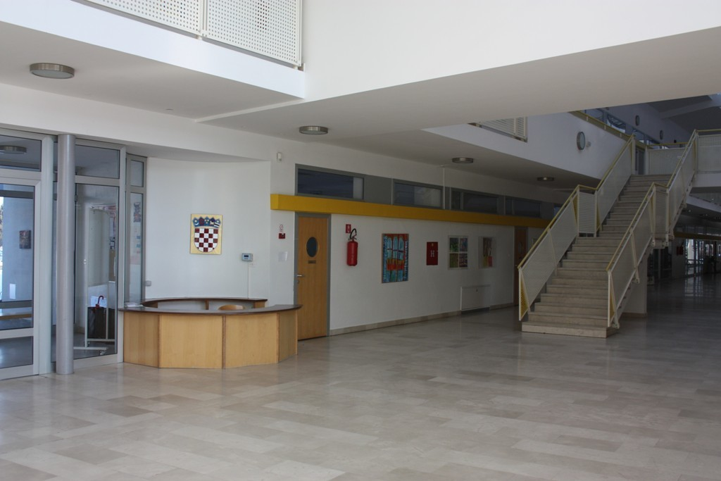

Slide 6
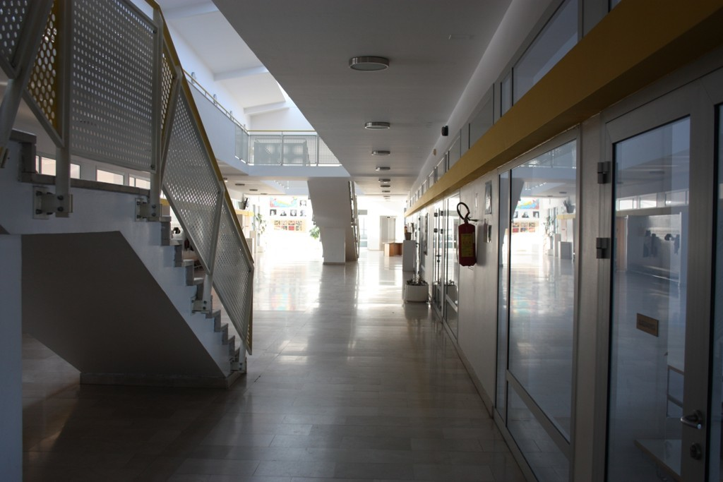

Slide 7
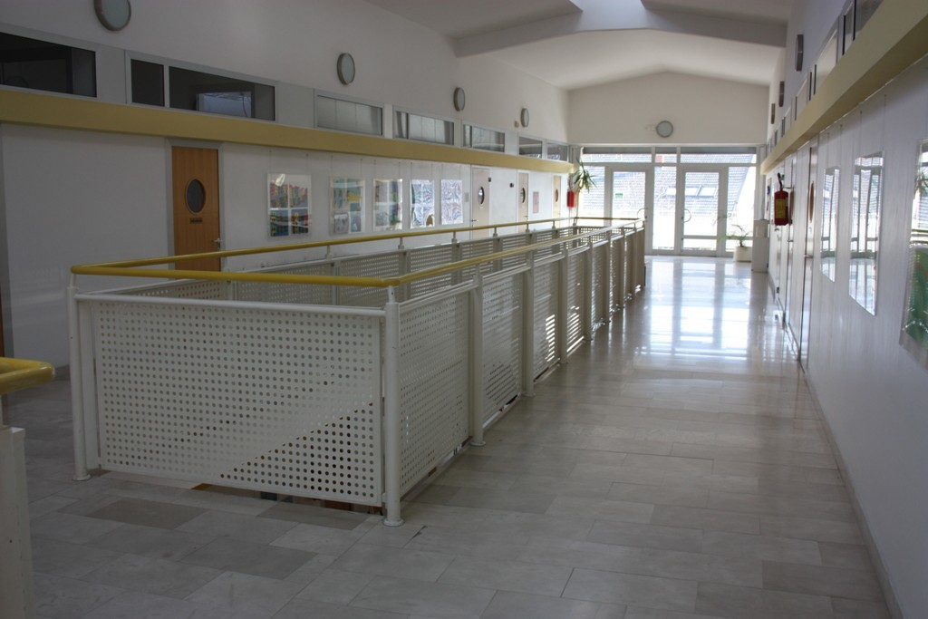

Slide 8
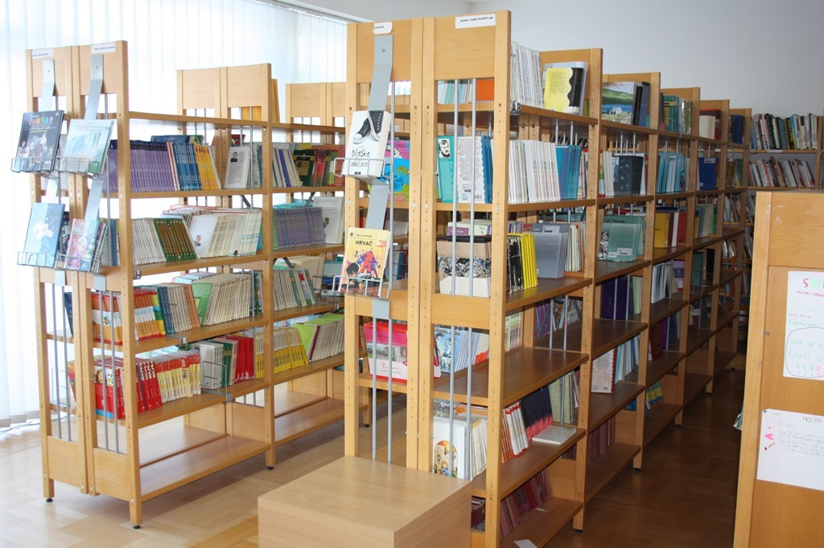

Slide 9
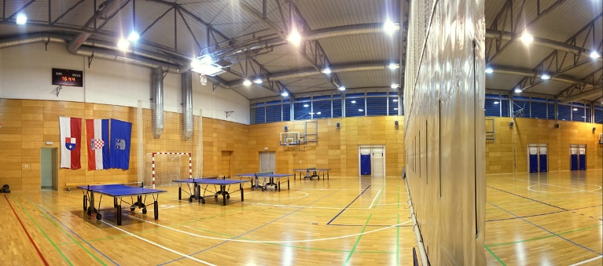
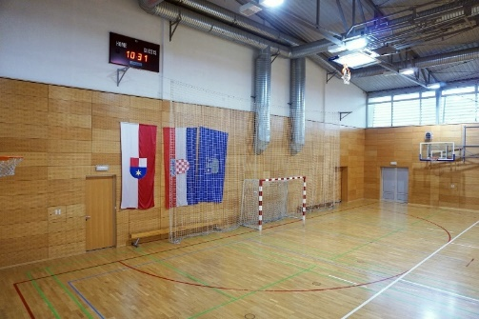
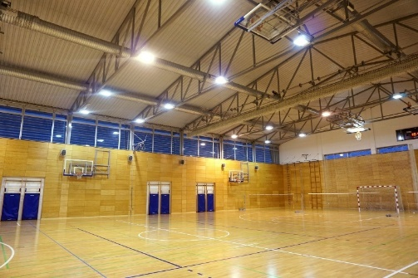

Slide 10
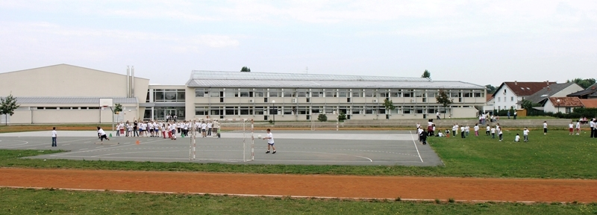

Slide 11
About
Made by: Jakov Novak 8.B (II. osnovna škola Čakovec)
For the eTwinning project: „Sharing our culture with stories and games using Scratch”

