Slide 1
The French dream jobs

Slide 2
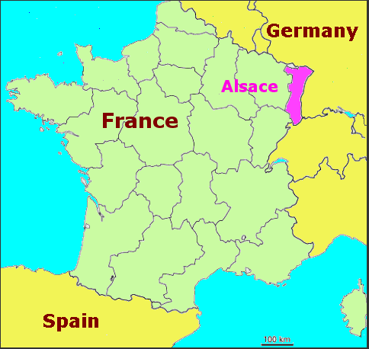
Our school…

Slide 3
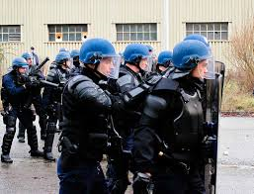
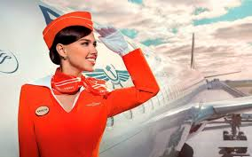
Some examples of our dream jobs…
Nurse
Vet
Lawyer
Football coach
Businesswoman
Policeman
Air hostess

Slide 4
…divided in 9 fields, as used on eTwinning
Journalism
Law
Medical field
Military Field, Police
Services
Sports
Technology, Industry
Trade and Business
Animals

Slide 5
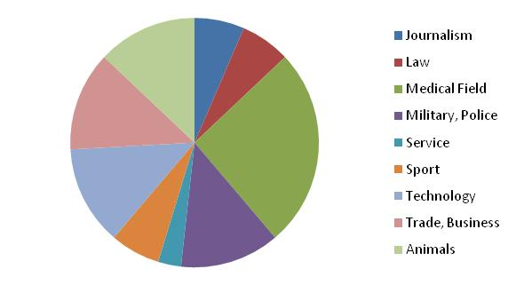
A chart about our class dream fields…

Slide 6
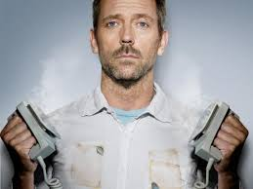
The 5 most common fields are…
- Medical field : 26%
- Army, Police : 13%
- Technology, industry : 13%
- Animal : 13%
-Trade, business : 13%
-

Slide 7
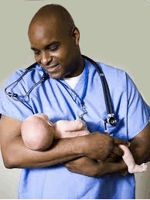
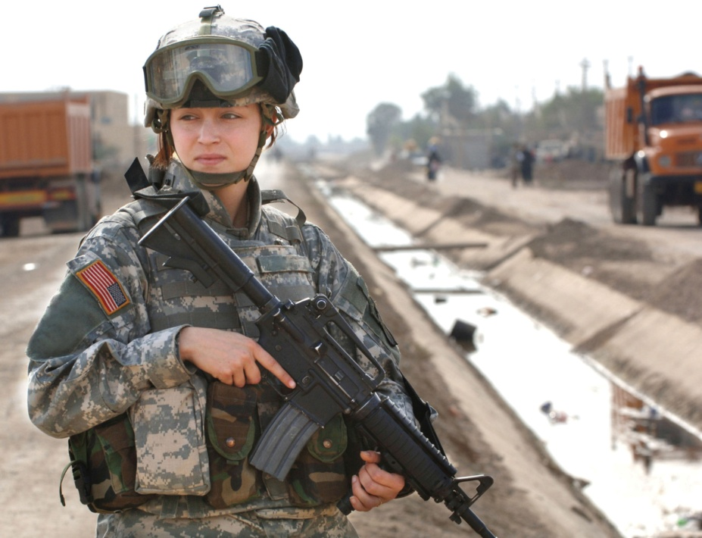
Boys/Girls
In our class, a lot of girls want to work in the medical field while a lot of boys want to work in the army or police…

Slide 8
3 examples of fields…

Slide 9
Medical field
26% of the students in our class want to work in medical field.
They like taking care of people, helping them
In France: you need to study for 3 years to be a nurse, 9 years to become a doctor. The exams are difficult…
But it’s quite easy to find a job
Sciences lessons in highschool may help you with the entrance examination

Slide 10
Animals
13% of the students want to work with animals
For example: vet, horse riding instructor…
They like being with animals
To do these jobs, you need some precise knowledge and to be fit
It’s important to do some training courses and to enter some specialized schools
So highschool is not helping a lot…

Slide 11
Trade and business
13% of the students want to work in that sector
For example: brand manager, salesman, trader, public relations manager…
They enjoy selling, promoting, working with money…
Generally you need to study for 5 years…
But the salaries are quite high
Economics and maths lessons in highschool can help!!!

Slide 12
Thanks for listening!
We hope you have
learnt about French
expectations…
And we look forward
to welcoming you in
France in April
2016!!!

