Slide 1
My class

Slide 2
Students’ dream jobs

Slide 3
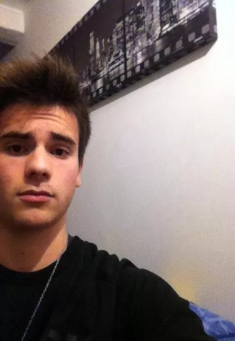
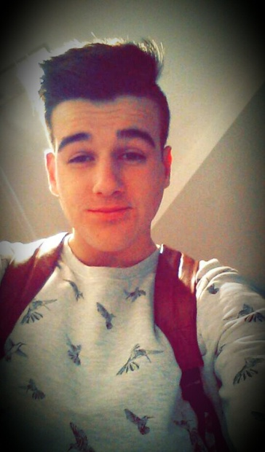
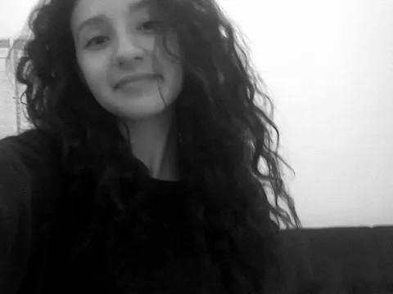
Hugo
Dorian
Zyneb

Slide 4
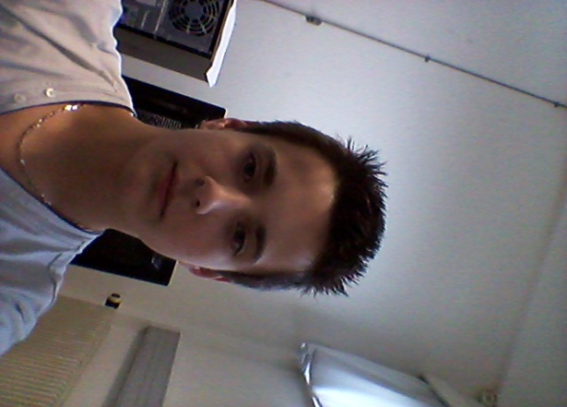
Louise
Maxime
Emilie

Slide 5
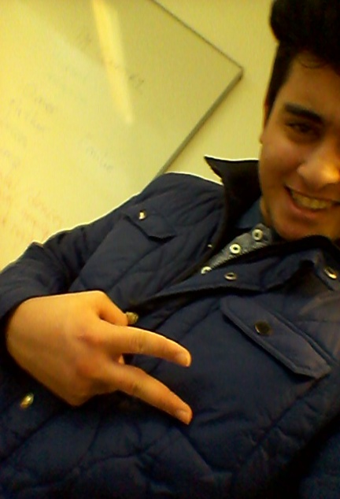
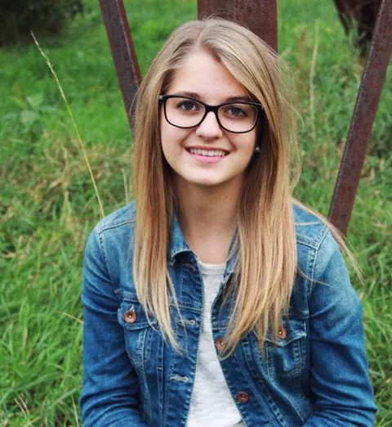
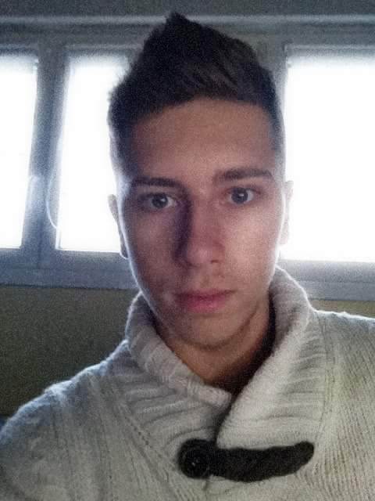
Ömer
Romane
Alban

Slide 6
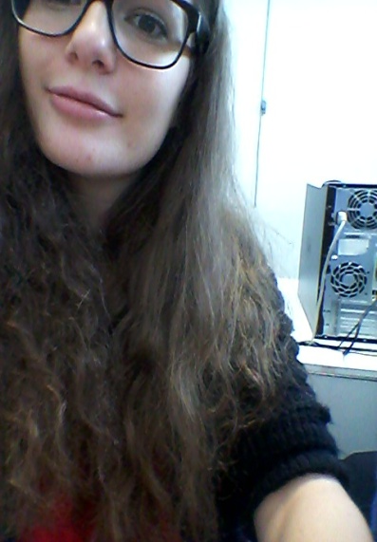
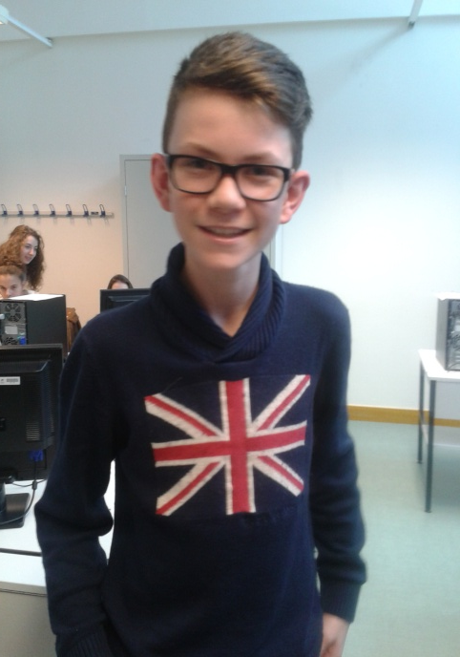
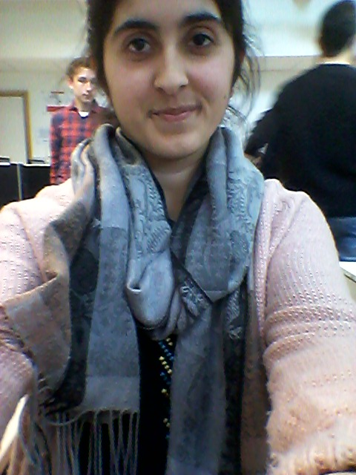
Camille
Arthur
Seyma

Slide 7
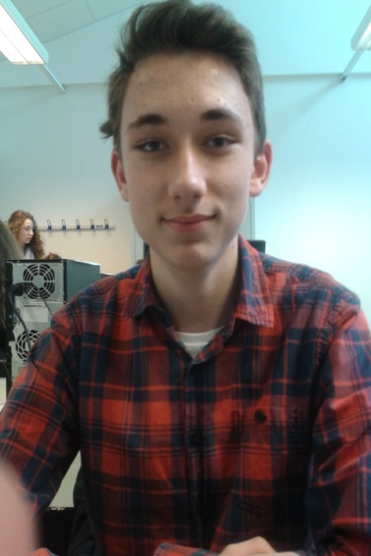
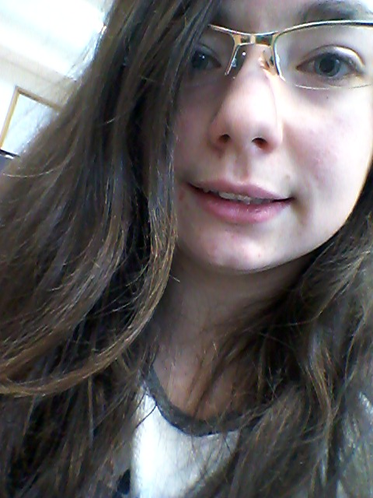
Grégoire
Maëva
Clément

Slide 8
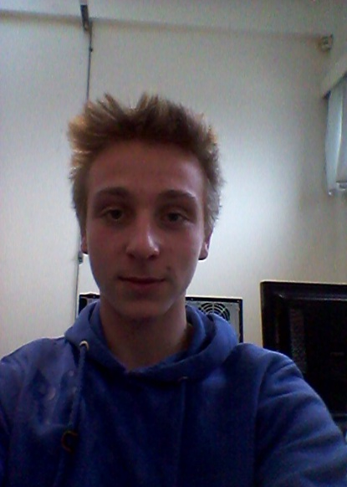
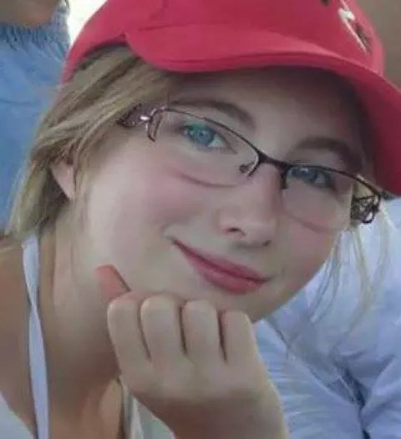
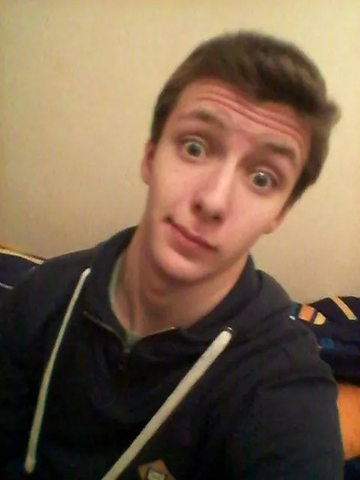
Tony
Aude
Florent

Slide 9
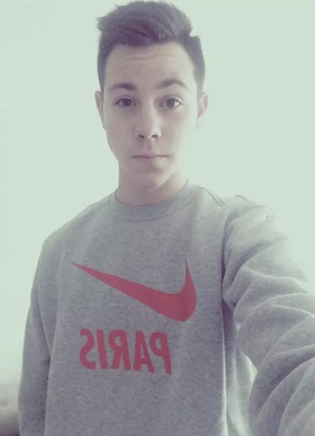
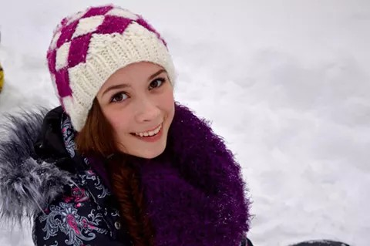
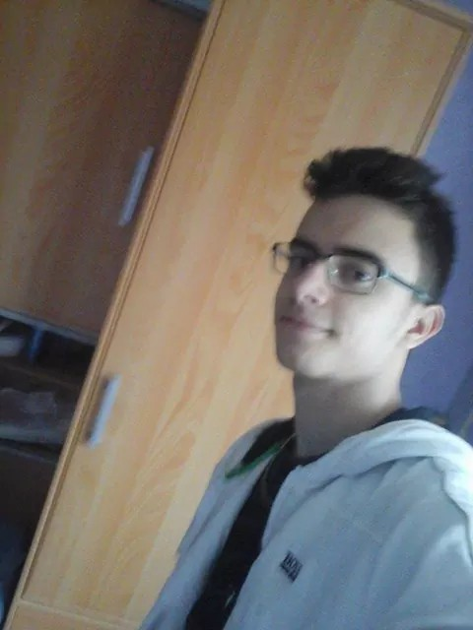
Lucas
Daphné
Alexis

Slide 10
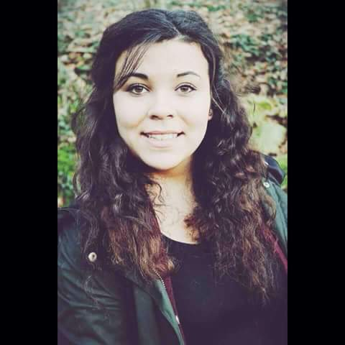
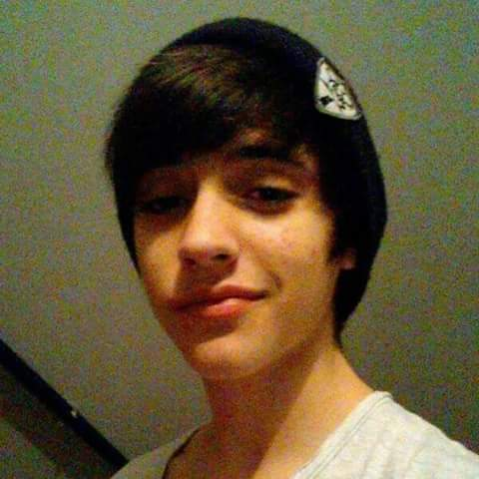
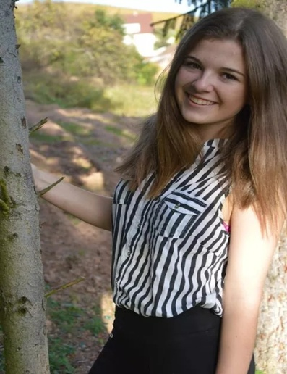
Joanna
Jimmy
Amélie

Slide 11
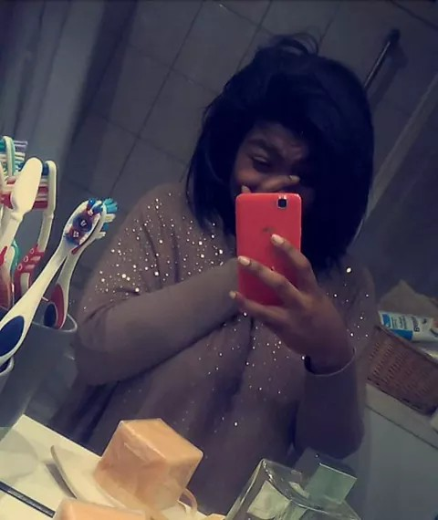
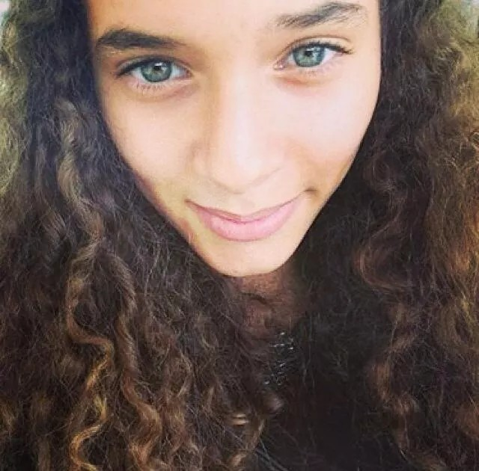
Mélinda
Imane

Slide 12
Groups destination
Greece | United Kingdom | Italy | Turkey | Spain
Dorian | Arthur | Jimmy | Ömer | Maxime
Grégoire | Tony | Alban | Alban | Ömer
Florent | Jimmy | Hugo | Lucas | Daphné
Clément | Romane | Alexis | Florent | Camille
Imane | Emilie | Lucas | Hugo | Seyma
Zyneb | Joanna | Maxime | Arthur | Amélie
Camille | Mélinda | Seyma | Clément | Louise
Louise | Daphné | Amélie | Mélinda | Aude
Maëva | Aude | Emilie | Joanna | Imane

Slide 13
Class time table

Slide 14
 | Monday | Tuesday | Wedn. | Thursday | Friday | Saturday
8h10-9h | Mathematics | History geography | Physics-chemistry | Method and scientific practice | Physic education Physic education | Physics chemistry or sciences
9h05-9h55 | English | History and geography | French | Method and scientific practice | Physics chemistry or sciences
10h05-10h55 | Physics chemistry | Economics | French | German or Spanish | French | Physics chemistry or sciences
11h-11h50 | Mathematics |  | French | Mathematics | French | Economics
12h55-13h45 | Legal social and civic education | Legal social and civic education | Turkish | Portuguese or Spanish | Mathematics
13h50-14h40 | German or Spanish | Spanish |  | English | Mathematics
14h45-15h35 | German or Spanish | Spanish |  | English | Mathematics
15h45-16h35 | History or geography | Portuguese Music

