Slide 1
INVENTIONS IN THE 20th CENTURY
By Lana L. and Ana G.

Slide 2
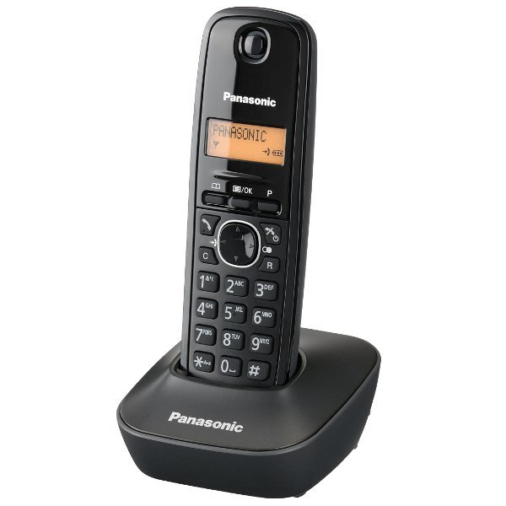
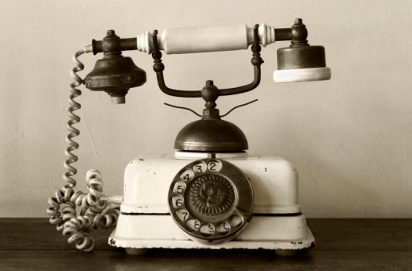
Top 10 inventions
10. Telephone - although he was not the only one working on this kind of tech. Alexander Graham Bell got the first patent for an electric telephone in 1876. Certainly, this instrument has revolutionized our ability to communicate.

Slide 3
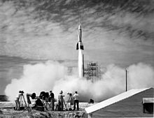
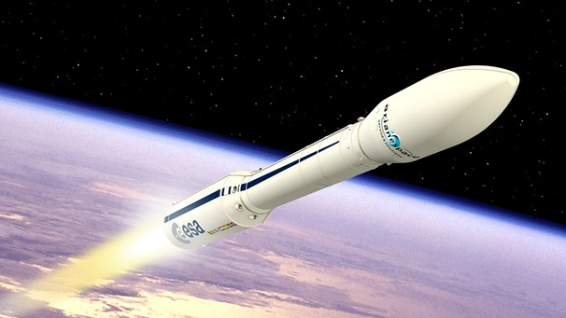
9. ROCKETS
While the invention of early rockets is credited to the Ancient Chinese, the modern rocket is a 20th century contribution to humanity, responsible for transforming military capabilities and allowing human space exploration.

Slide 4
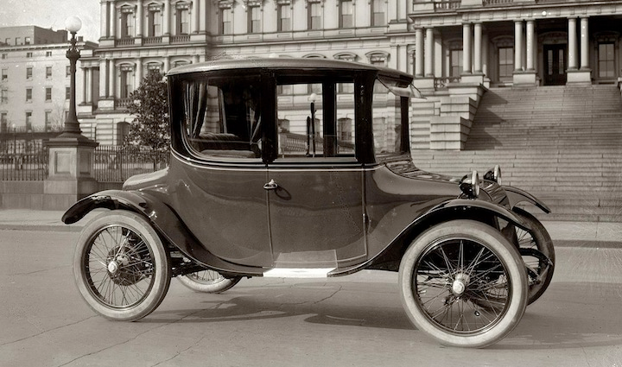
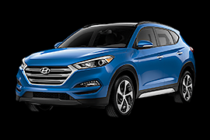
8. CARS
Cars completely changed the way we travel, as well as the design of our cities. They were invented in their modern form in the late 19th century by a number of individuals, with special credit going to the German Karl Benz for creating what’s considered the first practical motorcar in 1885.

Slide 5
7. FIRE
It can be argued that fire was discovered rather than invented. The earliest use of fire goes back as far as 2 million years ago, while a widespread way to utilize this technology has been dated to about 125,000 years ago. Fire gave us warmth, protection, and led to a host of other key inventions and skills like cooking.

Slide 6
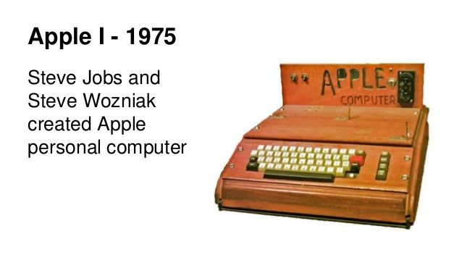
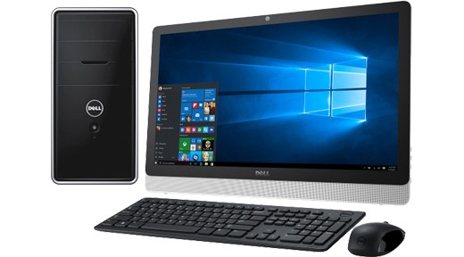
6. THE PERSONAL COMPUTER
Invented in the 1970s, personal computers greatly expanded human capabilities. While your smartphone is more powerful, one of the earliest PCs was introduced in 1974 by Micro Instrumentation and Telemetry Systems (MITS) via a mail-order computer kit called the Altair.

Slide 7
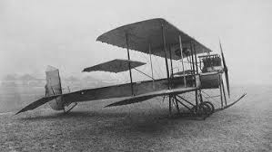
5. THE AIRPLANE
Invented in 1903 by the American Wright brothers, planes brought the world closer together, allowing us to travel quickly over great distances.

Slide 8
4. THE INTERNET
While the worldwide network of computers has been in development since the 1960s, when it took the shape of U.S. Defense Department’s ARPANET, the Internet as we know it today is an even more modern invention. 1990’s creation of the World Wide Web by Tim Berners-Lee is responsible for transforming our communication, commerce, entertainment, politics, you name it.

Slide 9
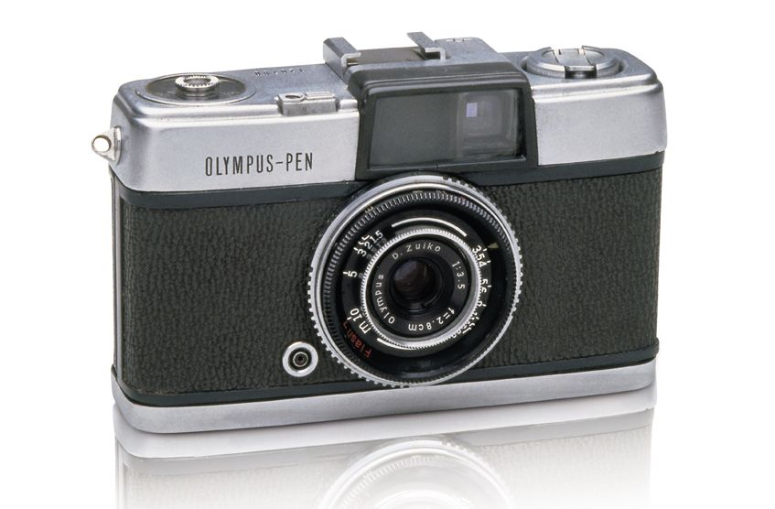
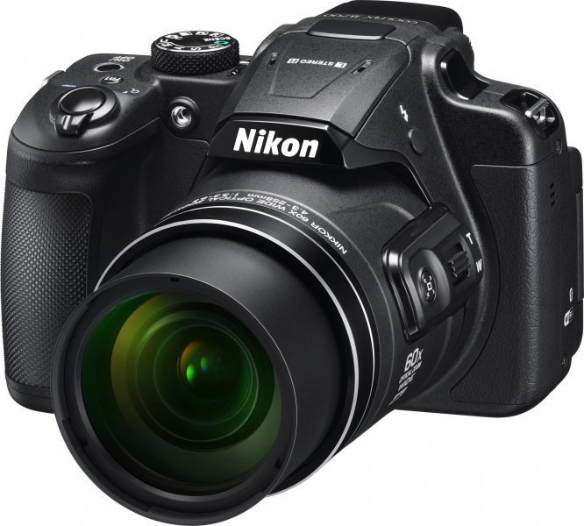
3. Camcorders
But what good would home video editing be without the ability to record your own content? Sony attempted to give consumers a camcorder based on its Betamax standard, but... it was Betamax. The camcorder as we know it popped off two years later when VHS camcorders hit the scene. Porn would never be the same.

Slide 10
2.WI-FI
The 802.11 standard set us free. No longer did we have to sit at computers or tether ourselves to a certain area to surf the web. With a wi-fi router installed in your house, you could roam around as you pleased. However, the real big deal will be when entire cities are completely covered in wi-fi Internet. Imagine that.

Slide 11
THE END

