Slide 1
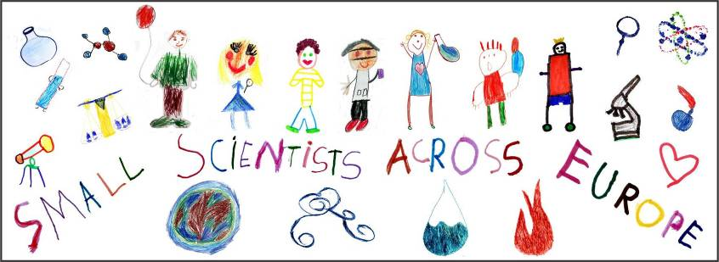
Book of experiments: AIR
Erasmus+ Project
KA 219 Strategic Partnership
SMALL SCIENTISTS ACROSS EUROPE
2017-1-FR01-KA219-037465_7
Prepared by
Director assistant of education
Almeda Kmieliauskaite

Slide 4
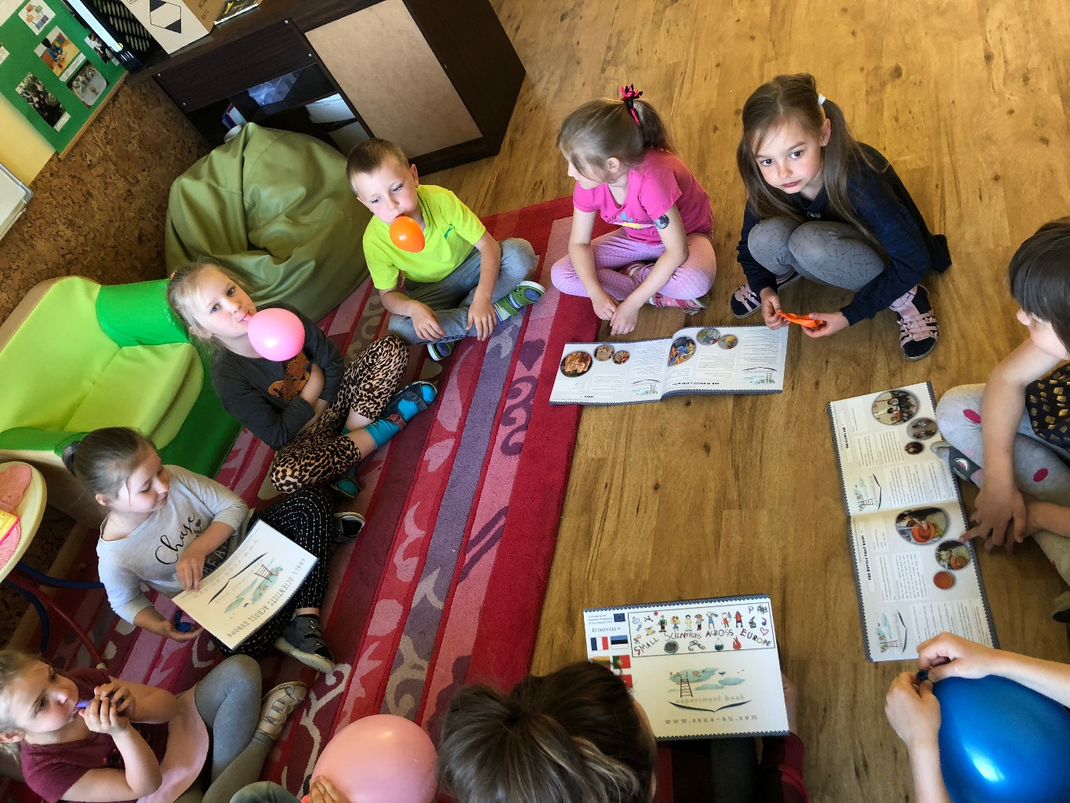
Balloons helps imagine the visible air

Slide 5
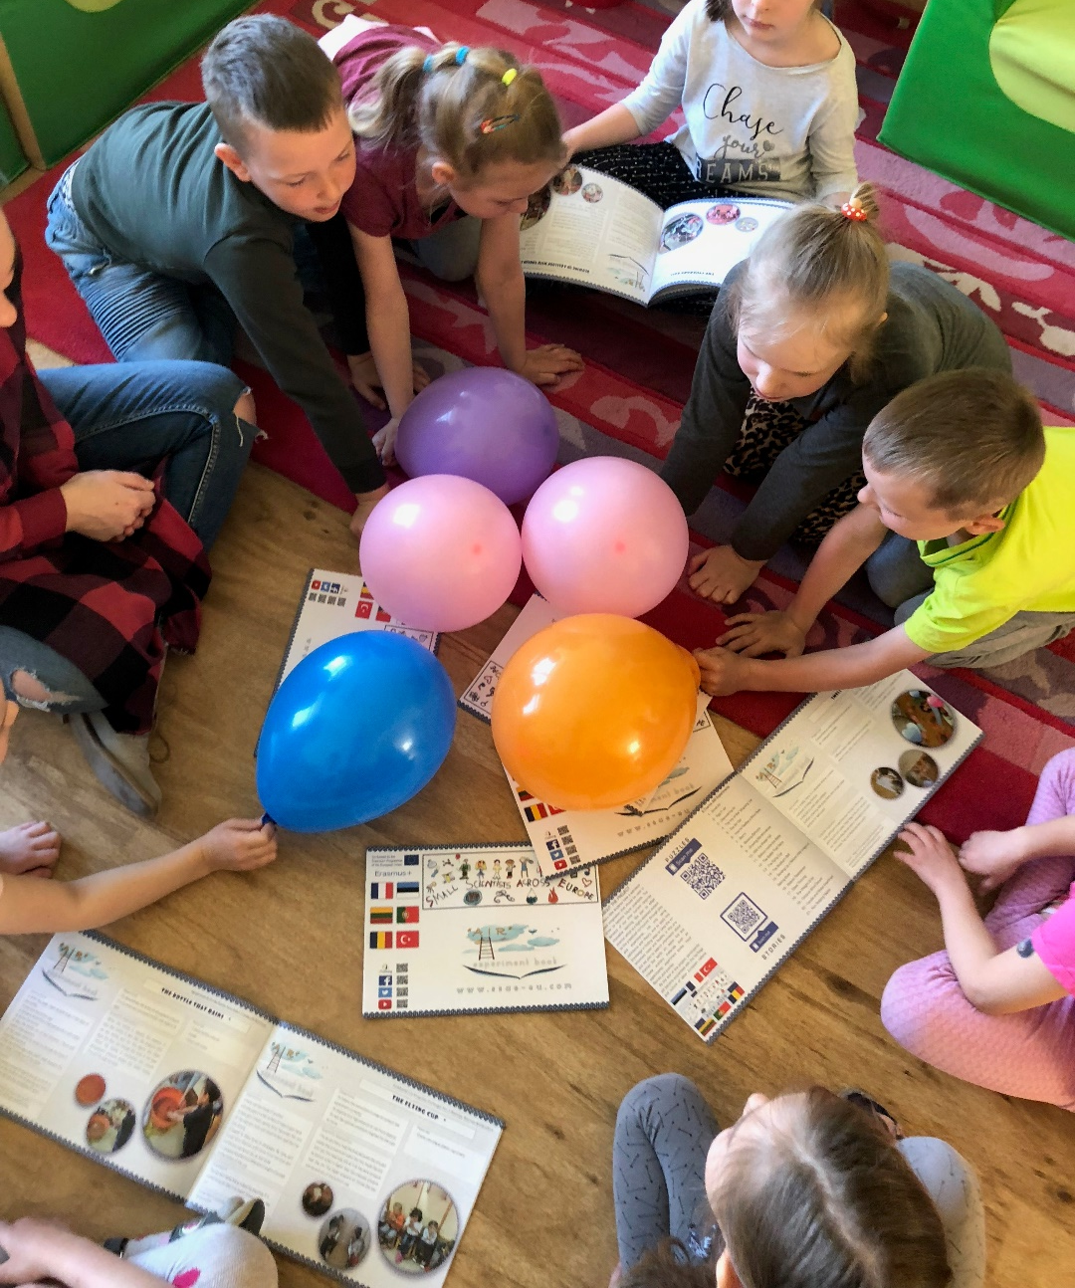

Slide 6
Thank you for attention
This project has been funded with support from the European Commission.
This publication reflects the views only of the author, and the Commission cannot be held responsible for any use which may be made of the information contained therein.

