Slide 1
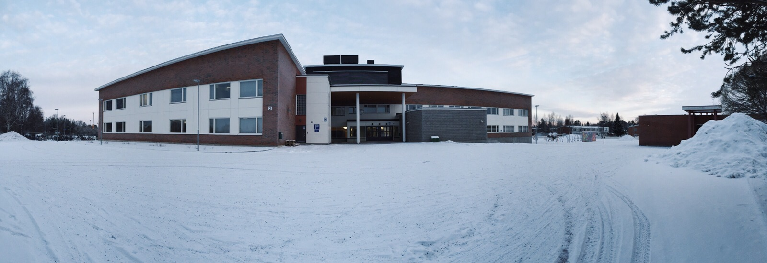
Putaan koulu
(Pudas school)

Slide 2
Presentation
Putaan koulu is a lower secondary school in Tornio. There are grades 7-9. There are 540 students and 52 teachers.
This school building where we are now was built in 2015.
Our principal is Jaakko Junes
The lenght of our schooldays are max. 8.00-15.30
The school has a student government, which plan events in school

Slide 3
General events
Floorball tournament
City of war (kaupunkisota)
Music afternoon (musiikki-iltapäivä)
Football tournament
Independence day celebration
Theme days
9th grade celebration

Slide 4
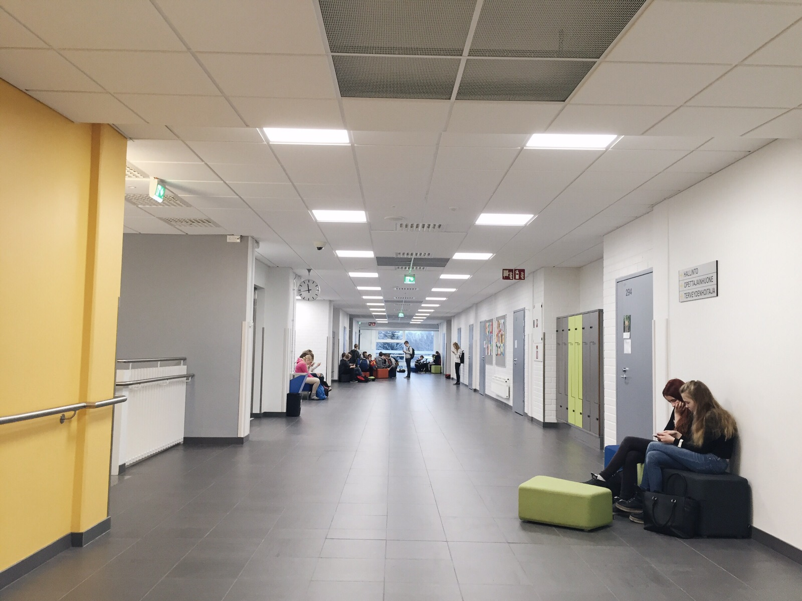
Second floor and break area

Slide 5
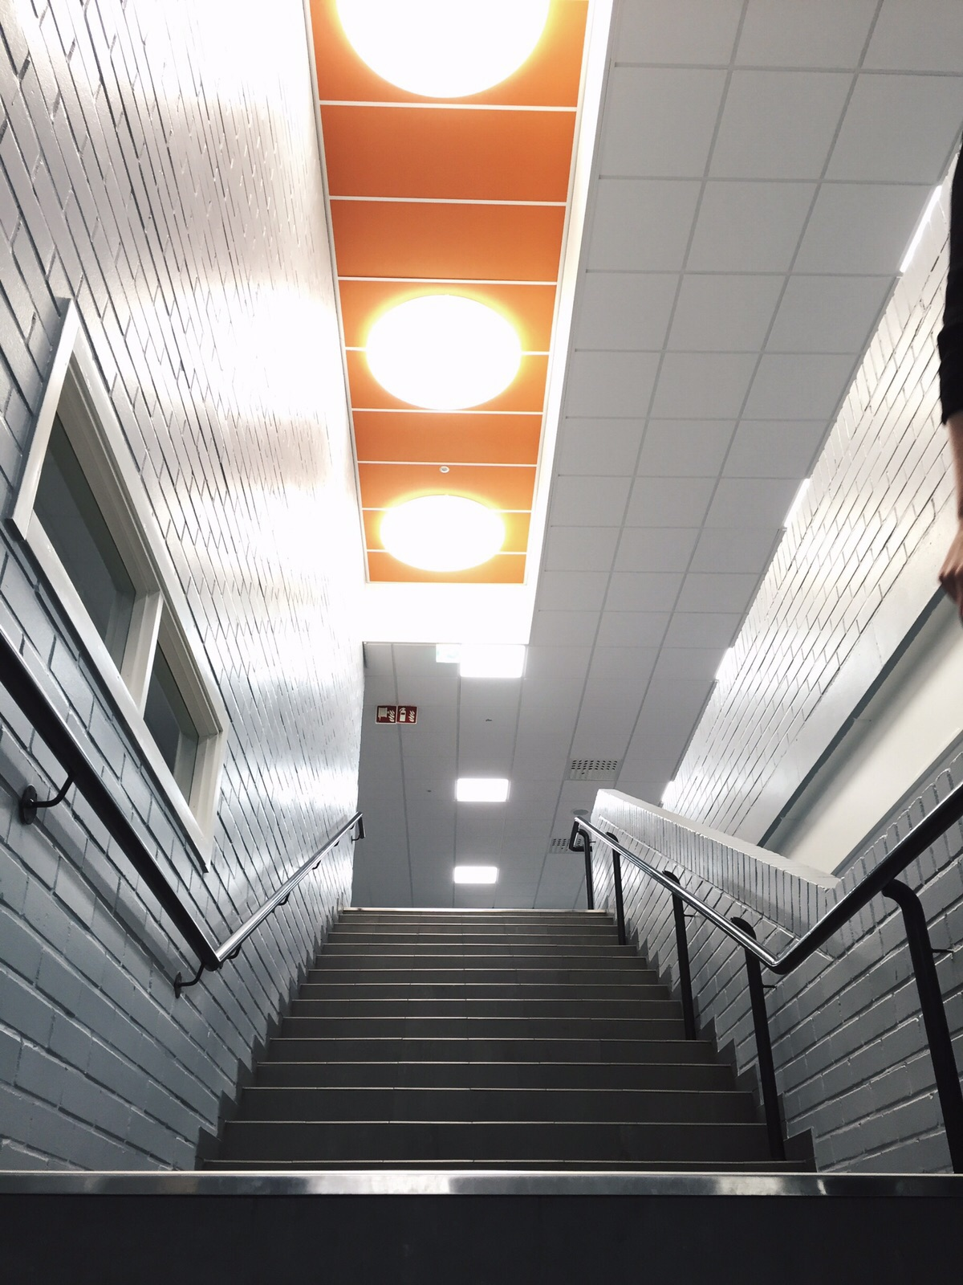
There are a lot of stairs in our school

Slide 6
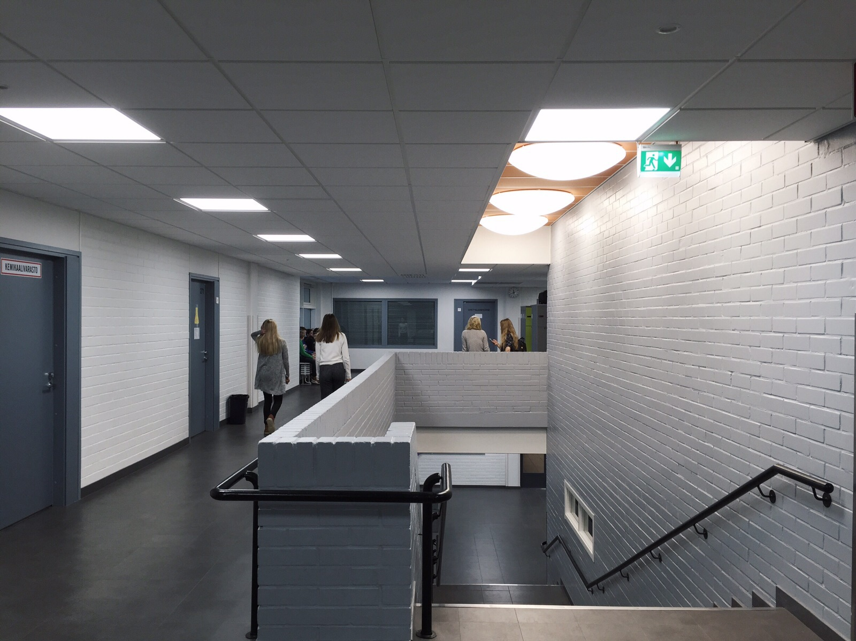
There is a hallway on the second floor

Slide 7
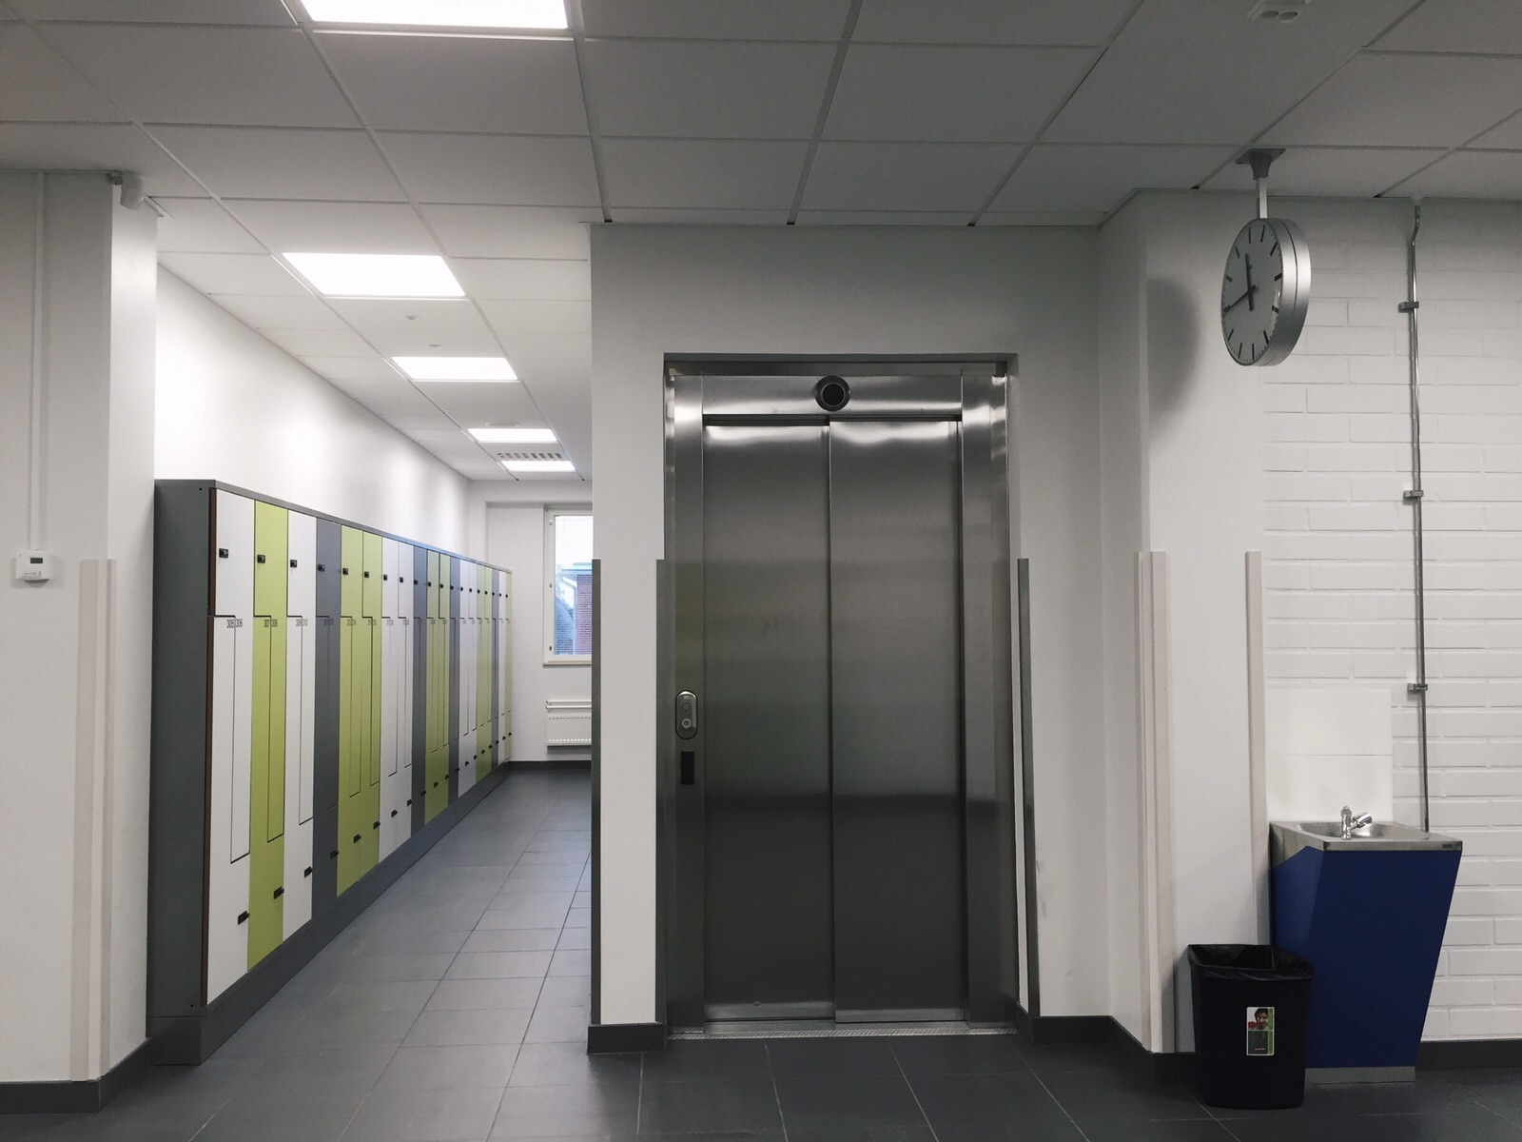
lockers and an elevator

Slide 8
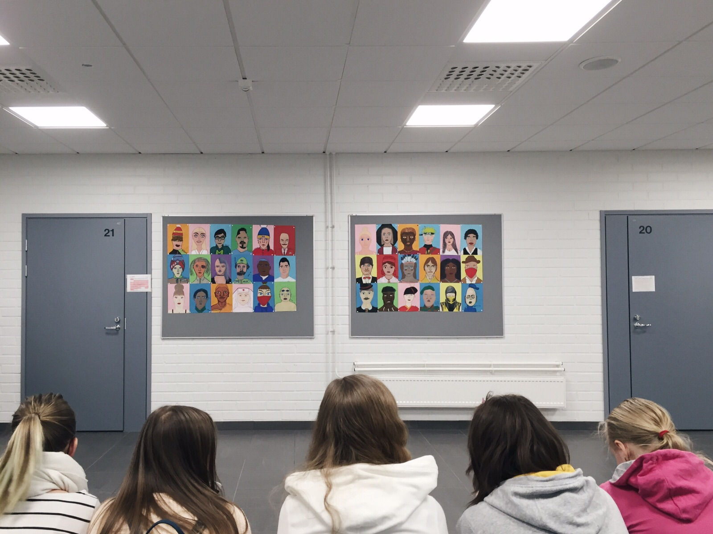
People having a break

Slide 9
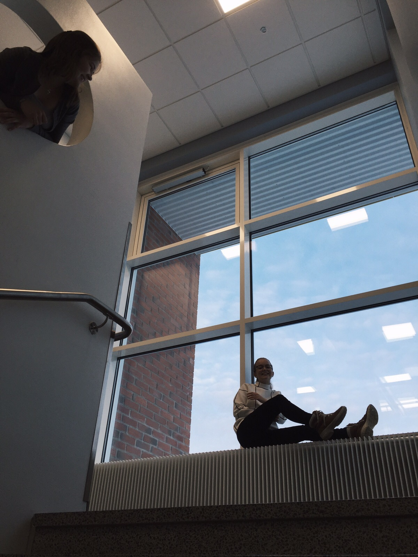
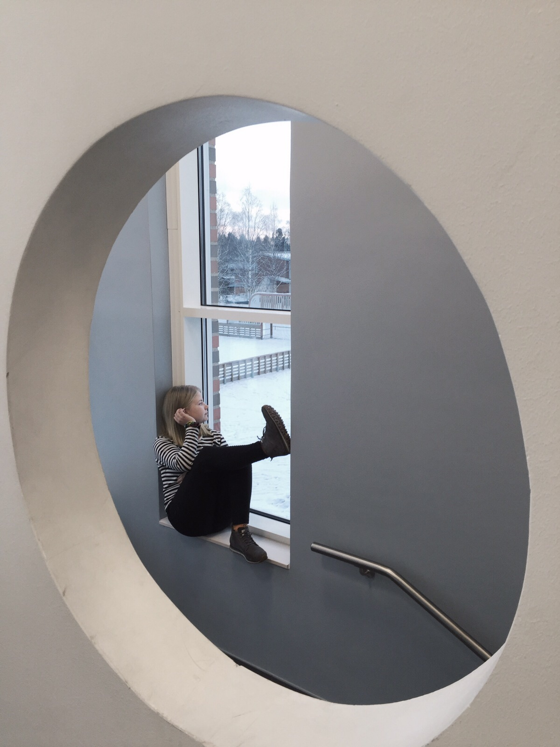
Stairs

Slide 10
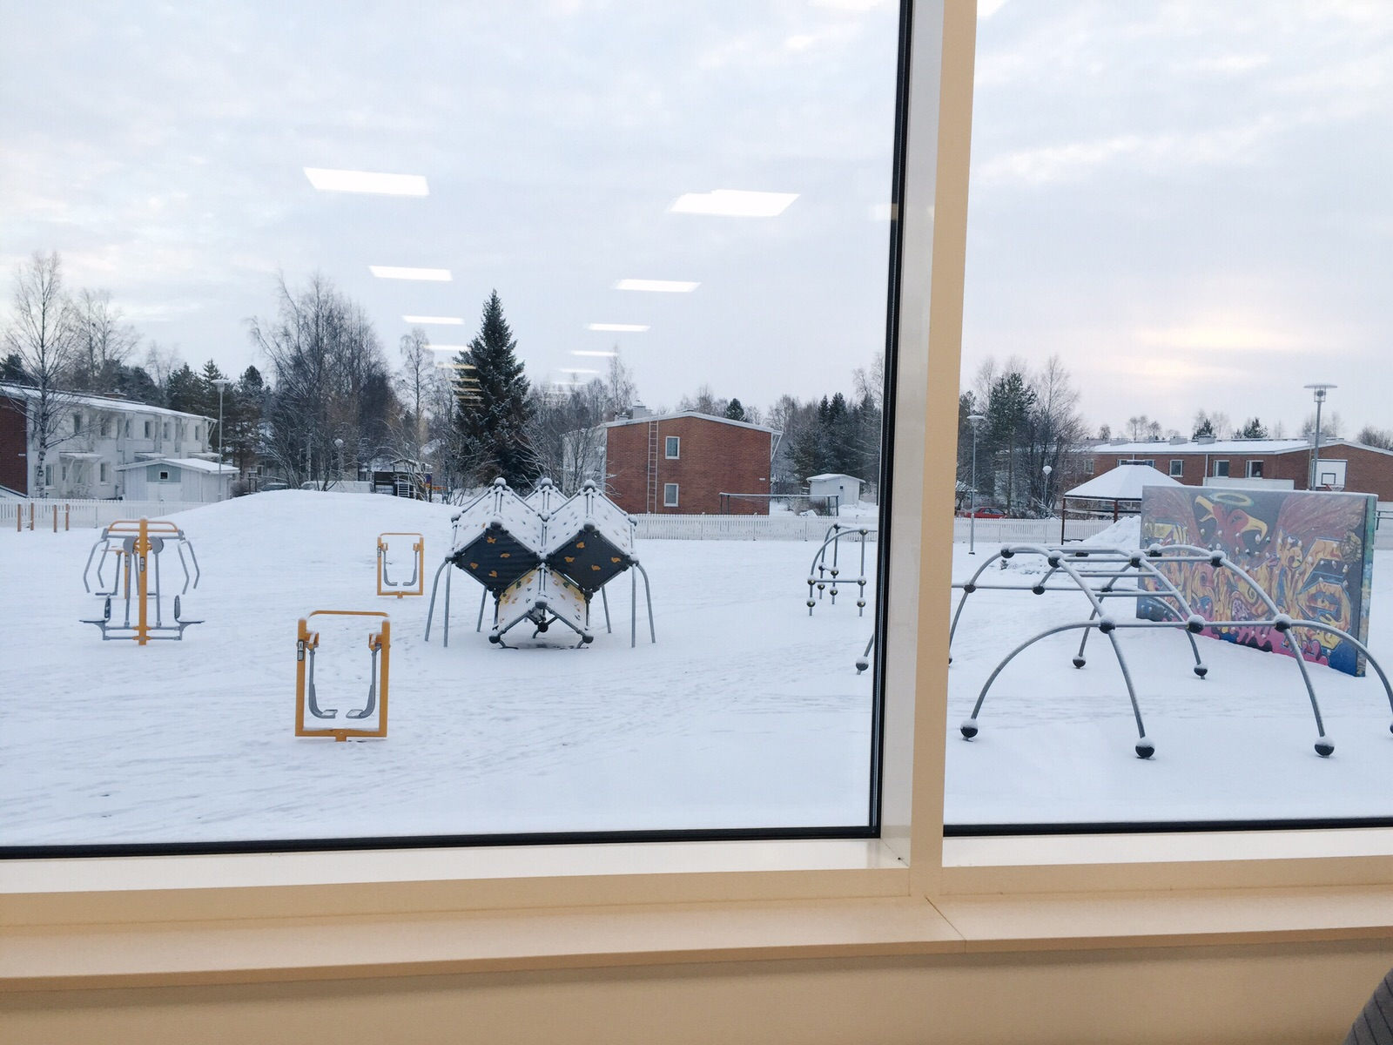
Fitness equipment

Slide 11
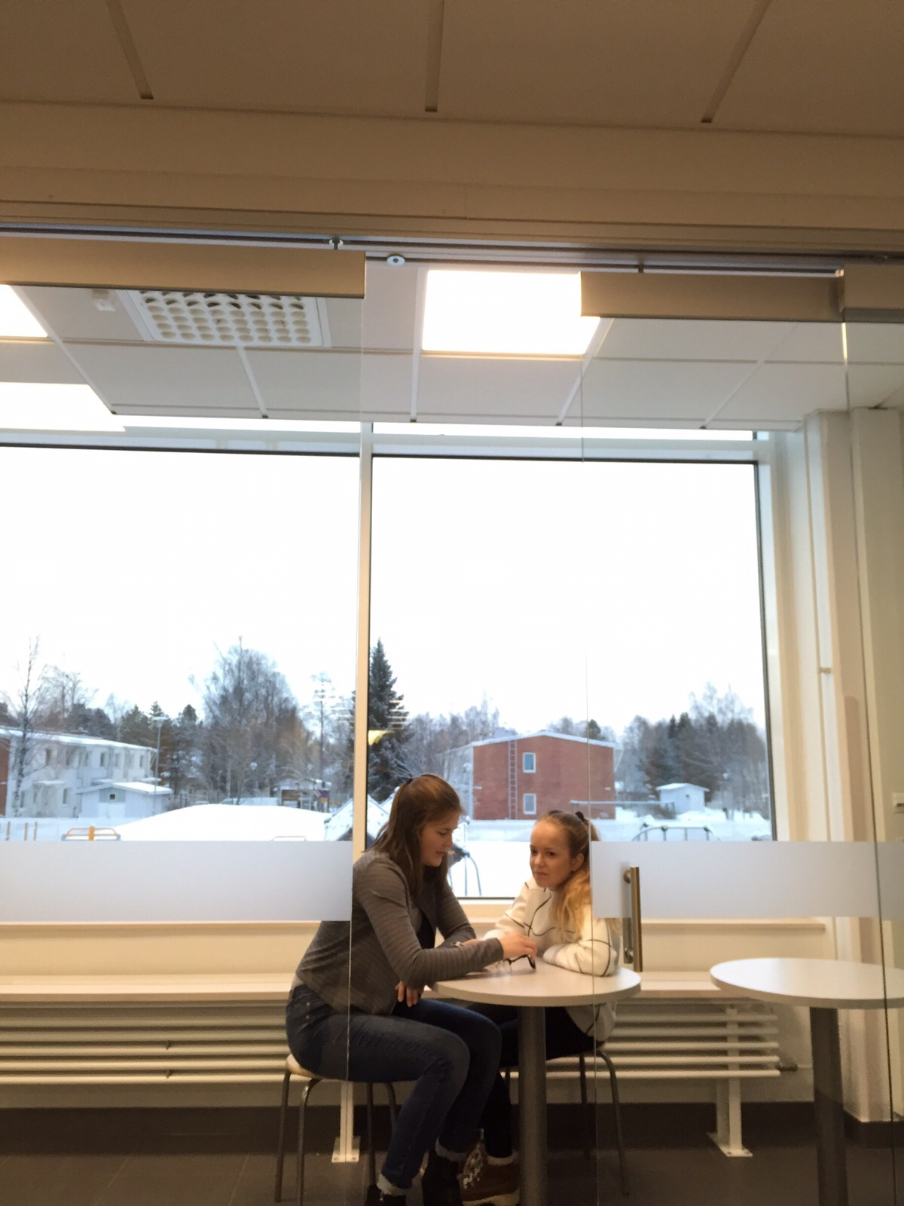
an aquarium, where you can study private

Slide 12
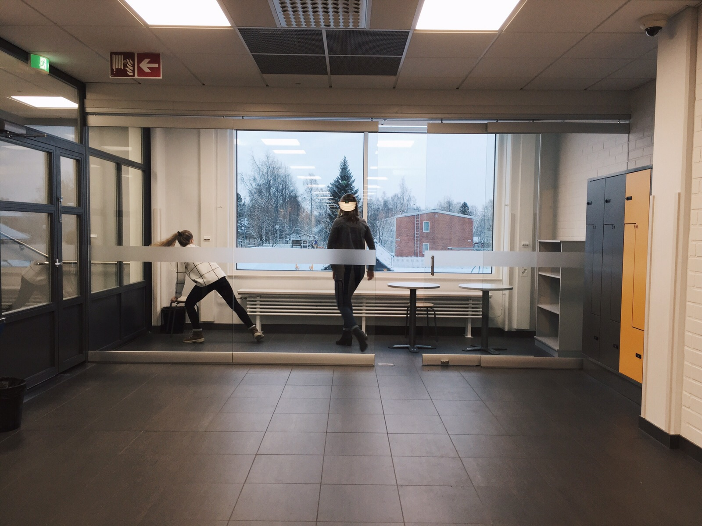

Slide 13
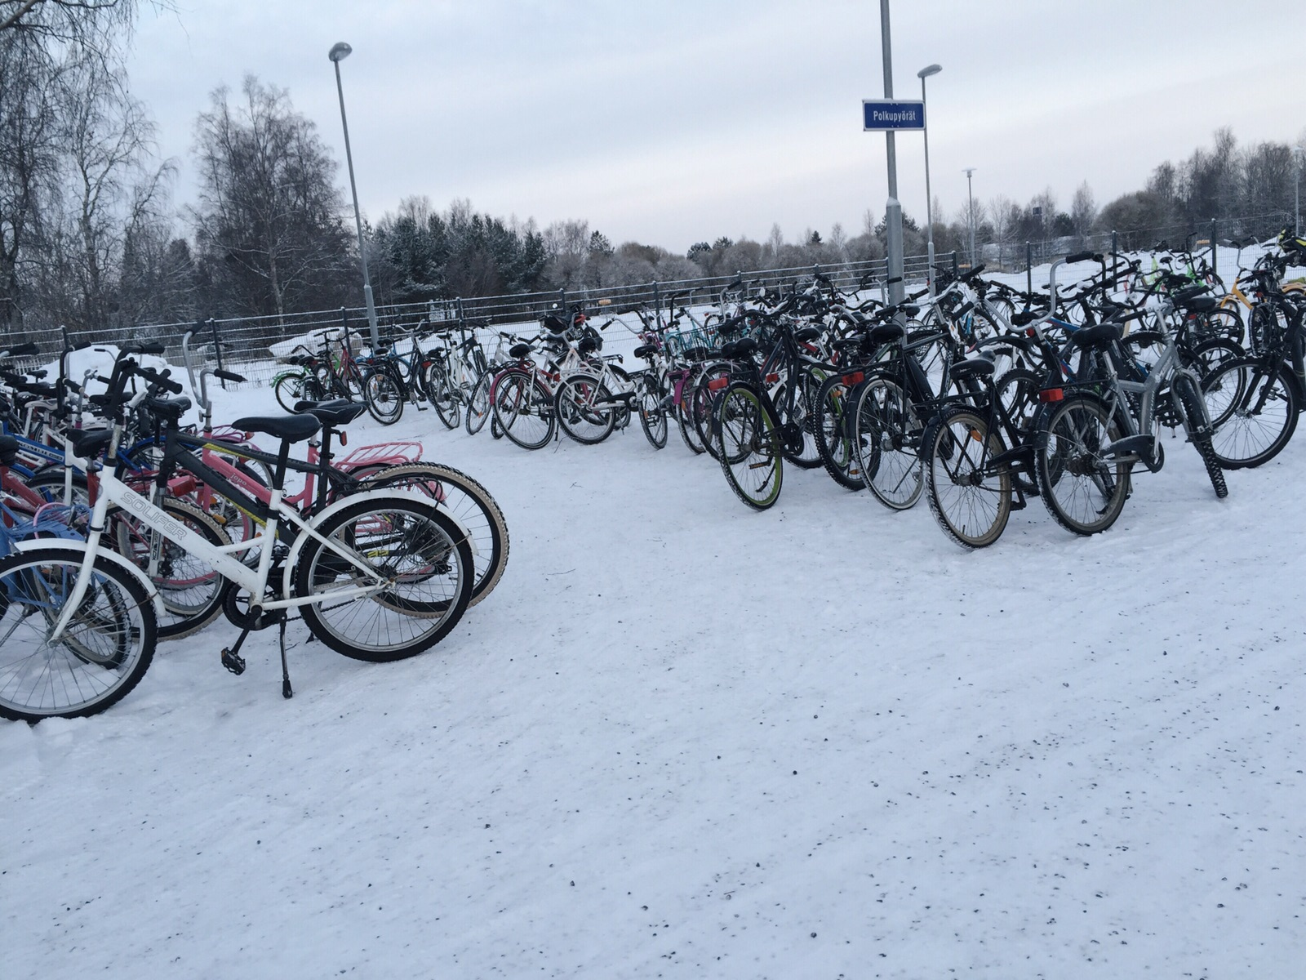
Parking space for bikes

Slide 14
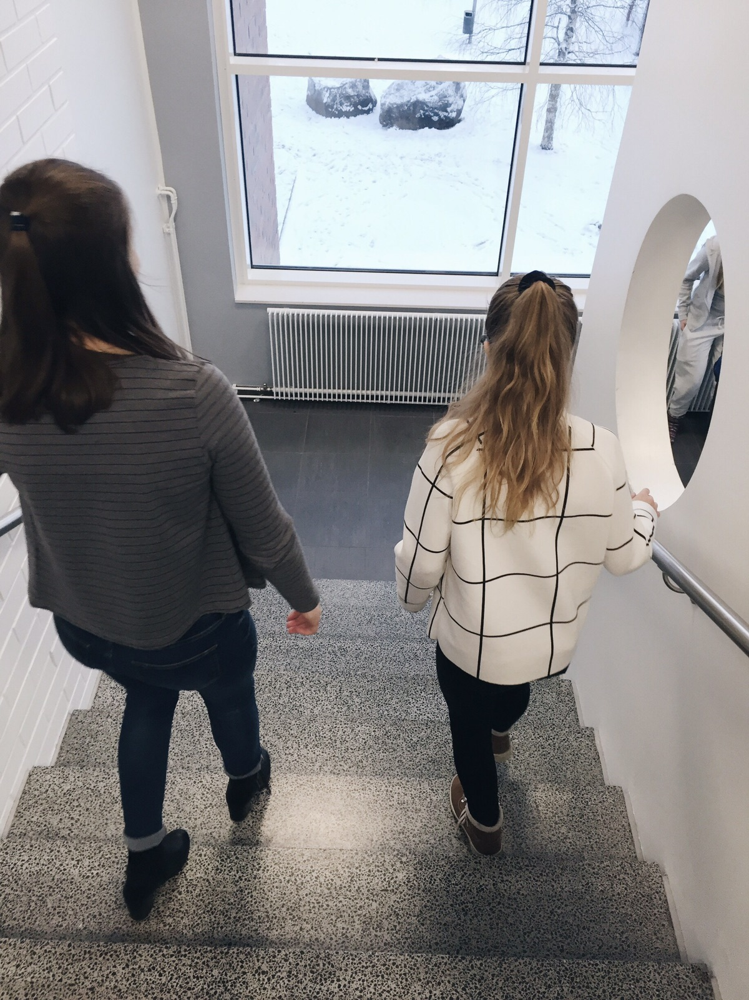
People walking downstairs

Slide 15
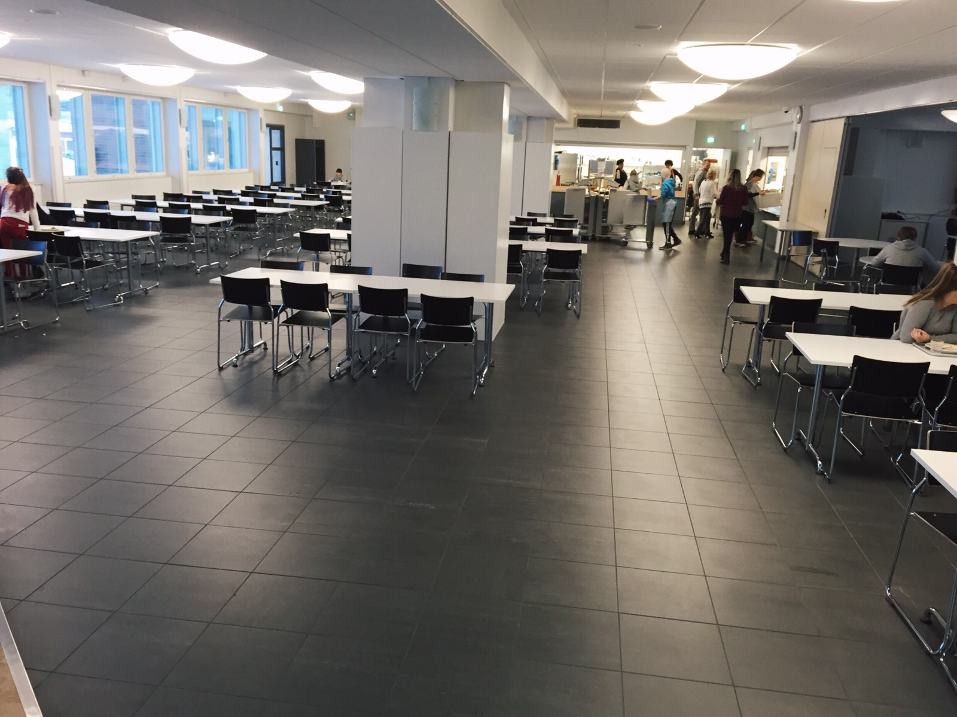
This is where we eat, school cafeteria (ruokala)

Slide 16
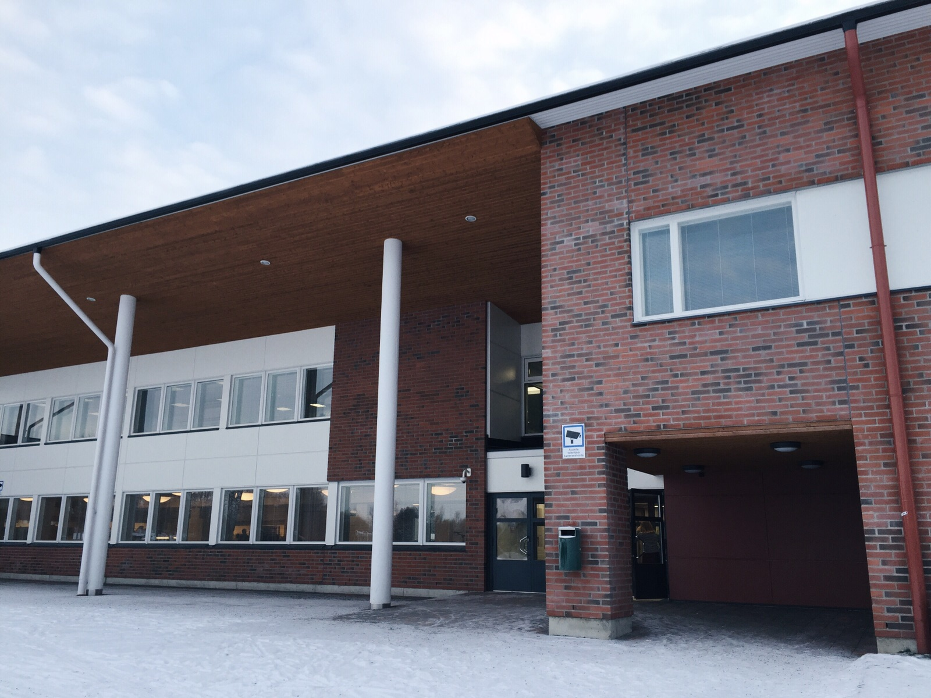
Another entry to our school

Slide 17
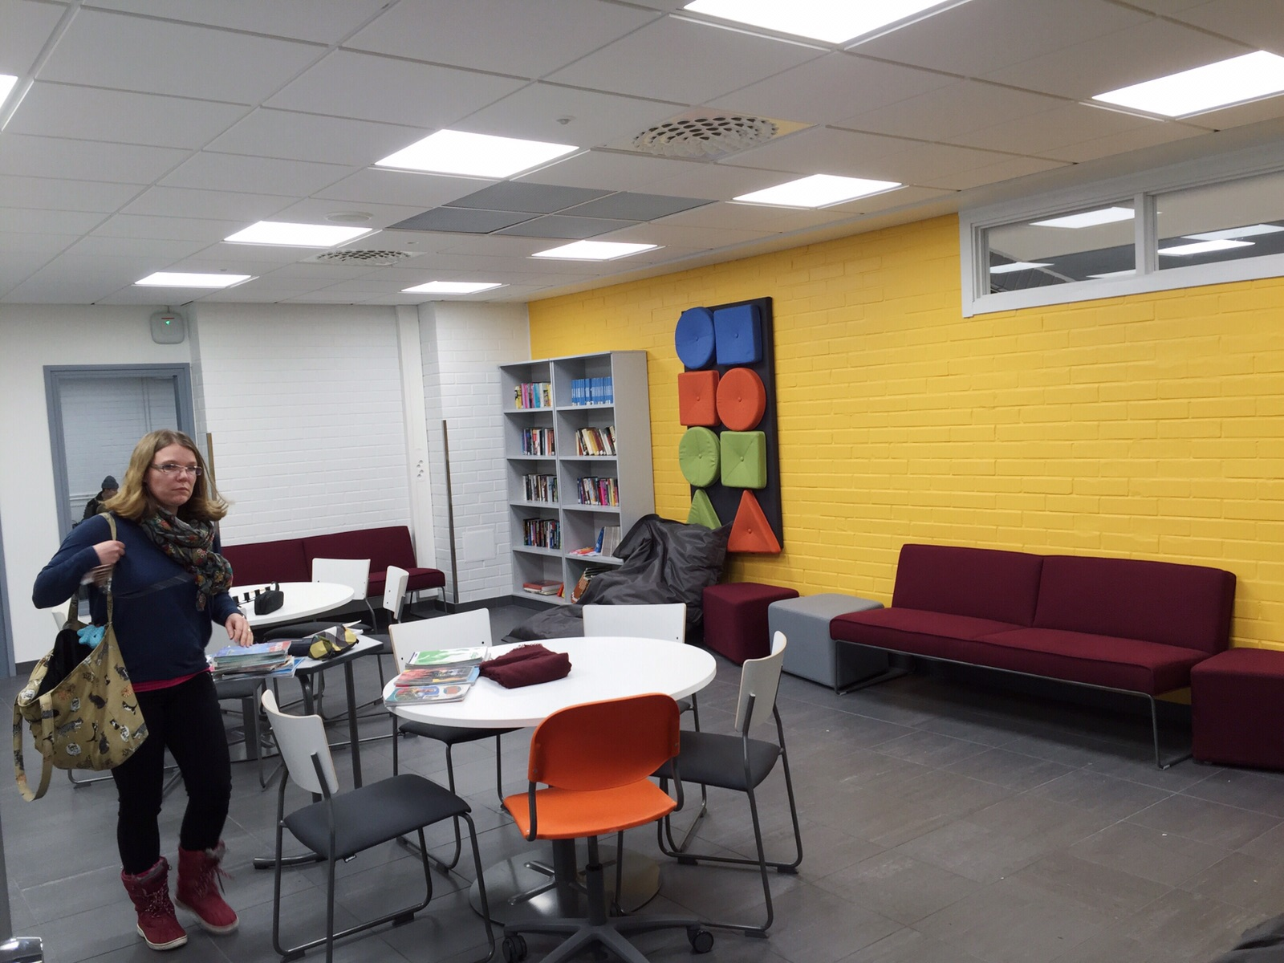
Library

Slide 18
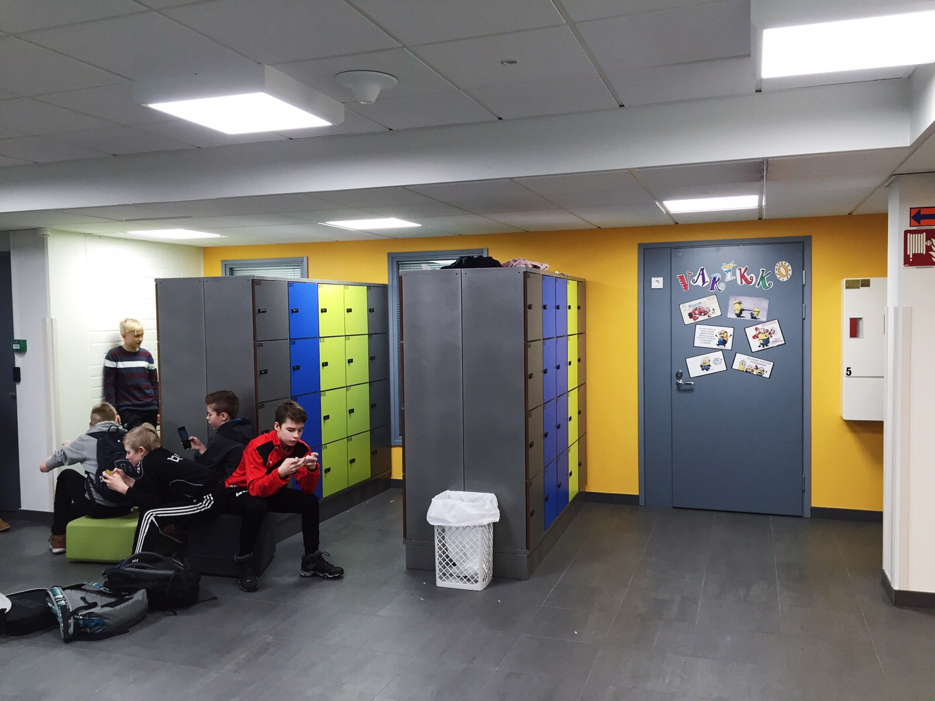

Slide 19
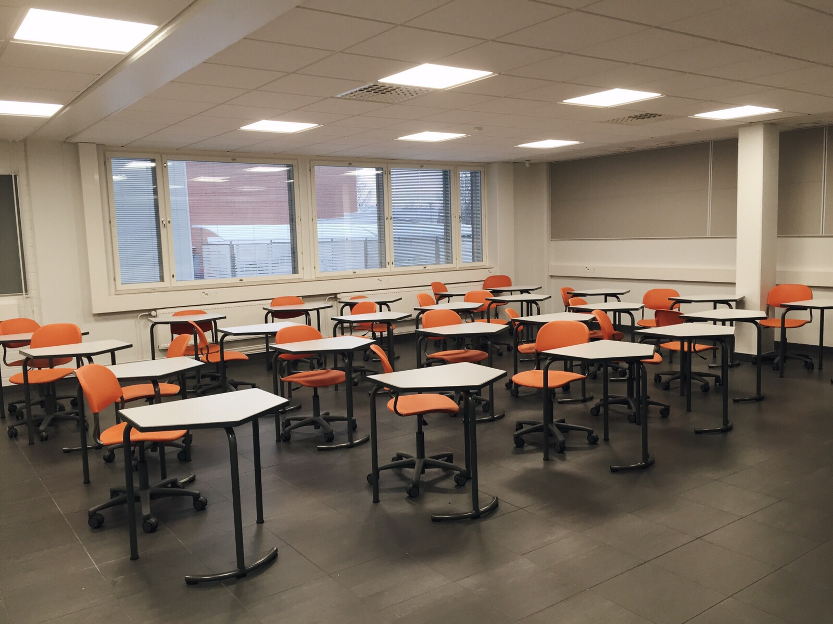
One of our classrooms

