Slide 1
Video Conference
16-12-2019
Photographs from Aigio

Slide 2
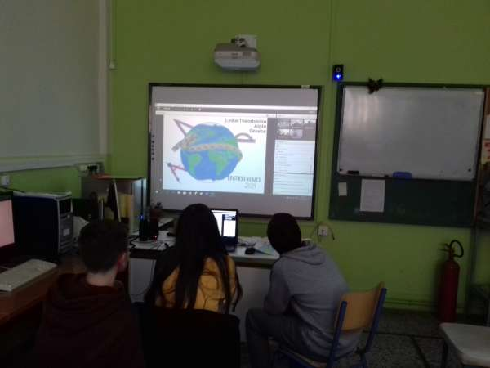
The videoconference has just started.
Lydia’s drawing is displayed.

Slide 3
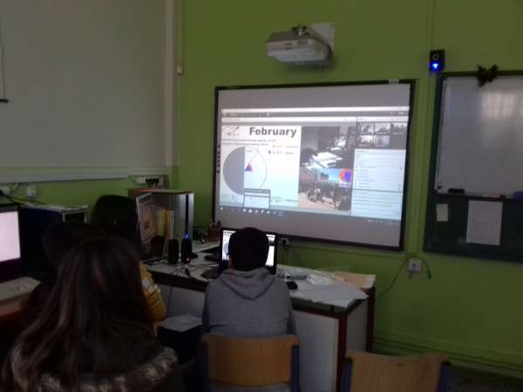
Aigio students are waiting to to present their measurement
Our presenters are Lydia and Aggelos.

Slide 4
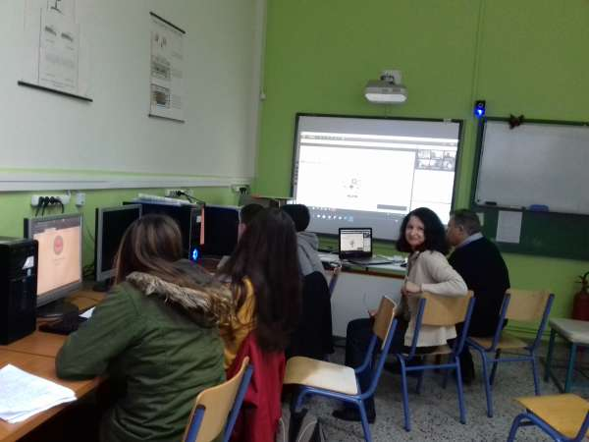
Students are going to participate in a quiz made by the students.
Two teams: Aigio girls and Aigio boys.

Slide 5
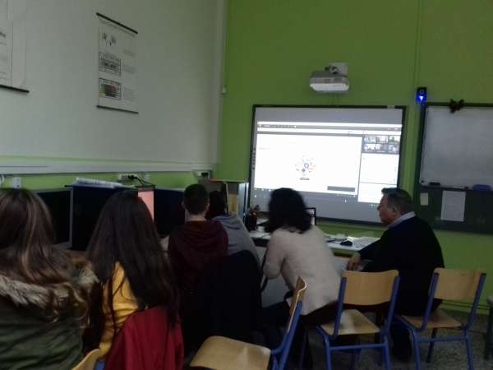
Dr Spyros Papadakis, Organizational Coordinator of the Regional Center for Educational Planning in Western Greece and Educational Coordinator of Computer Science in Western Greece is in our school in Aigio with us.

Slide 6
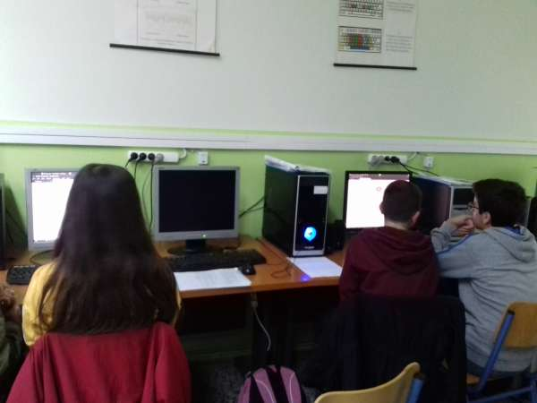
Waiting for another question in the quiz.

Slide 7
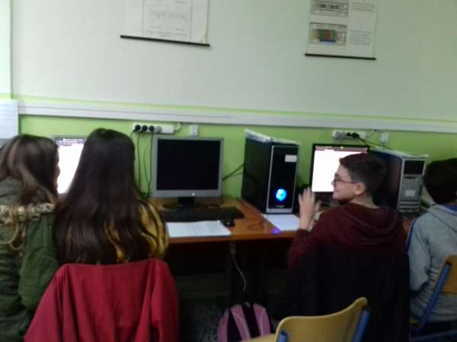
The quiz is over.
Not only knowledge but also speed were important!

Slide 8
We were very happy to participate in this special event.
Greetings from
Lydia, Helen, Aggelos, Dionisis and their teacher
Aspasia
Thank you!

