Slide 1
2019 ERATOSTHENIS - Etwinning
29th Chalkida Greece Kindergarden

Slide 2
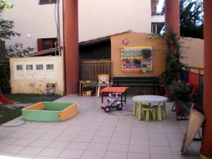
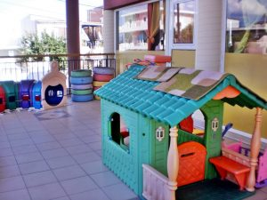
29th Chalkida kindergarden in zeemaps

Slide 3
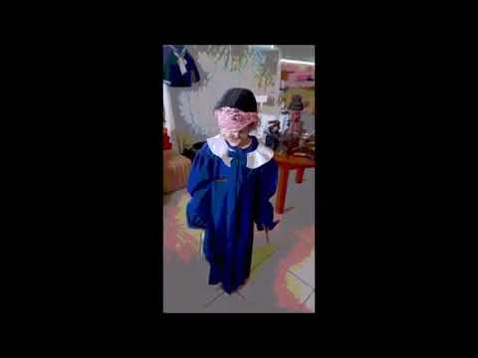
presentation of Children

