Slide 1
OUR FORESTS – OUR FUTURE
Kazlų Rūdos pagrindinė mokykla
The first year of the project
2014-2015

Slide 2
Presentations about Lithuania, our town and school
https://www.youtube.com/watch?v=bfB3_TfOKtM&feature=youtu.be
https://www.youtube.com/watch?v=pvIR3fH06Gg&feature=youtu.be
https://www.youtube.com/watch?v=bfB3_TfOKtM&feature=youtu.be
http://tagre.edu.glogster.com/mokykla/

Slide 3
LOGO competition

Slide 4
Forest Day

Slide 5
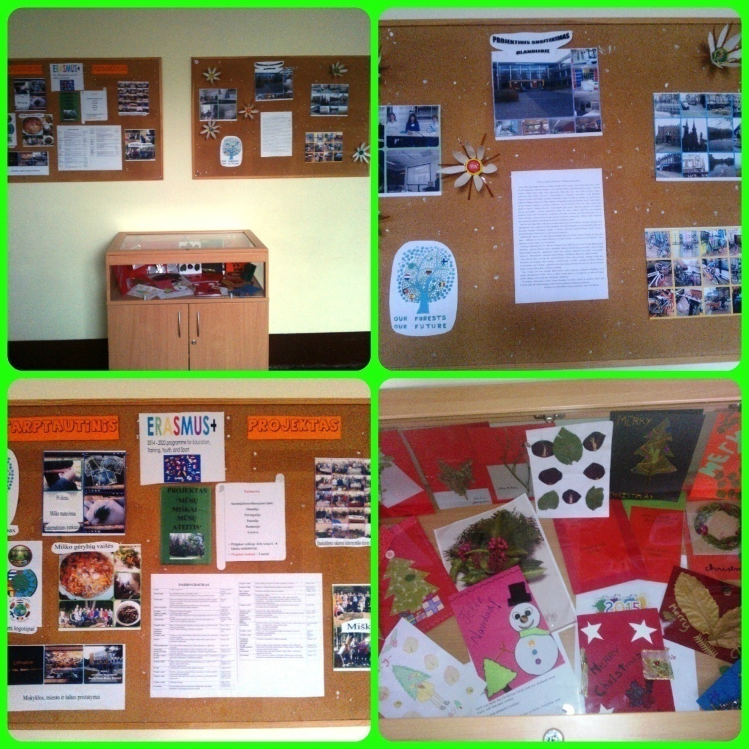
‘Our forests – our future’ in our school website and the project corner
http://www.krpagrindine.lt/erasmus-musu-miskai-musu-ateitis/

Slide 6
Organising Pi - Day

Slide 7
Making food from forest products. Mushroom Pie

Slide 8
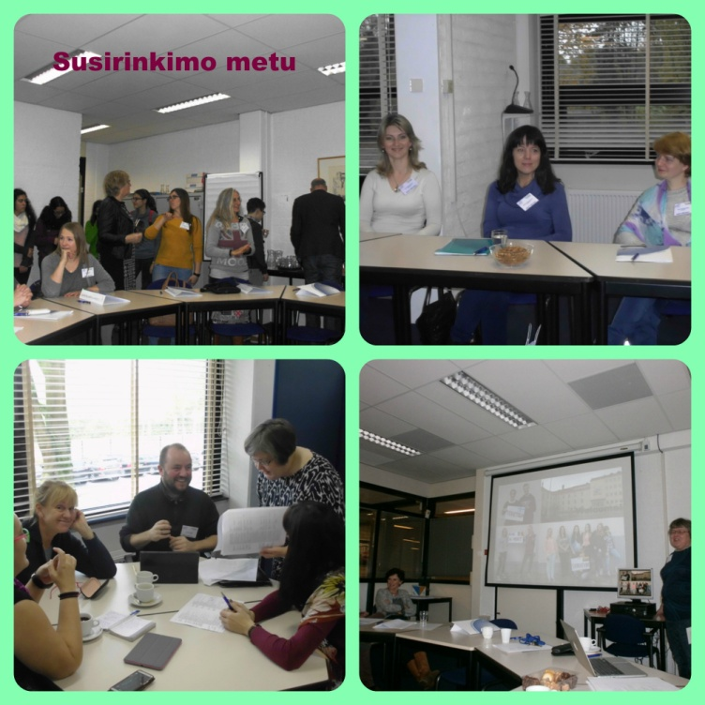
The first meeting in Holland

Slide 9
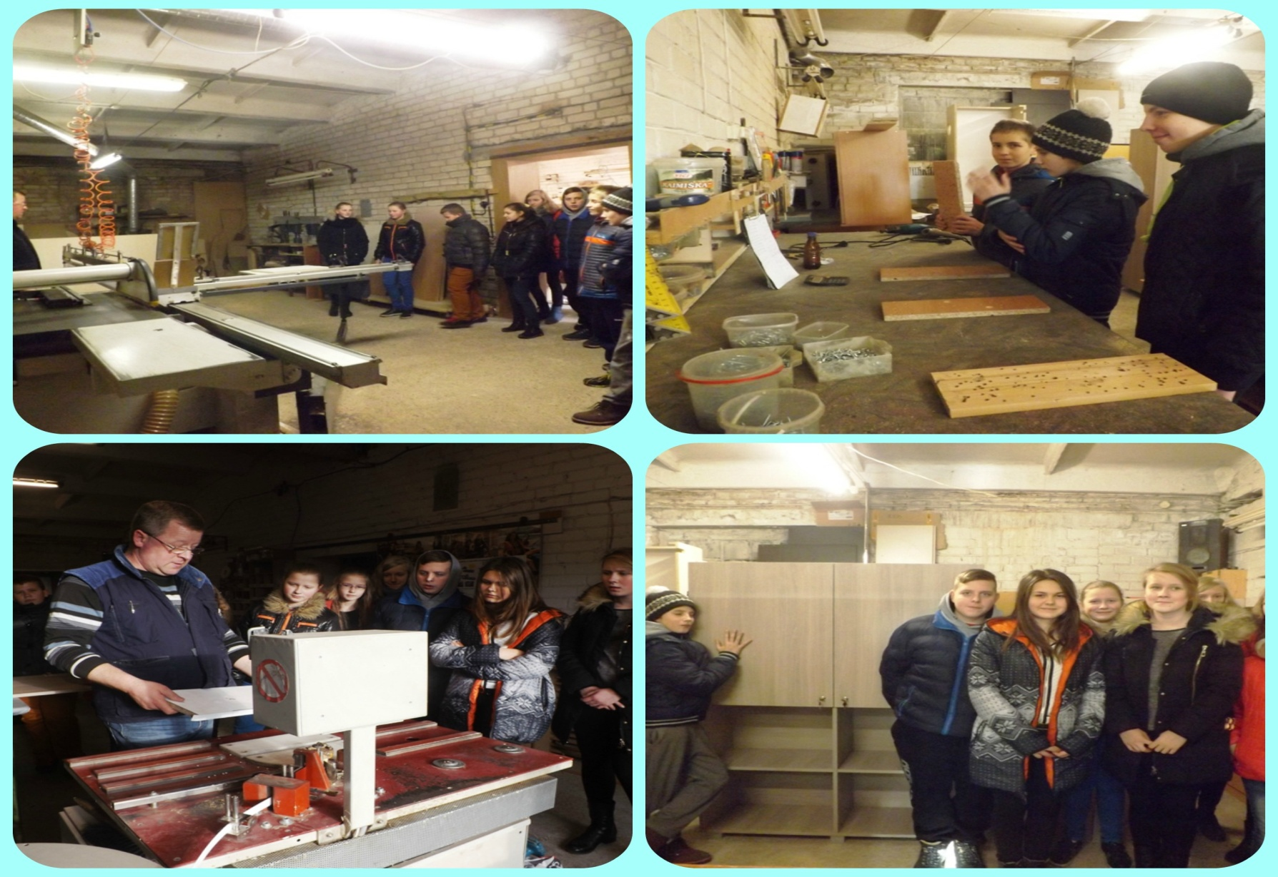
Visiting a local sawmill

Slide 10
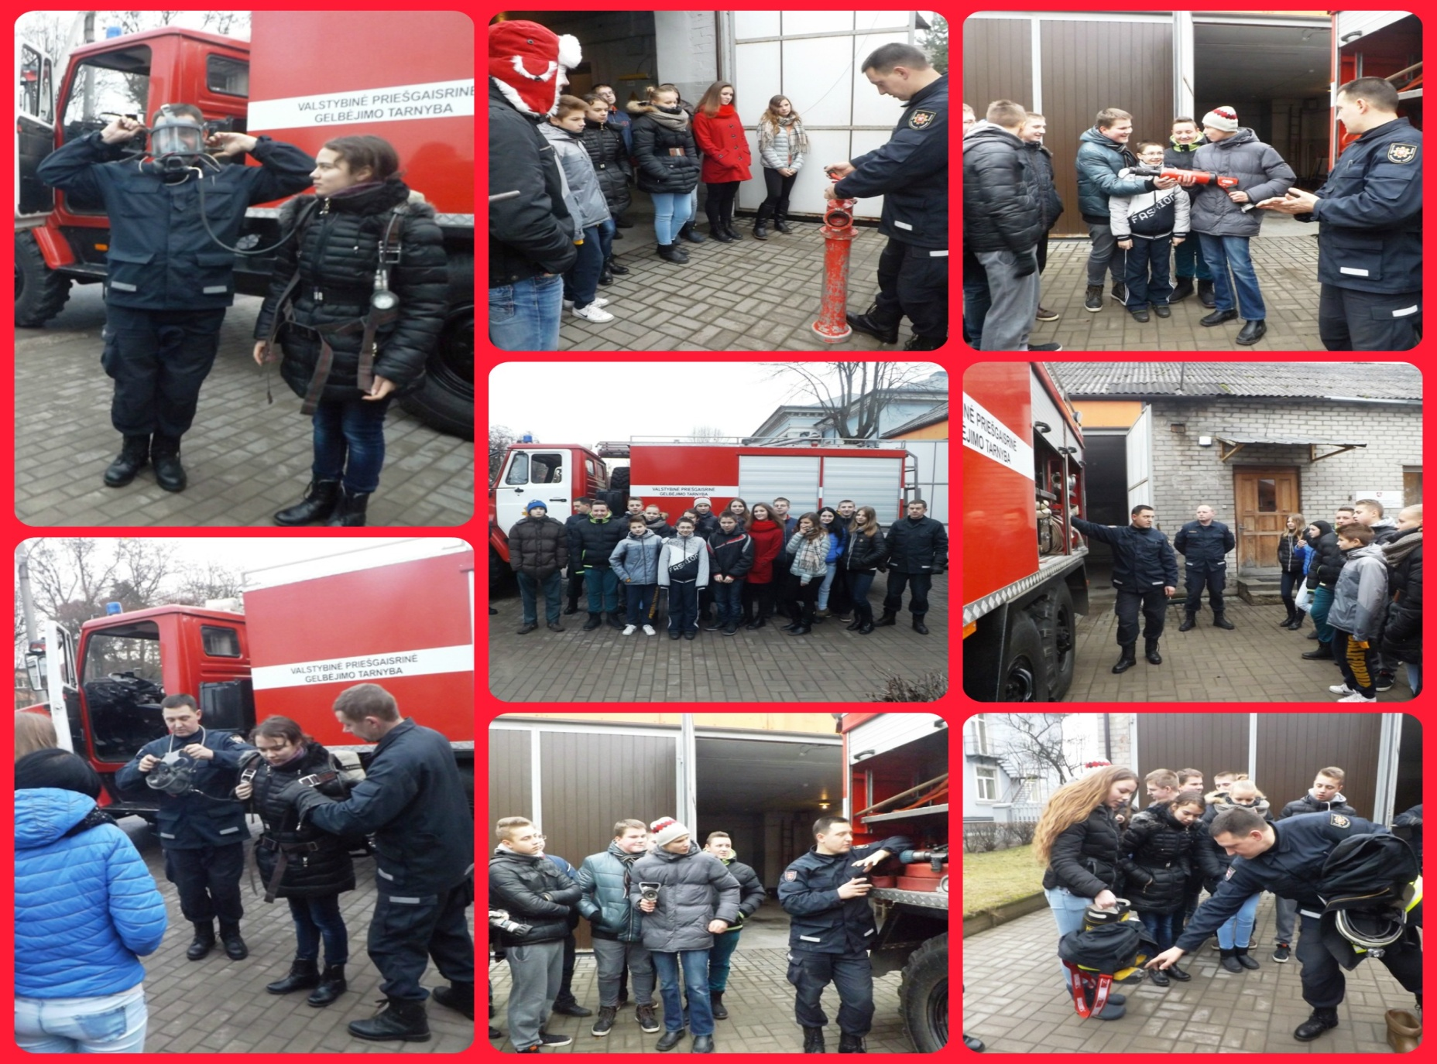
Visiting a fire station

Slide 11
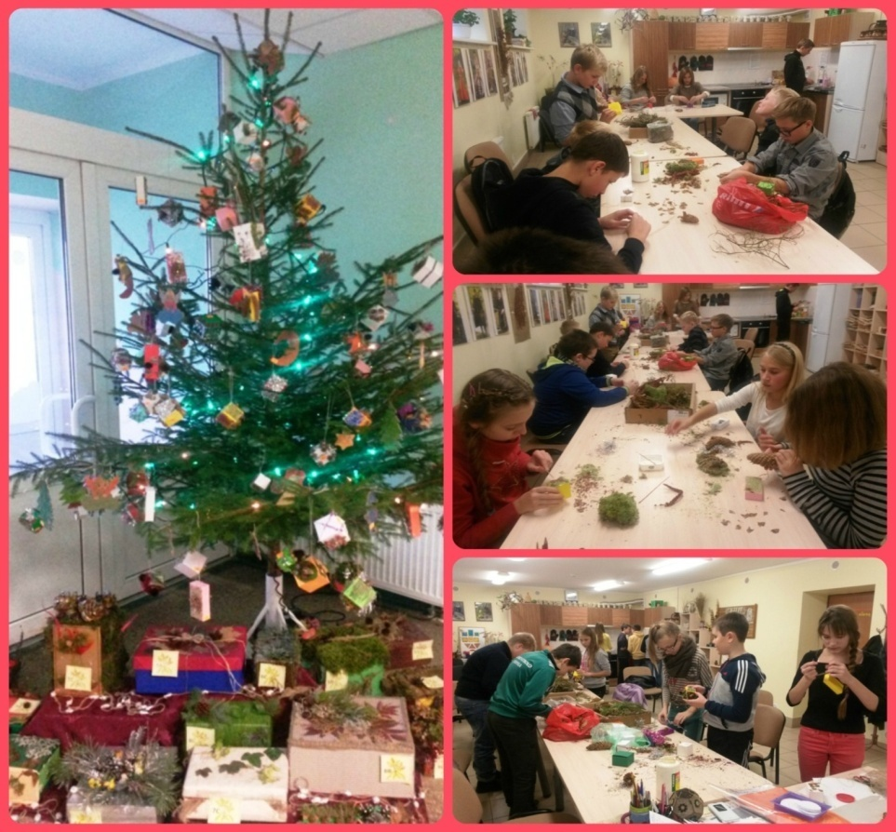
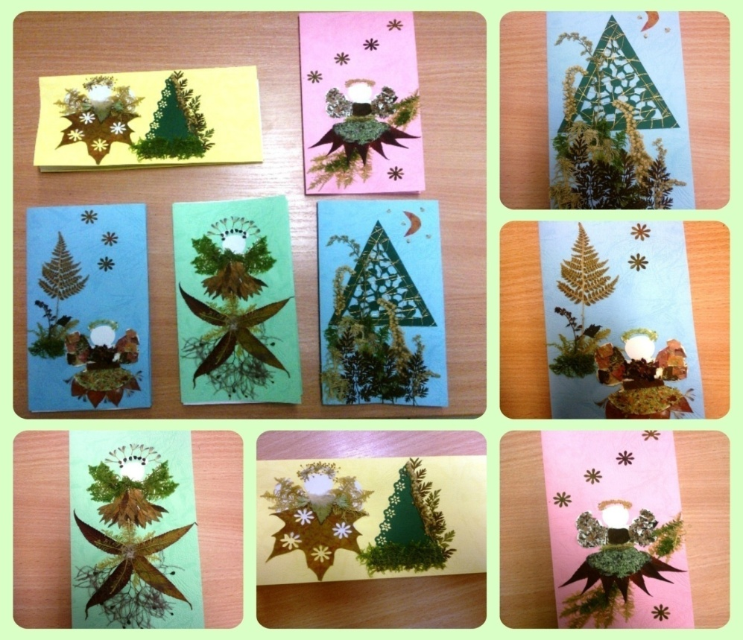
Christmas time

Slide 12
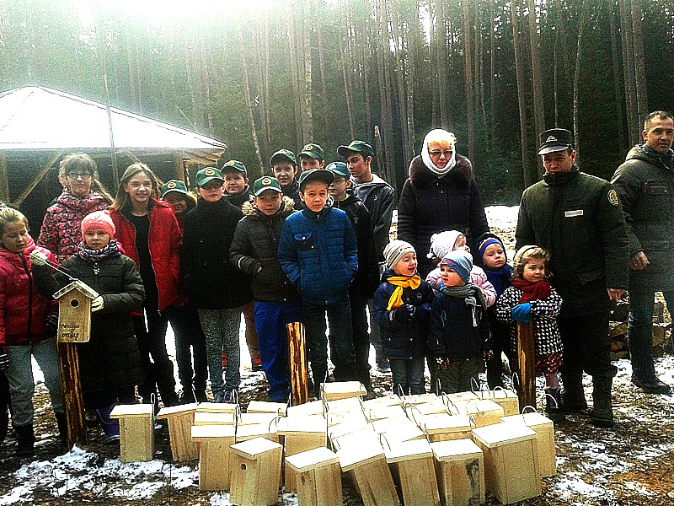
Making bird houses

Slide 13
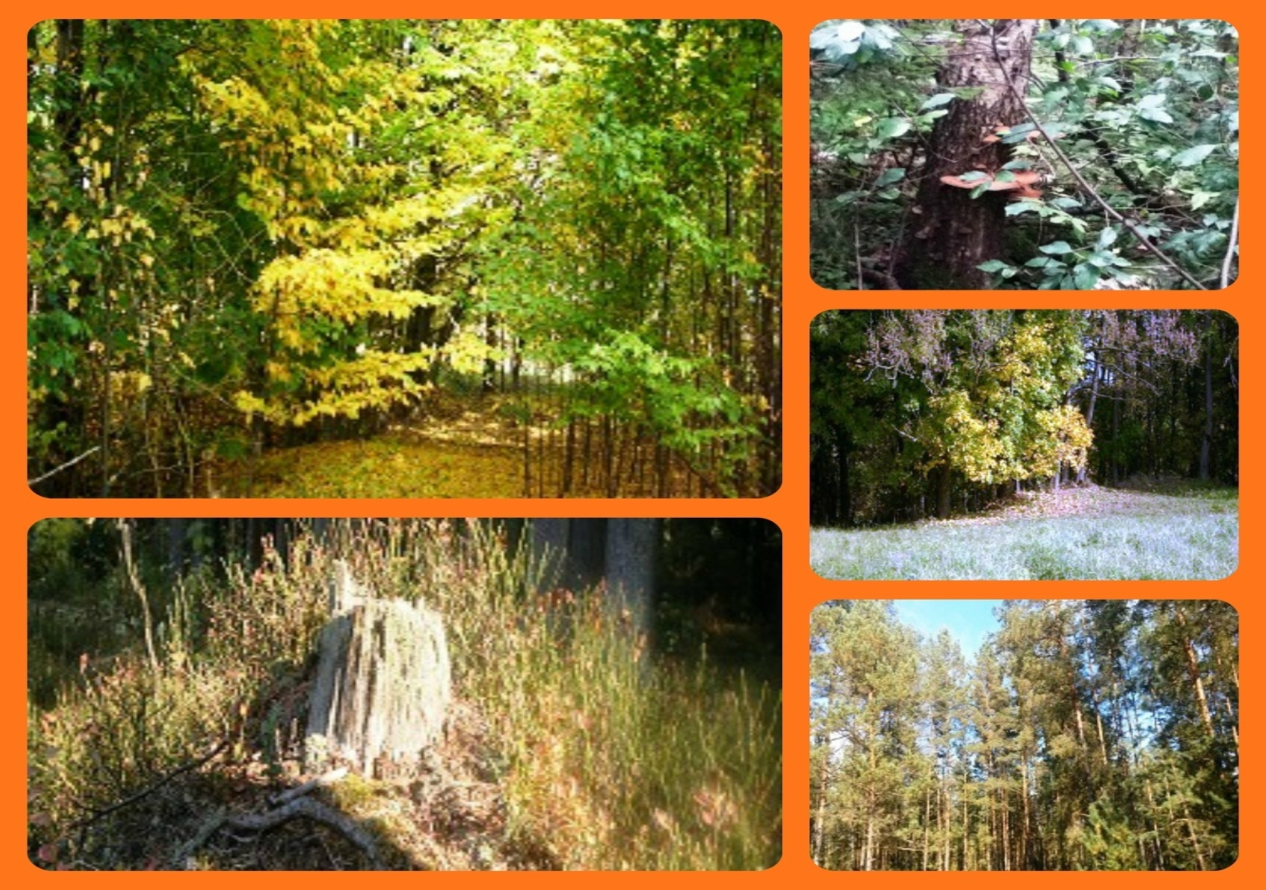
Mysterious forest

Slide 14
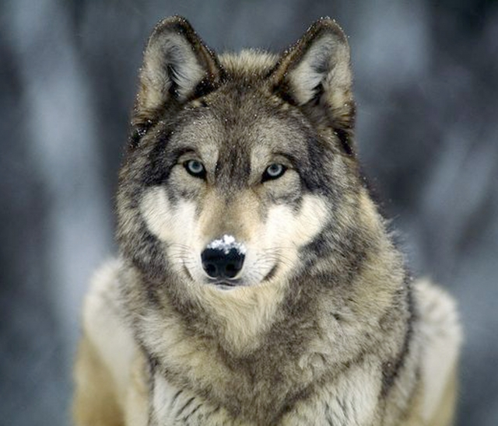
Animals in our forests
http://www.slideshare.net/tagre/animals-in-lithuania

Slide 15
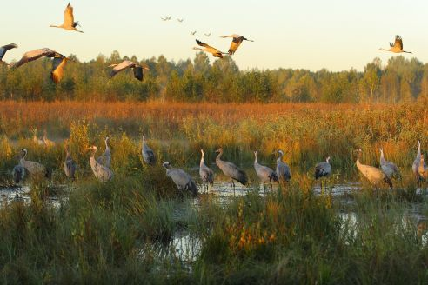
Tasks about our forests
http://www.slideshare.net/tagre/forests-48158648

Slide 16
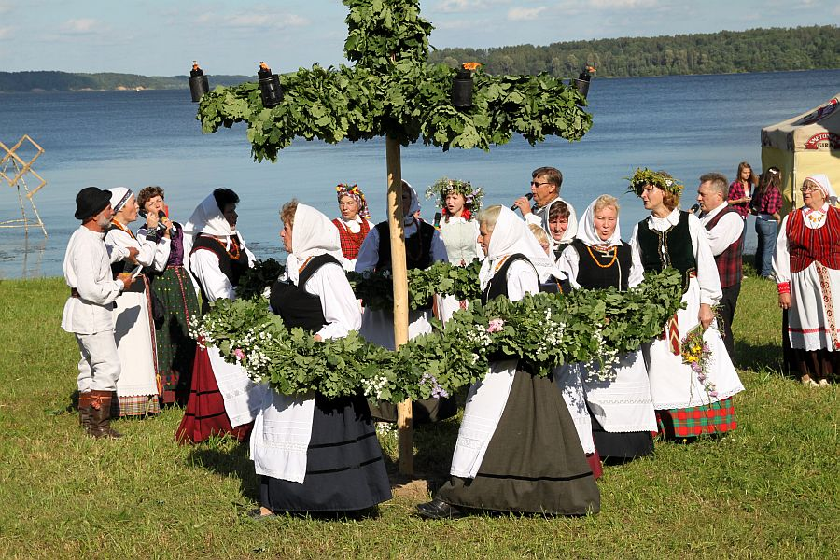
Festivals
http://www.slideshare.net/tagre/trees-in-festivals-of-lithuania

Slide 17
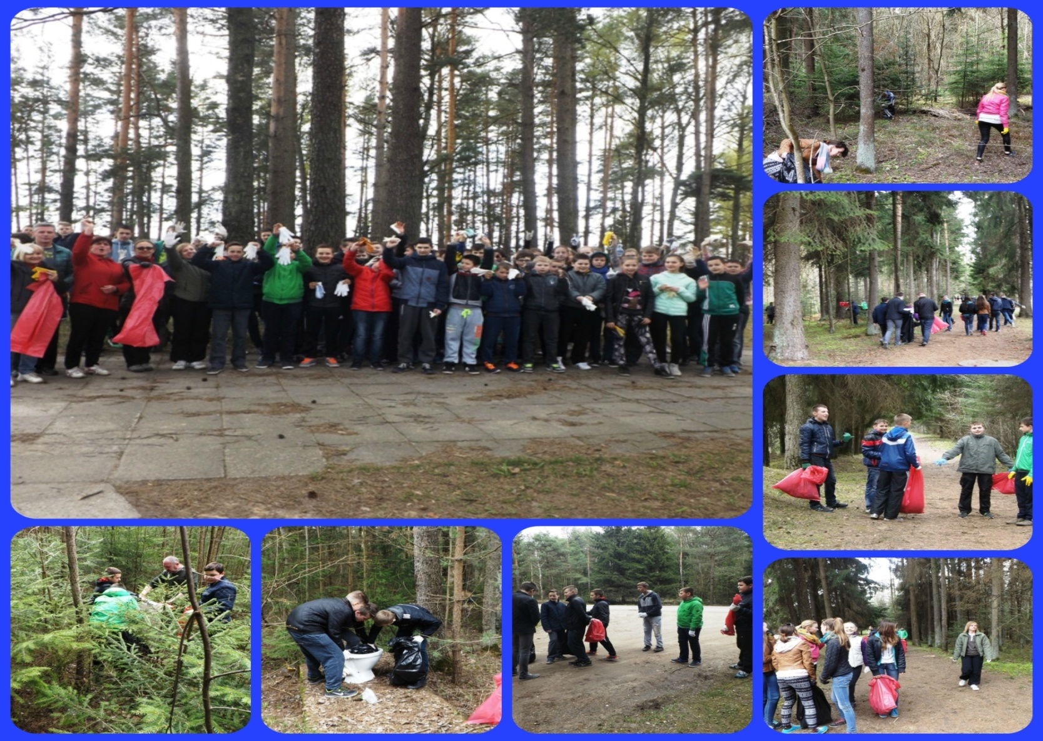
A DAY IN A FOREST! Let’s do it !

Slide 18
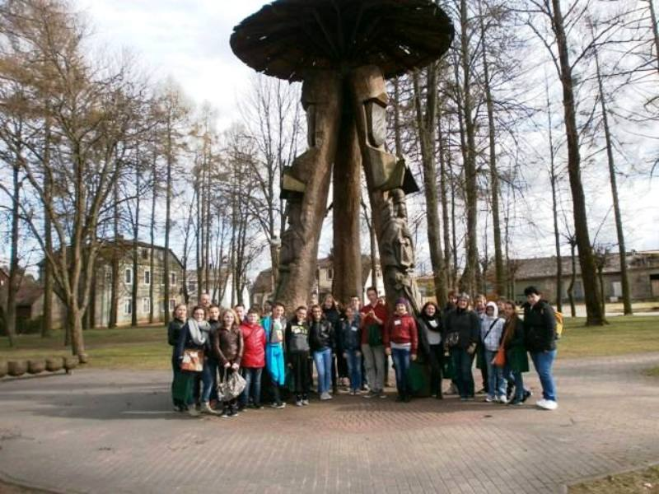
Romanians and Dutch partners in Lithuania

Slide 19
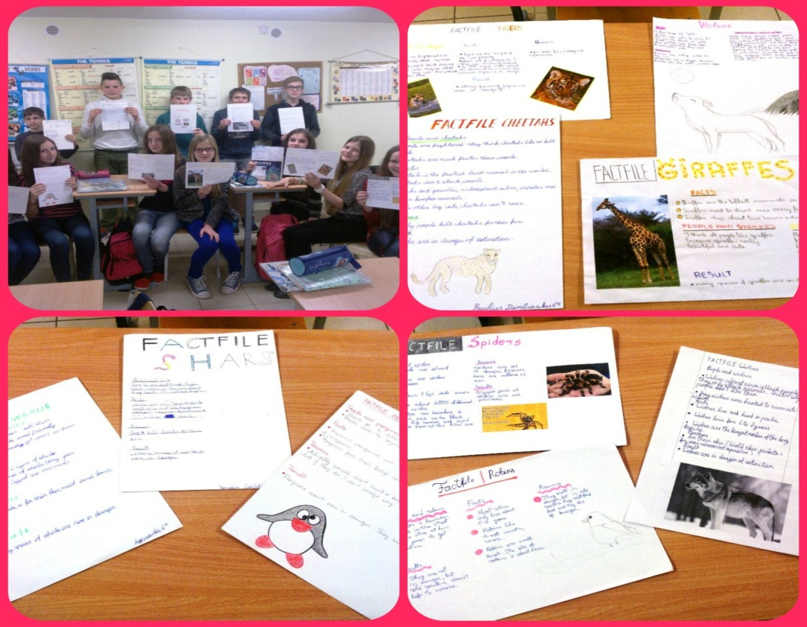
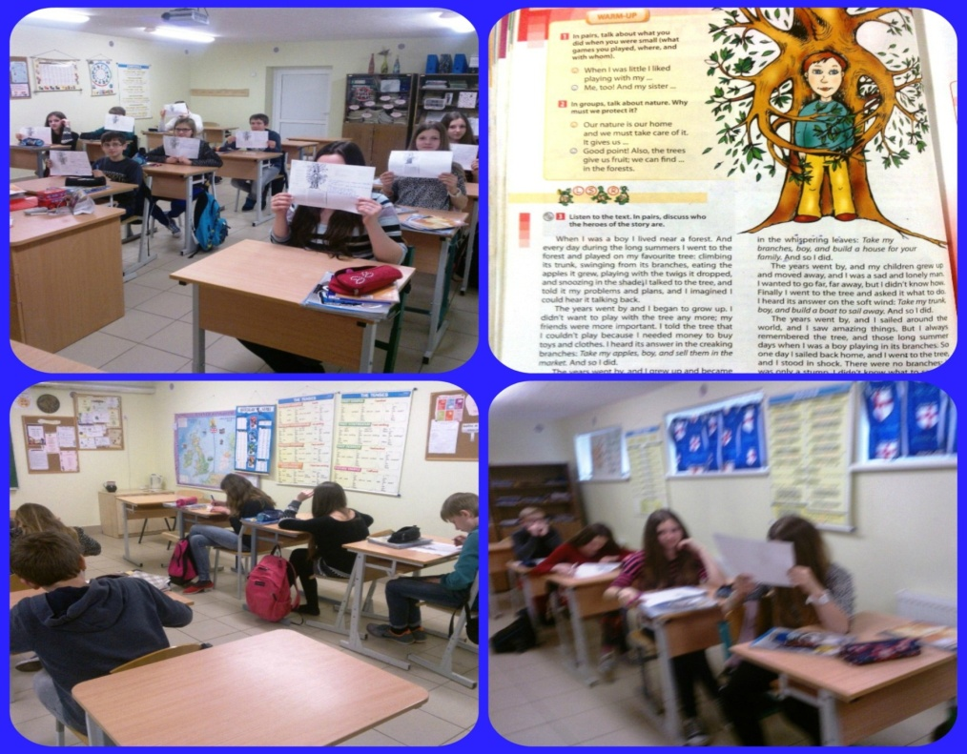
Reading and writing tasks

Slide 20
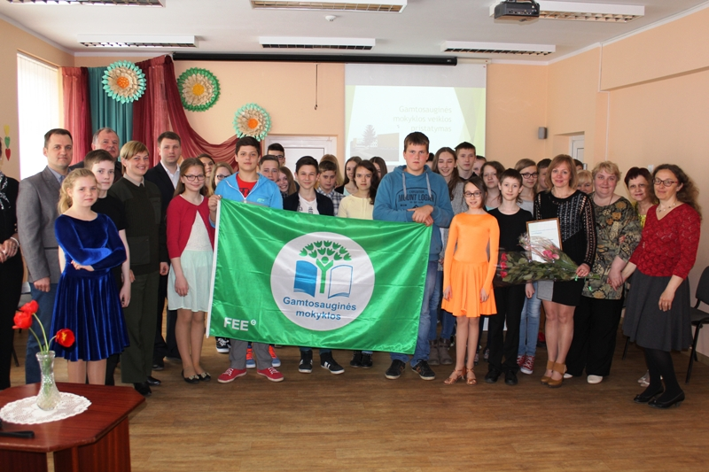
This spring our school got a green flag

Slide 21
Articles about our project
http://www.kazluruda.info/2014/10/06/tarptautinis-erasmus-projektas-kazlu-rudos-pagrindineje-mokykloje/
http://www.kazluruda.info/2015/04/27/pirmieji-sveciai-musu-mokykloje-projektas-musu-miskai-musu-ateitis-tesiasi/
http://www.sac.smm.lt/rpastas.php?id=1294

Slide 22
Our Herbarium
http://www.slideshare.net/tagre/herbariumai

Slide 23
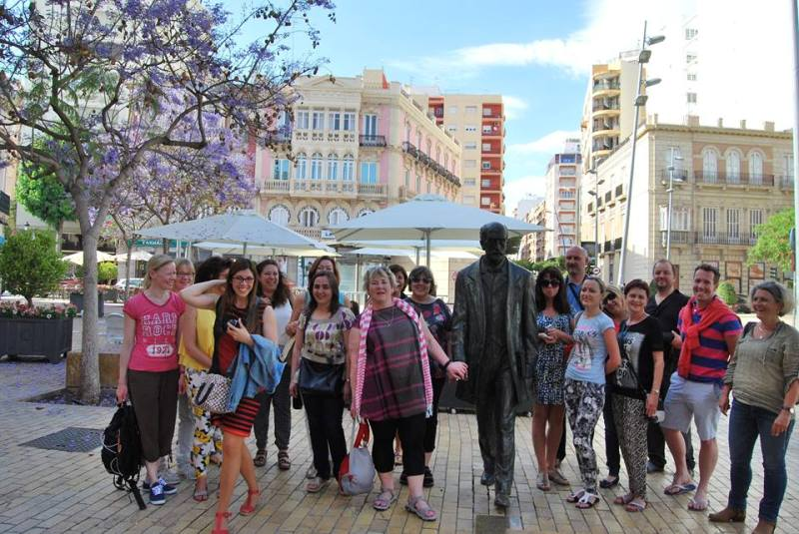
The project meeting and job shadowing in Spain

Slide 24
OUR FORESTS – OUR FUTURE
The second year
of the project
2015-2016

Slide 25
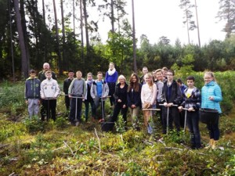
Planting trees in our forest

Slide 26
Making food from the products of forest
Raspberry pie with cedar nuts

Slide 27
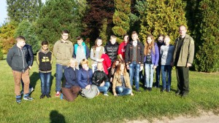
Visiting our local nursery garden

Slide 28
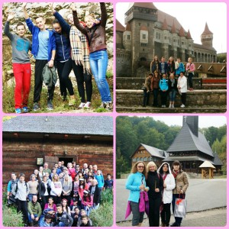
Project meeting in Romania

Slide 29
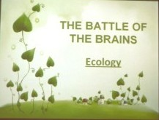
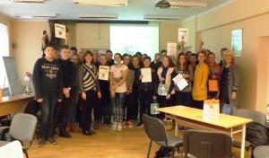
Contest “The battle of the brains. Ecology”

Slide 30
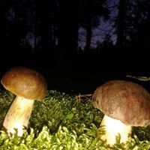
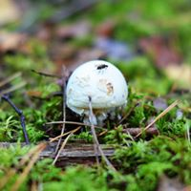
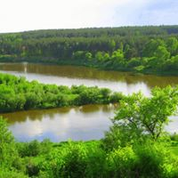
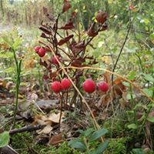
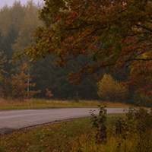
School contest of photos “Mysterious forest”
5 best photos took part in the international contest of “Mysterious forest”

Slide 31
Prepared statistics of the burned areas

Slide 32
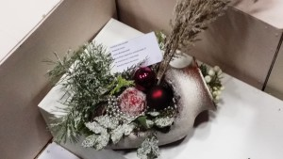
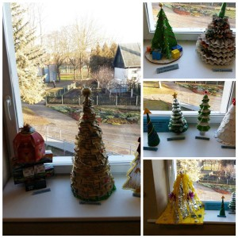
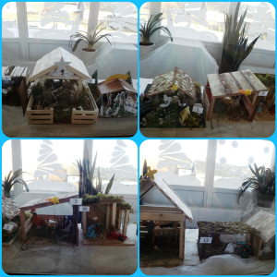
Christmas exhibition using forest products

Slide 33
Visiting local forestry company “Jūrės medis”
JSC Jūrės medis is one of the largest manufacturers of glue laminated timber structures in the Baltic states. The company has produced such structures since 1974. Extensive experience and high quality of products is approved by the quality certificate of the German Otto Graf Institute In 2012 the company received ISO9001 and ISO14001 certificates.
JSC Jūrės medis produces straight and bent laminated timber building structures, massive wood beams connected along the length and wooden roofs. They also produce log houses, bath houses and summer bungalows from glued beams. The constructions are produced from Lithuanian and Siberian spruce, pine and larch timber, using melamine glue.
JSC Jūrės medis also provides the following services:
Preparation of advance proposals,
Preparation of projects,
Supply and construction of steel components,
Wood impregnation,
Fire retardance,
Transportation,
Installation,
Consulting.

Slide 34
Getting to know about endangered species in ou forests

Slide 35
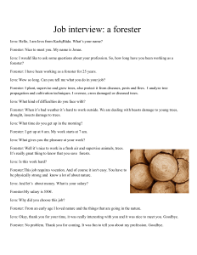
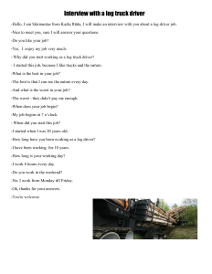
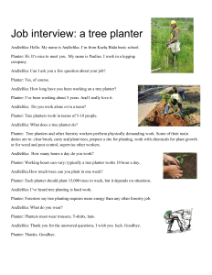
Interviewing workers of forestry

Slide 36
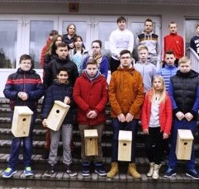
Making birdhouses

Slide 37
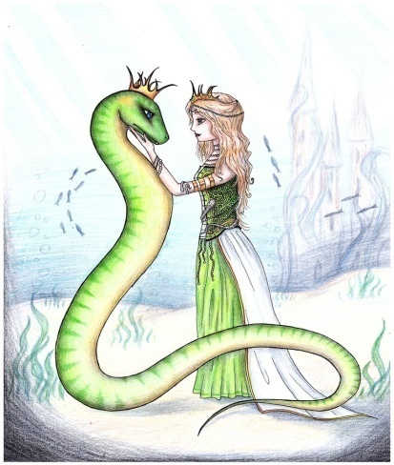
Reading and writing tasks about forest in mother tongue and English
During the lessons
of the Lithuanian language
students read the Lithuanian fairy –tale “Eglė žalčių karalienė” and wrote tasks about forest. (engl. Eglė The Queen of Serpents)

Slide 38
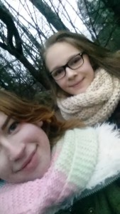
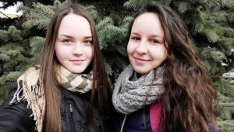
Selfies with a tree

Slide 39
Presentations about our partners of the project
Spain
Romania
Portugal
Finland
The Netherlands

Slide 40
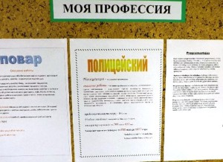
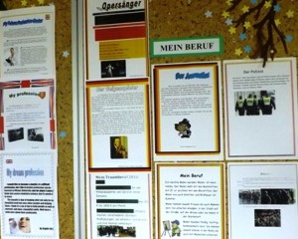
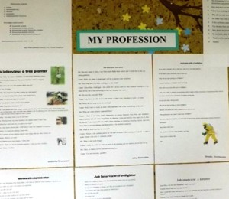
Presentations on jobs within forestry industry, wild camping and nature protection
We organized an exhibition about professions with all our Lithuanian, English, Russian and German languages teachers. The descriptions were in four different languages.

Slide 41
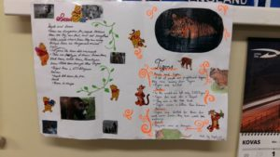
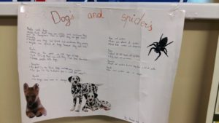
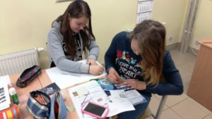
Lesson about students’ favourite animals

Slide 42
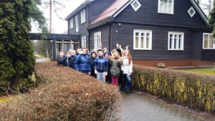
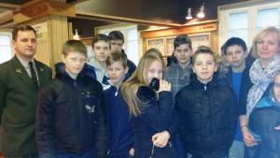
Lesson in the Forestry museum
Students had a lesson in the Forestry museum. They found out the history of the museum, how to protect and restore the forest. They found out about protected areas and resorts of Kazlų Rūda.

Slide 43
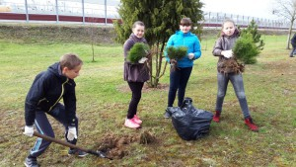
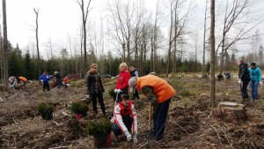
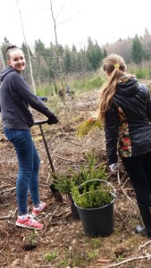
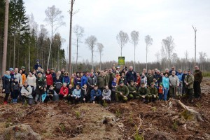
Plant a Tree Day
The whole community of our school took part in it. We planted trees in the forest and in the city.

Slide 44
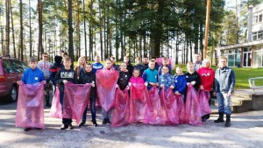
The International Day “Let’s Do It!”
Each year our school takes part in the day “Let’s Do It!”

Slide 45
Project meeting in Lithuania
We had a perfect weather and a good big company in Lithuania. We still have nice memories ☺

Slide 46
Making a herbarium
Students made a herbarium
about plants of Lithuania

Slide 47
OUR FORESTS – OUR FUTURE
The third year
of the project
2016-2017

Slide 48
Forest Day. Planting trees.

Slide 49
Making food from the products of forest
Sweet blueberry soup with dried cranberries

Slide 50
Lesson about sea eagles with special guests

Slide 51
Writing articles
Since September our students were writing the articles to the newspaper of the project.

Slide 52
Open air class
It was our dream. With a big help of our teachers, students’ parents and local companies it became a reality.

Slide 53
Project meeting in Finland

Slide 54
Drawing mural

Slide 55
Visiting a fire station in Marijampolė

Slide 56
Making digital Christmas cards

Slide 57
Christmas decorations

Slide 58
Lesson “How to be green during Christmas time”

Slide 59
Making collages “Forest in winter”

Slide 60
Making cribs from wooden materials

Slide 61
Lessons about fire in the forest

Slide 62
Contest “The battle of the brains. Ecology”

Slide 63
Visiting our local furniture company “Kazlų Rūdos Baldai”

Slide 64
Contest of photos “Forest in winter”

Slide 65
Making and hanging bird houses

Slide 66
An Exhibition for Pi- Day

Slide 67
Many activities for learning to protect our nature involving all schools of our city

Slide 68
A conference of our city schools “Live Eco-friendly”

Slide 69
Lessons about endangered animals

Slide 70
Creating the story“Mysterious Forest”
It will be finished in the end of our school year.

Slide 71
Lessons about using forest for our needs

Slide 72
Plant a tree day in spring

Slide 73
The International Day “Let’s Do It!”

Slide 74
Exhibition about professions in foreign laguages

Slide 75
Lessons about trees and animals from Lithuanian forest
During English lessons we read stories about trees, solved crosswords “Animals From Our Forest”, read about WWF, created stories about adventures in a forest, learnt some new names of animals and tried to guess the trace.

Slide 76
In May we plan to do:
Digital herbarium
To Visit Portugal
A day in our forest: Family’s Day.

Slide 77
THANKS FOR YOUR ATTENTION

